Slide 1
Module 6 - IVI In-Vehicle Infotainment Systems
Media Service to Audio HAL
Message Flow Simulation
Option 3 | Software simulation with traceable Android-style logs
1

Slide 2
01 | SCOPE
Project Objective
Simulate message flow between Media Service and Audio HAL.
Show how HMI actions propagate through the IVI audio stack.
Capture every transition as a readable log and structured trace.
Run repeatable scenarios without Android hardware.
Deliverables
Python source
Android-style logs
CSV trace
JSON summary
Three test scenarios
2

Slide 3
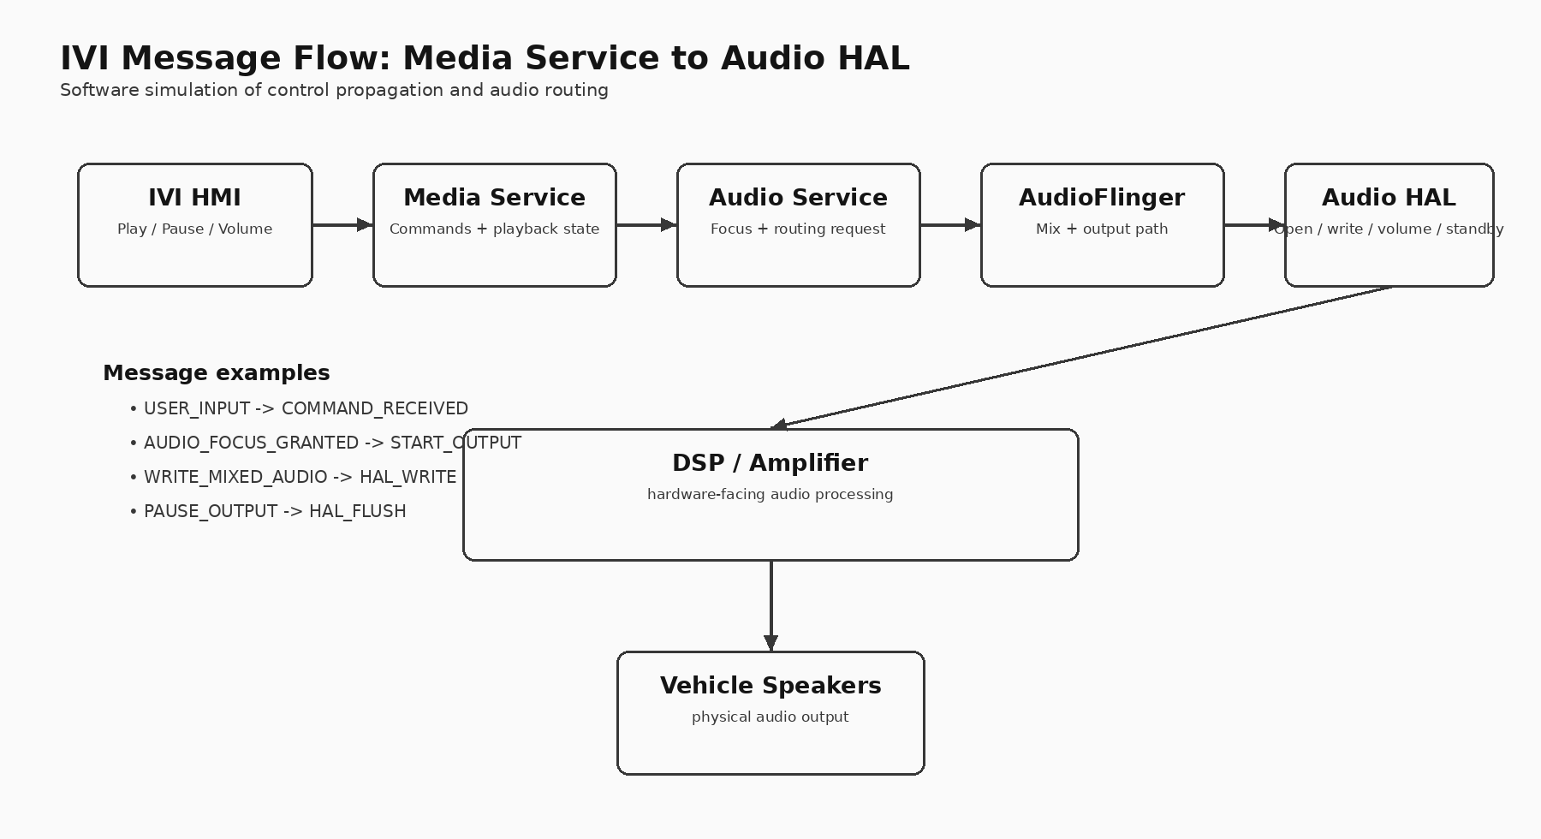
02 | ARCHITECTURE
Functional Architecture
3

Slide 4
03 | MESSAGE FLOW
Message Types in the Simulation
Playback
Focus
Routing
HAL
PLAY, PAUSE, RESUME, NEXT, STOP
AUDIO_FOCUS_GRANTED
AUDIO_FOCUS_RELEASED
START_OUTPUT
OPEN_OUTPUT
WRITE_MIXED_AUDIO
HAL_OPEN
HAL_WRITE
HAL_FLUSH
HAL_STANDBY
A single user action is intentionally traceable across multiple components. This makes the project useful for demonstration, debugging and viva discussion.
4

Slide 5
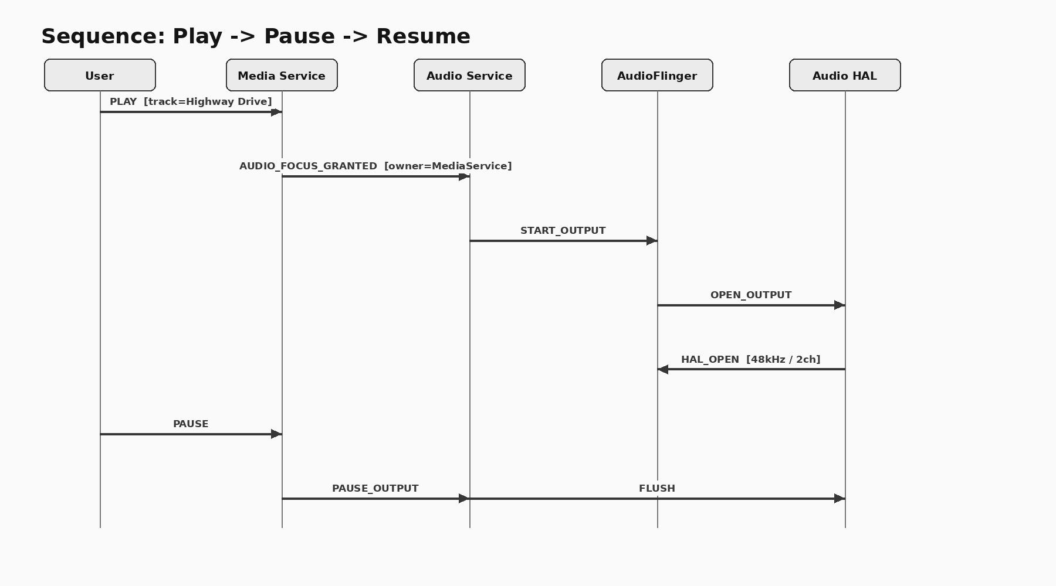
04 | PLAY AND PAUSE
Example Sequence
5

Slide 6
05 | VALIDATION
Repeatable Test Scenarios
Normal playback
Navigation ducking
Call interruption
Play -> volume -> next -> pause -> resume -> stop
Play -> reduce volume -> navigation prompt -> restore volume
Play -> focus loss -> pause -> call ends -> resume
6

Slide 7
06 | OUTPUT
Sample Android-Style Log
18:58:39.818 I/IVI_HMI: -> MediaService | USER_INPUT | command=PLAY track=Highway Drive
18:58:39.818 I/MediaService: -> MediaService | COMMAND_RECEIVED | command=PLAY track=Highway Drive
18:58:39.818 I/AudioService: -> AudioFlinger | AUDIO_FOCUS_GRANTED | owner=MediaService
18:58:39.818 I/AudioService: -> AudioFlinger | START_OUTPUT
18:58:39.818 I/AudioFlinger: -> AudioHAL | OPEN_OUTPUT
18:58:39.818 I/AudioHAL: -> DSP/Amplifier | HAL_OPEN | sample_rate=48000 channels=2
18:58:39.818 I/AudioFlinger: -> AudioHAL | WRITE_MIXED_AUDIO | frames=1024
18:58:39.818 I/AudioHAL: -> DSP/Amplifier | HAL_WRITE | frames=1024
18:58:39.818 I/MediaService: -> IVI_HMI | STATE_UPDATE | state=PLAYING track=Highway Drive
18:58:39.818 I/IVI_HMI: -> MediaService | USER_INPUT | command=VOLUME value=0.75
18:58:39.818 I/MediaService: -> MediaService | COMMAND_RECEIVED | command=VOLUME value=0.75
7

Slide 8
07 | CODE
Implementation Structure
Core model
Outputs
Testing
Message
TraceLogger
MediaService
AudioService
AudioFlinger
AudioHAL
session_logcat.txt
message_trace.csv
summary.json
Normal scenario
Navigation scenario
Call interruption
Automated unit tests
Runtime dependency: Python standard library only.
8

Slide 9
08 | RESULTS
Validation Results
Scenario
Messages
HAL events
normal
39
7
navigation
26
5
call
32
5
Automated checks passed for HAL command generation, call interruption/resume sequencing and output-summary consistency.
9

Slide 10
09 | CLOSE
Conclusion and Future Scope
The simulator fulfills the selected Module 6 message-flow objective.
User actions remain traceable from HMI to Media Service and Audio HAL.
The output is repeatable, testable and easy to demonstrate.
Future work: run the same sequence inside Android Automotive with real logcat capture.
10

