Slide 1

ATTENDAI
AI-Powered Face Recognition Attendance System
Submitted by:
NAME | ROLL NO.
SUBHAM SAHU | 202456503
SHAGUN PATRA | 202457504
RAHUL KUMAR BEHERA | 202456529
JAMMULA SAMARTH | 202456569
JASMINE PADHY | 202457578
PRIYANSHU PATTANAYAK | 202456589
Notes:
B-TECH PROJECT MID-SEM PRESENTATION 2011
BY KHUSHBU KHAN & ISAN SAHOO

Slide 2
Contents
Title
Abstract
Introduction
Problem Statement
System Architecture
Key Features
Tech Stack
Liveness Detection
Results
Future Scope
Conclusion
Notes:
B-TECH PROJECT MID-SEM PRESENTATION 2011
BY KHUSHBU KHAN & ISAN SAHOO
2

Slide 3
ABSTRACT
AttendAI is an AI-based smart attendance system designed to automate attendance and eliminate proxy fraud.
It uses face recognition for identity verification and liveness detection (blink-based) to ensure the physical presence of students.
The system operates through a browser-based interface, requiring no additional hardware, and performs real-time attendance marking.
Attendance data is securely stored in a cloud database and can be analyzed or exported for reporting.
Notes:
B-TECH PROJECT MID-SEM PRESENTATION 2011
BY KHUSHBU KHAN & ISAN SAHOO
3

Slide 4
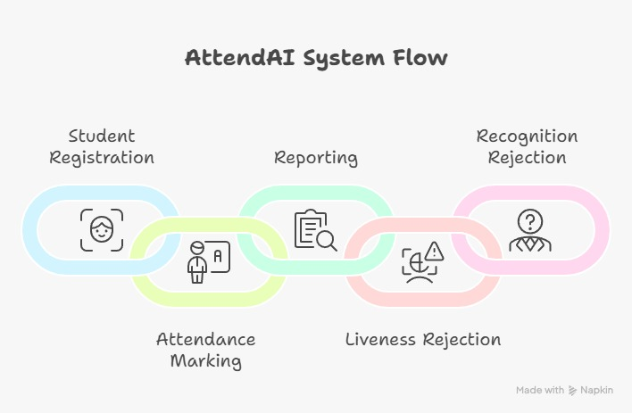
INTRODUCTION
Attendance tracking is essential in academic institutions.
Traditional methods are manual, time-consuming, and unreliable.
Increasing need for automated and secure solutions.
Face recognition enables contactless and efficient attendance.
AttendAI integrates AI and computer vision for smart attendance.
Notes:
B-TECH PROJECT MID-SEM PRESENTATION 2011
BY KHUSHBU KHAN & ISAN SAHOO
4

Slide 5

PROBLEM STATEMENT
Manual attendance consumes 5–10 minutes per class.
High risk of proxy attendance fraud.
Prone to human errors in record keeping.
No real-time monitoring or analytics.
Inefficient for large classrooms.
Notes:
B-TECH PROJECT MID-SEM PRESENTATION 2011
BY KHUSHBU KHAN & ISAN SAHOO
5

Slide 6
SYSTEM ARCHITECTURE
Client–Server based architecture.
Browser captures real-time webcam frames.
Flask backend handles API requests.
OpenCV performs face detection & recognition.
MediaPipe handles liveness detection.
Data stored in cloud database (MySQL / Supabase).
Notes:
B-TECH PROJECT MID-SEM PRESENTATION 2011
BY KHUSHBU KHAN & ISAN SAHOO
6

Slide 7
KEY FEATURES
Multi-frame face registration (20 images)
LBPH-based face recognition
Blink-based liveness detection
Auto continuous scanning (every 3 seconds)
Role-based access (Admin / Faculty / Student)
Analytics dashboard with attendance insights

Slide 8
TECH STACK
Backend & Processing
Python
Flask (API & server)
OpenCV (Face detection & recognition)
MediaPipe (Liveness detection)
Database & Security
MySQL / Supabase (PostgreSQL)
bcrypt (Password hashing)
dotenv (Environment configuration)
Frontend
HTML, CSS, JavaScript (Browser-based UI)

Slide 9
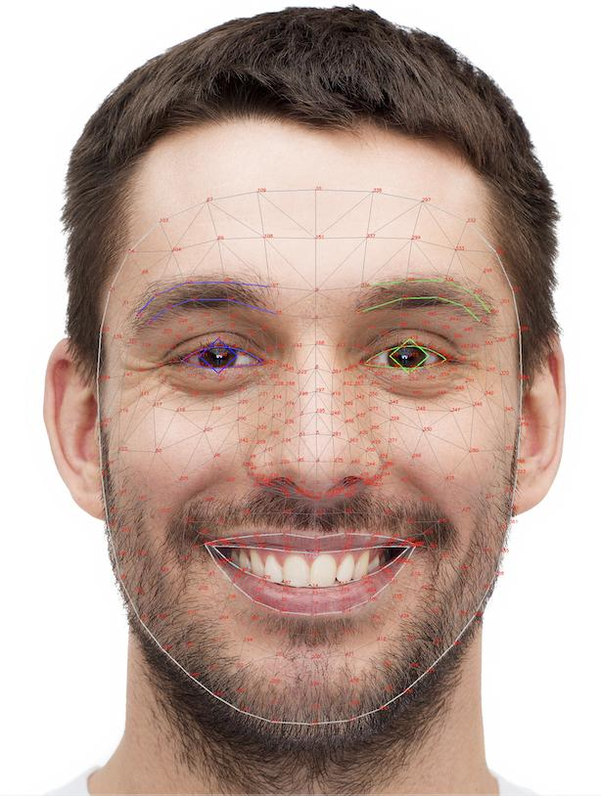
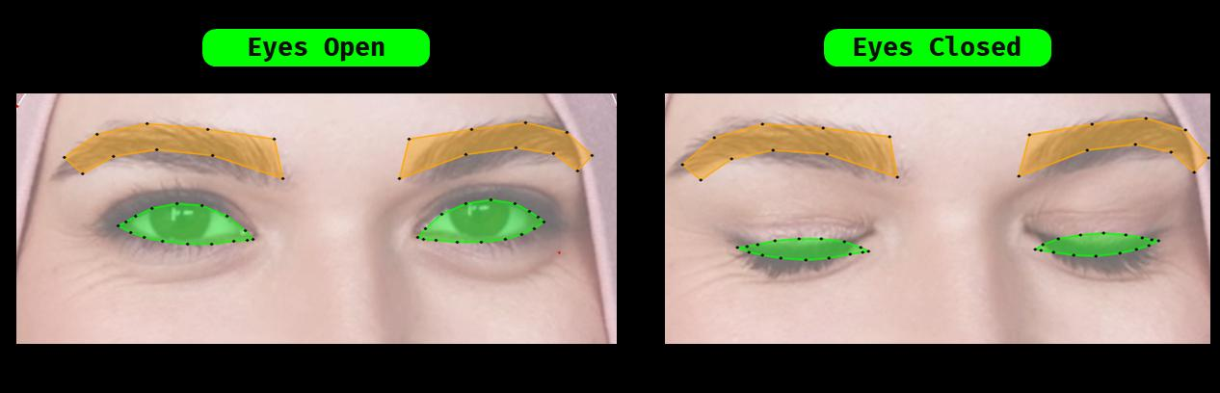
Liveness Detection
Uses Eye Aspect Ratio (EAR) for blink detection
EAR measures eye openness using facial landmarks
EAR drops significantly during a blink
Blink verified across consecutive frames
Confirms presence of a live human
Prevents photo/screen-based spoofing

Slide 10
~3 seconds per student recognition
~90 seconds for 30 students (auto scanning)
Accurate under normal lighting conditions
Successfully rejects photo/screen spoof attempts
Real-time attendance logging and dashboard
RESULT

Slide 11
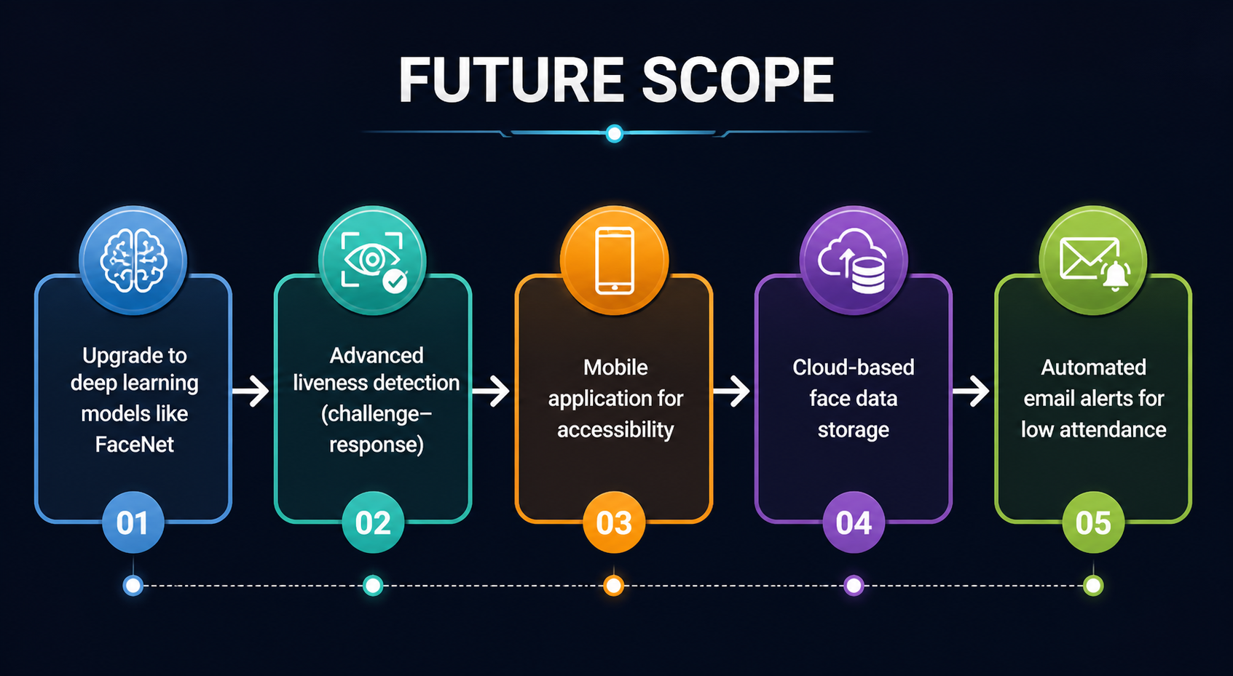
FUTURE SCOPE

Slide 12
CONCLUSION
Successfully automated attendance system
Reduced proxy attendance using liveness detection
Real-time and efficient performance
Scalable and deployable solution

Slide 13
Thank You

