Slide 1
EMPLOYEE ATTRITION ANALYSIS

Slide 2
BUSINESS PROBLEM :
The business problem addressed in this analysis is employee attrition. Understanding the factors contributing to attrition and identifying potential patterns and trends can help organizations take proactive measures to retain talented employees, improve employee satisfaction, and reduce turnover costs.

Slide 3
THE QUERIES ARE:

Slide 4

1. Creating the database and use it:

Slide 5

2. Write a query to get all employee data:

Slide 6
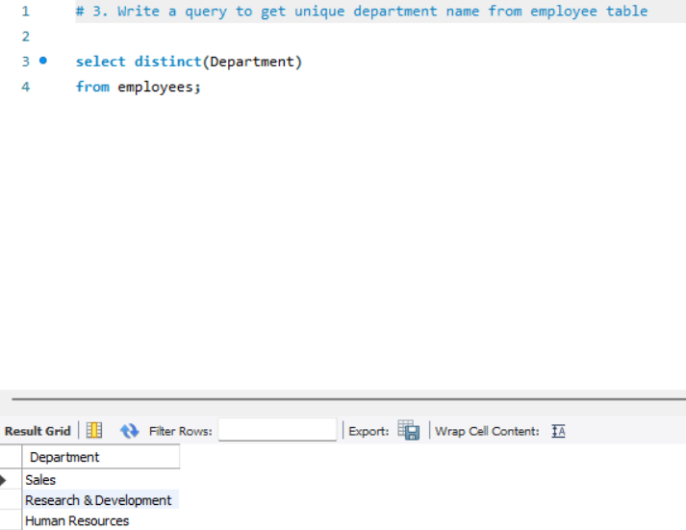
3. Write a query to get unique department name from employee table:

Slide 7
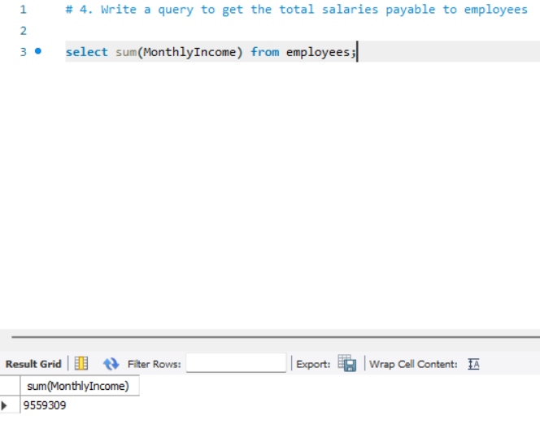
4. Write a query to get the total salaries payable to employees:

Slide 8
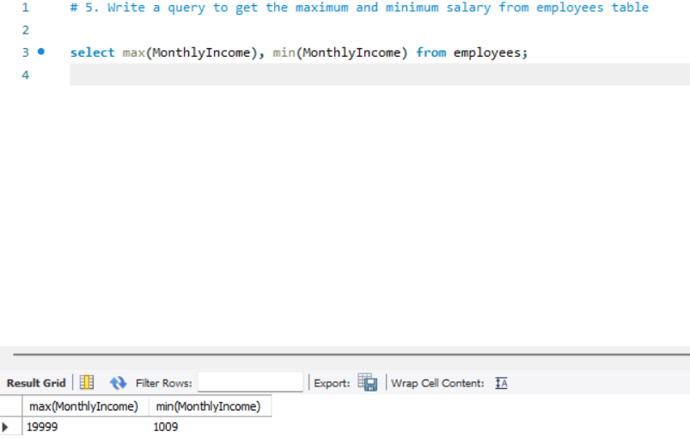
5. Write a query to get the maximum and minimum salary from employees table:

Slide 9
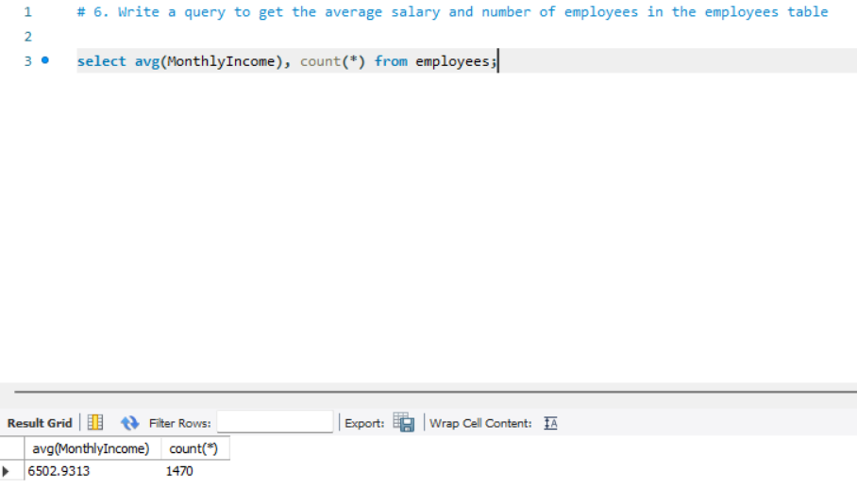
6. Write a query to get the average salary and number of employees in the employees table :

Slide 10
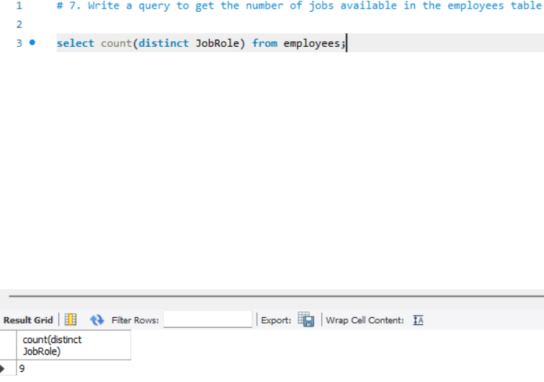
7. Write a query to get the number of jobs available in the employees table:

Slide 11
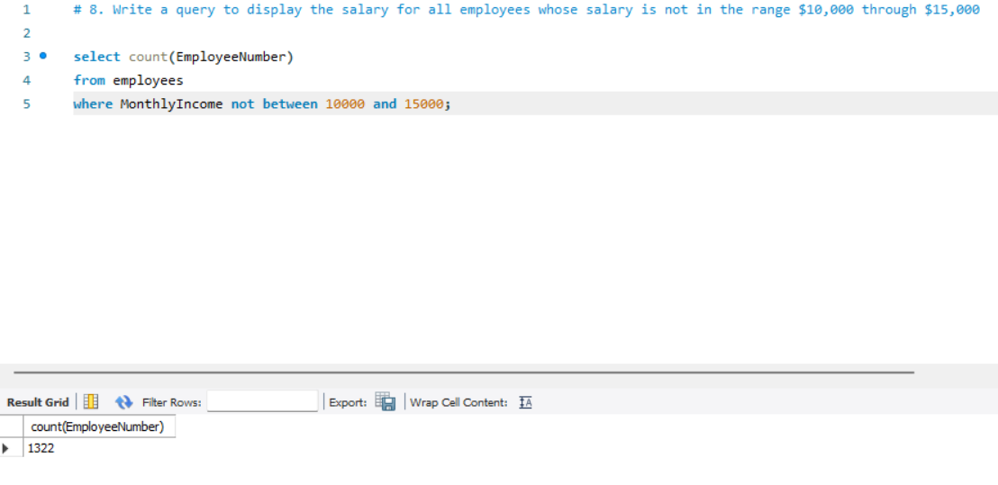
8. Write a query to display the salary for all employees whose salary is not in the range $10,000 through $15,000:

Slide 12
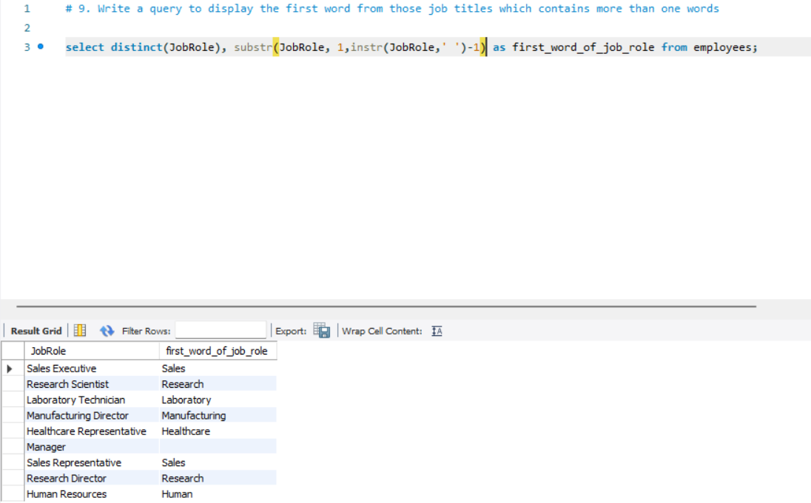
9. Write a query to display the first word from those job titles which contains more than one words:

Slide 13
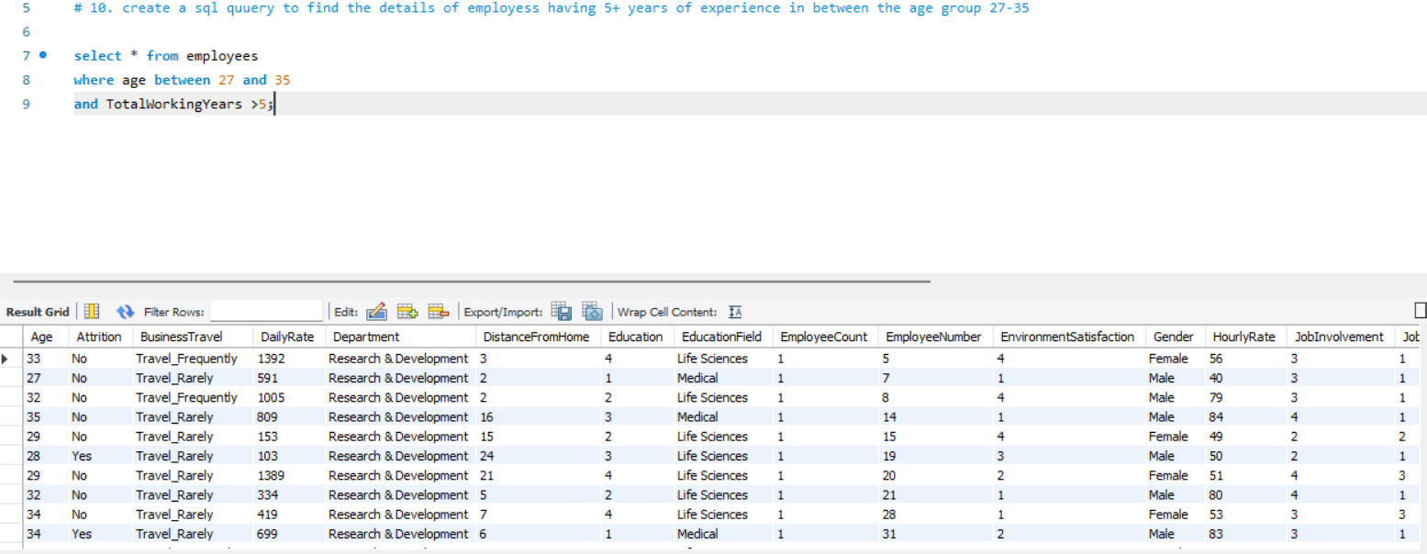
10. create a query to find the details of employees having 5+ years of experience in between the age group 27-35:

Slide 14
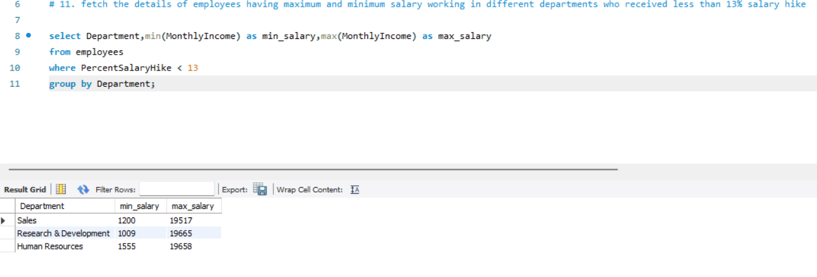
11. fetch the details of employees having maximum and minimum salary working in different departments who received less than 13% salary hike:

Slide 15
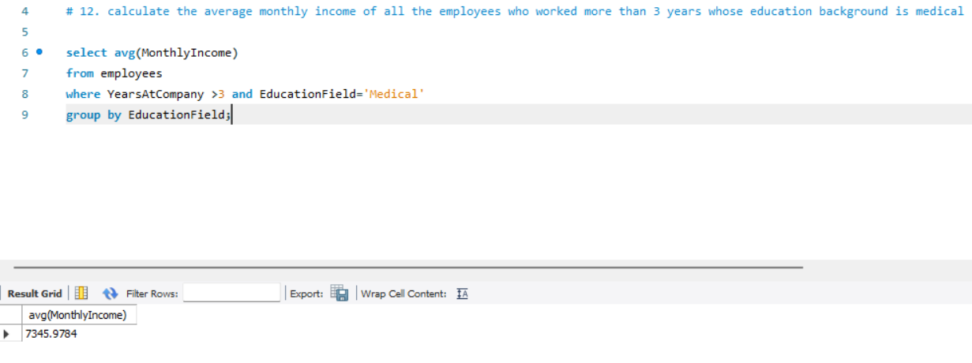
12. calculate the average monthly income of all the employees who worked more than 3 years whose education background is medical:

Slide 16
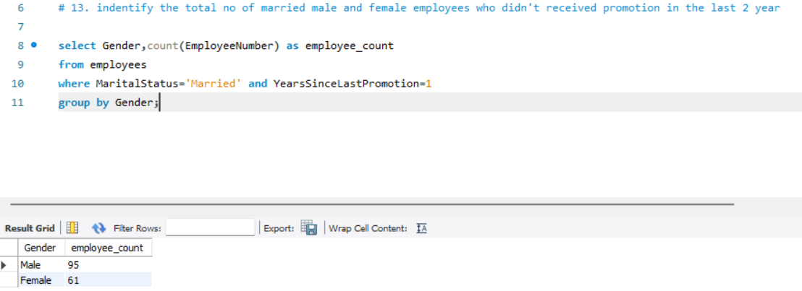
13. identify the total no of married male and female employees who didn't received promotion in the last 2 year:

Slide 17
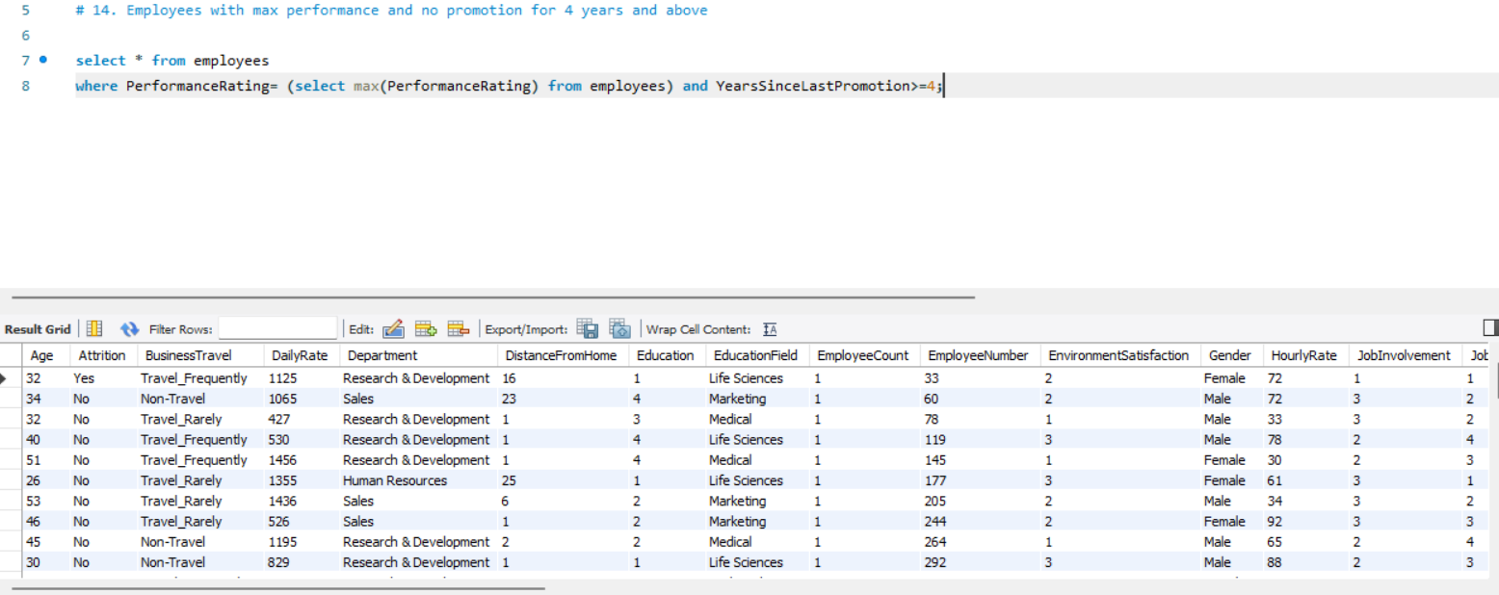
14. Employees with max performance and no promotion for 4 years and above:

Slide 18
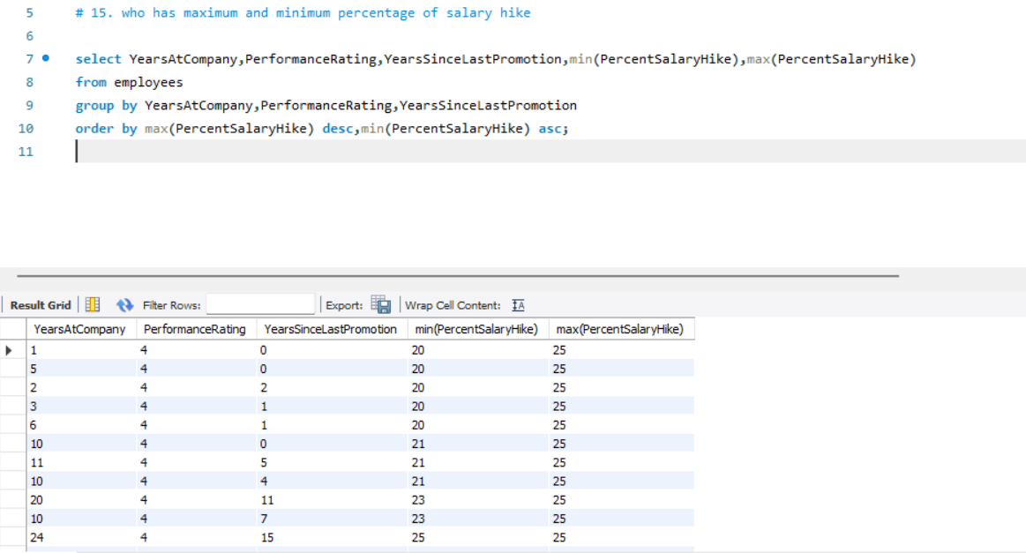
15. who has maximum and minimum percentage of salary hike:

Slide 19
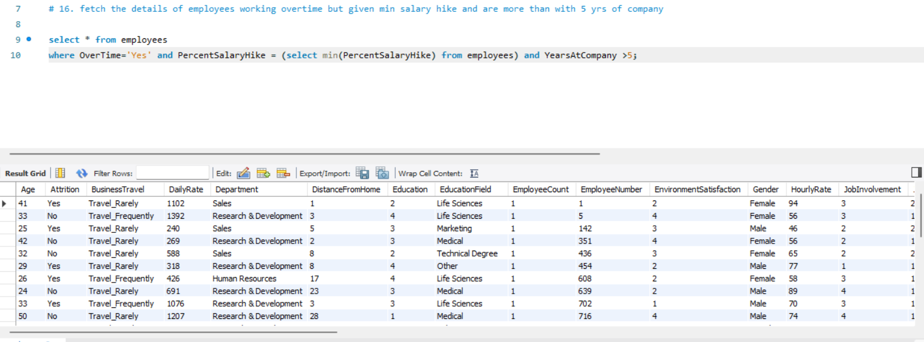
16. fetch the details of employees working overtime but given min salary hike and are more than with 5 yrs of company:

Slide 20
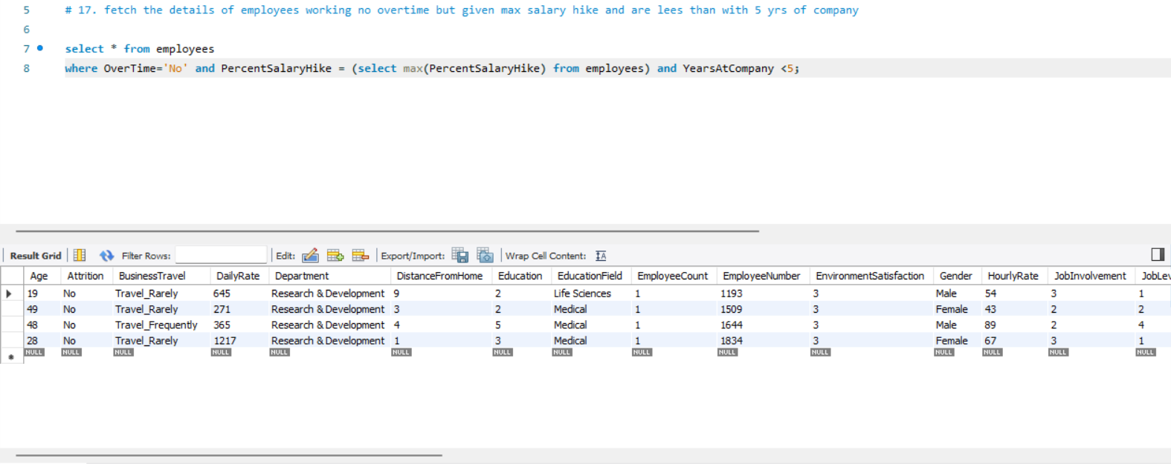
17. fetch the details of employees working no overtime but given max salary hike and are lees than with 5 years of company:

Slide 21
CONCLUSION:
Employee attrition is a complex issue affecting organizations. By conducting a comprehensive data analysis, we have gained insights into various aspects related to attrition, including experience, age, salary, promotion history, overtime work, and marital status. These insights can guide organizations in implementing targeted retention strategies, improving salary structures, providing growth opportunities, and addressing employee concerns to reduce attrition rates, enhance employee satisfaction, and maintain a productive workforce. By proactively addressing the identified factors, organizations can create a positive work environment that fosters employee loyalty, engagement, and long-term success.

