Slide 1
SOFTWARE ARCHITECTURE
GUIDED BY:
Dr.TANMAY MAHAPATRA
Shivang Konde: (2023H1120186P)
Subham Anand: (2023H1120195P)
Priyansh Deshmukh: (2023H1120193P)
Amit Mehta: (2023H1030078P)
Shyamnand Kumar: (2023H1030077P)

Slide 2
MICRO-SERVICES ARCHITECTURE

Slide 3
INTRODUCTION
Micro-services is loosely coupled distributed service. Each Micro-service architecture is developed, deployed, and scaled independently.
2. In MSA a large application is decomposed into easily manageable small components with each components having its own responsibilities.
3. Micro-Service is Service Oriented Architecture, loosely coupled elements and Self-contained (Code can be updated without knowing the internals of other micro services).

Slide 4
DIFFERENCE BETWEEN MONOLITHIC AND MICROSERVICE ARCHITECTURE
Aspect | Monolithic Architecture | Microservice Architecture
Architecture | Single-tier architecture | Multi-tier architecture
Size | Large, all components tightly coupled | Small, loosely coupled components
Deployment | Deployed as a single unit | Individual services can be deployed
Scalability | Horizontal scaling can be challenging | Easier to scale horizontally
Fault Tolerance | Entire application may fail if a part fails | Individual services can fail without affecting others

Slide 5
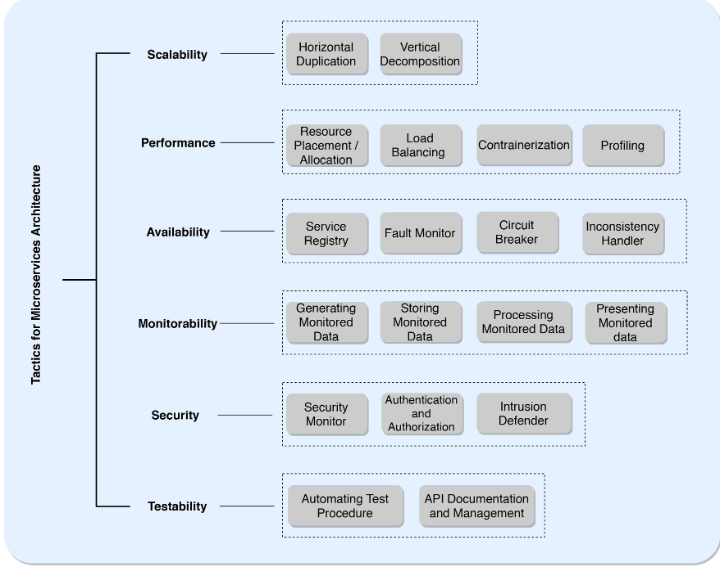
TACTICS FOR MICRO-SERVICES ARCHITECTURE

Slide 6
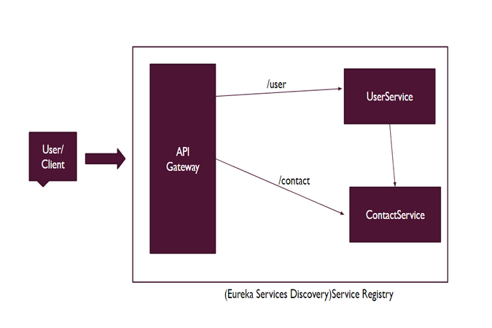
IMPLEMENTATION FLOW OF MSA

Slide 7
IMPLEMENTATION OF PROTOTYPE
We have implemented 4 micro services in our prototype.
1. User/Client: User which has all details of user.
2. Contact Micro-Service: Which has all contacts of every user, where user and contact micro- services, communicate with each other, we get the user's contacts from contact micro-service in a contact list of user.
3.Eureka Micro-services: Main role of Eureka server is automatic detection of devices and services on a network. Benefits of Eureka Server includes: Automatic Registration , Load Balancing, Centralized Service Registry.
4. API gateway: This allows faster communication between clients and micro-services.

Slide 8
STEPS TO RUN THE CODE
1. Extract the code from the zip file.
2. Set up the Eureka micro-service in IntelliJ and run the micro-service.
3. Set up the contact micro-service in IntelliJ and run the micro-service.
4. Set up the User micro-service in IntelliJ and run the micro service.
5.Set up the API Gateway micro-service in IntelliJ and run the micro-service.
6.Open the front end file containing Angular code run angular code using
ng serve - -open
7. Displaying the user details
https://github.com/Subhamdgm/Software_Architecture.git

Slide 9


