Slide 1
Laptop price prediction
Project Mentor :
Prof. arnab chakraborty
Team Members :
Shubham Shaw
Angelina Deepshikha Hans
Puja Verma
Gaurav Kumar
Nishant Yadav

Slide 2

Contents
Project Objective & Scope
Problem and Feasibility Analysis
Data Description
Methodology
Exploratory Data Analysis
Models Used
R2 Score and MAE Comparision
Future Scope of Improvements

Slide 3
Project objective & scope
Objective:
Given : A small laptop features and prices dataset taken from Kaggle (contains training and test data).
Goal : To Predict the price of a laptop based upon given data.
Finally : Apply on the test dataset and compare the differences in the results.
Scope :
Train the model to identify patterns between features and price.
.Utilize a dataset containing historical laptop data with features like brand, RAM size, storage, and market prices

Slide 4
Problem and feasibility analysis
Problem : Accurately determining laptop prices can be a challenge due to several factors. Market trends can fluctuate rapidly, and the value proposition of a laptop depends on the intricate interplay of various hardware specifications like processor brand, RAM size, storage capacity, and display technology. Traditional methods for price estimation might not effectively capture these nuanced relationships between features and price.
Solution : Machine learning offers a data-driven approach to price prediction. By analysing historical data containing laptop specifications alongside their corresponding market prices, the model can identify patterns and relationships between features. This knowledge can then be used to predict prices for new laptops with similar configurations.

Slide 5
Feasibility : Machine learning has been successfully applied for price prediction tasks in various domains, demonstrating its potential for this project. The availability of relevant laptop specification data and the existence of suitable machine learning algorithms make this approach feasible for laptop price prediction.

Slide 6
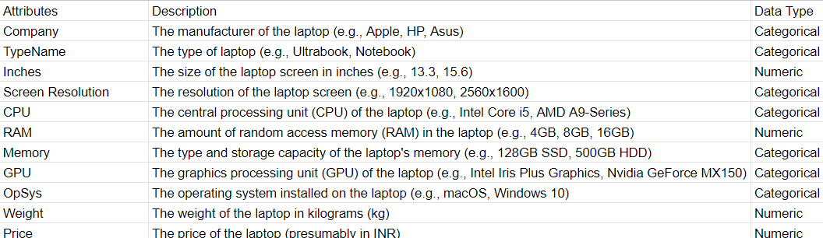
Data description
The description of the data with type and description of each Attribute is given/shown in the table.

Slide 7
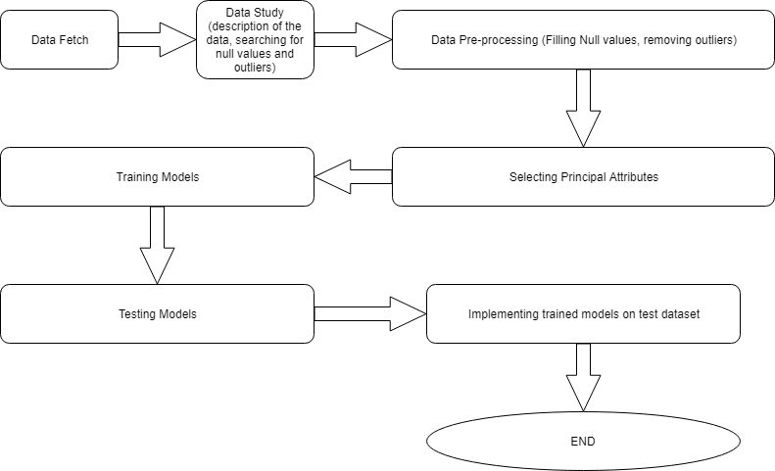
Methodology

Slide 8
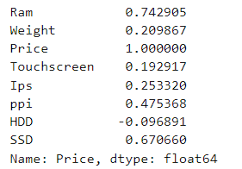
Exploratory data analysis
In EDA, We tried to find out the relationship between each variables through bar plots, scatter plots etc
There are two types of analysis we did:
Univariate Analysis : Found out the relationship of features with density and counts
Multivariate Analysis : Found out the relationship between two or more features using heatmaps, correlation coefficients, scatterplots etc
Correlation of each features with Price (Target Value)

Slide 9
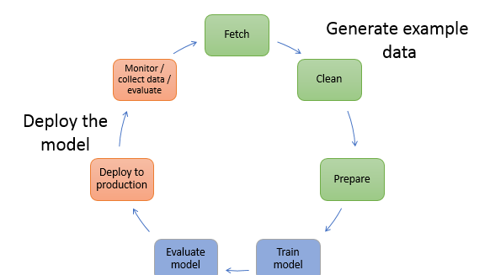
ModelS used
The Machine Learning models used for this project are:
K – NN
Regression ( Linear )
Decision Tree
Random Forest

Slide 10
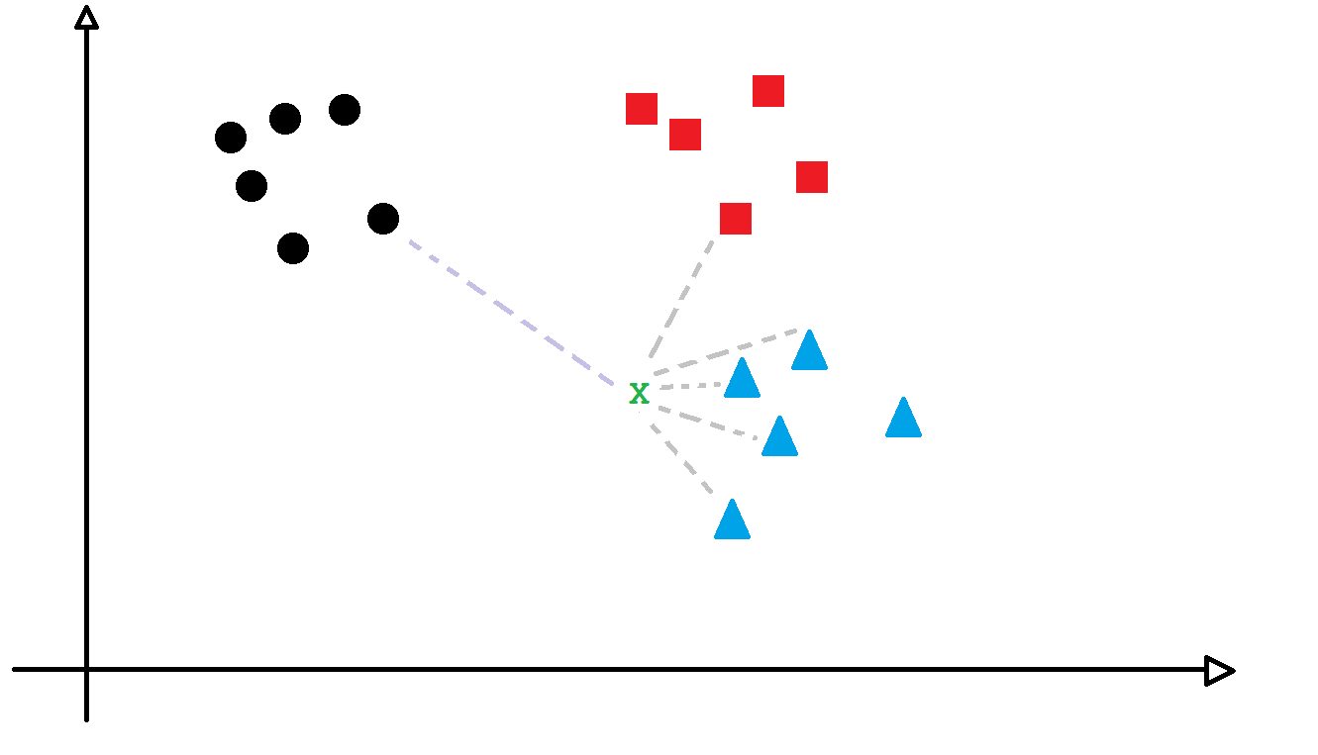
K – nn Regression
KNN regression predicts a value for a new data point by finding the k most similar points in the training data (based on features) and averaging their target values. While simple to understand, it can be slow for big datasets and requires careful selection of the number of neighbors to consider (k).

Slide 11
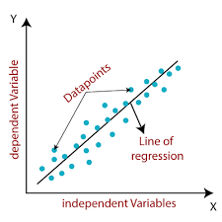
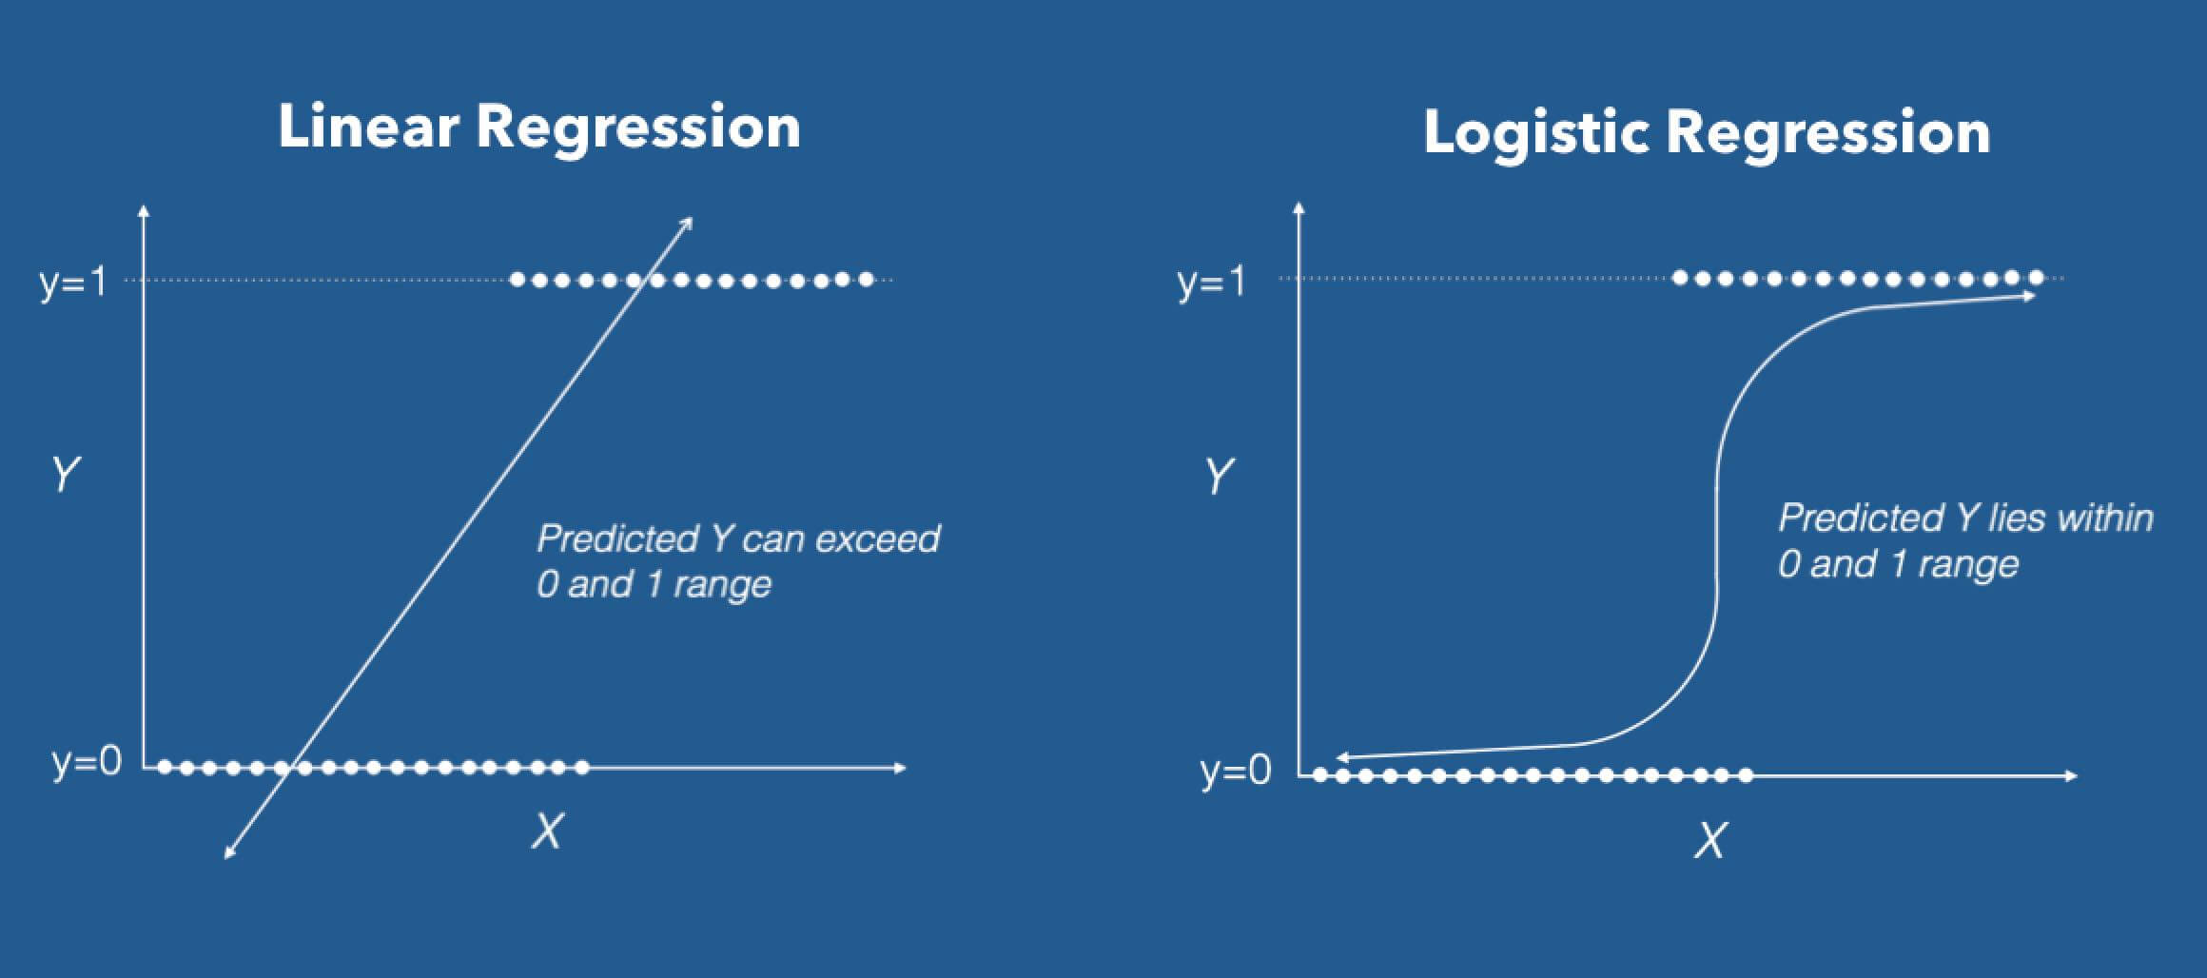
Linear regression
Linear regression is a statistical technique used to uncover the relationship between a dependent variable (what you're trying to predict) and one or more independent variables (what you're basing your prediction on). It does this by fitting a straight line (or plane for multiple variables) that best minimizes the difference between the predicted values and the actual data points. This allows you to understand how much the dependent variable changes on average with each unit change in the independent variable.

Slide 12
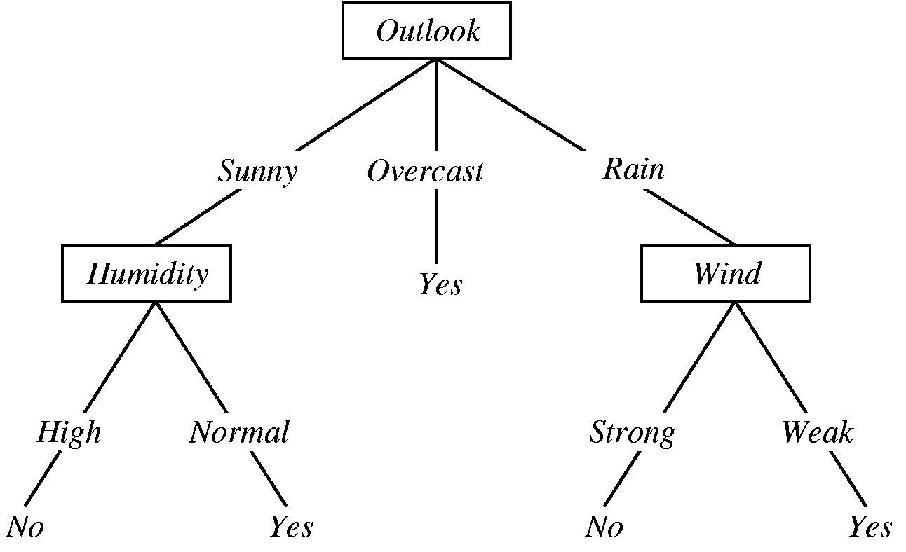
Decision tree
A decision tree is a graphical representation of specific decision situations that are used when complex branching occurs in a structured decision process. A decision tree is a predictive model based on a branching series of Boolean tests that use specific facts to make more generalized conclusions.
The main components of a decision tree involve decision points represented by nodes, actions and specific choices from a decision point. Each rule within a decision tree is represented by tracing a series of paths from root to node to the next node and so on until an action is reached.

Slide 13
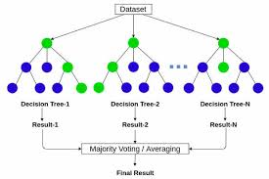
Random Forest
Imagine a bunch of decision trees guessing house prices. Random forest regression averages their guesses for a more accurate final prediction. It adds randomness to these trees to prevent them from all making the same mistake. This helps predict continuous values like prices better than a single tree

Slide 14
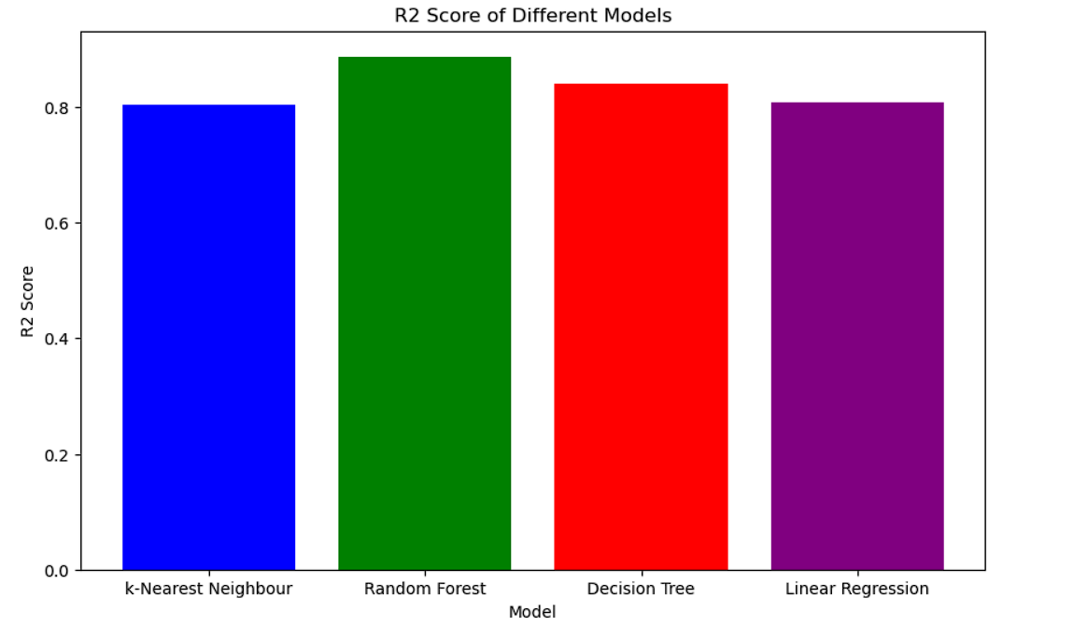
R2 Score comparison
R-Squared shows how well a regression model (independent variable) predicts the outcome of observed data (dependent variable).
R-Squared is also commonly known as the coefficient of determination. It is a goodness of fit model for linear regression analysis

Slide 15

Mean absolute error comparison
The mean absolute error (MAE) is defined as the average variance between the significant values in the dataset and the projected values in the same dataset
MODELS USED | MEAN ABSOLUTE ERROR
Linear Regression | 0.210
K- Nearest Neighbours | 0.192
Decision Tree | 0.181
Random Forest | 0.158

Slide 16
Future scope of improvements
richer data: include reviews, real-time prices, image recognition
smarter models: explore XGBoost, deep learning, explainability techniques
user-friendly app: web interface, price comparisons, custom alerts

Slide 17
Thank you

