Slide 1


Learning Management System
Presented by : Subhan Anjum(2021-CS-13)

Slide 2

Outlines of Presentation
Case Study
Introduction
Database Design
Activity Diagram
Limitations
Future Work
Conclusion

Slide 3
Case Study
Department of Computer Science UET Lahore follows the Outcome Based Education where each subject is
mapped with multiple CLOs. For the Lab work, these CLOs are further mapped to multiple rubrics. Rubrics are
the rules that measure the students at different levels in particular component of an assessment. Example of rubrics
for object-oriented programming are as follow:

Slide 4
Case Study Cont..
You are supposed to streamline the above process and develop desktop application(Windows Form Application
using C#) that will be operated by the teacher to manage data at one place. Following features will be
implemented in the application.
• Manage Students
• Manage CLOs
• Manage Rubrics
• Manage Assessments
• Manage Rubric Levels
• Mark the evaluations against a student

Slide 5
Case Study Cont..
And any other feature that can be helpful for the management of evaluations.
Instructor also requires multiple reports in pdf form that may include.
Assessment wise class result
And any other reports that you can help the committee to streamline the process.
CLO wise class result

Slide 6

Introduction

Slide 7

Streamlined Assessment Processes:
LMS provides a centralized platform for managing assessments, making it easier to organize and track student progress, evaluate their performance based on rubrics and learning outcomes, and streamline the assessment process.

Slide 8

Improved Organization:
LMS enables easy management, search, and sorting of student and course learning outcome data. With the ability to manage rubrics and assessments, add assessment components, mark attendance, and download reports, the system ensures that all important data is organized and easily accessible.

Slide 9

Increased Efficiency:
LMS helps to increase efficiency by automating administrative tasks such as attendance tracking and report generation. This frees up valuable time for instructors, allowing them to focus on teaching and providing feedback to students.

Slide 10

Improved Outcomes:
LMS enhances the evaluation of student performance by enabling instructors to evaluate student progress based on rubrics and learning outcomes. This allows instructors to identify areas where students may need additional support and provide targeted feedback to improve overall outcomes.

Slide 11
Target Audience
Audience: universities managing student data manually
Desktop app for managing student details for entire departments
Manage course learning outcomes (CLOs) with different rubrics and levels for each student
Enables admin to mark evaluations against each student
Simplifies attendance system management, easier than manual tracking.

Slide 12
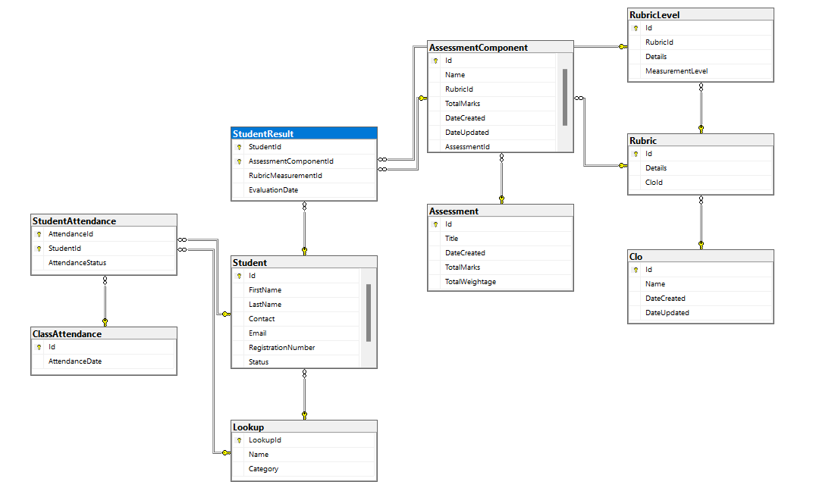
Database Design

Slide 13

Activity Diagrams

Slide 14
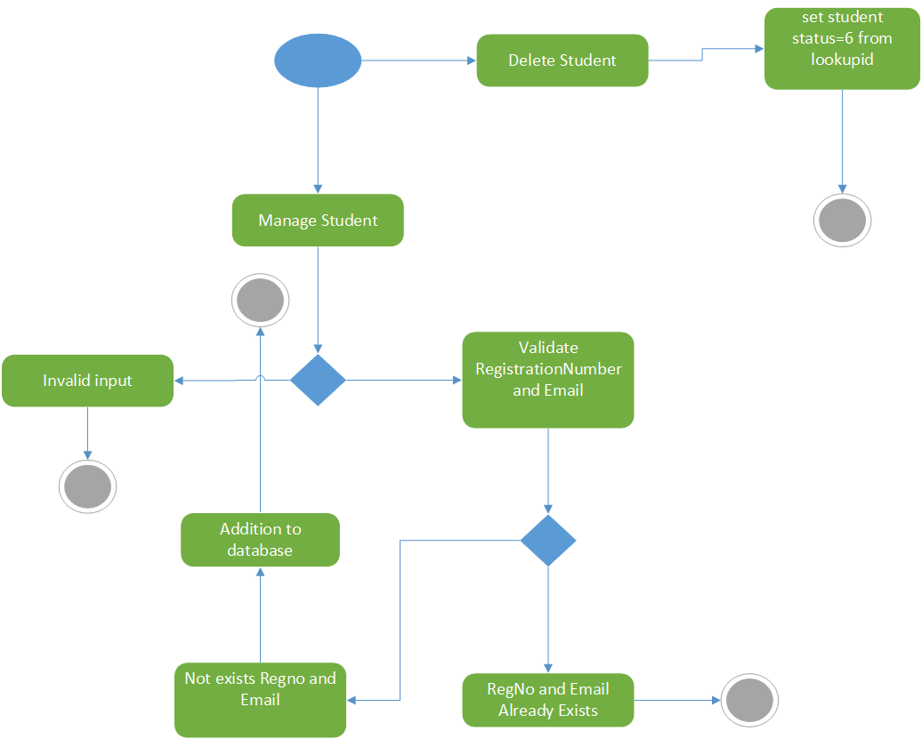
Manage Student

Slide 15
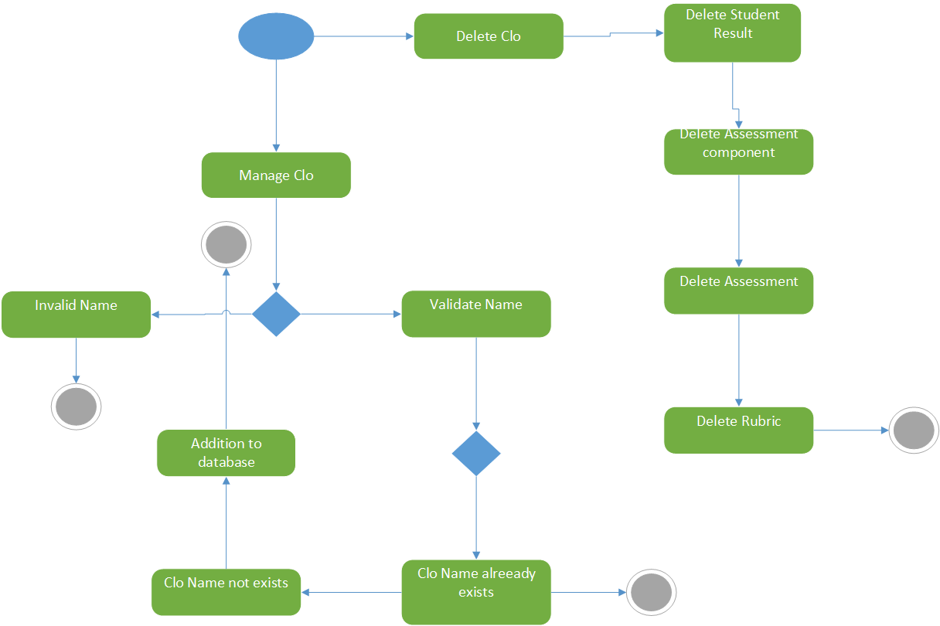
Manage Clo

Slide 16
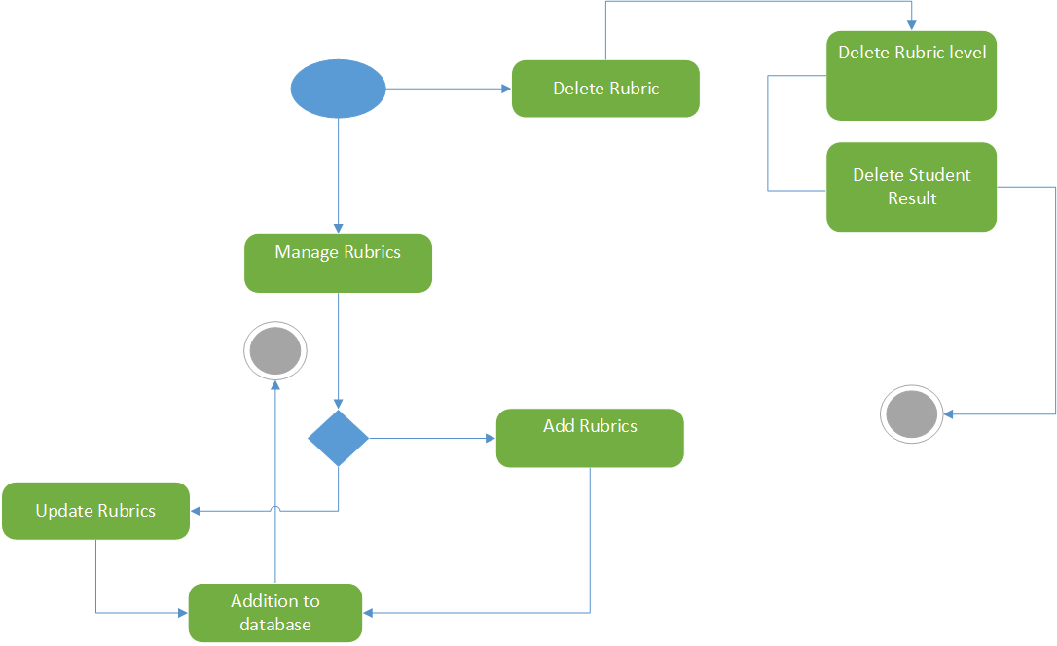
Manage Rubric

Slide 17
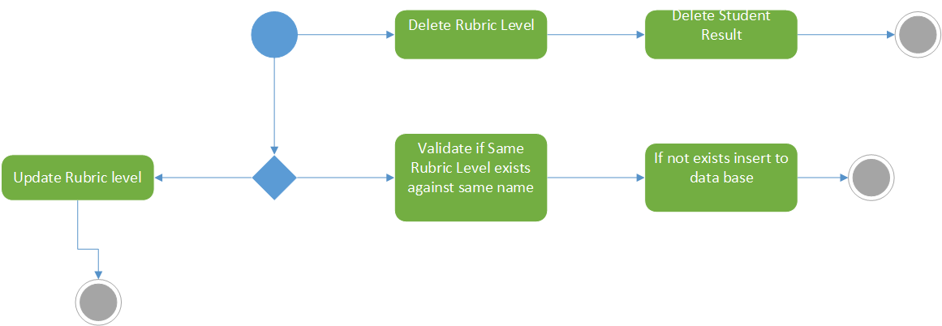
Manage Rubric Levels

Slide 18
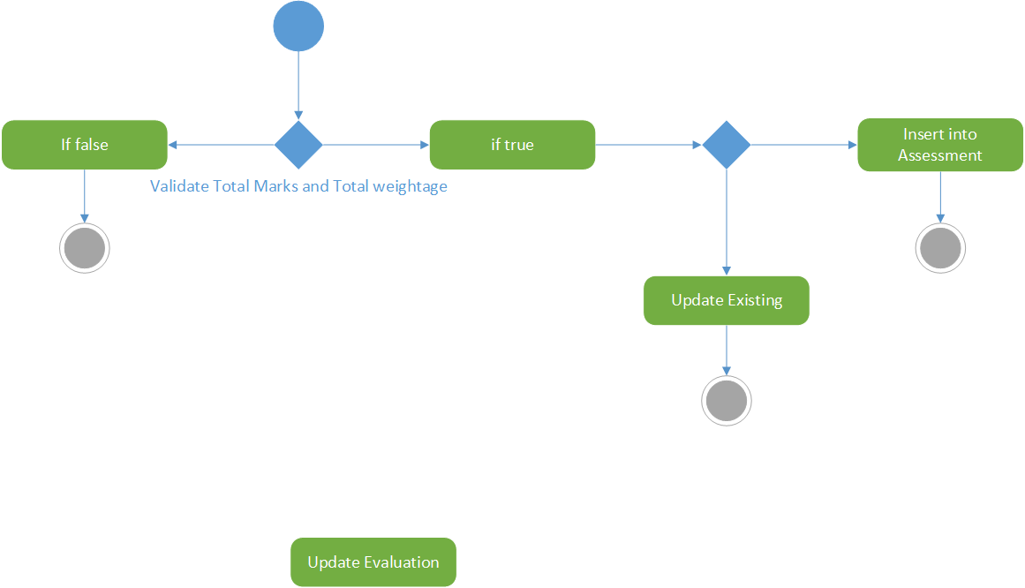
Manage Assessment

Slide 19
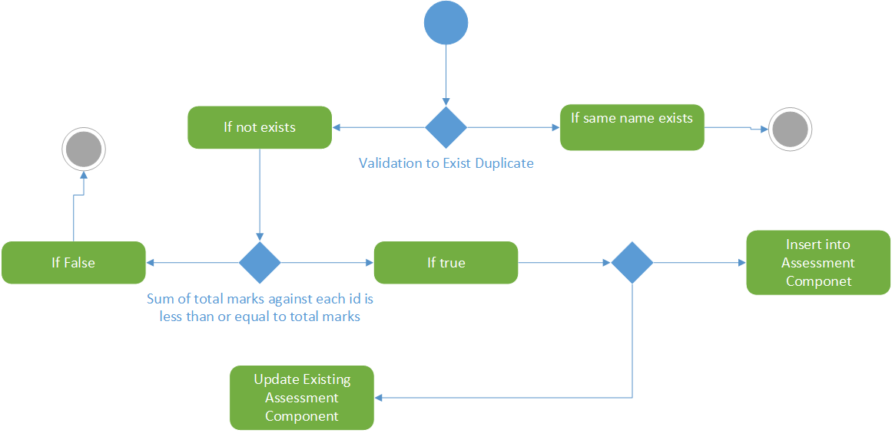
Manage Assessment Component

Slide 20
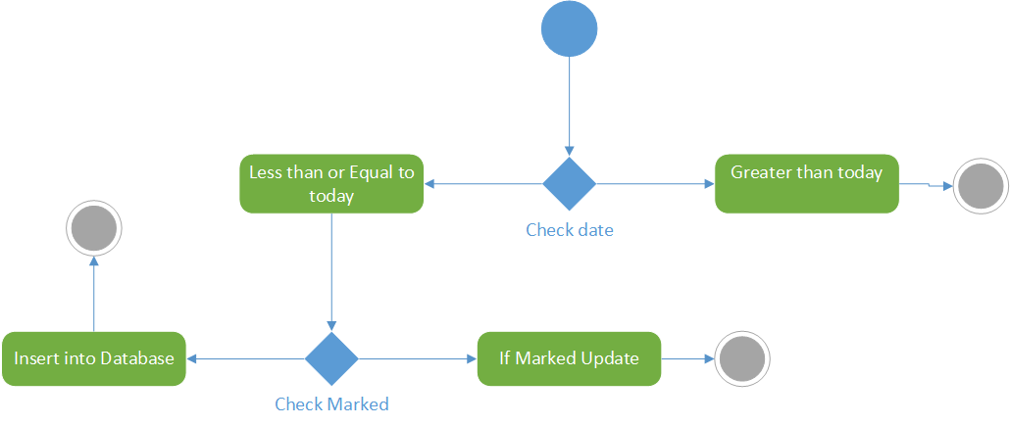
Manage Attendance

Slide 21
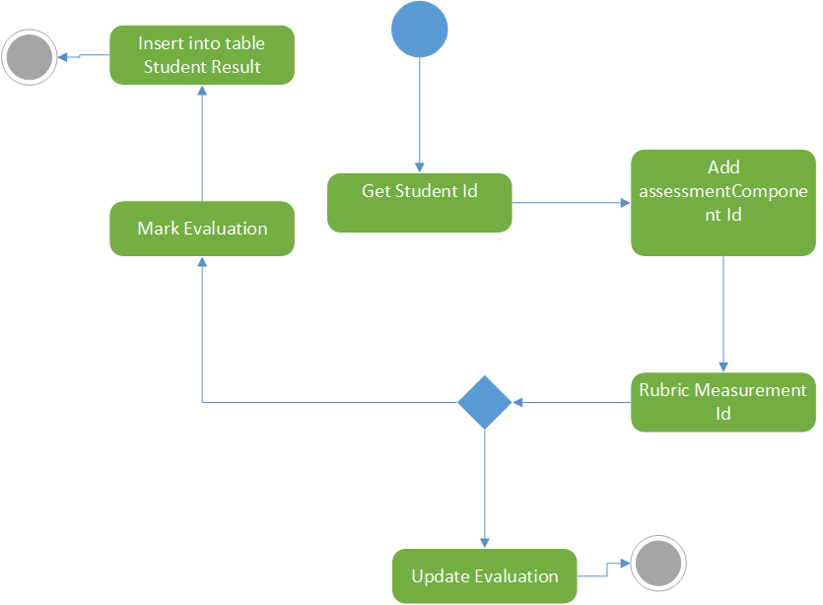
Mark Evaluations

Slide 22

Limitations

Slide 23

Limitation: Single User Orientation

Slide 24

Issue: Lack of Login Form and Insecure Data

Slide 25

Limitation: Optional Attendance Marking

Slide 26

Future Work

Slide 27

Implement user authentication system

Slide 28

Make Student Dashboard

Slide 29

Create separate user accounts for teachers and administrators

Slide 30

Improve attendance system

Slide 31

Refactor code into object-oriented structure

Slide 32
Conclusion
SQL databases offer quick and easy search, sort, and manipulation capabilities
Access controls and user permissions improve data security
SQL databases provide significant benefits for data management in businesses and organizations.

