Slide 1


Slide 2

Kidicode

Slide 3
Group Members Introduction
Group Id: S25PROJECTEA754
Student Name: SUBHAN MAHMOOD
VUID: BC190402729
Supervisor Name: Abdullah Qamar

Slide 4

INTRODUCTION OF PROJECT
The scope of the Kidicode project involves the design and development of a comprehensive Learning Management System (LMS) and web application tailored for a company offering STEM and AI coding courses to children in Pakistan. This platform will provide a seamless and interactive learning environment that supports online (via Zoom and Microsoft Teams), in-person, and hybrid education models. It will cater to multiple user roles including administrators, instructors, students, and parents, each with specific dashboards and permissions. Core features of the system will include user registration and authentication, course creation and management, interactive assessments such as quizzes and coding challenges, and gamification elements like points, badges, and leaderboards to enhance engagement. The LMS will also include SCORM/xAPI integration for learning activity tracking, progress monitoring tools for students and parents, and a secure payment gateway for handling subscriptions and course purchases. Additionally, the platform will feature a company portfolio and blog section to showcase training programs, achievements, and success stories. The project will be built using modern web technologies such as Laravel for the backend, React/Vue/Angular for the frontend, and MySQL or PostgreSQL for database management, with deployment on cloud platforms like AWS or Firebase. This project aims to deliver a robust, scalable, and user-friendly system to promote coding education among young learners in Pakistan..

Slide 5
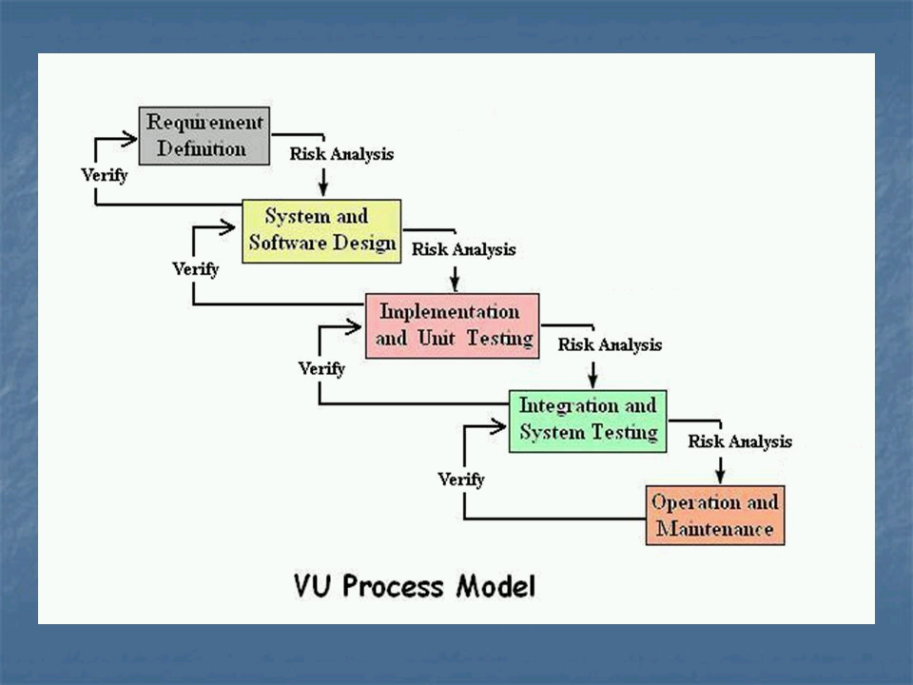

Slide 6
Use Case Diagram

Slide 7
Business Rules Catalog
Functional Requirements refer to the specific behaviors, features, and functions a system must perform. These define what the system should do, such as tasks, data handling, and interactions between users and the system. For example, in a vaccination portal, functional requirements include user registration, child profile creation, updating vaccination status, and generating reports.
User Registration and Login Users should be able to create an account using email, phone number, or social media. After registration, they must log in securely to access their respective dashboards.
Role-Based Dashboards
Admin Dashboard: Allows the admin to manage users, view analytics, add or remove courses, and update website content.
Instructor Dashboard: Instructors can upload course materials, create quizzes, view student performance, and communicate with students.
Student Dashboard: Students can view enrolled courses, access learning materials, take quizzes, submit assignments, and track their progress.
Parent Portal: Parents can view their child’s course progress, quiz results, and receive performance updates.

Slide 8
Business Rules Catalog
Course Management Admins and instructors should be able to create new courses, assign difficulty levels (Beginner, Intermediate, Advanced), upload videos, notes, and add deadlines. Courses can be edited or deleted anytime.
Quizzes and Assignments Instructors can create multiple types of assessments including MCQs, coding problems, and written assignments. Students must be able to attempt and submit them, and view results after grading.
Gamification System To keep students motivated, the system should award points for completing tasks, give badges for achievements, and display a leaderboard showing top-performing students.
Progress Tracking Each student’s progress should be tracked and displayed using graphs or percentage bars. Instructors and parents should also have access to this information.

Slide 9
Business Rules Catalog
SCORM/xAPI Support The platform should support SCORM or xAPI packages to allow standard tracking and reporting of learning activities.
Payment and Subscription
Students should be able to view free and paid courses.
For paid courses, the platform should offer monthly or yearly subscription plans.
Secure payment integration (e.g., PayPal, JazzCash) must be available for fee processing.
Blog and Portfolio Section The website should include a section where the admin can post blogs, share company news, student achievements, and highlight success stories.
Responsive Design and Accessibility The application should work smoothly on all devices including desktops, tablets, and smartphones. It should be easy to navigate for both kids and parents.

Slide 10
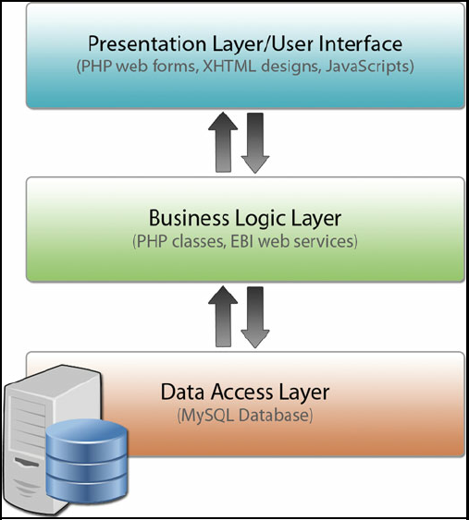
Architectural Design

Slide 11
Team Structure

Slide 12
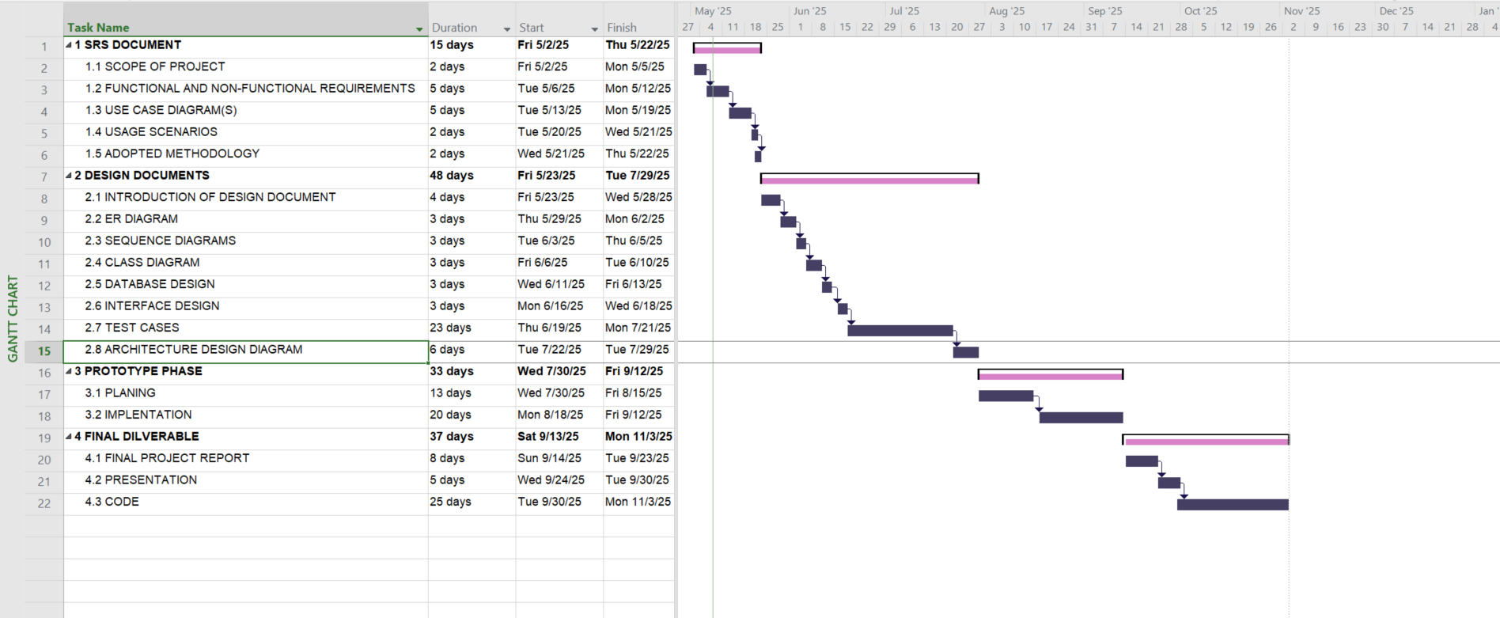
Project Schedule

Slide 13
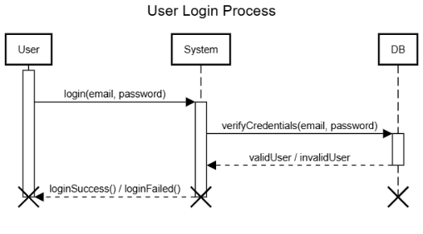
Sequence Diagrams

Slide 14
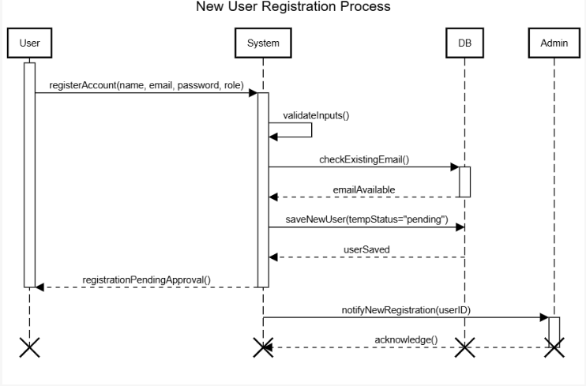
Sequence Diagrams

Slide 15
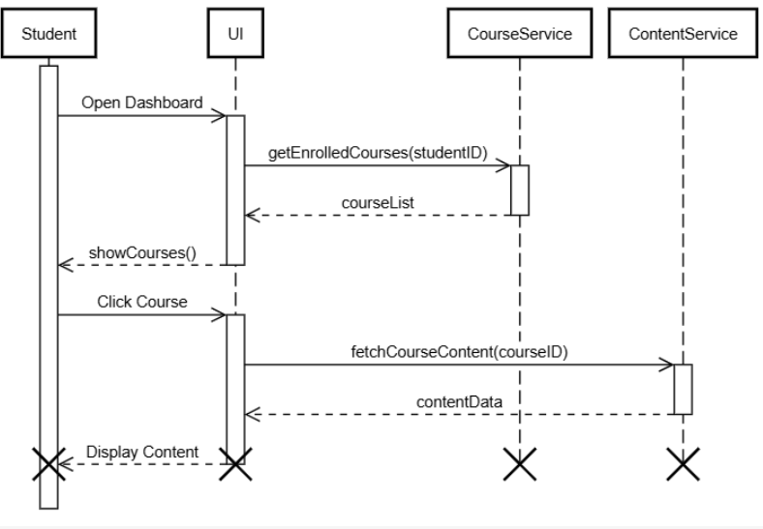
Sequence Diagrams

Slide 16
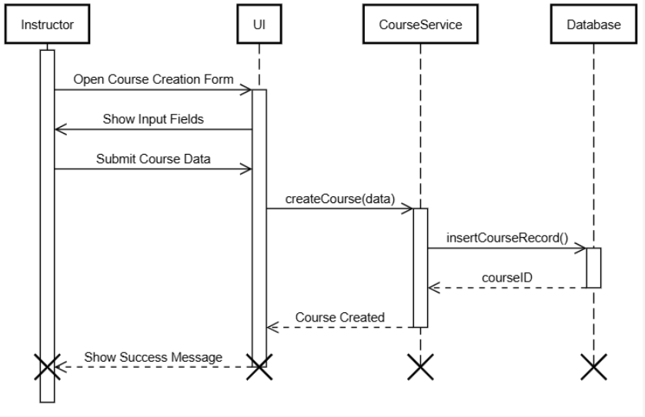
Sequence Diagrams

Slide 17
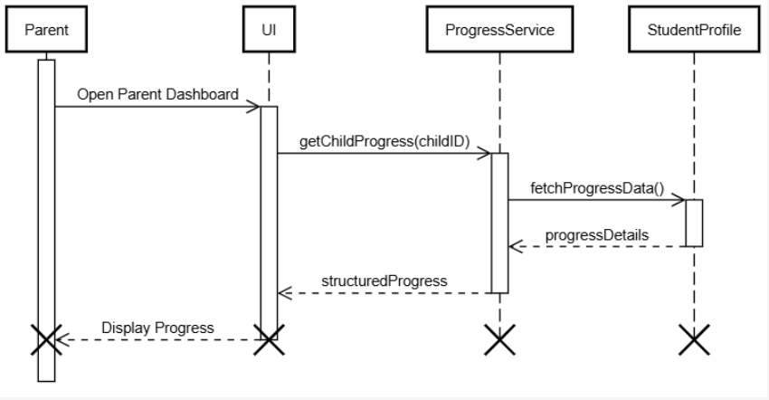
Sequence Diagrams

Slide 18
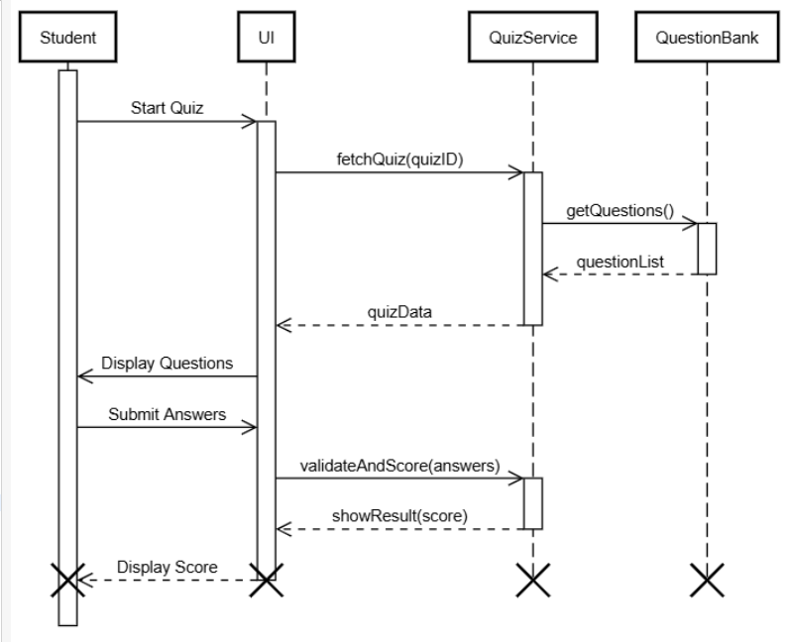
Sequence Diagrams

Slide 19
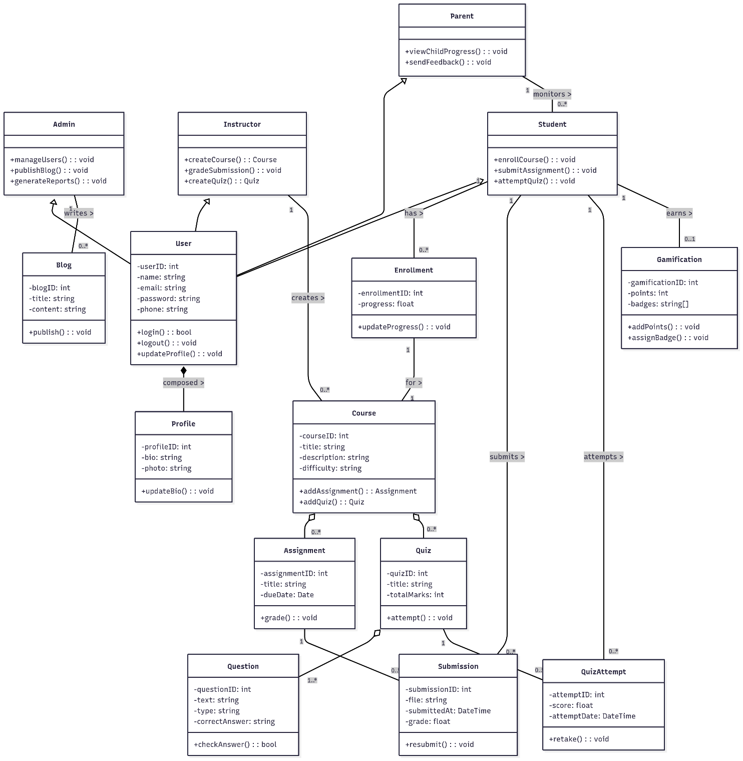
Logical Model/Class Diagram

Slide 20
Entity-Relationship Diagram

Slide 21
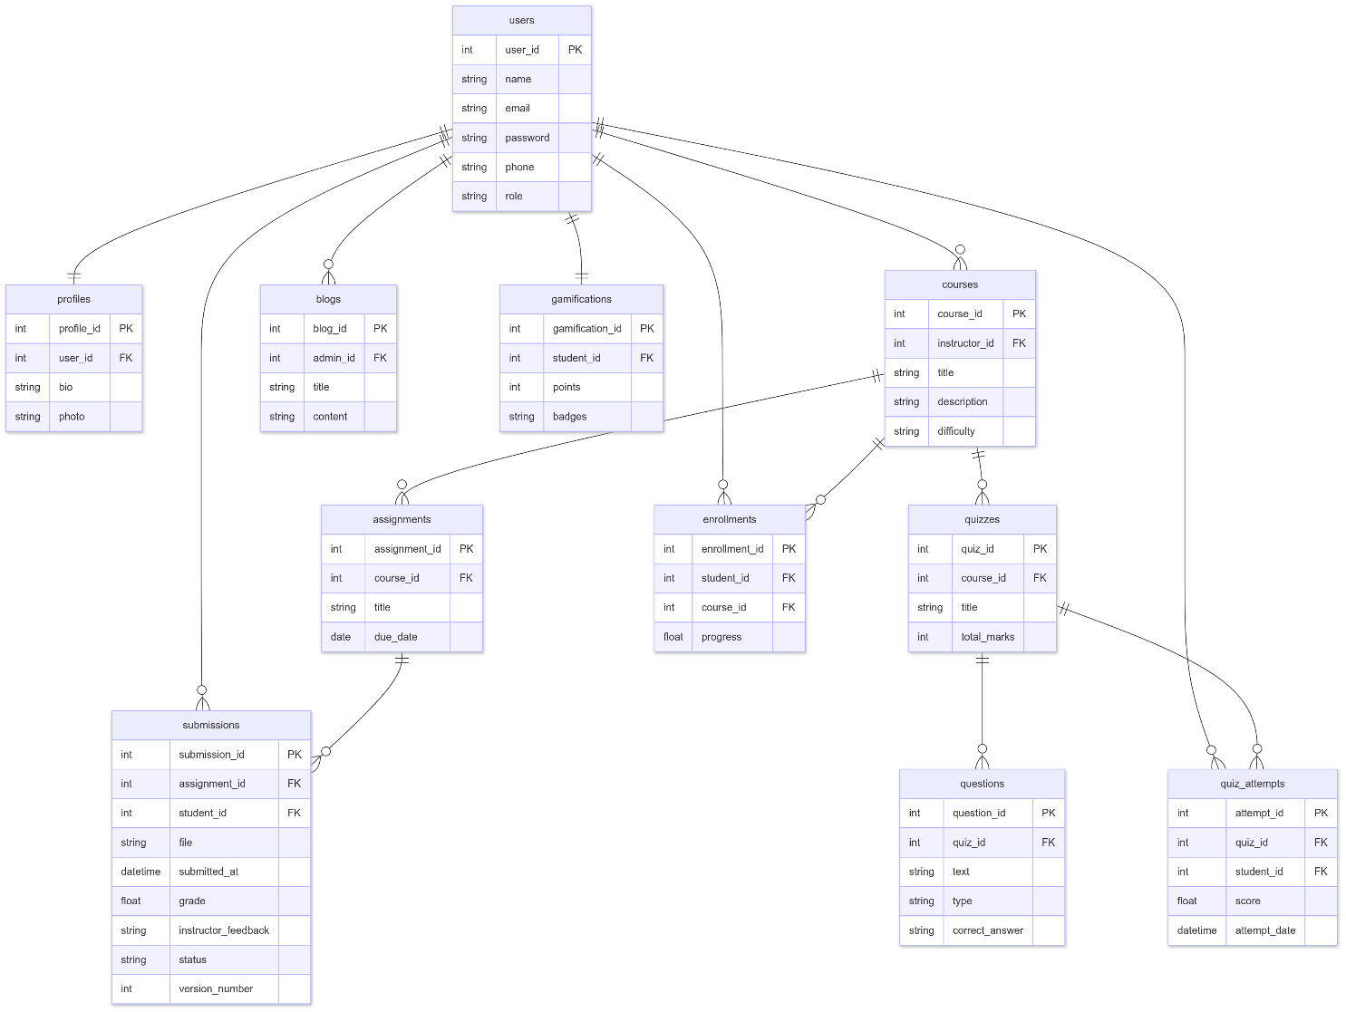
Database Diagram

Slide 22
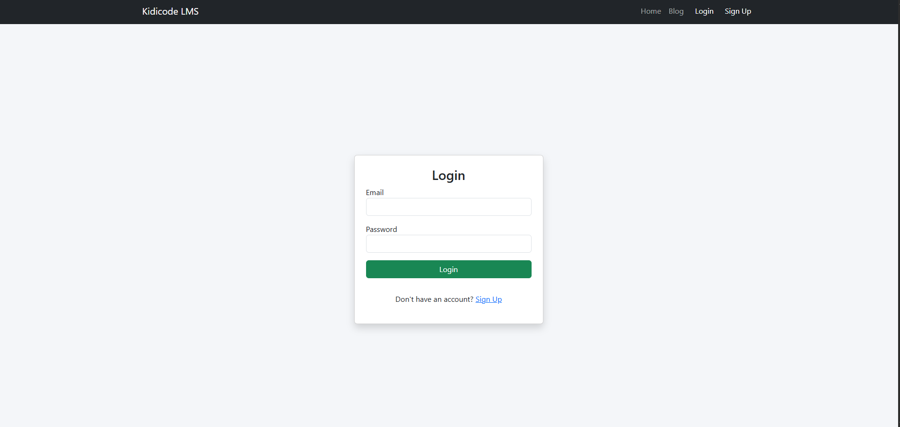
User Interfaces

Slide 23
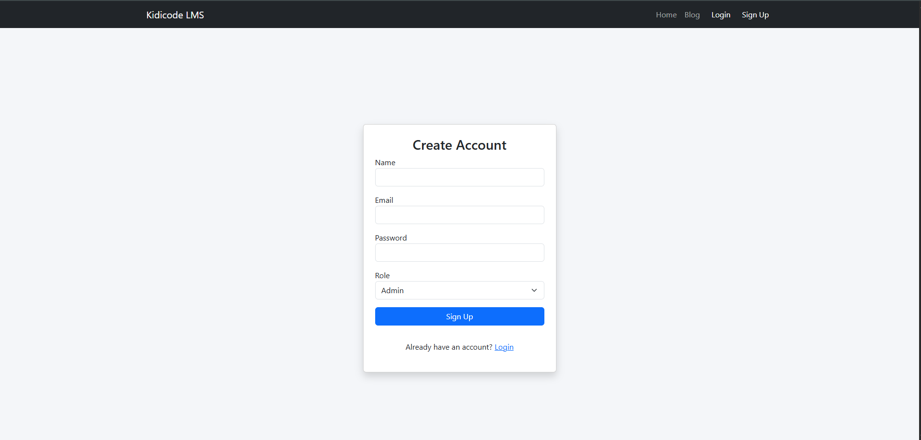
User Interfaces

Slide 24
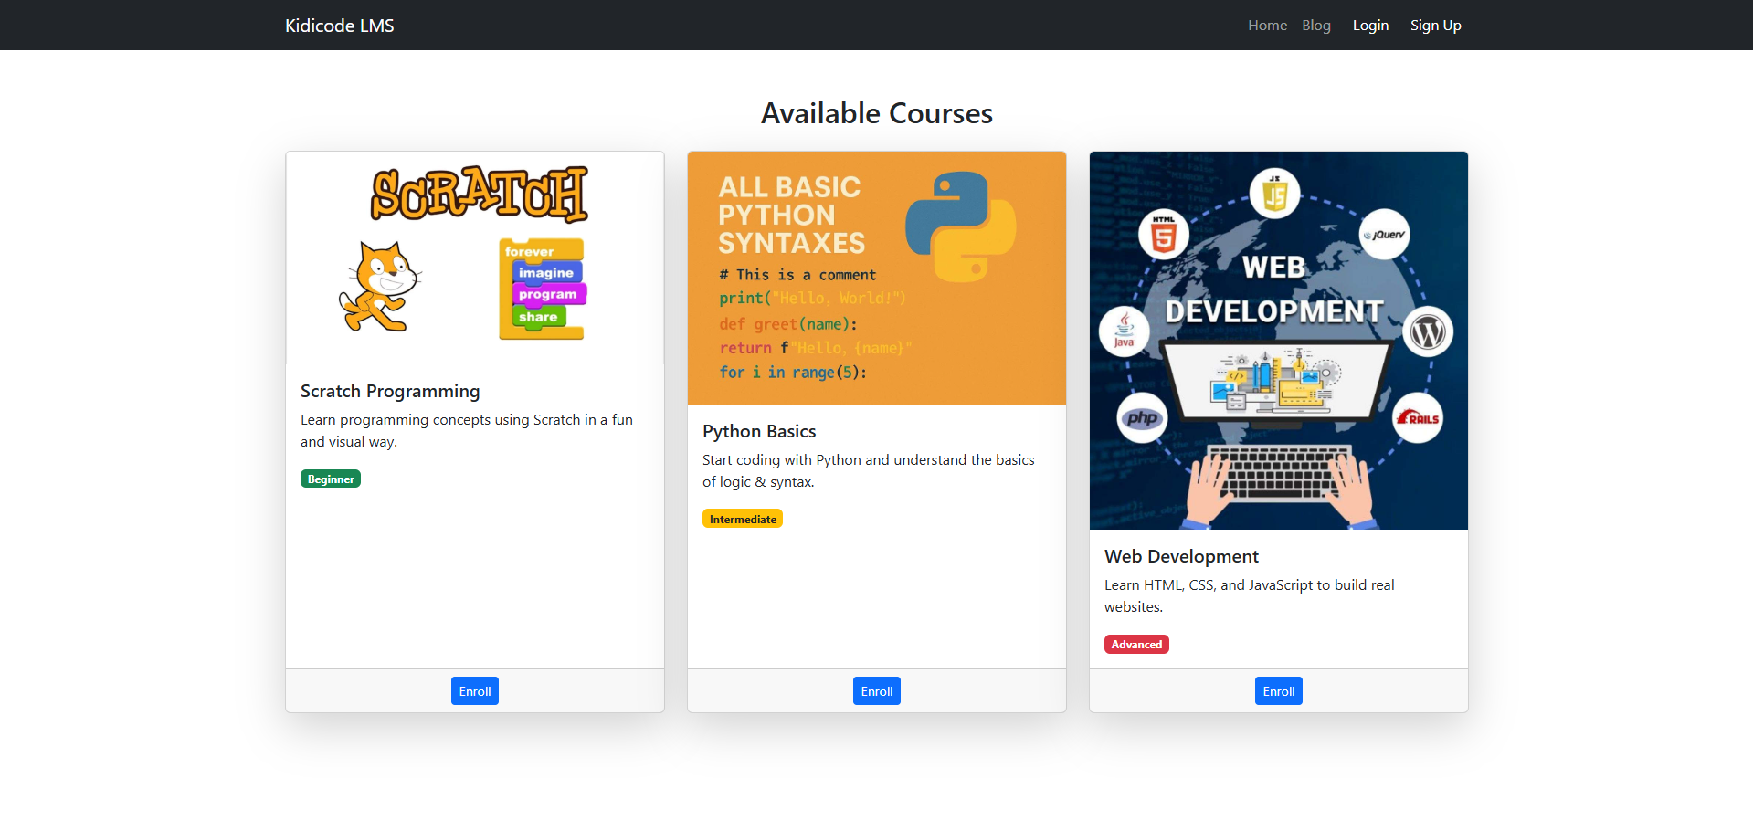
User Interfaces

Slide 25
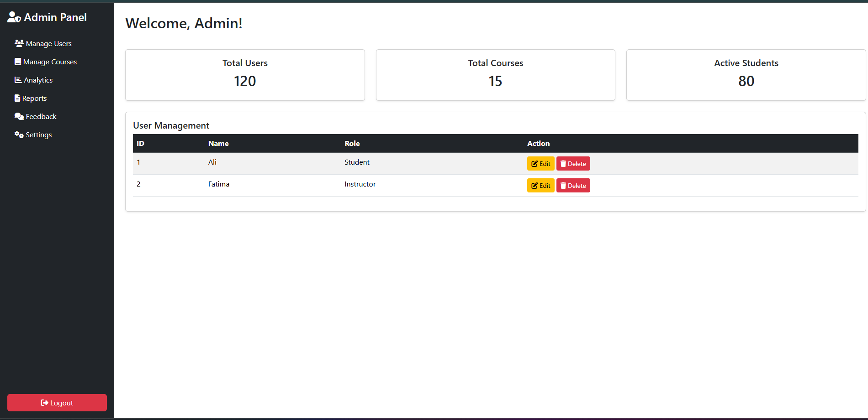
User Interfaces

Slide 26
Tools
Tools :
Ms Office
Sublime Text
SQLyog
Xammp
Languages:
PHP
Javascript
HTML
Bootstrap
Css

Slide 27
Thank You

