Slide 1

SATS ASA – «From Presence to Profits»
9ᵗʰ - 12ᵗʰ
February 2026

Slide 2
Contents
Presentation
Positioned as a Market-leading Fitness Group Across the Nordics
Long-term Health and Lifestyle Trends Underpin Fitness Demand
Historical Analysis and Forecasts
Valuation and Concluding Thoughts

Slide 3

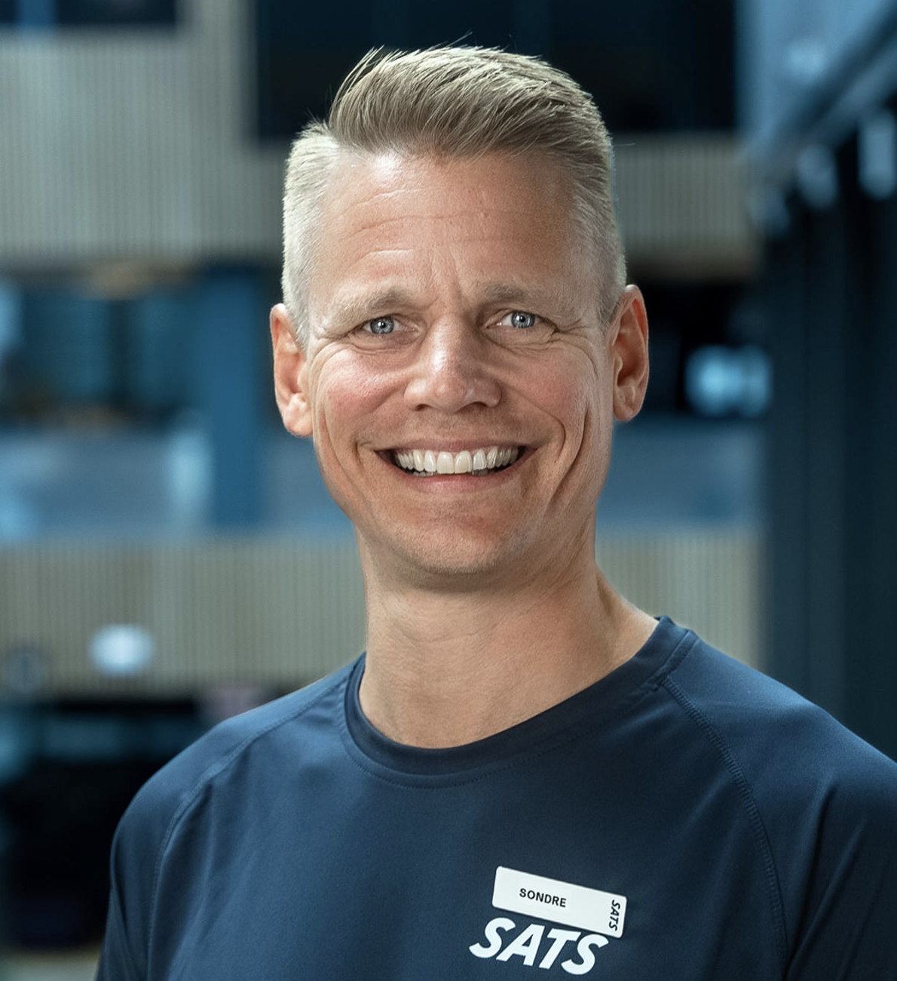

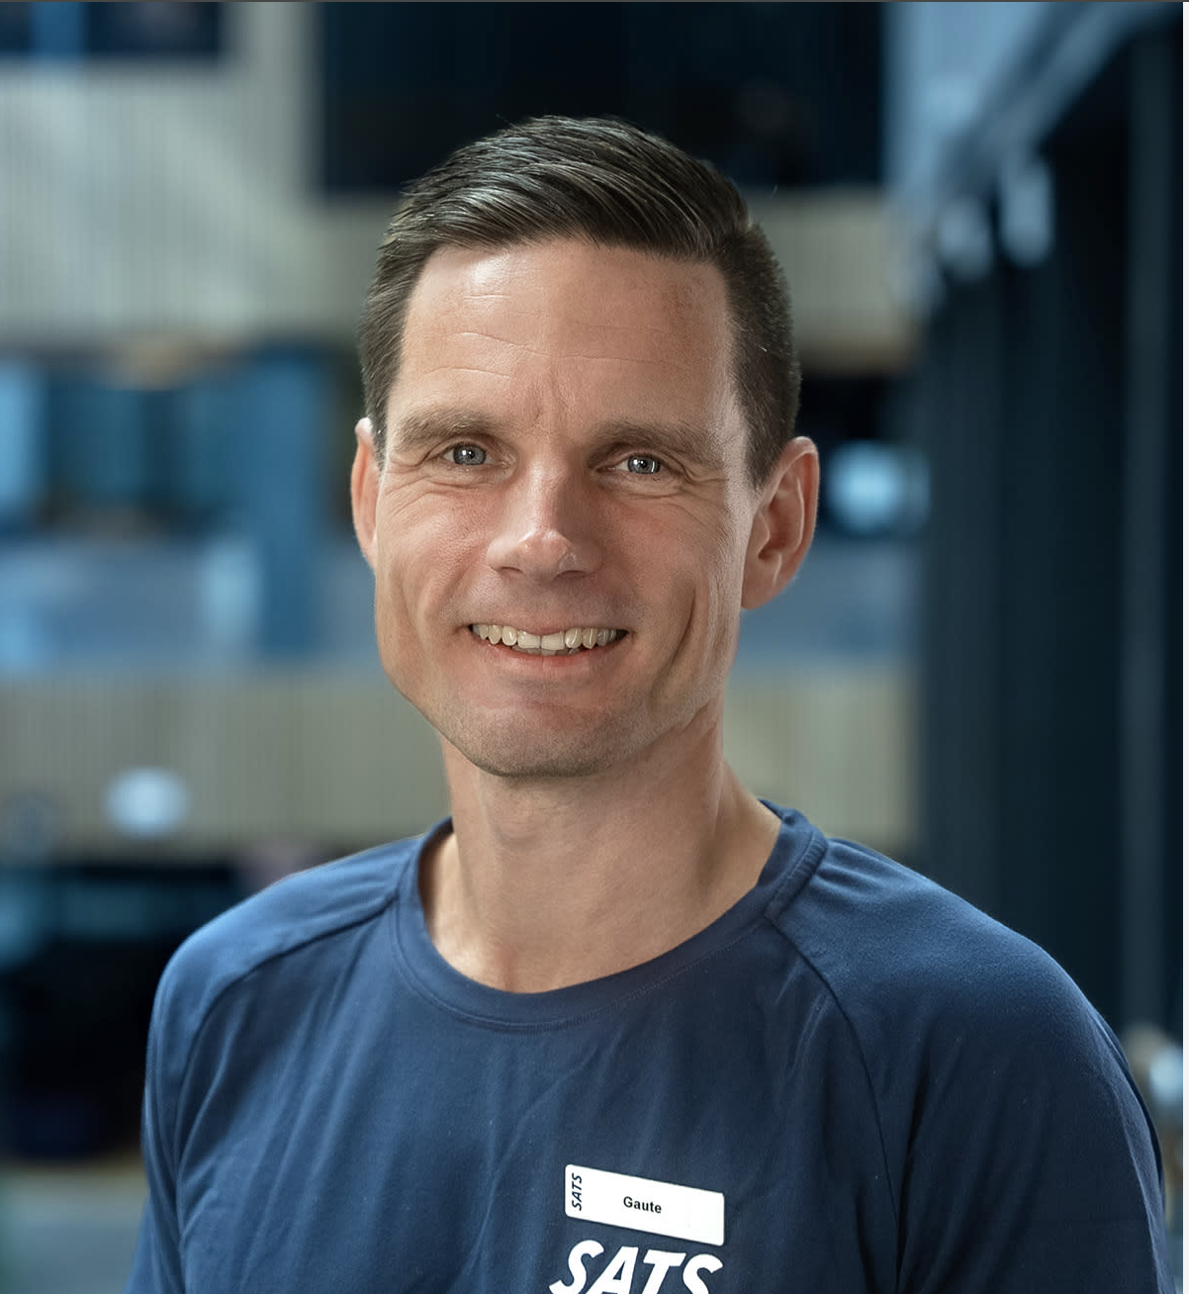
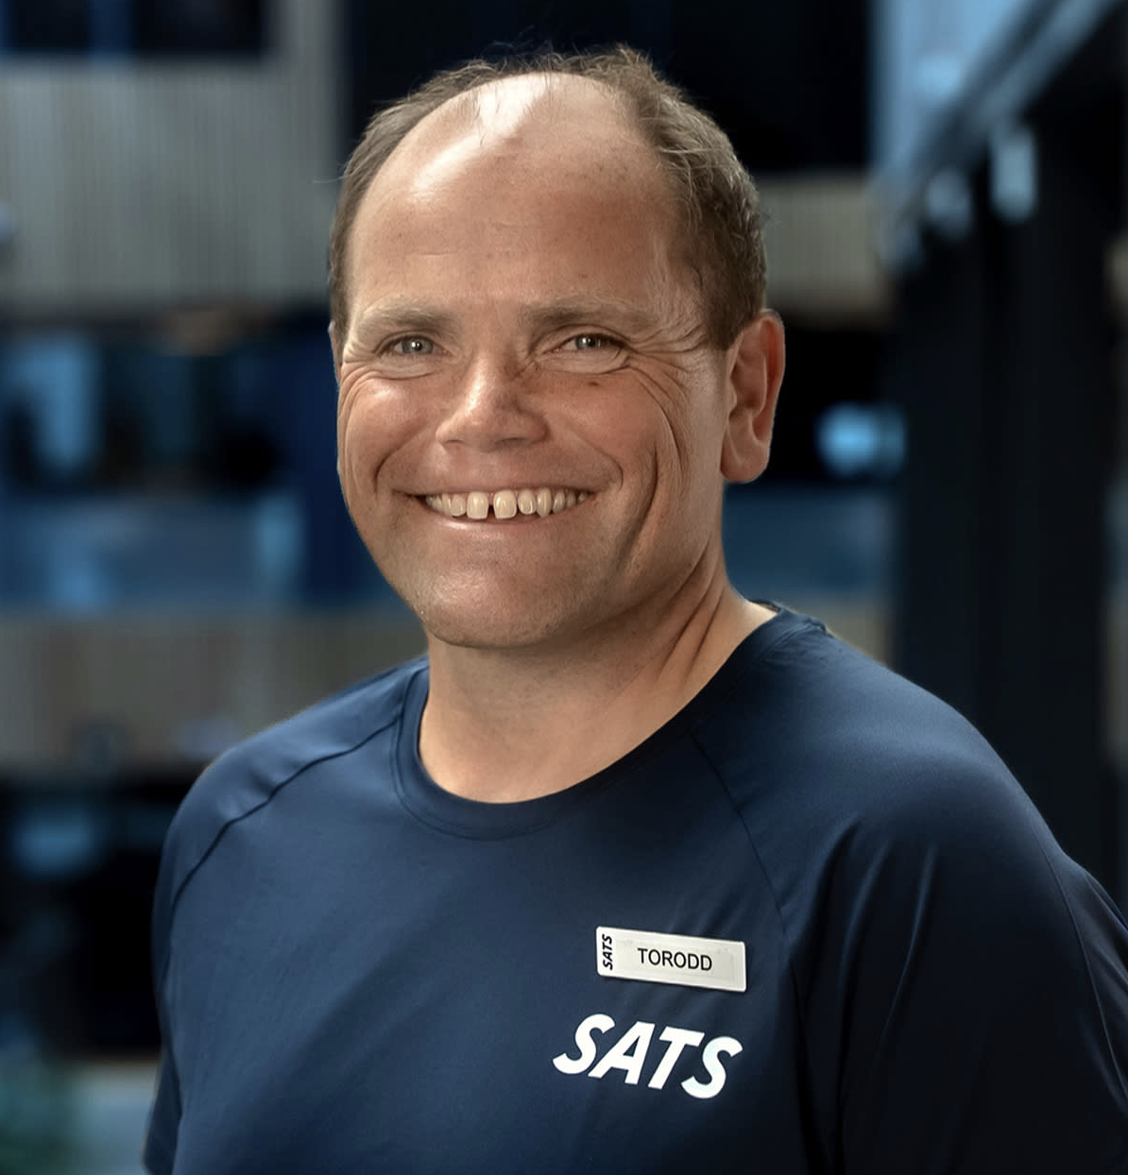




Company Overview
#1 Positioned as a Market-leading Fitness Group Across the Nordics
A business model where recurring memberships drive profitability through scale
SATS Group is the leading fitness operator in the Nordics, operating a large-scale, membership-based gym network with strong brand recognition across Norway, Sweden, Denmark and Finland. Recurring membership revenues and high operating leverage support earnings and cash flow upside as utilization increases.
Company Snapshot
1
Leading position underpinned by recurring revenues
Experienced executive team
2
3
Market leader with ~30% share in the Nordic commercial fitness club market, more than 2x the size of the second-largest player
~2,700 members per club and NOK 15–20m revenue per mature club support stable cash flows and high earnings visibility
High operating leverage drives a clear earnings inflection, with EBIT margins expanding from ~0% in 2022 to ~16% in 2025 as utilization normalizes
Sondre Gravir
Cecilie Elde
Gaute Sandal
CEO
CFO
CDO
Torudd Gøystdal
Ellen Marie Vanberg
Mia Lund Hanusek
COO
CPO
CMO
Diversified presence across four Nordic markets
Scaling revenues translating into higher EBIT margins
Improving profitability and returns
4
5
6
NOKm
Ratios
EBITDA %
5.5 NOKb
EBIT %
ROE
ROIC
UFCF Yield
Sources: Economic Mind, Company Financial Reports, Bloomberg, SLME Advisory Estimates
Note: Market share based on Economic Mind’s bottom-up analysis of 154 companies operating physical fitness clubs in the Nordics (NO, SE, DK, FI).

Slide 4
Market Overview
#2 Long-term Health and Lifestyle Trends Underpin Fitness Demand
Supportive macro environment and structural demand underpin Nordic fitness growth
Stabilizing Norwegian economy supports consumption
Cyclical shifts with periods of relative outperformance
Strengths
1
2
YoY Growth – SATS vs Nordic Market
Scale advantage in a consolidating Nordic market
Strong positioning in a structurally health-driven market
Weaknesses
High fixed-cost structure increases earnings volatility
Capital-intensive expansion model requiring upfront capex
Sustained double-digit market expansion
Competitive dynamics reinforce scale advantages
Opportunities
3
4
Underpenetrated Norwegian market (~20% adult participation) supports long-term membership upside
Corporate wellness gap supports B2B growth
The Nordic fitness market delivered a 10.6% CAGR over 2014-2024 and is projected to grow at a similar pace through 2028, reaching ~NOK 21bn
NOKbn
~32% Nordic market share, well ahead of peers
Clear scale gap to the next-largest player (~12%)
Threats
Rapid expansion of low-cost operators increasing pricing pressure
Consumer discretionary sensitivity in weaker macro environments
Sources: Economic Mind, Company Financial Reports, SSB, Norges Bank, Treningsindustrien, SLME Advisory Estimates
Note: (1) 2024A based on official data from SSB. 2025E reflects Norges Bank estimates. 2026–2028F based on Norges Bank projections and extended using a normalized macro assumption. (4) “Other” includes EVO Fitness, MOVA, Feel24 and additional smaller operators.

Slide 5
Financials and Estimates
#3 Historical Analysis and Forecasts
Accelerating top-line growth with expanding margins and strong cash flow generation driving improving returns
1
NOKm
Historical
Forecast
Financial Commentary
Revenue growth re-accelerating to 8.7% in ’25 (from 7.0% in ’24) driven by continued membership momentum (~21k net adds in NO & SE).
We forecast a stable ~8% top-line CAGR through ’32F, supported by recurring subscription revenues, selective club expansion, demand for health & fitness, and normalising macro conditions in the Nordics.
EBITDA margin stabilising around ~38%, reflecting strong operating leverage in a largely fixed-cost model.
Absolute EBITDA expected to grow from MNOK 2 110 in ’25A to MNOK 3 516 in ’32F, implying meaningful earnings inflection versus pre-pandemic levels.
Strong free cash flow generation and rising capital efficiency drive structurally improving returns, with stable ROE at ~ 30% through ’32F and forward EV/EBITDA compressing to 2.6x, implying significant valuation upside if execution and membership momentum continue.
2
Multiples
Historical
Forecast
3
%
Historical
Forecast
Sources: Company Financial Reports, Bloomberg, SLME Advisory Estimates
Note:

Slide 6
Valuation and Recommendation
#4 Valuation and Concluding Thoughts
We recommend a Buy. Based on our analysis, we anticipate an indicative valuation range of NOK45 – NOK60 per share, approximately 6.4% - 41% upside versus current share price (NOK 42.3)
We view SATS as a structurally improved fitness operator with stronger earnings visibility, expanding margins and a clear deleveraging trajectory. The business benefits from recurring revenues and operating leverage, while valuation does not fully reflect normalized earnings power. Based on conservative assumptions, our analysis supports a Buy recommendation and a target price of NOK 49.5
Buy – TP NOK 49
DCF Valuation – Sensitivity Analysis
WACC
To our eyes, SATS is a structurally improved, cash-generative business with visible margin recovery and strong operating leverage.
ARPU growth and stable membership trends support continued EBITDA expansion and improving earnings quality.
At ~NOK 42,3, SATS trades below normalized earnings power, and we see a target price of NOK 49,5, implying ~18% upside.
Terminal Growth
NOK
Valuation Summary – Football Field
Multiple Valuation
42,3
49,5
Current Share Price
Nordic peers trade at 19.3x EV/EBIT and 19.5x P/E vs. SATS at 14.8x and 16.8x, implying a clear valuation discount.
Stronger profitability and operating leverage justify trading in line with peers, with higher structural margins and improving capital efficiency underpinning re-rating potential.
A conservative 13x terminal EBIT multiple supports a share price of NOK 57 vs. NOK 42.30 today (~35% upside).
NOK
DCF Target Price
Sources: Company Financial Reports, Bloomberg, SLME Advisory Estimates
Note:

Slide 7
Appendix
#1 Company Overview
#2 Market Overview
#2.1 Risks
#3 Financials and Estimates
#3.1 Reformulated Income Statement
#3.2 Reformulated Balance Sheet
#3.3 Detailed Revenue Forecast
#3.4 Key Assumptions
#4 Valuation and Recommendation
#4.1 DCF Model – Base Case
#4.2 Multiple Comparison
#4.3 Key Value Drivers – SATS ASA vs. Comparable Companies

Slide 8
Key Risks
#Appendix 2.1
Risks and uncertainties could potentially lead to weaker performance than expected. Our downside scenario indicates a -13% loss of capital
1
Consumer Downturn in the Nordics
Lower household spending reduces new memberships and increases churn,
weakening revenue growth and operating leverage.
2
Pricing & ARPU Execution Risk
If members resist price increases or trade down from Premium/PT, margin expansion
assumptions fail.
3
Cost Inflation Mismatch
Wage, rent and energy inflation not offset by pricing directly compresses EBITDA.
4
Competitive Pressure From Low-cost Operators
Aggressive expansion by budget chains limits pricing power and caps penetration
growth.
5
Slower Deleveraging
Weaker cash flow or higher rates delay balance sheet normalization, reducing equity
upside.
Sources: Company Financial Reports, Economic Mind, Treningsindustrien
Note:

Slide 9
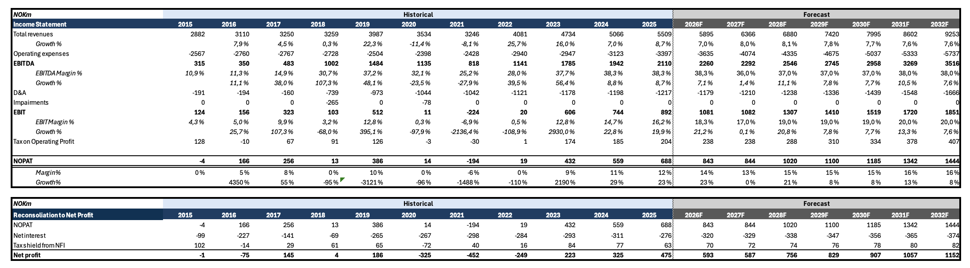
Reformulated Income Statement
#Appendix 3.1
Sources: Company Financial Reports, Bloomberg
Note:

Slide 10
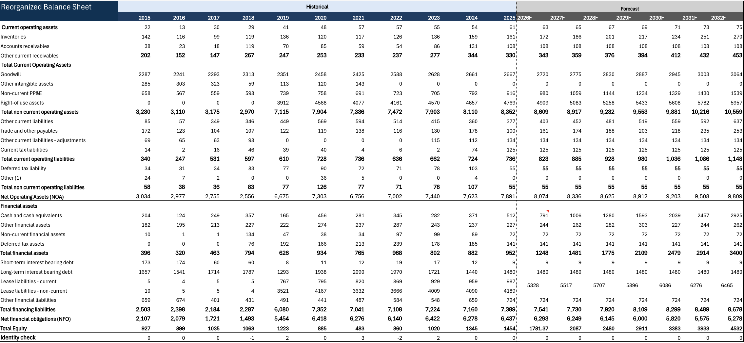
Reformulated Balance Sheet
#Appendix 3.2
Sources: Company Financial Reports, Bloomberg
Note:

Slide 11
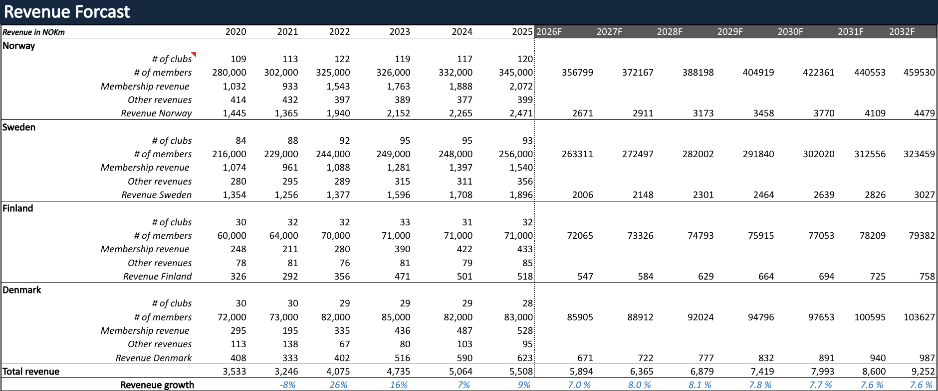
Detailed Revenue Forecast
#Appendix 3.3
Sources: Company Financial Reports, Bloomberg
Note:

Slide 12
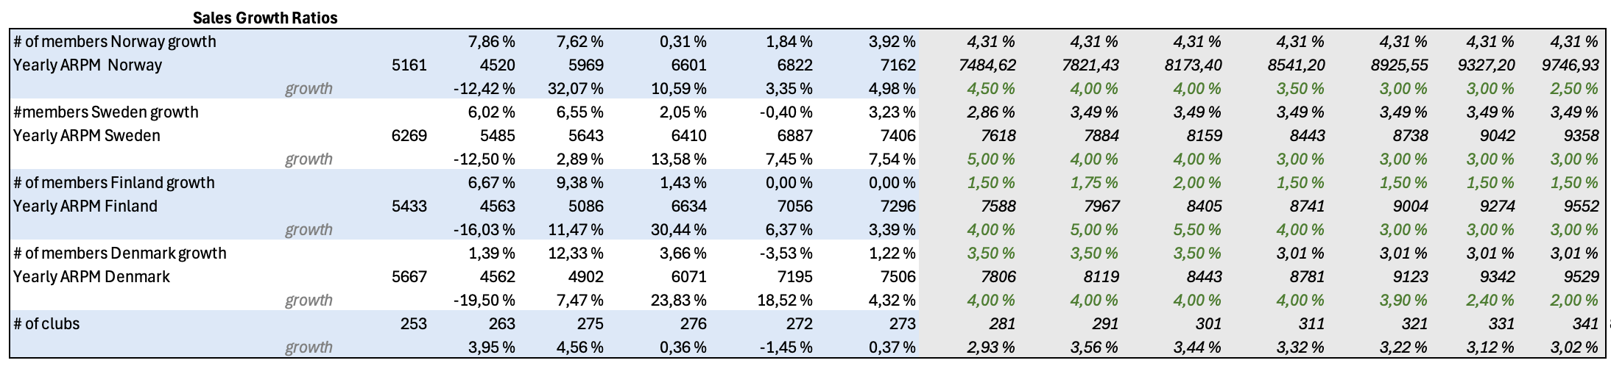
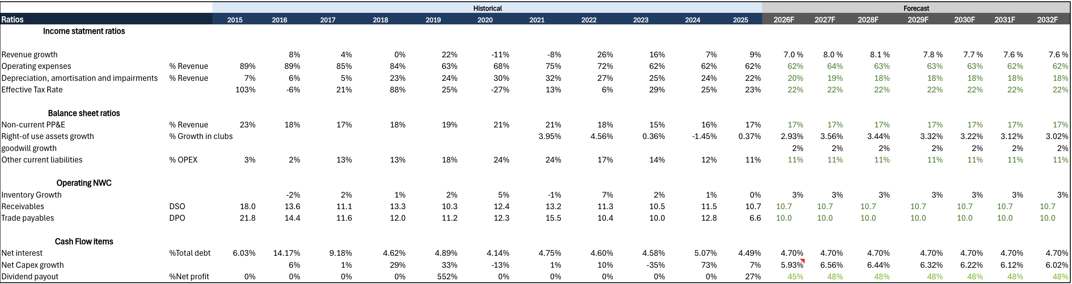
Key Assumptions
#Appendix 3.4
Selected operating and balance sheet ratios are used to anchor the forecast, linking revenue growth, margin development and capital intensity to historical performance and normalized long-term operating trends.
Management targets approximately 8–12 net new club openings per year, supporting steady network expansion and long-term membership growth across the Nordic footprint.
Sources: Company Financial Reports, Bloomberg
Note: 1) Q4’25, Company Outlook

Slide 13
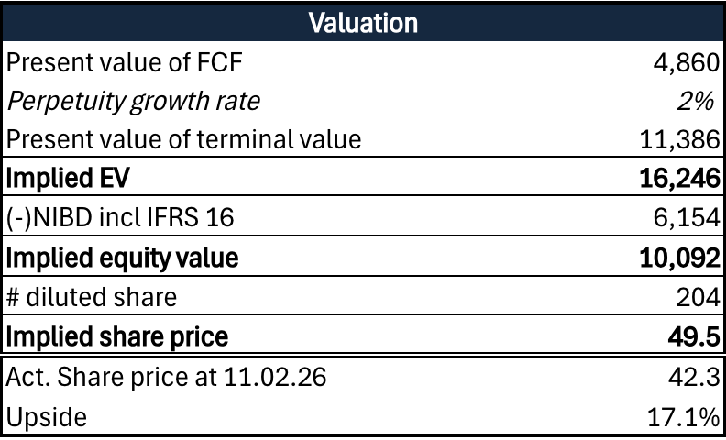
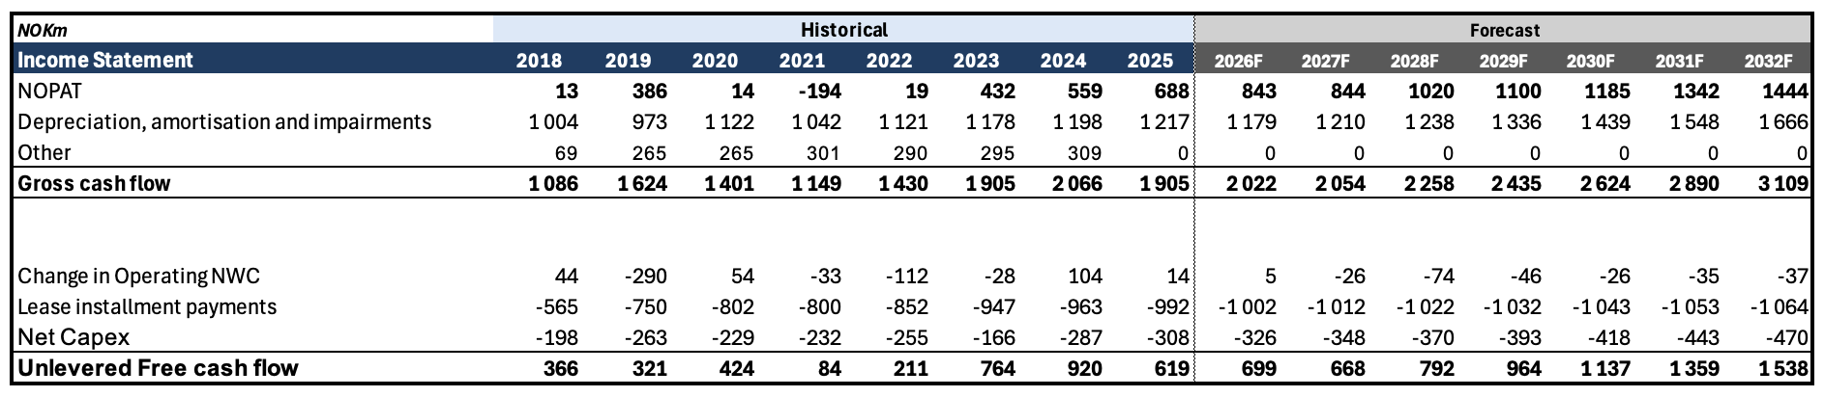
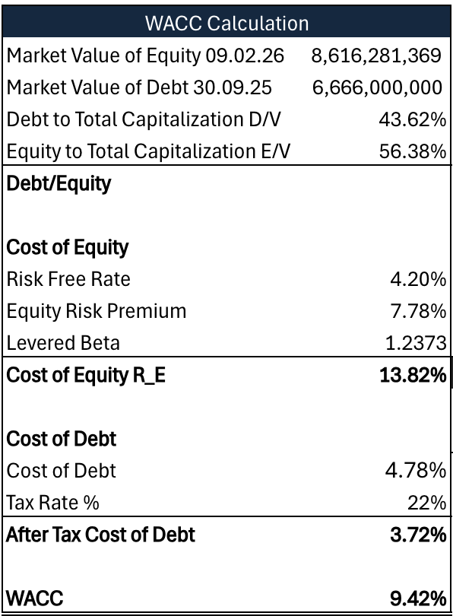
DCF Model– Base Case
#Appendix 4.1
  The valuation outcome is primarily driven by membership growth, club utilization and margin stability across the existing portfolio. As expansion moderates, value creation becomes increasingly linked to capital efficiency and the group’s ability to scale earnings within the current club base.
Key Assumptions
We assume SATS will deliver mid-to-high single-digit revenue growth through the forecast period, driven by continued membership growth and pricing/mix, with growth gradually normalizing as the base expands.
We forecast EBITDA margins to remain broadly stable at 2024–2025 levels, supported by operating leverage, cost discipline, and improved utilization across the club portfolio.
Our projections follow the model’s operating drivers: Opex and D&A are anchored to historical relationships with sales and the asset base, while operating NWC effects are kept modest. Capex is modelled using net capex assumptions in line with historical intensity, and IFRS 16 leases are treated as financing by deducting lease principal repayments in UFCF to ensure consistency with NIBD (incl. IFRS 16) and the discount rate framework
Sources: Company Financial Reports, Bloomberg
Note:

Slide 14




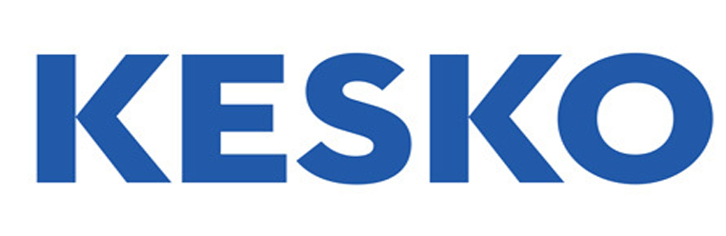



Multiple Comparison
#Appendix 4.2
16,1
15,5
Company
Country
EV (NOKm)
15.282
7.579
18.935
5.720
31.748
137.367
EBITDA Margin
38%
25%
16%
64%
18%
98%
Revenue Growth
9%
2%
17%
27%
9%
5%
Sources: Company Financial Reports, Bloomberg
Note:

Slide 15
Key Value Drivers
#Appendix 4.3
SATS ASA vs. Comparable Companies
ROE
ROIC
EBITDA Margin
SATS’ value drivers show clear outperformance versus peers in 2023–2024. After a weak 2022 (negative ROE and ROIC), the company rebounds strongly, with ROE improving to 23.8% (2023) and 27.6% (2024) versus peers at 9.1% and 12.3%.
Profitability and capital efficiency have both re-rated upward. ROIC moves from -0.4% (2022) to 5.7% (2023) and 7.1% (2024), outperforming peers (2.7% and 4.9%), while EBITDA margins remain structurally higher at 37.7–38.3% versus peers at 11.2–13.7%.
A ~+10pp ROE, +3pp ROIC and +19–27pp EBITDA margin premium versus peers underscores a structural profitability gap driven by operating leverage and higher club utilization. We therefore believe SATS merits a valuation premium, contingent on sustained utilization and cost discipline.
Commentary
Sources: Company Financial Reports, Bloomberg
Note:

