Slide 1
HelpDesk
From a laptop to a monitored Kubernetes cluster
DevOps final capstone | Subhan Rahiman | 24BCS10095
github.com/SubhanRahiman7/final-devops-project
Notes:
Introduce yourself. One sentence: I built a support-ticket app and took it through the whole DevOps life cycle - tests, containers, CI/CD, security scanning, Terraform, Kubernetes, Helm and monitoring.

Slide 2



What I built, and why
The application
The goal
The rule
A support-ticket dashboard: React frontend, FastAPI backend, PostgreSQL database. A real app with live data, not a static page.
Show how one application travels from a developer laptop to a monitored Kubernetes environment, automatically and safely.
Nothing reaches production unless tests pass and the security scan is clean. Every image is traceable to a commit.
96%
7
42 > 0
2 > 5
test coverage
CI jobs, all green
fixable CVEs after the Trivy fix
pods when the HPA scales
Notes:
Why: the course asks for the whole path, not isolated tools. The numbers on the bottom are real results from my runs.

Slide 3




Tech stack
Application
Build and ship
Security
React + Vite, FastAPI, SQLAlchemy, Alembic, PostgreSQL, pytest
Docker multi-stage images, Docker Compose, GitHub Actions, GHCR
Trivy image + IaC scans, Gitleaks, Dependabot, non-root containers
Infrastructure
Run
Observe
Terraform: AWS VPC, subnets, NAT, EKS node group, KMS
Kubernetes, Helm chart, nginx Ingress, HPA, probes, PVC
Prometheus, Grafana dashboard, alert rules, /health /ready /metrics
Notes:
Six layers. Each one is covered by a slide later. Python 3.12 for the backend, as required.

Slide 4
How a change travels
Code
React + FastAPI
Git / GitHub
push to main
CI
pytest, build, lint
Scan
Trivy, Gitleaks
Image
tag = commit SHA
Registry
GHCR
Kubernetes
Helm upgrade
Monitor
Prometheus + Grafana
Terraform provisions the AWS VPC + EKS cluster that Helm deploys into.
Inside the cluster
Browser
Ingress
/ and /api
Frontend
nginx, 2 pods
Backend
FastAPI, 2-5 pods
PostgreSQL
PVC storage
Notes:
Top row is the delivery pipeline; the amber box is the security gate - a failed scan stops everything after it. Bottom row is what runs in Kubernetes.

Slide 5
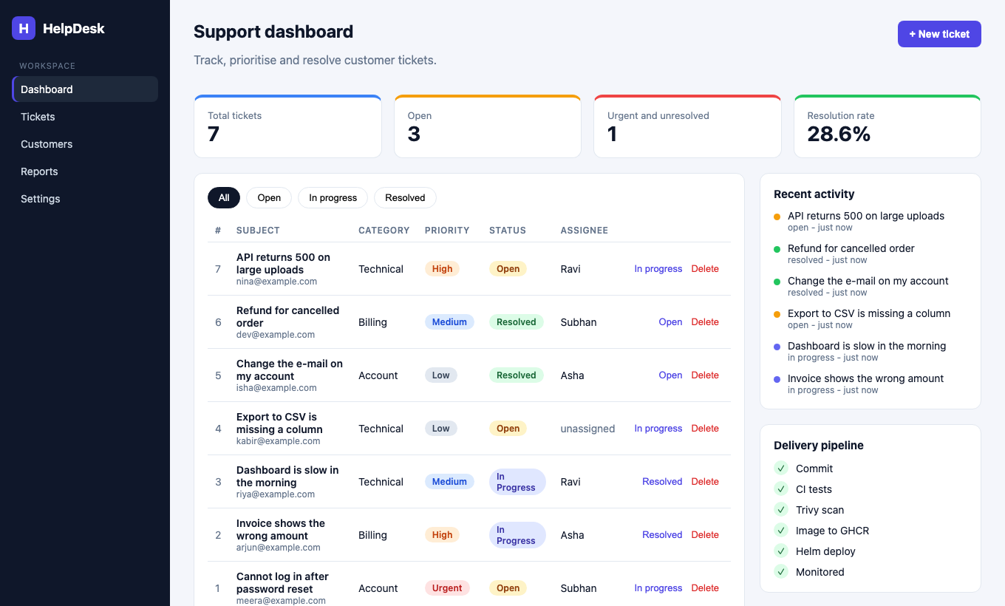
A real application, not a static page
React dashboard: KPI cards, filters, priority badges, create-ticket modal
FastAPI REST API: create, read, update, delete and stats
PostgreSQL with Alembic migrations; data survives restarts
Responsive UI that shows loading and error states
Notes:
This is the running app. Create a ticket, refresh, and the number changes: the data goes frontend to backend to PostgreSQL and back.

Slide 6
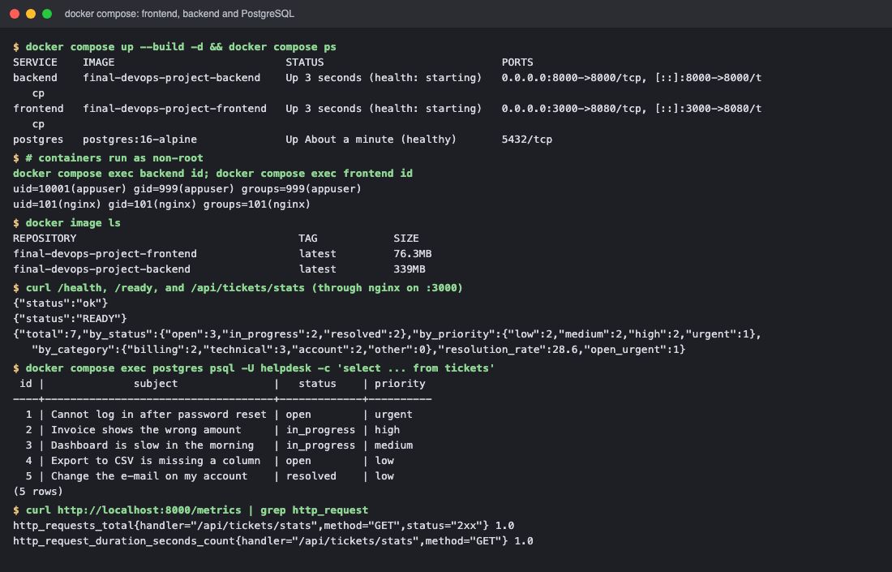
One command starts the whole stack
PROOF 1 - Docker Compose
docker compose up --build starts frontend, backend and PostgreSQL
Both app containers run as non-root users
Frontend is a multi-stage build: Node, then nginx
/health, /ready and /metrics answer on the backend
Notes:
Backend waits for the database to be healthy before it starts and runs the Alembic migration on startup.

Slide 7
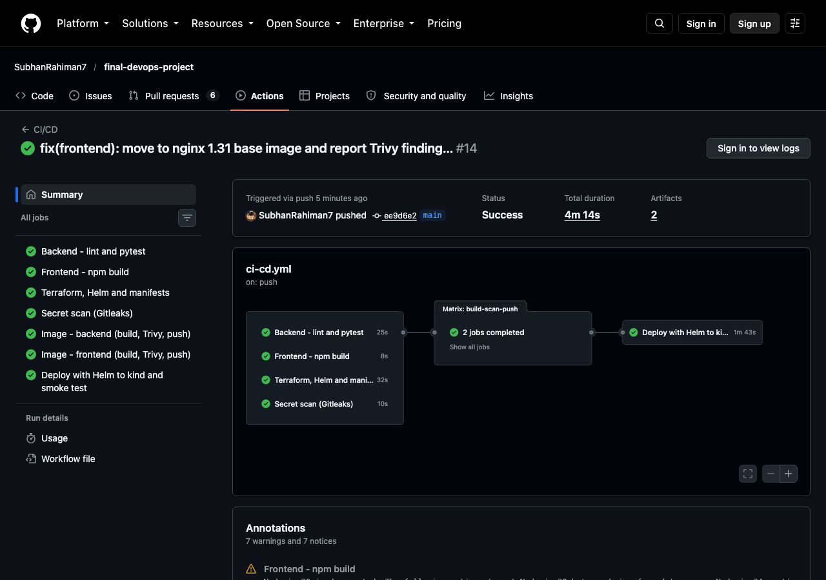
CI/CD: every push is tested, scanned and shipped
PROOF 2 - CI/CD pipeline
pytest and the frontend build run first; a red test stops everything
Both images are built, scanned with Trivy, then pushed to GHCR
Image tag is the Git commit SHA, never latest
The same Helm chart is deployed to a kind cluster and smoke-tested
Notes:
This is a green run on main. Jobs: backend tests, frontend build, Terraform and Helm checks, Gitleaks, two image jobs (build, scan, push), and the deploy to kind.

Slide 8
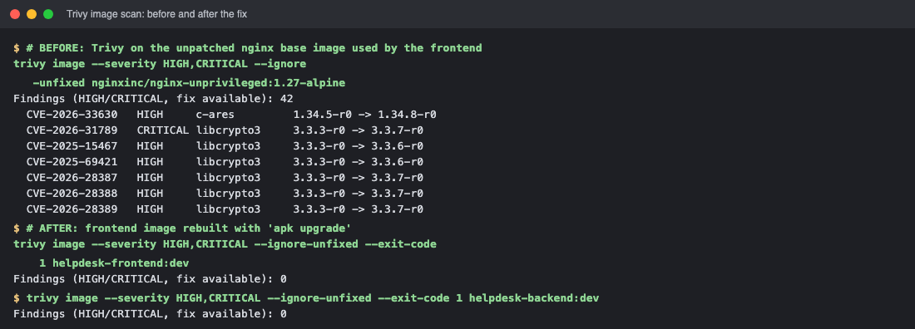
The security gate caught a real problem
42
fixable HIGH/CRITICAL CVEs in the old nginx base image
0
after moving to a current base and apk upgrade
Three pipeline runs went red, so no vulnerable image was published. That is the gate doing its job.
Notes:
What Trivy scanned: both container images, plus the Terraform, Helm and Dockerfile code. The findings were operating-system packages (for example libcrypto3) in the base image, not my code. A clean result means no known fixable HIGH or CRITICAL CVEs at scan time - it is one control, not a guarantee.

Slide 9

The code base
PROOF 3 - Main repository
backend/, frontend/, docker-compose.yml
terraform/, helm/, k8s/, monitoring/, troubleshooting/
.github/workflows with the CI/CD pipeline
31 commits with descriptive messages; no secrets in Git
Notes:
The layout follows the capstone structure. .env and tfvars are git-ignored; Gitleaks scans the whole history in CI.

Slide 10
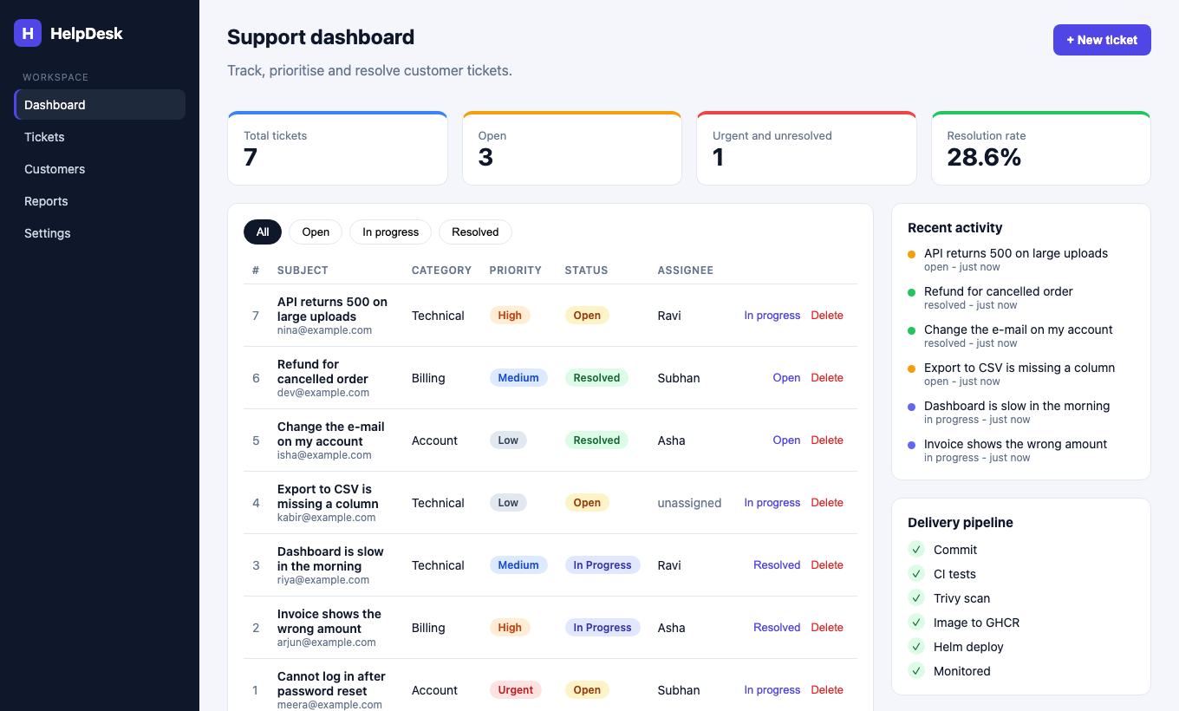
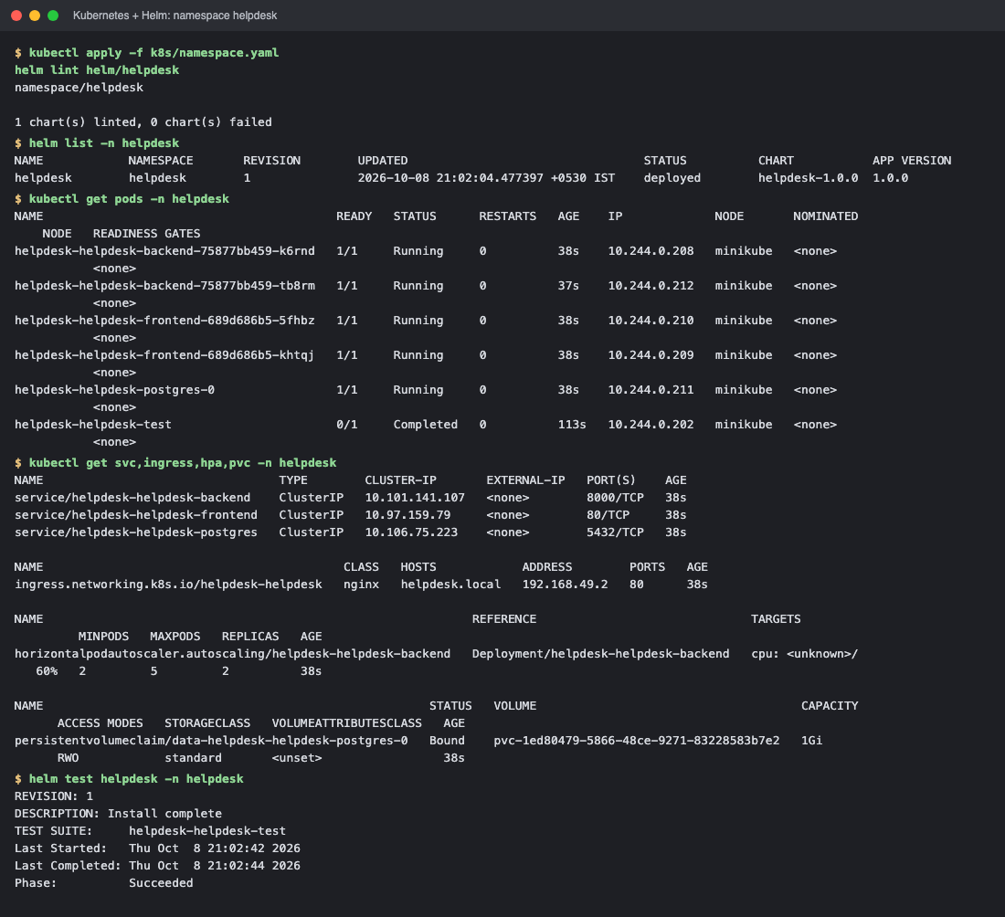
Kubernetes and Helm
PROOF 4 - Kubernetes deployment
One Helm chart, dev and prod values, helm test, rollback
2 replicas each for frontend and backend, ClusterIP Services
Ingress sends / to the frontend and /api to the backend
Probes, resource limits, PVC for PostgreSQL, non-root
The same app, opened through the Ingress hostname
Notes:
All pods Running, helm list shows the release, helm test passed. Two real bugs found here: duplicate demo data from parallel replicas (fixed with advisory locks) and the PostgreSQL crash loop with dropped capabilities (fixed by running as the postgres user).

Slide 11
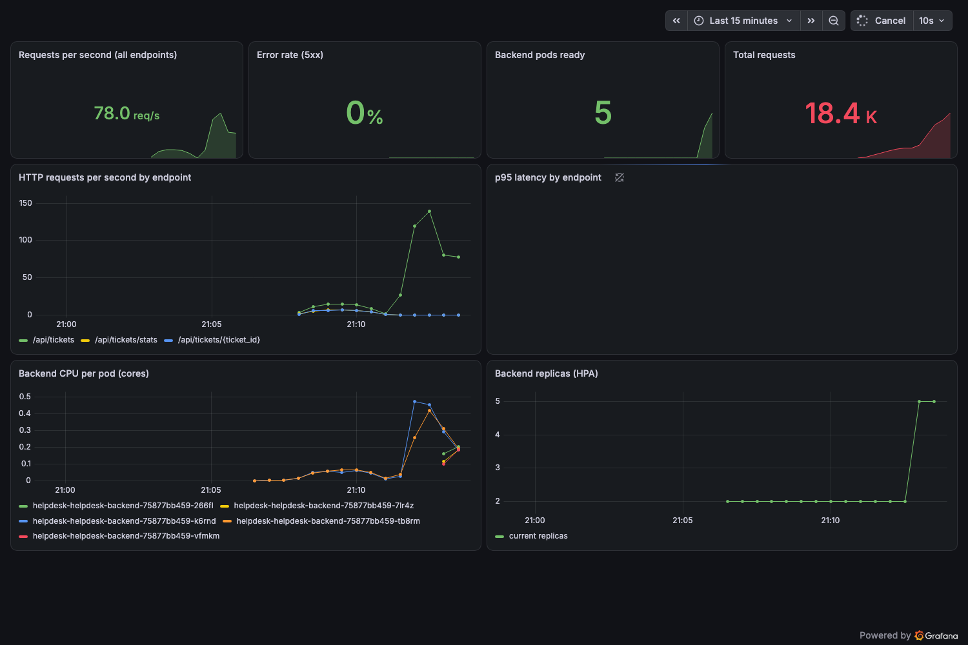
Autoscaling and monitoring
2 > 5
backend pods under load (HPA, 60% CPU target)
UP
Prometheus scrapes both backend pods
Grafana shows requests per second, latency, errors, CPU per pod and the replica count live.
Notes:
Eight load pods called the API; CPU rose to about 339% of the request, the HPA went from 2 to 4 to 5 pods. Prometheus finds the backend through a ServiceMonitor, and there are alert rules for backend down, 5xx rate and latency.

Slide 12
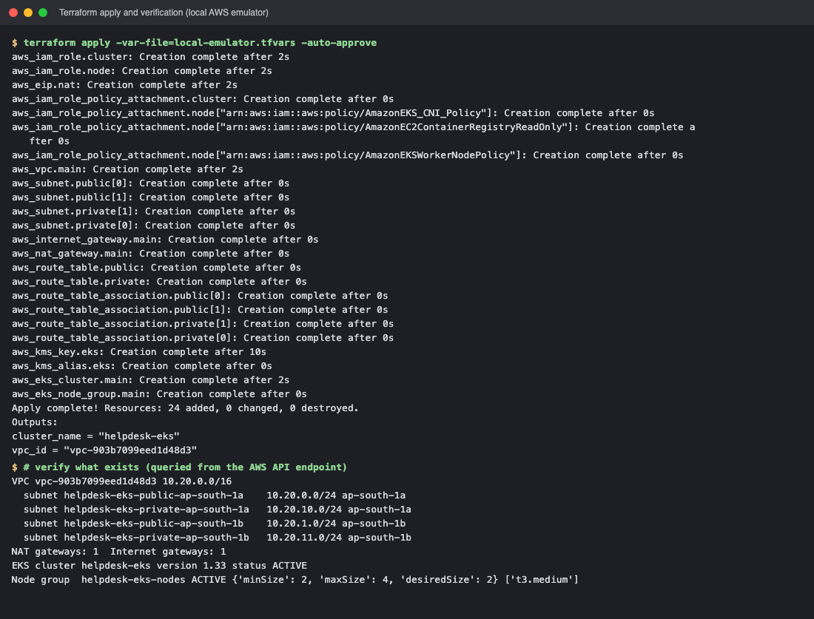
Terraform: AWS VPC and EKS as code
VPC with 2 public and 2 private subnets, NAT, EKS and a node group
24 resources; KMS key encrypts Kubernetes Secrets
Planned, applied and destroyed cleanly; state ends empty
Honest note: run against the Moto AWS emulator, because my AWS account is blocked. The code is unchanged for real AWS.
Notes:
Be upfront: no real EKS cluster was created. The Kubernetes demo runs on minikube, and CI uses kind.

Slide 13
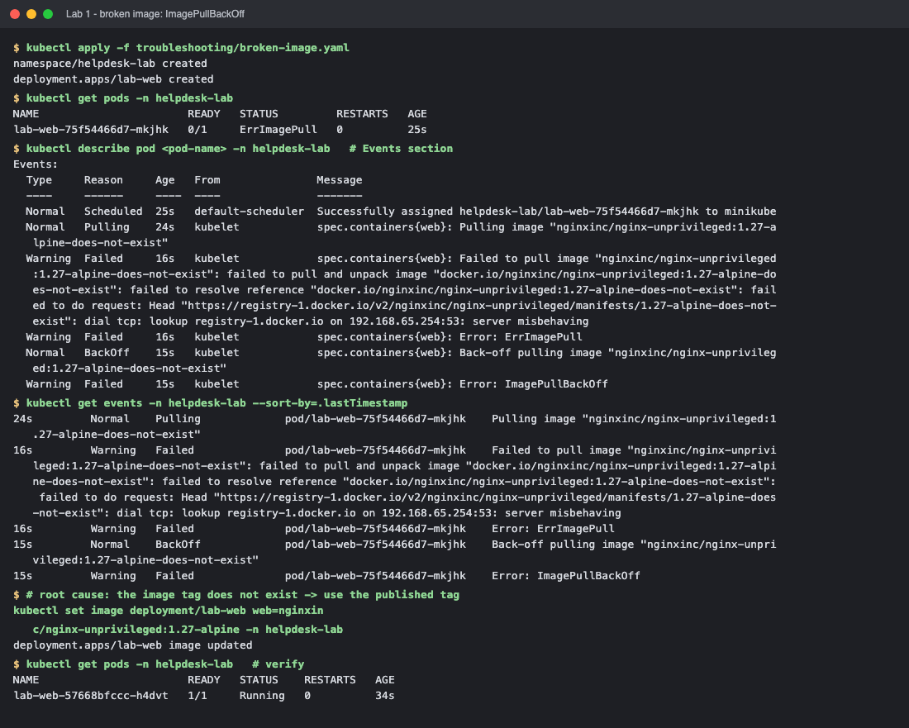
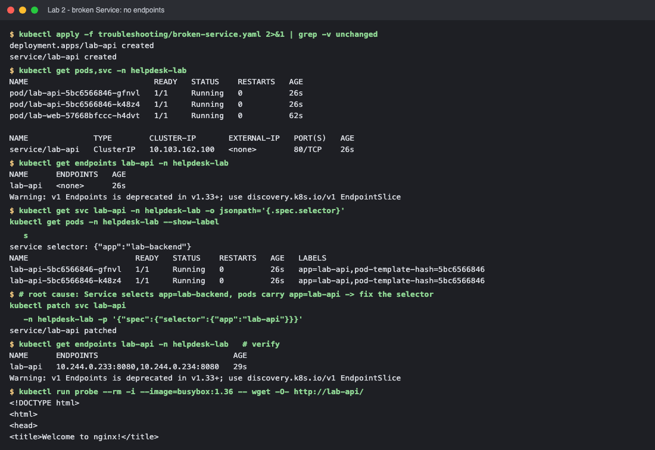
Troubleshooting: find, fix, verify
Lab 1: broken image
Lab 2: broken Service
Symptom: Pod: ErrImagePull
Investigate: kubectl describe pod, get events
Root cause: The image tag does not exist
Fix: kubectl set image with a real tag
Symptom: Pods Running, no traffic
Investigate: get endpoints shows <none>
Root cause: Service selector does not match the pod labels
Fix: patch the selector to app=lab-api
Notes:
Method for both: get, describe and events, logs, compare labels and ports, fix the smallest thing, verify from the outside.

Slide 14
Why these tools, and not the alternatives
Need | I chose | Instead of | Because
Run containers | Kubernetes | Docker Compose / ECS | self-healing, rolling updates, autoscaling
Package the deployment | Helm | plain YAML files | one chart, dev/prod values, rollback
Store images | GHCR | Docker Hub | lives with the repo, uses the built-in token
Create infrastructure | Terraform | AWS console clicks | repeatable, reviewable, destroy cleans up
Observe | Prometheus + Grafana | CloudWatch | open source, works on any cluster
Notes:
The instructor asked for the alternatives. Short answers; the first column is the need, the second is what I used.

Slide 15

What I learned
Gates find real problems: Trivy found 42 CVEs I would have shipped.
Replicas race: start-up work such as migrations must be safe in parallel.
Hardening has consequences: dropping all capabilities broke PostgreSQL until it ran as the right user.
Be explicit about what was and was not run in real AWS.
Thank you
github.com/SubhanRahiman7/final-devops-project

