Slide 1

Government of Uttar Pradesh
Department of Excise
उत्तर प्रदेश आबकारी विभाग
Ask the Data
Questions in plain language, answered from the department's own figures and rules, on the department's own server
Proof of concept | Presentation to the Cabinet and the Chief Secretary
Notes:
Welcome. This is a working proof of concept, not a mock-up. Everything shown in the demo slides came from the live system running in the department's office, answering real questions against real department data.

Slide 2



The problem: a simple question can take days
Figures sit in many files
Each question needs an analyst
Rules live in another place
Revenue, dispatch, shop and enforcement figures are held in separate workbooks, reports and portals.
An officer asks, an analyst finds the files, builds the table and sends it back. A new angle on the same question starts the cycle again.
Acts, rules and policy orders are published as documents. Linking a rule to a figure is done by hand.
An officer who needs a number for a meeting today should be able to get it today, with the source shown, without waiting for a report to be prepared.
Government of Uttar Pradesh | Department of Excise | Ask the Data: proof of concept
2
Notes:
Set the scene in the department's own terms. Examples to mention: a district total needed before a review meeting; a rule position needed alongside a figure.

Slide 3


What this proof of concept does
An officer types a question in everyday English. The system finds the answer in the department's data, draws a chart where it helps, and shows the exact query it used.
Ask
Chat
Knowledge library
One question, one answer page: the figure, a chart, a plain summary and the query behind it.
A conversation that can look up figures and rules as it goes, and take follow-up questions.
Excise acts, rules and policy orders, searchable in the same chat.
It runs on a server in the department's own office. No question and no figure is sent to an outside AI service.
Government of Uttar Pradesh | Department of Excise | Ask the Data: proof of concept
3
Notes:
Three entry points, one engine. Ask is for a single well-formed question. Chat is for exploring. The knowledge library lets the same chat quote the department's published rules.

Slide 4



How an answer is made
1 You ask
2 The system understands
3 The data answers
4 You see the result
Type the question the way you would put it to a colleague.
An AI model turns the question into a precise search of the data.
The search runs against the department's data bank, read-only.
A figure, a chart, a short summary and the exact query used.
Every answer shows its working. The query is visible and can be copied, so an officer or an auditor can check where a number came from.
Government of Uttar Pradesh | Department of Excise | Ask the Data: proof of concept
4
Notes:
This is the one picture to remember. The key point for this audience: the AI does not invent figures. It writes a search; the database returns the numbers. The query is always displayed.

Slide 5
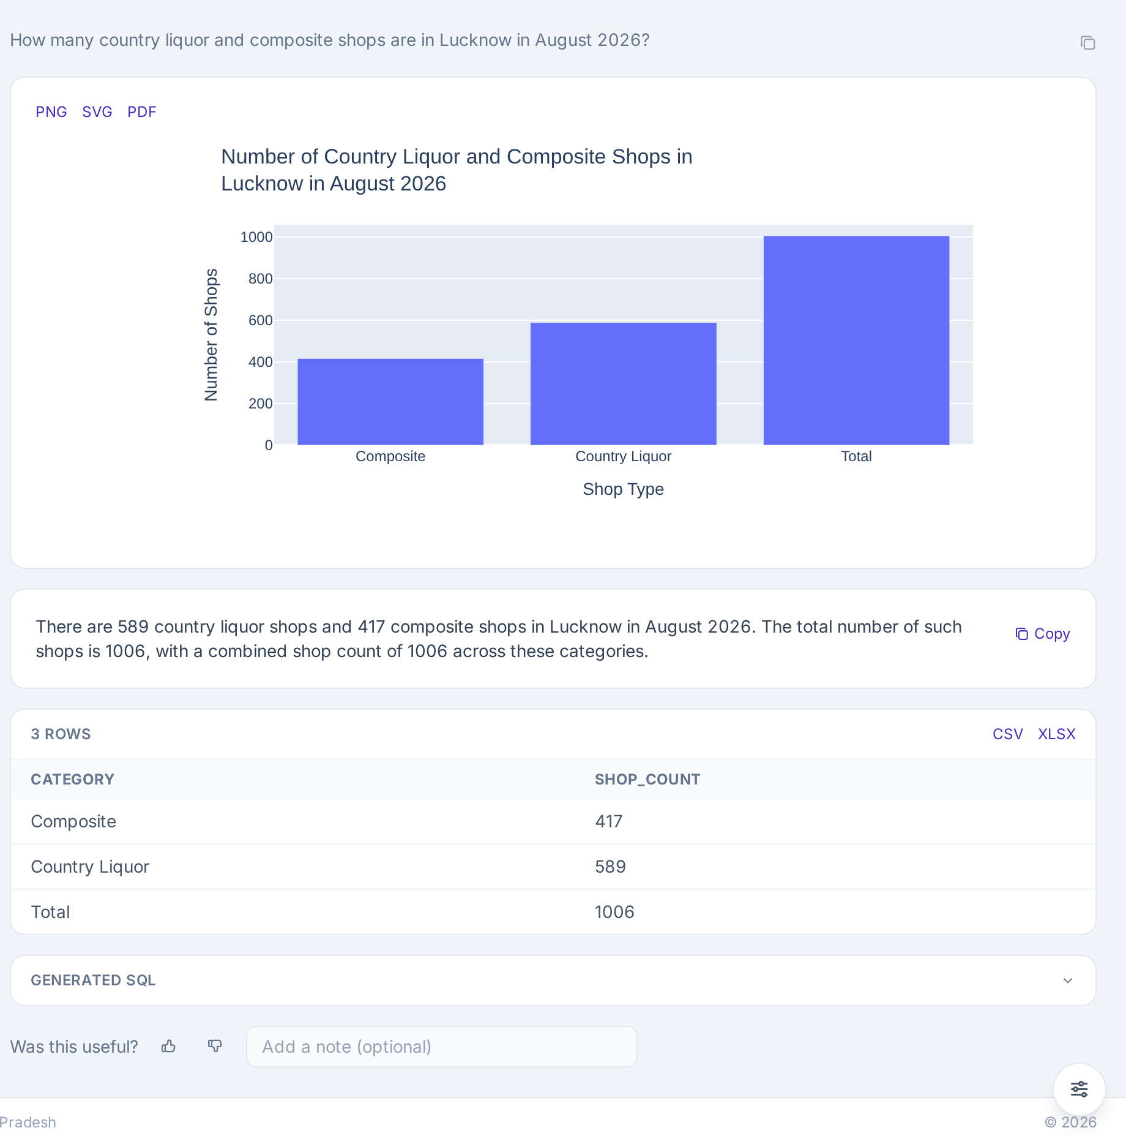
Live example: how many shops, and of which kind?
"How many country liquor and composite shops are in Lucknow in August 2026?"
Total: 1,006 shops.
Split: 589 country liquor and 417 composite.
The total is counted by the database itself, not added up by the AI.
Source: the monthly dispatch report from the department's IESCMS system.
Government of Uttar Pradesh | Department of Excise | Ask the Data: proof of concept
5
Notes:
Click the screenshot to open it full size. Read the question aloud, then point to the total and the two parts. This question was chosen because it has a split and a total. Earlier versions gave only one combined number; we fixed that so each part is shown.

Slide 6
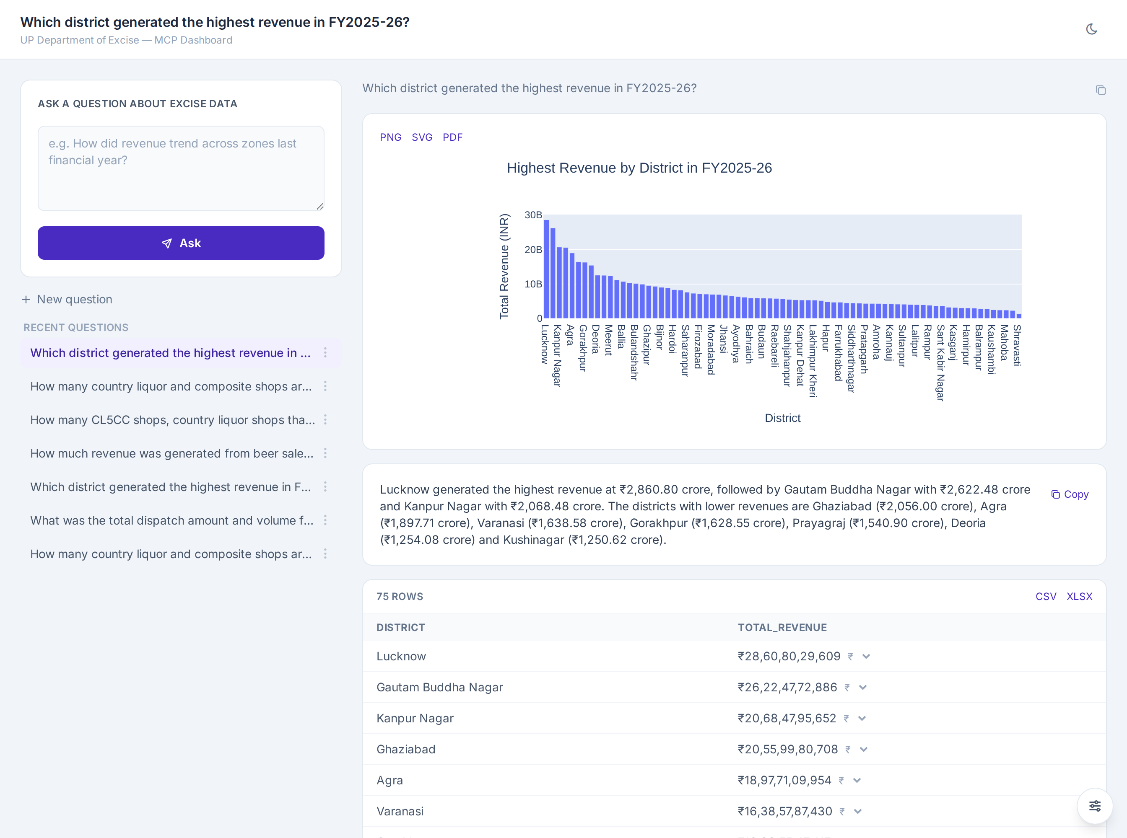
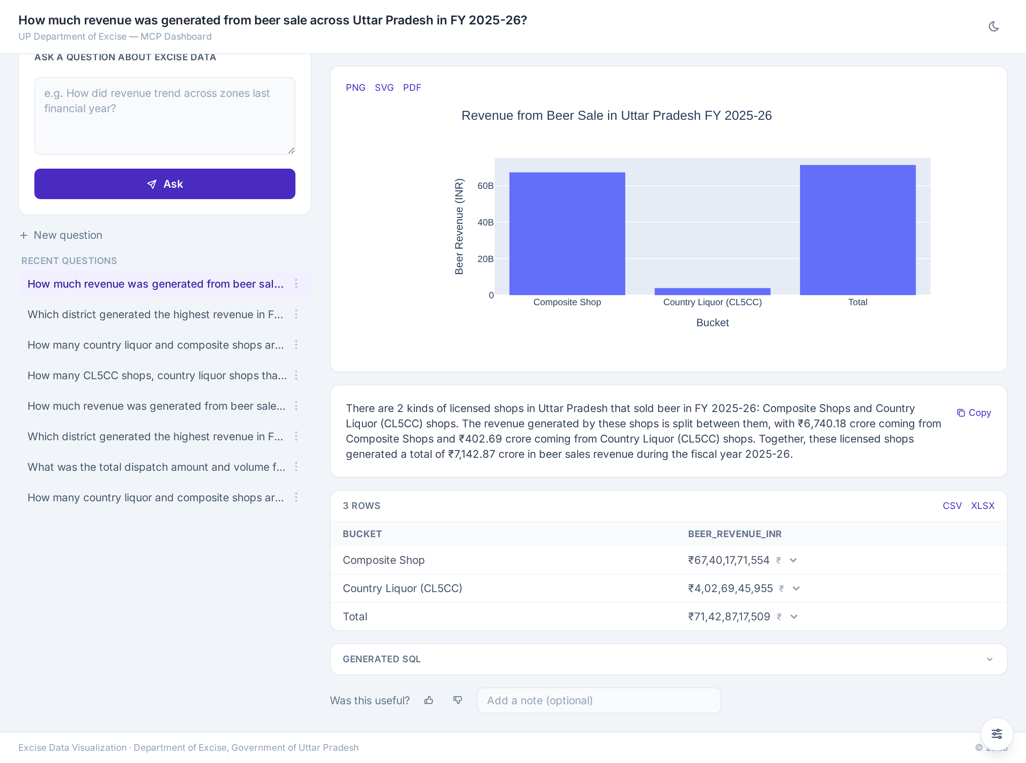
Live example: revenue by district and for a product
"Which district generated the highest revenue in FY2025-26?"
"How much revenue came from beer sale across Uttar Pradesh in FY2025-26?"
Lucknow is the highest, at ₹2,860.80 crore out of a state total of about ₹55,463 crore.
Beer revenue is ₹7,142.87 crore: ₹6,740.18 crore from composite shops and ₹402.69 crore from country liquor shops that also sell beer (CL5CC).
Government of Uttar Pradesh | Department of Excise | Ask the Data: proof of concept
6
Notes:
Click either screenshot to open it full size. Money is shown in rupees with lakh and crore, never in dollars. The system converts the figures in code, not by asking the AI to do the arithmetic, after an early version got a crore conversion wrong.

Slide 7
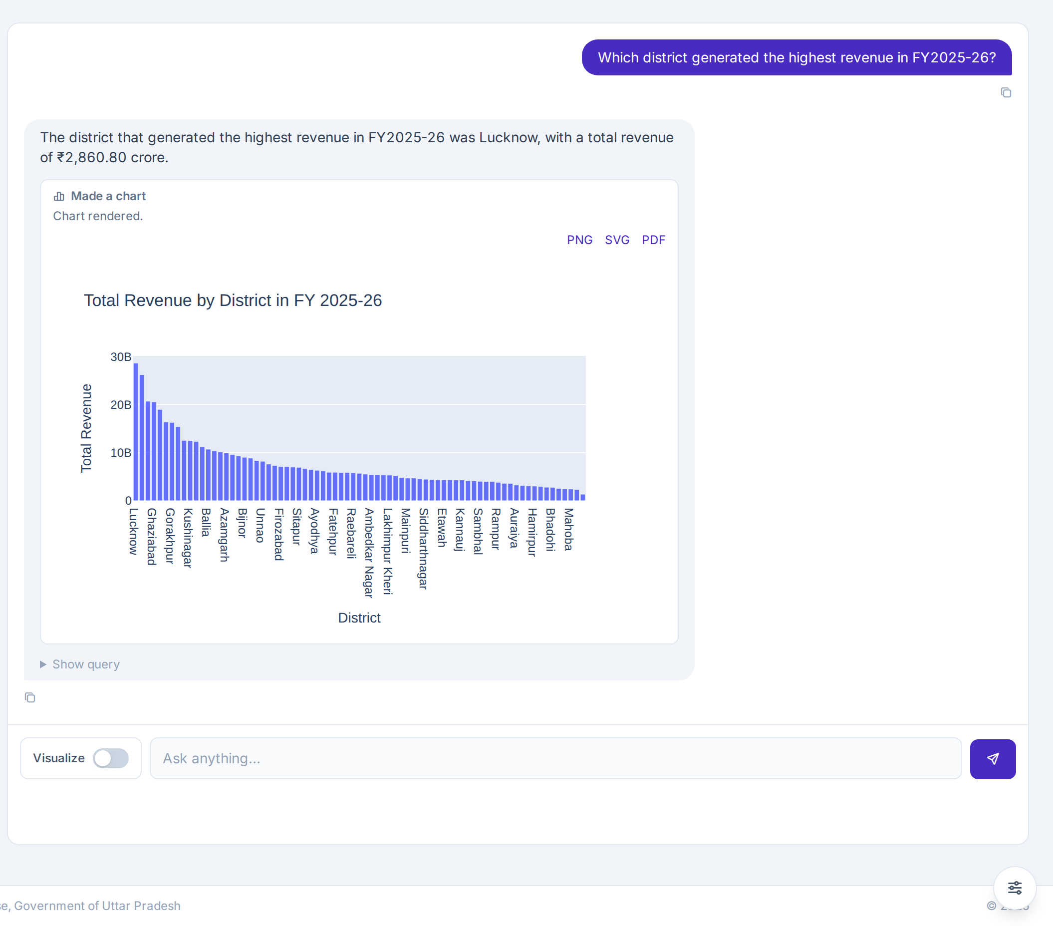
Live example: a conversation with a chart
"Which district generated the highest revenue in FY2025-26?"
The same question in Chat: the answer first, then the chart.
Lucknow is highest at ₹2,860.80 crore, from all 75 districts.
The chart downloads as PNG, SVG or PDF, and the whole conversation exports as a PDF.
The query behind the answer stays one click away.
Government of Uttar Pradesh | Department of Excise | Ask the Data: proof of concept
7
Notes:
Click the screenshot to open it full size. Point at the chart, then the "Show query" control under the answer. The chart toggle in the message box asks for a chart explicitly.

Slide 8




The data behind the answers
9,322
28,405
3,455
dispatch records, Lucknow, August 2026, from IESCMS
shops with FY2025-26 revenue, across all 75 districts
district revenue records from the NITI workbooks
3,812
11,124
330+
sales-volume records by liquor type and year
enforcement records: raids, seizures, convictions
acts, rules and policy documents in the knowledge library
All of it is held on the department's own server, in a database the AI can read but never change.
Government of Uttar Pradesh | Department of Excise | Ask the Data: proof of concept
8
Notes:
These are the row counts loaded so far. The data bank is a copy; the source systems are untouched. More sources can be added without changing how officers ask questions.

Slide 9

The AI models
Two open-source models run on the office server. Each has one job. Nothing is sent to an outside service.
Llama 3.1 (8 billion)
Qwen 2.5 Coder (7 billion)
The conversationalist
The specialist
Talks with the officer, decides when to look something up, and writes the plain-language summary.
Writes the database search and the chart code. It sees the data layout, not the officer's chat.
Why two models: a conversational model and a code-writing model are each better at their own task.
Why local: the department's questions and figures never leave the building.
Government of Uttar Pradesh | Department of Excise | Ask the Data: proof of concept
9
Notes:
Both models are open weights, run through Ollama on the office server. Neither is a DeepSeek model. The server has no GPU today, which is why answers take one to three minutes.

Slide 10




Safety and control
Sign-in
Email one-time code. Each person has a role: Admin or Analyst.
Read-only data
The AI connects with a database account that can read but cannot change anything.
Checked queries
Every query is inspected first. Only a single read request is allowed.
Locked box for charts
Chart code runs in an isolated space: no network, limited time and memory.
Full record
Every question, query and action is logged for audit.
The only outside connection is the secure tunnel that lets officers reach the site.
Government of Uttar Pradesh | Department of Excise | Ask the Data: proof of concept
10
Notes:
Each layer works on its own: if one failed, the next would still stop a harmful action. Be ready for the question "can it change our data?" The answer is no: the database itself refuses any write from this account.

Slide 11
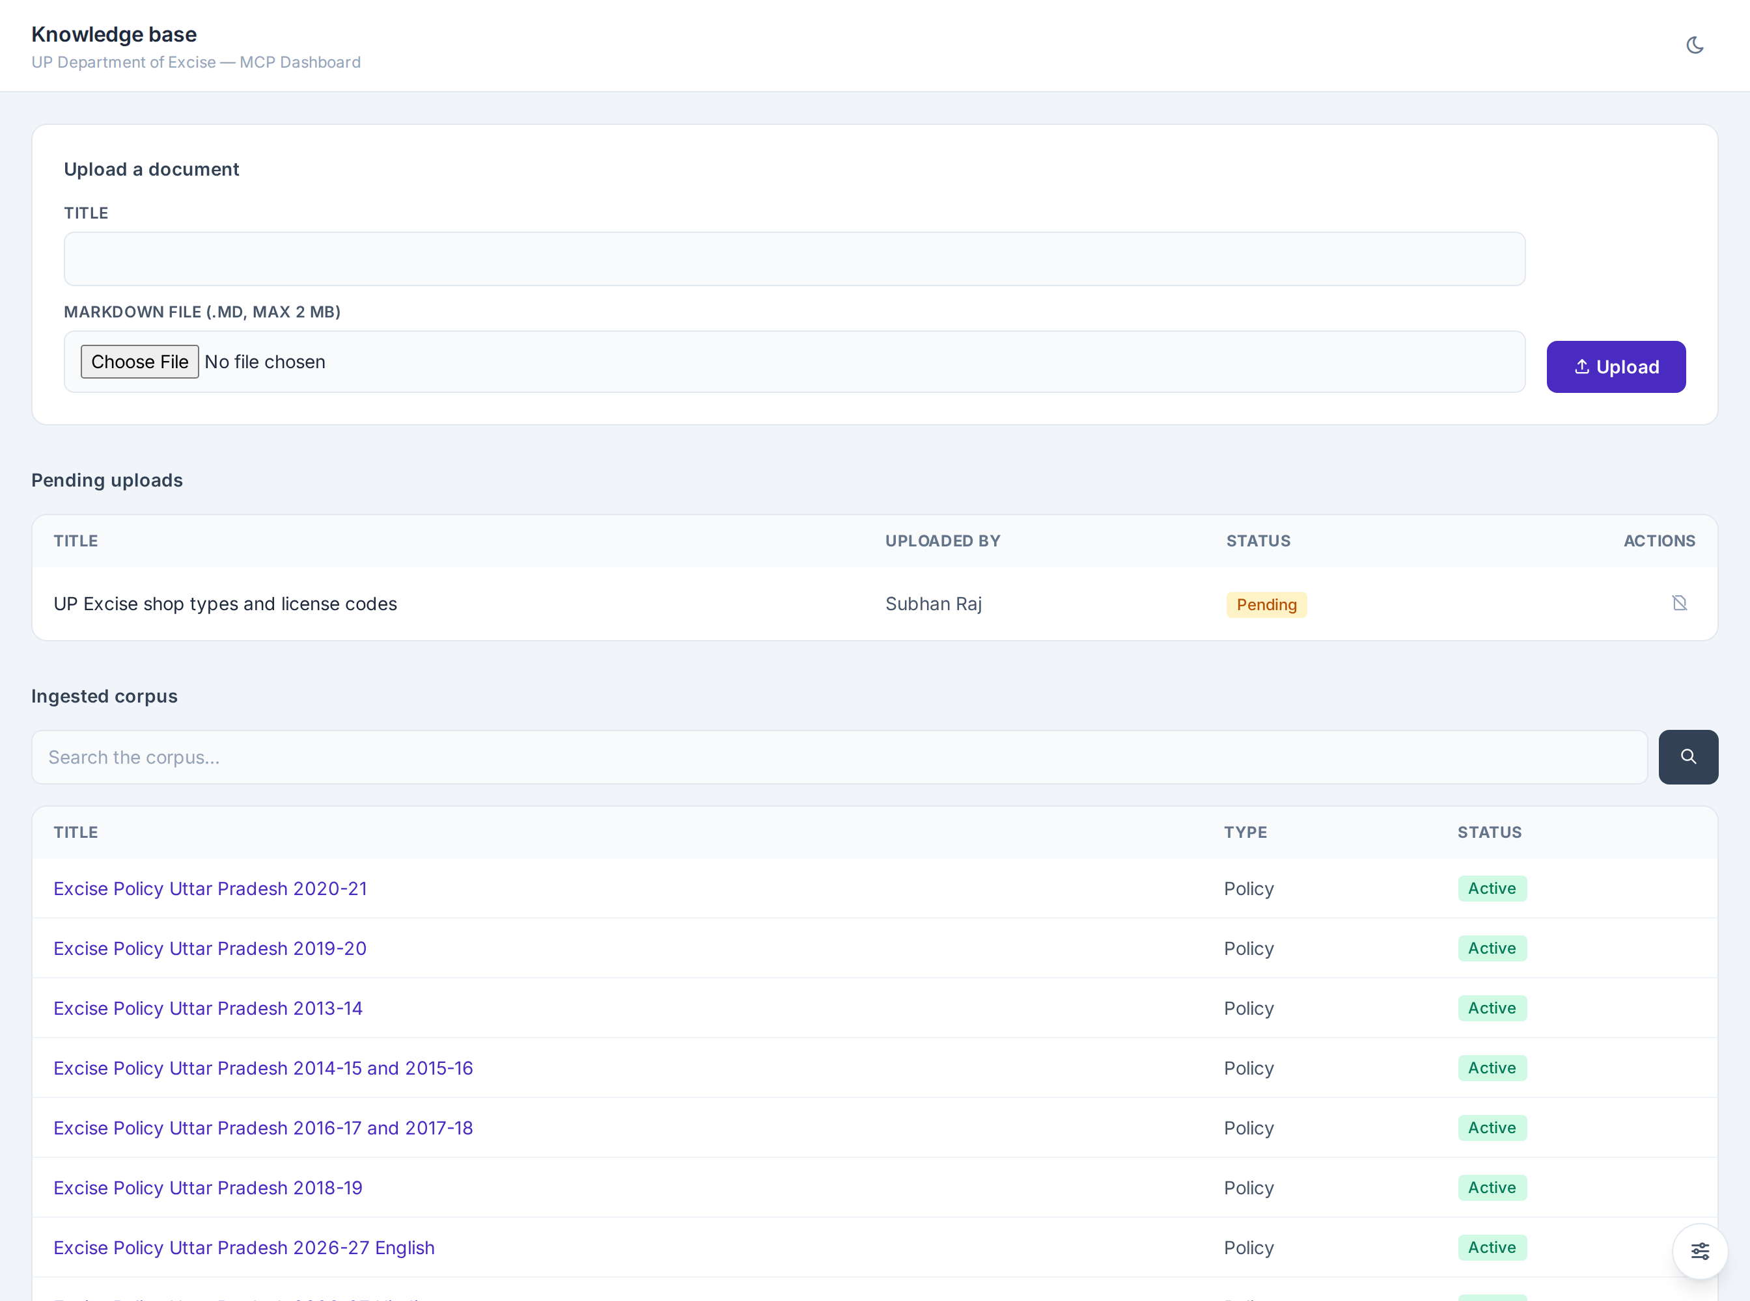
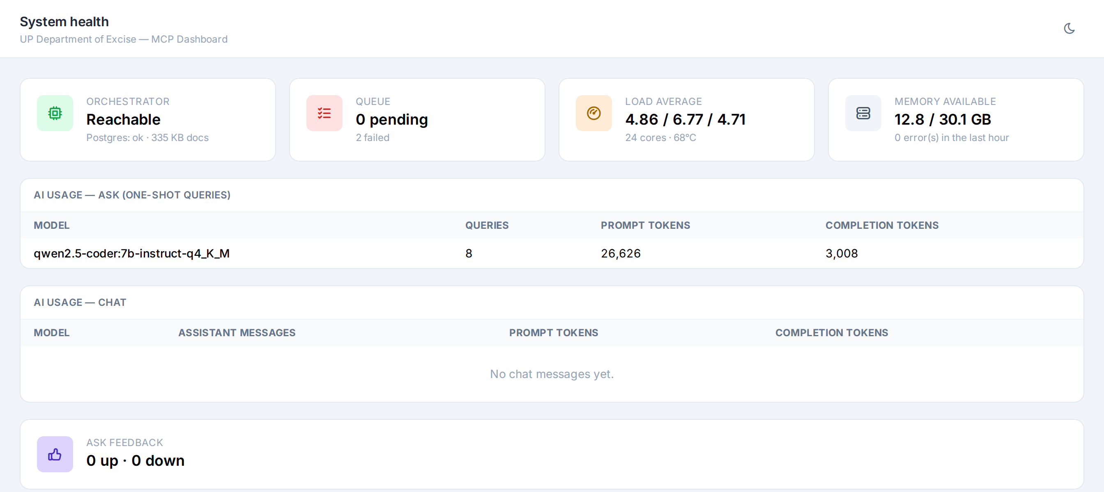
What administrators see
Knowledge base: upload a rule note, see every document the chat can quote, and withdraw one.
System health: whether the AI service is up, the queue, the server load, and how much each model was used.
Government of Uttar Pradesh | Department of Excise | Ask the Data: proof of concept
11
Notes:
Click either screenshot to open it full size. Administrators also have screens for users, the activity log, data loading runs and a data dictionary where a plain-language note can be attached to any table or column to guide the AI.

Slide 12

How we built it, and how we tested it
Data bank
Question engine
Knowledge library
Chat and Ask screens
Real-question testing
Department data loaded and cleaned. Rows that fail checks are set aside, not guessed.
Question to query to answer, with a retry when the first attempt fails.
Published rules split into searchable sections.
Web screens for officers and for administrators.
Each demo question was run live and the answer checked against the source.
The automated tests cover the safety checks, the data loaders and the chat flow. Live testing against real questions found problems the tests could not, and each one was fixed and recorded.
Government of Uttar Pradesh | Department of Excise | Ask the Data: proof of concept
12
Notes:
Mention that the build followed a written plan with milestones, and that every live failure found in testing is documented. Honest testing is part of the case for trusting the results.

Slide 13
What we learned, and the limits today
What we learned
Limits today
A language model can give a confident wrong answer. We added checks so an empty result is reported as empty.
District revenue after 2018 in the NITI workbooks is booked at the central treasury in Lucknow. We cross-checked against shop-level revenue and now point the system to the correct source.
Money conversions are done in code. A model got one crore figure wrong by ten times.
The server has no graphics card, so an answer takes one to three minutes.
Shop-level monthly detail is loaded for Lucknow only (August 2026).
Shop-level Bhang data has no source yet.
Answers should be treated as a fast first reading, to be checked against the source for formal use.
Government of Uttar Pradesh | Department of Excise | Ask the Data: proof of concept
13
Notes:
Being open about limits is deliberate. The cabinet will ask what can go wrong; this slide answers before they do.

Slide 14



What comes next
Faster hardware
More data
A dedicated server with a graphics card brings answers down to seconds.
Monthly feeds for every district, and the missing sources such as Bhang shops.
Saved analyses and reports
Wider access
Re-run a favourite question each month and export a report with the data date on it.
Roles for district and division officers, with their own question history.
Government of Uttar Pradesh | Department of Excise | Ask the Data: proof of concept
14
Notes:
Roadmap items come from the project plan. Saved analyses and offline reading are planned, not built.

Slide 15

The decision we are asking for
This proof of concept shows that officers can get sourced answers from the department's own data in minutes, on the department's own server.
We ask the Cabinet and the Chief Secretary for a decision on the next step.
Proposed next steps
1. A pilot with a small group of district and division officers.
2. A dedicated server with a graphics card.
3. Monthly data feeds from the source systems.
Government of Uttar Pradesh | Department of Excise | Ask the Data: proof of concept
15
Notes:
DECISION REQUEST: to be written after the review with the project lead. Replace the next steps above with the specific approval being sought.

