Slide 1

Ask the Data
Government of Uttar Pradesh
Department of Excise
उत्तर प्रदेश आबकारी विभाग
Ask a question in plain language.
The answer comes from the department's own figures and rules, on the department's own server.
Proof of concept
Notes:
Welcome. This is a working proof of concept, not a mock-up. Everything in the demo slides came from the live system running in the department's office. It answered real questions against real department data.

Slide 2



The problem: a simple question can take days
Figures sit in many files
Each question needs an analyst
Rules live in another place
Revenue, dispatch, shop and enforcement figures are held in separate workbooks, reports and portals.
An officer asks, an analyst finds the files, builds the table and sends it back. A new angle starts the cycle again.
Acts, rules and policy orders are published as documents. Linking a rule to a figure is done by hand.
An officer who needs a number for a meeting today should get it today, with its source, without waiting for a report.
Government of Uttar Pradesh | Department of Excise | Ask the Data: proof of concept
2
Notes:
Set the scene in the department's own terms. Two examples to mention: a district total needed before a review meeting, and a rule position needed alongside a figure.

Slide 3


What this proof of concept does
An officer types a question in everyday English. The system finds the answer in the department's data, draws a chart where it helps, and shows the exact query it used.
Ask
Chat
Knowledge library
One question, one answer page: the figure, a chart, a plain summary and the query behind it.
A conversation that can look up figures and rules as it goes, and take follow-up questions.
Excise acts, rules and policy orders, searchable in the same chat.
It runs on the departmental server, completely local.
No external AI service provider and no closed-source or proprietary tool is used. All models run locally.
Government of Uttar Pradesh | Department of Excise | Ask the Data: proof of concept
3
Notes:
We built three entry points on one engine. Ask takes a single well-formed question. Chat is for exploring. The knowledge library lets the same chat quote the department's published rules.

Slide 4
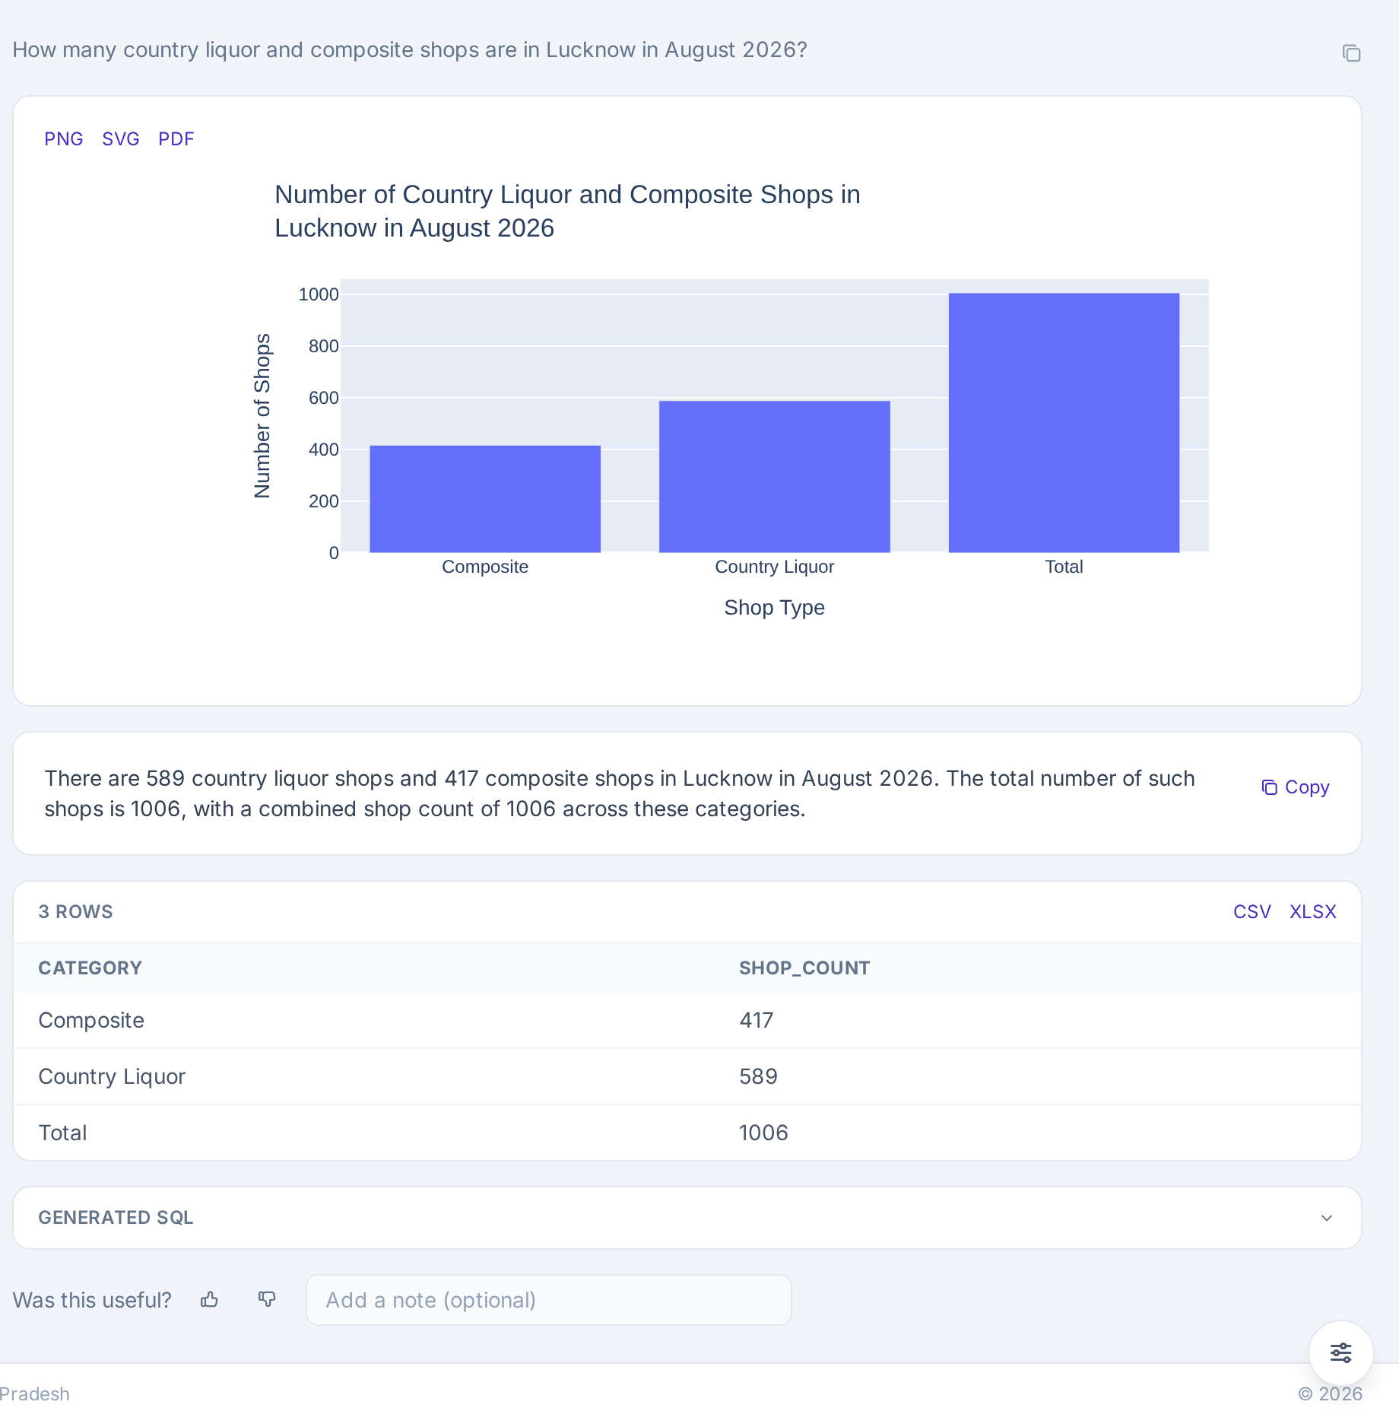
Live example: how many shops, and of which kind?
"How many country liquor and composite shops are in Lucknow in August 2026?"
Total: 1,006 shops.
Split: 589 country liquor and 417 composite.
The database counts the total; the AI does not add it up.
Source: the monthly dispatch report from the Integrated Excise Supply Chain Management System (IESCMS).
Government of Uttar Pradesh | Department of Excise | Ask the Data: proof of concept
4
Notes:
Click the screenshot to open it full size. Read the question aloud, then point to the total and the two parts. This question was chosen because it has a split and a total. Earlier versions gave one combined number; we fixed that so each part is shown.

Slide 5
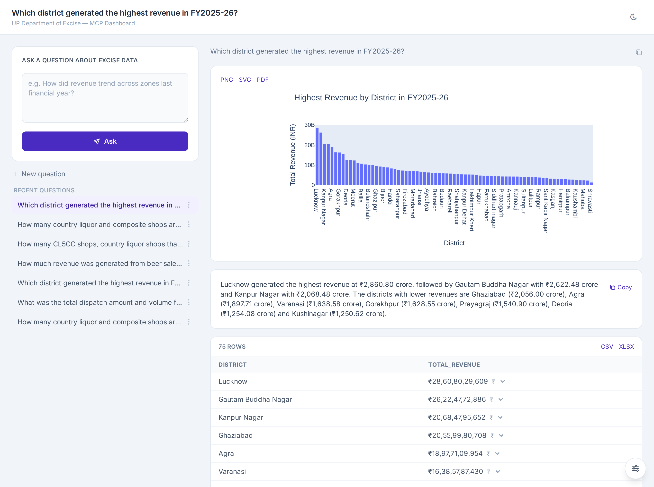
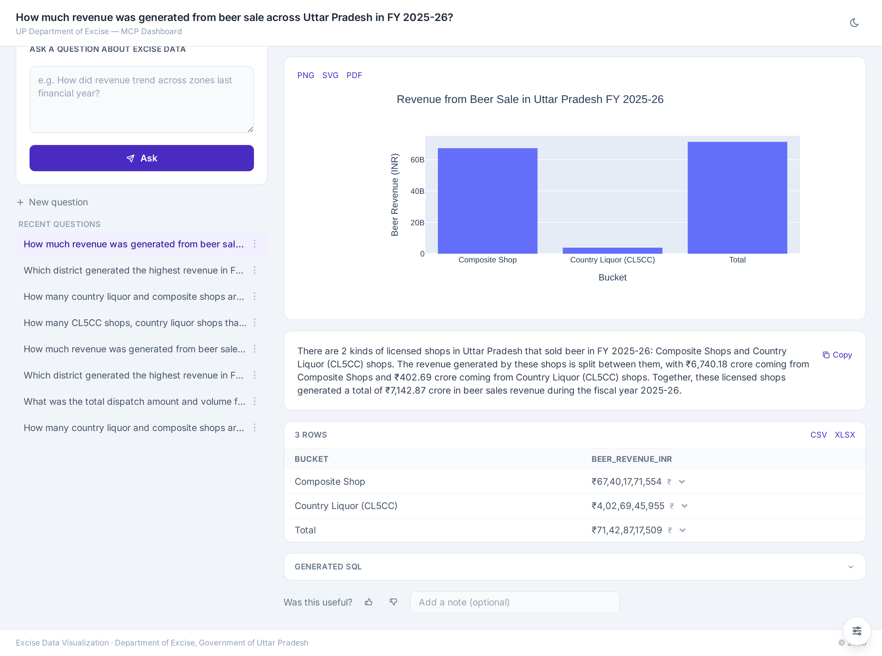
Live example: revenue by district and for a product
"Which district generated the highest revenue in FY2025-26?"
"How much revenue came from beer sale across Uttar Pradesh in FY2025-26?"
Lucknow is the highest, at ₹2,860.80 crore out of a state total of about ₹55,463 crore.
Beer revenue is ₹7,142.87 crore: ₹6,740.18 crore from composite shops and ₹402.69 crore from country liquor shops that also sell beer (CL5CC).
Government of Uttar Pradesh | Department of Excise | Ask the Data: proof of concept
5
Notes:
Click either screenshot to open it full size. Money is shown in rupees with lakh and crore, never in dollars. The system converts the figures in code, not by asking the AI to do the arithmetic, after an early version got a crore conversion wrong.

Slide 6





Safety and control
Sign-in
Email one-time code. Each person has a role: Admin or Analyst.
Read-only data
The AI connects with a database account that can read but cannot change anything.
Checked queries
Every query is inspected first. Only a single read request is allowed.
Locked box for charts
Chart code runs in an isolated space: no network, limited time and memory.
Full record
Every question, query and action is logged for audit.
Government of Uttar Pradesh | Department of Excise | Ask the Data: proof of concept
6
Notes:
Each layer works on its own: if one failed, the next would still stop a harmful action. Be ready for the question "can it change our data?" The answer is no: the database itself refuses any write from this account.

Slide 7




What comes next
High-performance compute
More data
A high-performance computing (HPC) node with high-end GPU servers runs larger, more capable models and shortens response times.
Monthly feeds for every district, and the missing sources such as Bhang shops.
Saved analyses and reports
Wider access
Re-run a favourite question each month and export a report with the data date on it.
Roles for district and division officers, with their own question history.
Government of Uttar Pradesh | Department of Excise | Ask the Data: proof of concept
7
Notes:
Roadmap items come from the project plan. Saved analyses and offline reading are planned, not built.

Slide 8

The decision we are asking for
This proof of concept shows that officers can get sourced answers from the department's own data in minutes, on the department's own server.
We ask the respected authorities for a decision on the next step.
Proposed next steps
1. A pilot with a small group of district and division officers.
2. A high-performance GPU compute node.
3. Monthly data feeds from the source systems and involved stakeholders.
Government of Uttar Pradesh | Department of Excise | Ask the Data: proof of concept
8
Notes:
DECISION REQUEST: to be written after the review with the project lead. Replace the next steps above with the specific approval being sought.

