Slide 1
Dehazing single image using Dark Channel Prior
DIP Project
Subhani Shaik
Dhruv Kaushik
Deepak Singh

Slide 2
Introduction
Haze, fog, and smoke are phenomena due to atmospheric absorption and scattering.
Images of outdoor scenes are usually degraded by them.
The haze-free image is more visually pleasing.
Removing haze can significantly increase the visibility of the scene and correct the color shift caused by the airlight
Haze removal (or dehazing) is highly desired in consumer/computational photography and computer vision applications.

Slide 3
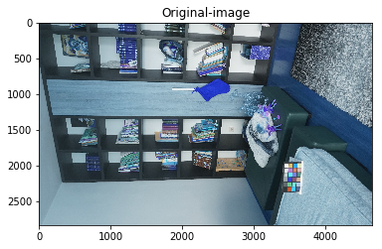
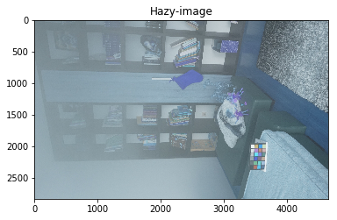
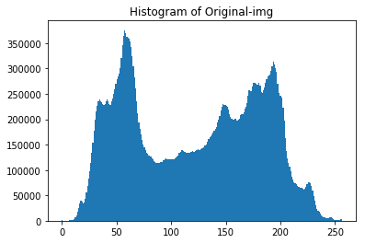
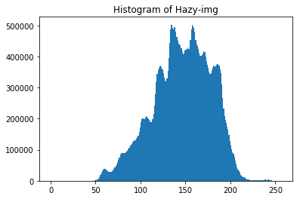
Dehazing with histogram equalization

Slide 4
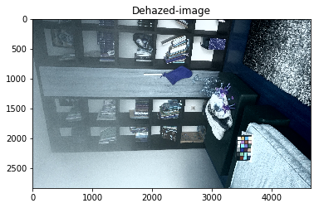
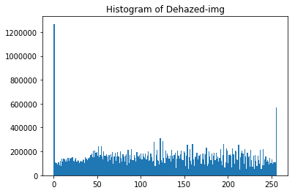
Dehazing with histogram equalization
Results after Histogram Equalization

Slide 5

Haze Imaging Model
I is the observed intensity
J is the scene radiance
A is the global atmospheric light
t is the medium transmission (describing the portion of the light that is not scattered and reaches the camera)
A(1-t(x)) is Airlight
J(x)t(x) is direct attenuation

Slide 6

Dark channel prior
J^{dark} is a color channel of J
Ohm(x) is a local patch (15x15) centered at x.

Slide 7

Dark channel prior
The basic observation (called Dark-channel prior) is that on haze-free outdoor images, most of the non-sky patches, at least one color channel has very low intensity at some pixels. The low intensities in the dark channel are mainly due to:
●Dark objects, shadows of trees and rocks.
●Colorful objects Ex- green, red, yellow, blue
Since the natural outdoor images are usually colorful and full of shadows, it is reasonable to generalize the observation.

Slide 8

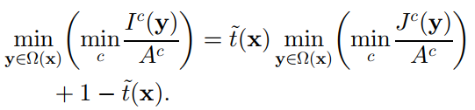
Dehazing using deep channel prior
We normalize each color channel independently
Calculate the dark channel on both sides

Slide 9


Dehazing using deep channel prior
As the scene radiance J is a haze-free image, the dark channel of J is close to zero due to the dark channel prior
Thus eliminate the multiplicative term and estimate the transmission t~

Slide 10



Dehazing using deep channel prior
The color of the sky in a hazy image I is usually very similar to the atmospheric light A. So, in the sky region
keep a very small amount of haze for the distant objects by introducing a constant parameter (0 < Omega<= 1)

Slide 11

Dehazing using deep channel prior
Use the dark channel image to detect the most haze-opaque region and improve the atmospheric light estimation.
We first pick the top 0.1 percent brightest pixels in the dark channel. These pixels are usually most haze-opaque.
Among these pixels, the pixels with highest intensity in the input image I are selected as the atmospheric light.
Recovered Image:

Slide 12

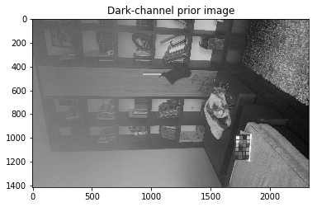
Dehazing using deep channel prior

Slide 13
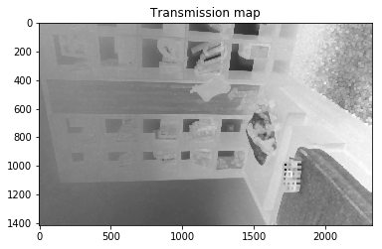
Dehazing using deep channel prior

Slide 14

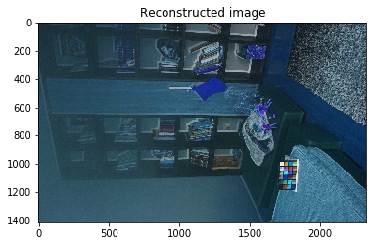
Dehazing using deep channel prior

Slide 15
Thank You

