Slide 1
Image based Plant Disease Detection
Srivatsava Kesanupalli (MT18054)
Subhani Shaik (MT18117)

Slide 2
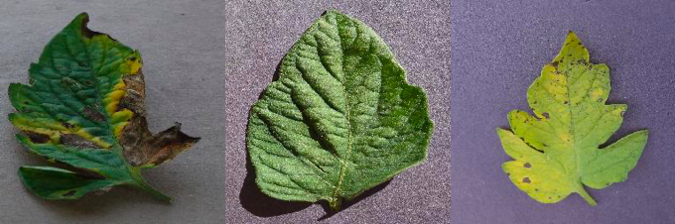
Introduction
Farmers face several challenges due to plants being affected by diseases which leads to a dip in crop production. Early detection of the disease can aid the farmers in taking the right action.

Slide 3
Problem Statement
Plant health is important for high yield crop production.
Farmers face several challenges due to plants being affected by diseases which leads to a dip in crop production.
Early detection of the disease can aid the farmers in taking the right action.
Our goal is to detect the right disease based on the plant leaf images.

Slide 4
Methodology
Dataset : PlantVillage dataset
38 classes of healthy and diseased crop leaf images.
Preprocessed according to the architecture.
Papers on the problem used Support Vector Machines and CNNs to detect and classify the images based on the type of disease and the type of plant leaf in the picture.
We used AlexNet and GoogleNet to replicate the current state-of-the-art results and compare with them.

Slide 5
Methodology
Earlier implementations are based on the classical image processing techniques like SIFT, HoG features of the image.
We used SVM as baseline model.
Used RBF kernel with OVR method.
Trained different preprocessed data.
and experimented on different deep learning architectures like CNNs- AlexNet, GoogLeNet and tried GAN.

Slide 6
Results
SVM
Trained using RBF kernel
Pre-processed dataset
For 28x28 image:
Accuracy: 0.8316
Precision : 0.84, Recall: 0.83, F1-Score: 0.84
For 128x128 image:
Accuracy:0.94
Precision: 0.94, Recall:0.92 , F1-score:0.93

Slide 7
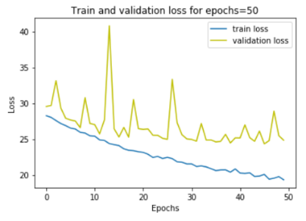
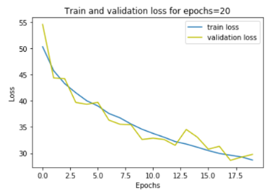
Results
CNN with dataset without augmentation Test Accuracy = 0.92
with augmentation Test Accuracy = 0.93
For

Slide 8
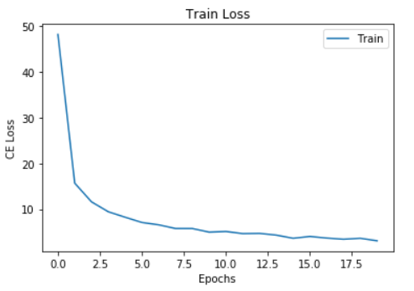
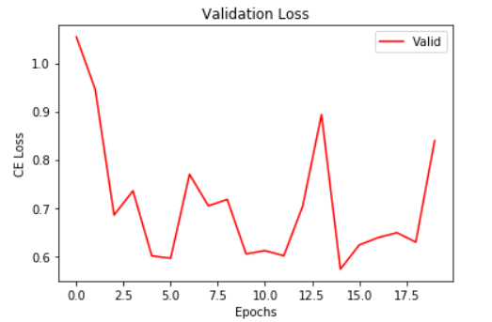
Results
AlexNet with Transfer learning: changed the classifier and trained for 20 epochs.
Accuracy: 0.91
AlexNet from Scratch: loss is not converged as fast as pretrained model.
Accuracy: 0.87

Slide 9
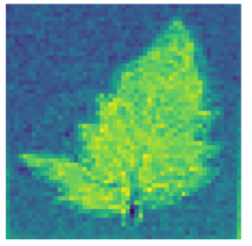
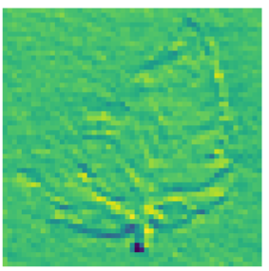
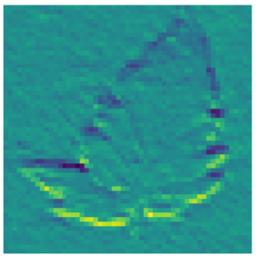
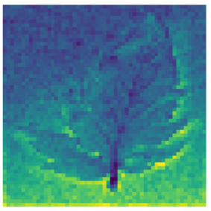
Results
Visualizing Activation map of first convolution layer in AlexNet architecture.

Slide 10
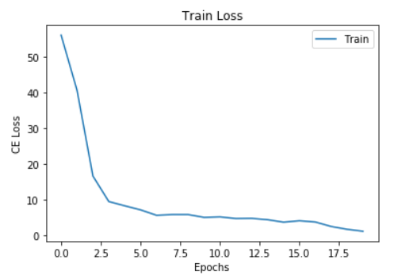
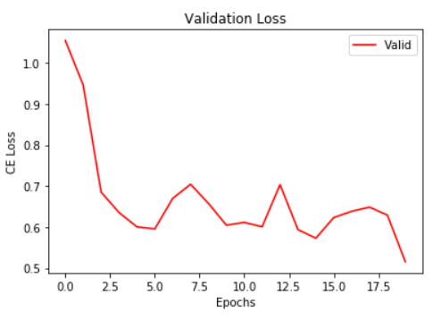
Results
GoogLeNet with Transfer learning: changed the classifier and trained for 20 epochs.
Accuracy: 0.92
GoogLeNet from Scratch: loss is not converged as fast as pretrained model.
Accuracy: 0.89

Slide 11
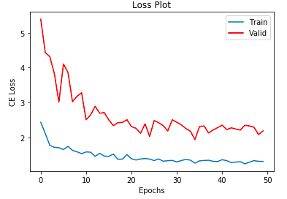
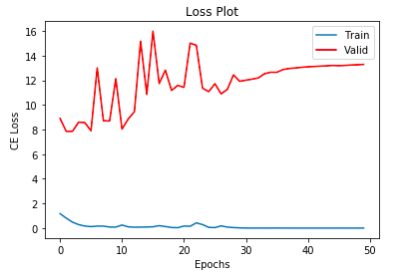
Results
Multi-tasking :
Leaf + Disease classification
Disease classification

Slide 12
Conclusion
Given the number of diseases that can occur to a plant and leaf structure being identical it can be difficult to classify. Our experiments showed that it would be better to use a multi-task network to classify leaves first and then the type of diseases.
With a lot of training, although we could achieve better performance, it can be done in less training iterations if multi-task learning is used.

Slide 13
Thank You

