Slide 1
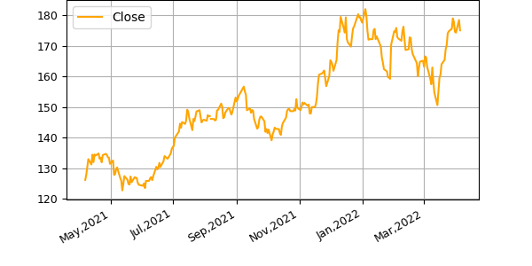
Company overview
Buisness Description
Financial summary
Apple Inc. designs, manufactures, and markets smartphones, personal computers, tablets, wearables, and accessories worldwide.
It also sells various related services.
In addition, the company offers iPhone, a line of smartphones; Mac, a line of personal computers; iPad, a line of multi-purpose tablets; AirPods Max, an over-ear wireless headphone; and wearables, home, and accessories comprising AirPods, Apple TV, Apple Watch, Beats products, HomePod, and iPod touch.
Further, it provides AppleCare support services; cloud services store services; and operates various platforms, including the App Store that allow customers to discover and download applications and digital content, such as books, music, video, games, and podcasts.
Additionally, the company offers various services, such as Apple Arcade, a game subscription service; Apple Music, which offers users a curated listening experience with on-demand radio stations; Apple News+, a subscription news and magazine service; Apple TV+, which offers exclusive original content; Apple Card, a co-branded credit card; and Apple Pay, a cashless payment service, as well as licenses its intellectual property.
The company serves consumers, and small and mid-sized businesses; and the education, enterprise, and government markets.
It distributes third-party applications for its products through the App Store.
The company also sells its products through its retail and online stores, and direct sales force; and third-party cellular network carriers, wholesalers, retailers, and resellers.
Apple Inc. was incorporated in 1977 and is headquartered in Cupertino, California.
.
USD | 2019 | 2020 | 2021
Revenue | 260.17B | 274.52B | 365.82B
Growth(%) | -2.04% | 5.51% | 33.26%
EBITDA | 81.86B | 81.02B | 123.14B
Margin(%) | 0.31% | 0.3% | 0.34%
FCF | 58.9B | 73.36B | 92.95B
Margin(%) | 0.23% | 0.27% | 0.25%
Share Price Performance

Slide 2
Income Statement
USD | 2021 | 2020 | 2019 | 2018
Total Revenue | 365.82B | 274.51B | 260.17B | 265.6B
Cost of Revenue | 212.98B | 169.56B | 161.78B | 163.76B
Gross Profit | 152.84B | 104.96B | 98.39B | 101.84B
Research & Development | 21.91B | 18.75B | 16.22B | 14.24B
Selling General Administration | 21.97B | 19.92B | 18.25B | 16.7B
Interest Expense | -2.65B | -2.87B | -3.58B | -3.24B
Total Operating Expense | 256.87B | 208.23B | 196.24B | 194.7B
Operating Income | 108.95B | 66.29B | 63.93B | 70.9B
EBIT | 108.95B | 66.29B | 63.93B | 70.9B
Total Other Income/Expense Net | 258M | 803M | 1.81B | 2B
Income Before Taxes | 109.21B | 67.09B | 65.74B | 72.9B
Income Tax Expense | 14.53B | 9.68B | 10.48B | 13.37B
Net Income from Continued Operations | 94.68B | 57.41B | 55.26B | 59.53B
Net Income | 94.68B | 57.41B | 55.26B | 59.53B
Net Income Applicable to Common Shares | 94.68B | 57.41B | 55.26B | 59.53B

Slide 3
Cash Flow Statement
USD | 2021 | 2020 | 2019 | 2018
Net Income | 94.68B | 57.41B | 55.26B | 59.53B
Depreciation | 11.28B | 11.06B | 12.55B | 10.9B
Change To Net Income | 2.98B | 6.52B | 5.08B | -27.69B
Change to Inventory | -2.64B | -127M | -289M | 828M
Change to Liabilities | 14B | -1.98B | -2.55B | 9.17B
Change to Account Receivables | -10.12B | 6.92B | 245M | -5.32B
Changes to Operating Activites | -6.15B | 881M | -896M | 30.02B
Total Cash from Operating Activites | 104.04B | 80.67B | 69.39B | 77.43B
Investments | -2.82B | 5.33B | 58.09B | 30.84B
Capital Expenditure | -11.09B | -7.31B | -10.49B | -13.31B
Other Cashflow From Investing Activities | -608M | -791M | -1.08B | -745M
Total Cashflows From Investing Activities | -14.54B | -4.29B | 45.9B | 16.07B
Dividends Paid | -14.47B | -14.08B | -14.12B | -13.71B
Repurchase Of Stocks | -92.53B | -75.99B | -69.71B | -75.27B
Net Borrowing | 12.66B | 2.5B | -7.82B | 432M
Issuance of Stock | 1.1B | 880M | 781M | 669M
Other Cashflow from Finanacing Activity | -129M | -126M | -105M | -105M
Total Cash from Financing Activities | -93.35B | -86.82B | -90.98B | -87.88B
Change in Cash | -3.86B | -10.44B | 24.31B | 5.62B

Slide 4
Balance Sheet
Assets
Liabilities
USD | 2021 | 2020 | 2019 | 2018
Cash | 34.94B | 38.02B | 48.84B | 25.91B
Short Term Investments | 27.7B | 52.93B | 51.71B | 40.39B
Net Receivables | 51.51B | 37.45B | 45.8B | 48.99B
Inventory | 6.58B | 4.06B | 4.11B | 3.96B
Other Current Assets | 14.11B | 11.26B | 12.35B | 12.09B
Total Current Assets | 134.84B | 143.71B | 162.82B | 131.34B
USD | 2021 | 2020 | 2019 | 2018
Accounts Payable | 54.76B | 42.3B | 46.24B | 55.89B
Short Term Debt | 9.61B | 8.77B | 10.26B | 8.78B
Other Current Liabilities | 53.58B | 47.87B | 43.24B | 39.29B
Total Current Liabilities | 125.48B | 105.39B | 105.72B | 115.93B
USD | 2021 | 2020 | 2019 | 2018
Total Current Liabilities | 125.48B | 105.39B | 105.72B | 115.93B
Long Term Debt | 109.11B | 98.67B | 91.81B | 93.73B
Other Liabilities | 43.05B | 46.11B | 50.5B | 48.91B
Total Liabilities | 287.91B | 258.55B | 248.03B | 258.58B
USD | 2021 | 2020 | 2019 | 2018
Total Current Assets | 134.84B | 143.71B | 162.82B | 131.34B
Property Plant Equipment | 49.53B | 45.34B | 37.38B | 41.3B
Net Tangible Assets | 63.09B | 65.34B | 90.49B | 107.15B
Long Term Investments | 127.88B | 100.89B | 105.34B | 170.8B
Other Assets | 38.76B | 33.95B | 32.98B | 22.28B
Total Assets | 351B | 323.89B | 338.52B | 365.73B
USD | 2021 | 2020 | 2019 | 2018
Common Stocks | 57.37B | 50.78B | 45.17B | 40.2B
Other Stockholder Equity | 163M | -406M | -584M | -3.45B
Treasury Stocks | 163M | -406M | -584M | -3.45B
Retained Earnings | 5.56B | 14.97B | 45.9B | 70.4B
Total Stockholder Equity | 63.09B | 65.34B | 90.49B | 107.15B

Slide 5
Operational Summary
USD | Stock Price | Enterprise Value | Rev. CAGR | EBITDA Margin 2019 | EBITDA Margin 2020 | EBITDA Margin 2021 | EBIT Margin 2019 | EBIT Margin 2020 | EBIT Margin 2021 | FCF Margin 2019 | FCF Margin 2020 | FCF Margin 2021 | Net Income Margin 2019 | Net Income Margin 2020 | Net Income Margin 2021
AAPL | 175.06 | 2.97T | 0.12 | 0.31% | 0.3% | 0.34% | 0.25% | 0.24% | 0.3% | 0.23% | 0.27% | 0.25% | 0.21% | 0.21% | 0.26%
MSFT | 310.88 | 2.32T | 0.1 | 0.46% | 0.48% | 0.51% | 0.34% | 0.37% | 0.42% | 0.3% | 0.32% | 0.33% | 0.31% | 0.31% | 0.36%
FB | 231.84 | 603.09B | 0.19 | 0.43% | 0.46% | 0.46% | 0.34% | 0.38% | 0.4% | 0.3% | 0.27% | 0.33% | 0.26% | 0.34% | 0.33%
IBM | 128.89 | 165.14B | -0.09 | 0.23% | 0.17% | 0.22% | 0.14% | 0.09% | 0.12% | 0.15% | 0.2% | 0.17% | 0.12% | 0.08% | 0.1%
AMZN | 3,281.10 | 1.76T | 0.19 | 0.13% | 0.13% | 0.16% | 0.05% | 0.06% | 0.05% | 0.08% | 0.07% | -0.03% | 0.04% | 0.06% | 0.07%
GOOGL | 2,811.82 | 1.78T | 0.17 | 0.32% | 0.34% | 0.4% | 0.22% | 0.23% | 0.31% | 0.19% | 0.23% | 0.26% | 0.21% | 0.22% | 0.3%

Slide 6
Valuation Summary
USD | Stock Price | Equity Value | Enterprise Value | EV/Revenue 2018 | EV/Revenue 2019 | EV/Revenue 2020 | EV/Revenue 2021 | EV/EBITDA 2018 | EV/EBITDA 2019 | EV/EBITDA 2020 | EV/EBITDA 2021 | EV/EBIT 2018 | EV/EBIT 2019 | EV/EBIT 2020 | EV/EBIT 2021 | Price/Earnings 2018 | Price/Earnings 2019 | Price/Earnings 2020 | Price/Earnings 2021 | Trailing PE
AAPL | 175.06 | 2.86T | 2.97T | 10.76 | 10.98 | 10.41 | 7.81 | 32.82 | 34.9 | 35.26 | 23.2 | 40.3 | 44.69 | 43.1 | 26.22 | 58.3 | 58.5 | 52.89 | 30.87 | 29.1
MSFT | 310.88 | 2.33T | 2.32T | 21.12 | 18.52 | 16.3 | 13.87 | 47.11 | 40.14 | 34.06 | 27.38 | 66.48 | 54.25 | 44.01 | 33.33 | 144.6 | 60.84 | 53.42 | 38.29 | 33.11
FB | 231.84 | 631.05B | 603.09B | 11.3 | 8.93 | 7.34 | 5.35 | 21.26 | 20.64 | 15.96 | 11.53 | 25.33 | 26.31 | 19.32 | 13.5 | 30.31 | 35.78 | 22.68 | NA | 16.84
IBM | 128.89 | 115.53B | 165.14B | 1.45 | 1.5 | 1.57 | 2.01 | 6.98 | 6.58 | 9.15 | 9.31 | 8.7 | 10.87 | 16.76 | 16.91 | 13.47 | 12.13 | 20.52 | NA | 20.3
AMZN | 3.28K | 1.67T | 1.76T | 7.17 | 5.95 | 4.32 | 3.55 | 59.59 | 44.68 | 32.69 | 22.48 | 134.41 | 114.82 | 72.91 | 67.11 | 158.66 | 139.86 | 76.95 | NA | 50.63
GOOGL | 2.81K | 1.86T | 1.78T | 13.61 | 11.5 | 10.2 | 7.23 | 42.26 | 36.15 | 30.07 | 17.99 | 59.31 | 51.83 | 45.17 | 23.66 | 63.59 | 56.7 | 47.54 | NA | 25.06
High | 3.28K | 2.86T | 2.97T | 21.12 | 18.52 | 16.3 | 13.87 | 59.59 | 44.68 | 35.26 | 27.38 | 134.41 | 114.82 | 72.91 | 67.11 | 158.66 | 139.86 | 76.95 | 38.29 | 50.63
Median | 271.36 | 1.77T | 1.77T | 11.03 | 9.95 | 8.77 | 6.29 | 37.54 | 35.53 | 31.38 | 20.24 | 49.81 | 48.26 | 43.55 | 24.94 | 60.95 | 57.6 | 50.21 | 34.58 | 27.08
Mean | 1.16K | 1.58T | 1.6T | 10.9 | 9.56 | 8.36 | 6.64 | 35 | 30.52 | 26.2 | 18.65 | 55.76 | 50.46 | 40.21 | 30.12 | 78.15 | 60.63 | 45.67 | 34.58 | 29.17
Low | 128.89 | 115.53B | 165.14B | 1.45 | 1.5 | 1.57 | 2.01 | 6.98 | 6.58 | 9.15 | 9.31 | 8.7 | 10.87 | 16.76 | 13.5 | 13.47 | 12.13 | 20.52 | 30.87 | 16.84

Slide 7
Institutional Holdings
USD | Reported Date | % Owned | No. of shares
Vanguard Group, Inc. (The) | 31 Dec,2021 | 7.73% | 1,261,261,357
Blackrock Inc. | 31 Dec,2021 | 6.25% | 1,019,810,291
Berkshire Hathaway, Inc | 31 Dec,2021 | 5.44% | 887,135,554
State Street Corporation | 31 Dec,2021 | 3.88% | 633,115,246
FMR, LLC | 31 Dec,2021 | 2.16% | 352,204,129
Geode Capital Management, LLC | 31 Dec,2021 | 1.62% | 264,351,901
Price (T.Rowe) Associates Inc | 31 Dec,2021 | 1.37% | 223,148,792
Northern Trust Corporation | 31 Dec,2021 | 1.17% | 190,876,014
Bank Of New York Mellon Corporation | 31 Dec,2021 | 0.89% | 144,695,935
Norges Bank Investment Management | 31 Dec,2021 | 0.87% | 142,076,403

Slide 8
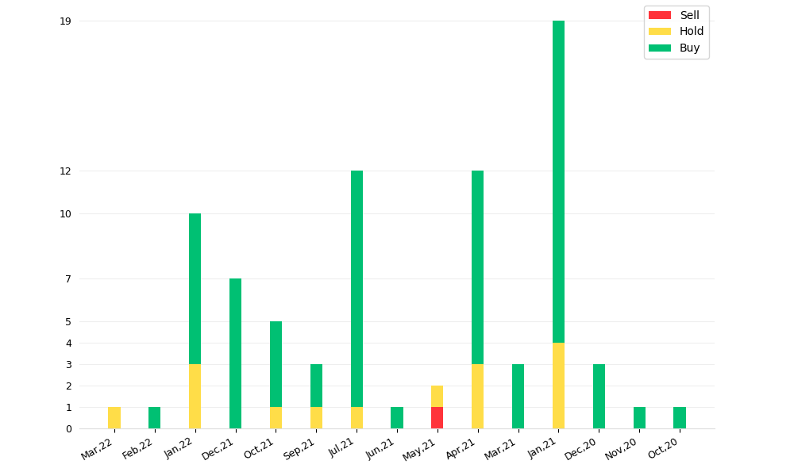
Broker Ratings
USD | Broker | Rating
11-Mar-22 | Barclays | Hold
15-Feb-22 | Tigress Financial | Buy
31-Jan-22 | Credit Suisse | Hold
28-Jan-22 | Oppenheimer | Buy
28-Jan-22 | New Street Research | Hold
28-Jan-22 | Deutsche Bank | Buy
28-Jan-22 | Morgan Stanley | Buy
28-Jan-22 | Raymond James | Buy
28-Jan-22 | UBS | Buy
28-Jan-22 | Barclays | Hold
21-Jan-22 | Wells Fargo | Buy
14-Jan-22 | Loop Capital | Buy
22-Dec-21 | Citigroup | Buy
14-Dec-21 | Evercore ISI Group | Buy
14-Dec-21 | B of A Securities | Buy

Slide 9
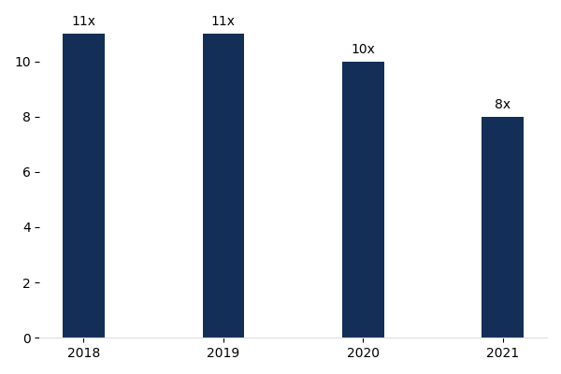
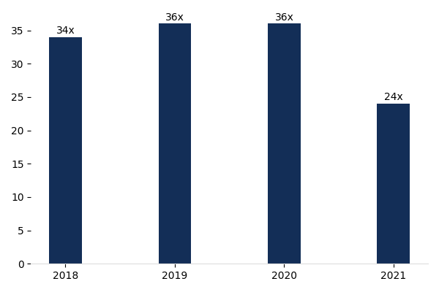
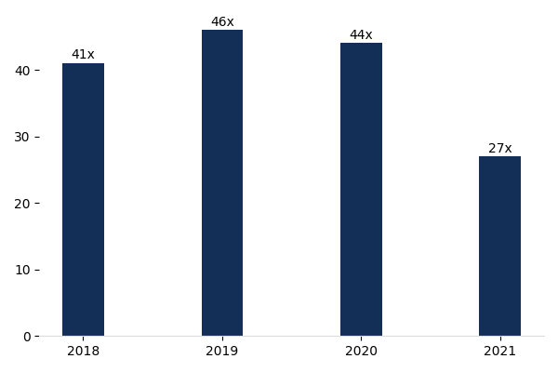
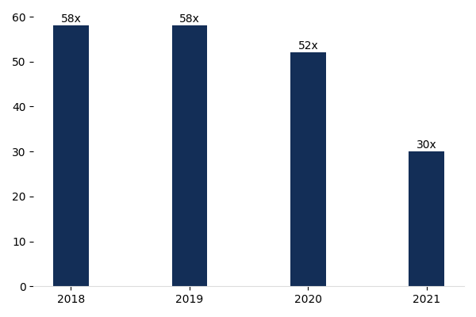
Valuation Outputs
EV/Sales
EV/EBITDA
EV/EBIT
P/E

