Slide 1
RSS Programming Language
Presented By: Team 20
Richa Shastri - 1209458663
Sarvesh Kulkarni - 1210322864
Subhankar Mishra - 1209249583

Slide 2
Objectives
Modular Programming
Strongly typed
Simple Syntax
Von Neumann architecture
Applicative order evaluation
Simple runtime
Able to handle complex expression and function calls
Support for data structures.

Slide 3
Overview
Our language called RSS is a high level, user friendly, procedural language.
It has as a simple syntax.
Supports operators, conditional statements, data types, data structure, functions declaration and call, iterations and recursive calls.
The compiler of RSS is very intelligent and does maximum processing, syntax checking, and function handling.
The runtime is very simple, fast and efficient.

Slide 4
Inspirations
RSS Language is inspired from many languages
C++
Java
ADA
Visual Basic

Slide 5
Tools Used
The tools that were used to build the compiler and runtime interpreter are:
Lexical Analysis and Parsing: Antlr
Intermediate code generation: Antlr and Java
Runtime environment: Java

Slide 6
Features
Our language contains the following features
Local and global variable
The compiler can easily differentiate even if you use same name for local/global/array variables.
Data types: The following data types are supported for local,global and arrays.
Int
String
Boolean
Data structure
Array : a sequential data structure.
Both array and its members can be passed as an argument in function call.

Slide 7
Features (contd…)
Operators: Following operators are supported in the order of the priority
Arithmetic : *,/,%,+,-,
Conditional: >=,<=,>,<,==,!=
Logical: &&, ||
Complex expressions
Handle complex expressions such as : a=func1(func1(x+2)))+a*b + a/b
Conditional operations
Implements condition statement such as If , else if , else
Handles dangling else problem
Else Statement is not mandatory
Condition checks in IF can be expressions,variables or boolean literals like true and false
Iterative operations
Implements a loop similar to For loop in C++.

Slide 8
Features (contd…)
Function declaration
Declare a function with arguments and return value data type
Arguments are passed by value
Functions can be called from anywhere in the programme.
Function call
Before calling a function its is not necessary that the function be declared or defined
Optional Return statement
Recursive Function call
A function can be called to itself any number of times.

Slide 9

How it works?
High Level Language
.RSS file
Antlr4 tool
Parse Tree
Parse tree walker
IL Code
.RSSC file
Runtime
Java
Output

Slide 10
Code Transition
High Level
Intermediate
Output
class Class1
bool b
func main ()
int a[10]
a[0] = 5
print (a [0])
end
end
Programstart
Class Class1
Dec _Gbb
Func main
Dec _Lia[] 10
SET _Lia[].0 5
Print _Lia[].0
Functionend
Programend
Classend
5
.rss file
.rssc file

Slide 11
Grammar
Language has Context Free grammar
EBNF grammar is used
“Parse” is the entry point for syntactic grammar in the code.

Slide 12
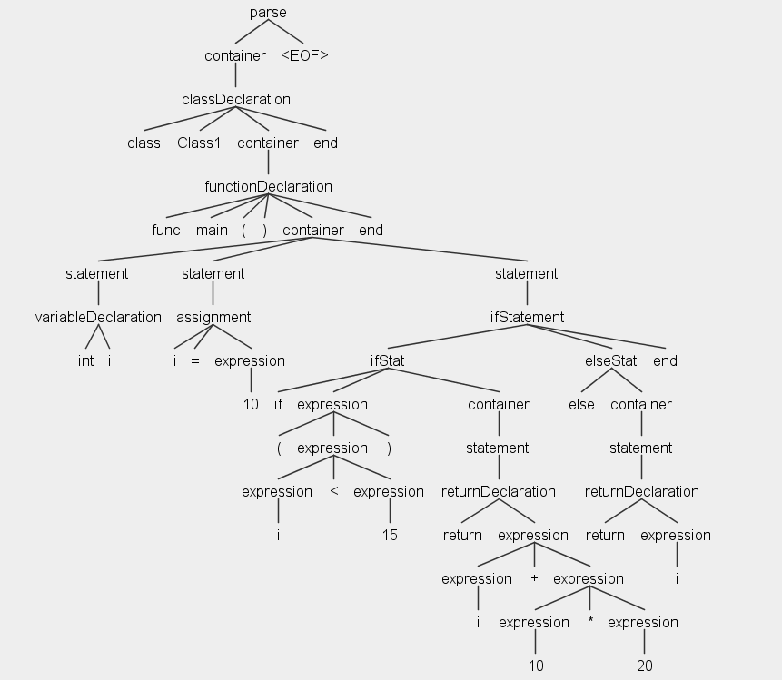
Parse Tree

Slide 13
RSS Compiler
The Input .rss file is fed into the compiler
ANTLR performs lexical analysis and parsing on the High level RSS file which then generates the parse tree on the basis of the defined grammar.
A walker class is used to traverse through the nodes of the tree.
For each syntactic rules, there are exit and entry functions created by ANTLR in the baselistener class.
We have overridden the BaseListener to generate the intermediate code.
Once all the nodes are traversed, the intermediate file .rssc will be generated.

Slide 14
Complex function calls and expression
High Level Code
Output
class Class1
int a
func main ()
::a = 5
print("Output : " + (square(square(::a)) + 3*5))
print("Global Variable 'a' value : " + ::a)
end
func square(int a) returns int
a = a*a
return a
end
end
Output : 640
Global Variable 'a' value : 5

Slide 15
RSS Runtime
Runtime is written in Java
.rssc intermediate file is given as input which generates the final output.
The intermediate language is read line by line.
Each line of intermediate code is divided into lexical tokens.
The first token in a line determines the actions to be performed.
Based on it, appropriate function call is made.
Symbol table is used for value storage.

Slide 16
Symbol Table
Example:
Class class1
Void main()
…..
Function1 call
….
End
Function1 ()
…..
Function2 call
….
End
Function2 ()
…..
End
Global Variables
Main Function Variables
Insertion
Search and Deletion
Function1 Variables
Function2 Variables

Slide 17
Factorial Program (using recursion)
High Level Code
Output
class Class1
func main ()
int a
a = 5
print (factorial (a))
end
func factorial (int n) returns int
int result
if (n == 1)
return 1
end
result = factorial (n-1) * n
return result
end
end
120

Slide 18
Challenges Faced
Learning Antlr4 tool was one of the major challenge we faced.
Another major challenge was to build the entire runtime from scratch using stack based approach.
Implementation of function activation and argument handling
Implementation of arrays and handling recursive function in runtime was another major hurdle.

Slide 19
References
http://www.antlr.org/
http://stackoverflow.com/questions/tagged/antlr
https://www.javacodegeeks.com/2012/04/antlr-tutorial-hello-word.html
http://www.oursland.net/tutorials/antlr/AntlrEclipse.html
http://www.antlr2.org/doc/sor.html

Slide 20
Thank You

