Slide 1
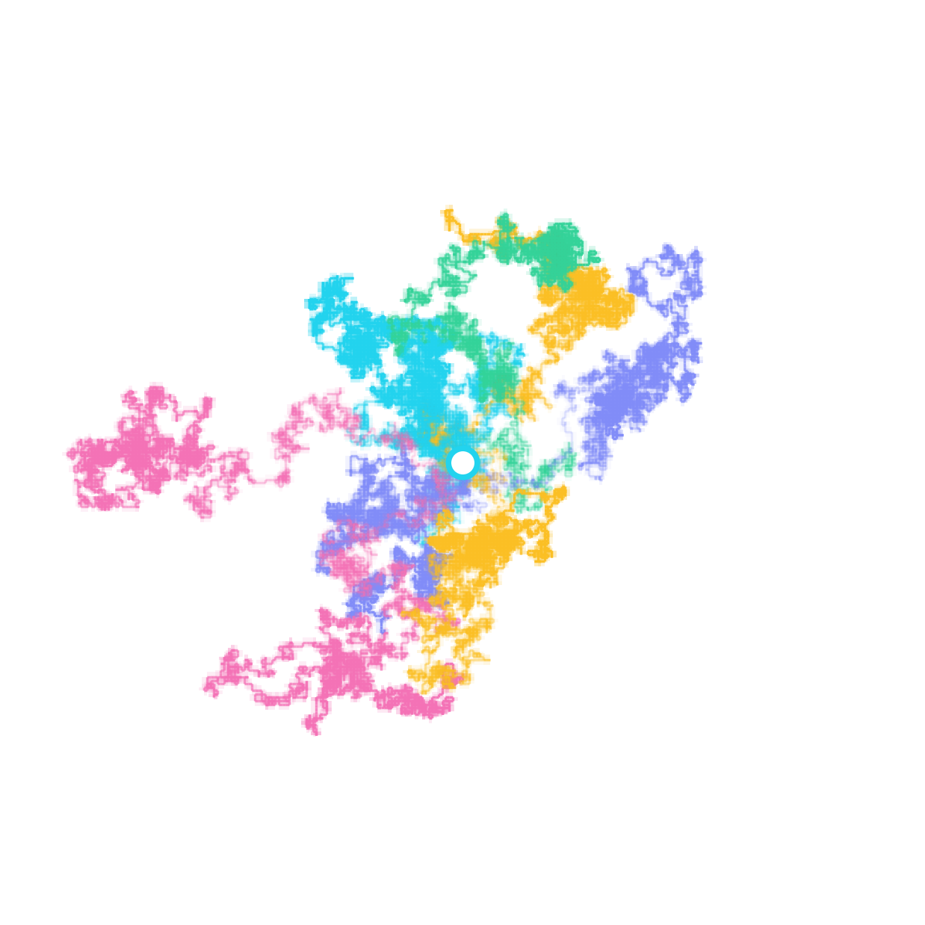
IDC612 · COURSE PROJECT · IIT KANPUR
Random Walk
Laboratory
How the dimension of space changes diffusion, probability distributions and recurrence — Monte Carlo simulation tested against exact theory for d = 1, 2, 3, 4, 5.
E|Xₙ|² = n
α = ½
Pólya 1921
error ∝ 1/√N
Subhankar
Indian Institute of Technology Kanpur · 2026
Notes:
Introduce the project: a computational laboratory that simulates lattice random walks in 1 to 5 dimensions and checks every simulated statistic against an exact mathematical prediction. The picture on the right shows nine real 2D walks generated by our engine, all starting from the origin.

Slide 2
01 · MOTIVATION
Why random walks — and what we set out to test
Where random walks appear
CENTRAL RESEARCH QUESTION
◉
Brownian motion
How does the dimension d of a lattice random walk change its geometry, its statistics, and its agreement with exact mathematical theory?
Einstein (1905): pollen diffuses with ⟨x²⟩ = 2Dt
∿
Polymer physics
Ideal chain: end-to-end size R ∼ N^½
∇
Diffusion & heat
01
Exact second moment
02
Diffusive scaling
Continuum limit is the heat equation ∂ₜρ = D∇²ρ
Verify E|Xₙ|² = n in every dimension
Measure α in R ∼ nᵅ (theory ½)
↗
Finance
Bachelier (1900): asset prices as random walks
Algorithms
03
Recurrence vs transience
04
Monte Carlo accuracy
⟳
Markov-chain Monte Carlo, PageRank, randomized search
Observe Pólya's sharp transition at d = 3
Show estimation error shrinks like 1/√N
RANDOM WALK LABORATORY · IDC612 · IIT KANPUR
02 / 10
Notes:
Random walks are the simplest model of diffusion and appear across physics, chemistry, biology, finance and computer science. Our central question: how does dimension change the behaviour? We turn this into four testable objectives, each with an exact theoretical answer that the simulation must reproduce.

Slide 3
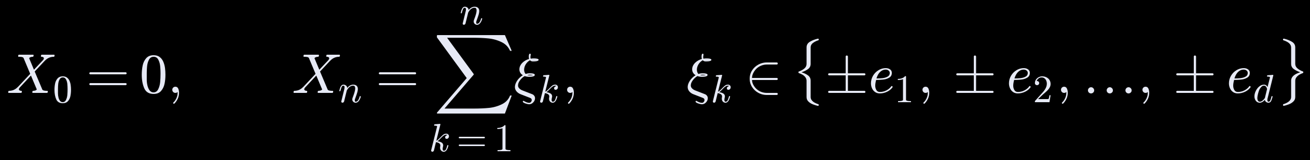
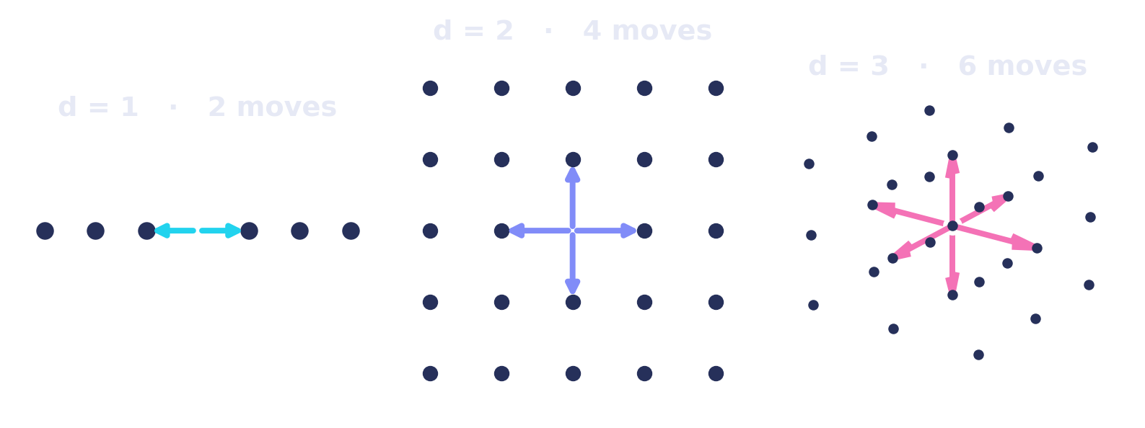
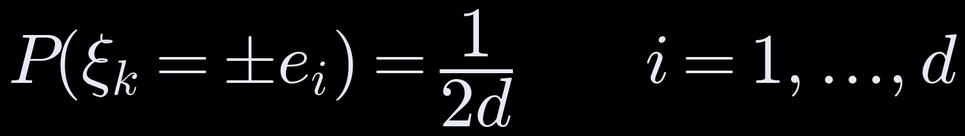
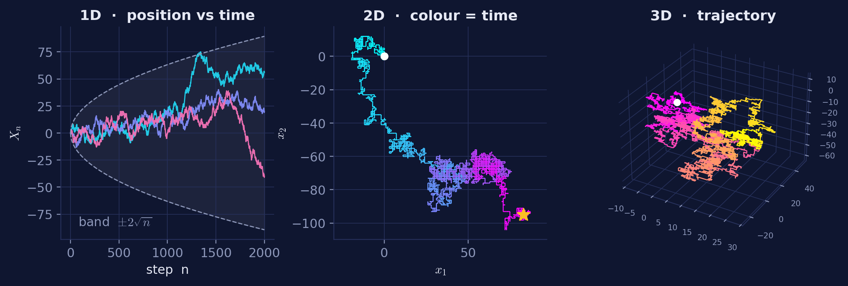
02 · MATHEMATICAL MODEL
The model: nearest-neighbour random walk on the lattice ℤᵈ
Definition
Possible moves from one lattice site
Exactly one coordinate changes per step → 2d equally likely moves. Steps are independent and unbiased; the walker starts at the origin.
Sample paths from our engine
▸ Typical distance grows like √n, not n — the walk is diffusive
▸ Paths are statistically self-similar (fractal-like)
▸ Same rules for every d; 4D / 5D are inspected via 2-D projections
RANDOM WALK LABORATORY · IDC612 · IIT KANPUR
03 / 10
Notes:
The walk lives on the integer lattice. At every step exactly one of the d coordinates is chosen uniformly and moved by +1 or -1, so there are 2d equally likely neighbours, each with probability 1/(2d). This is the classical Polya model. Note: it is NOT the variant where all coordinates move simultaneously; the theory differs between the two, and our code and tests enforce the one-coordinate rule.

Slide 4
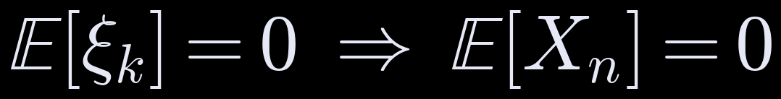
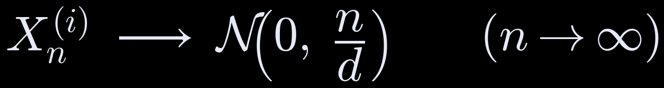
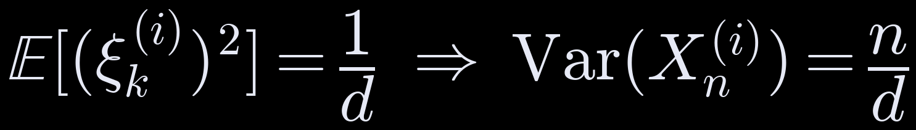
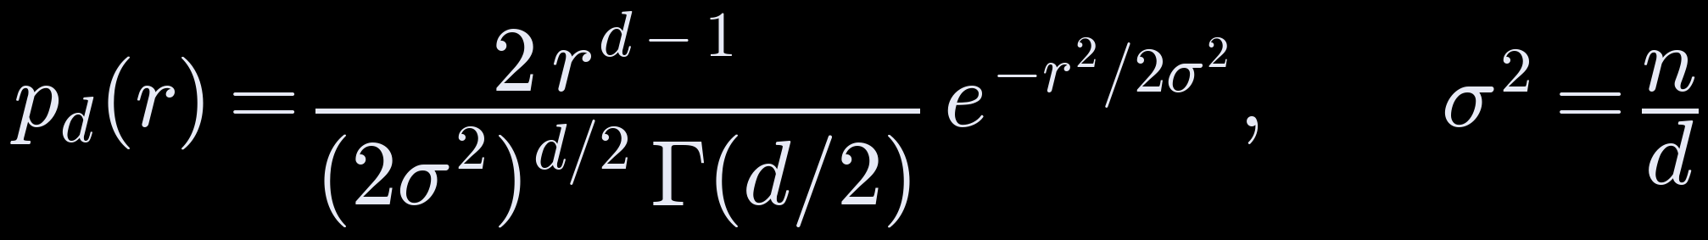
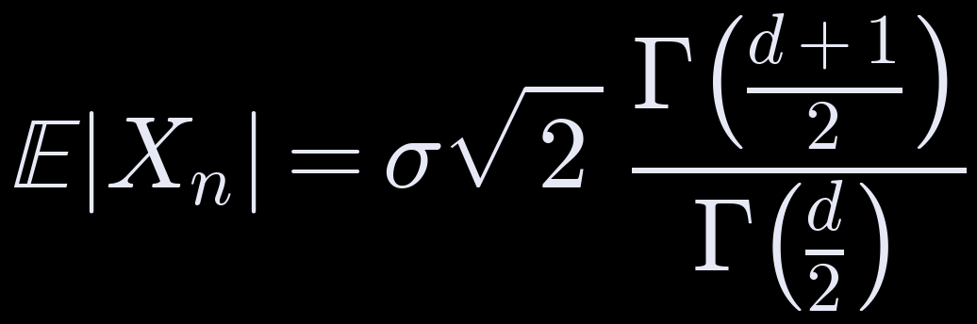
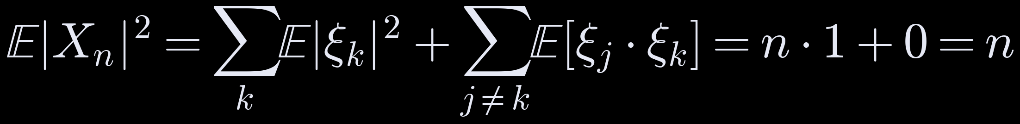
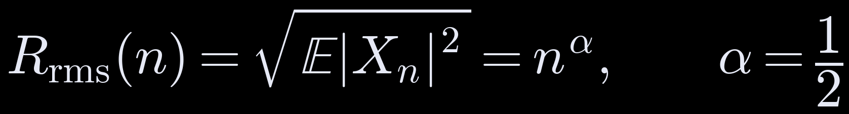
03 · EXACT THEORY
What theory predicts — derived directly from the model
1
Zero drift · by symmetry of the ± moves
⑤ Central Limit Theorem — the shape
Each coordinate is a sum of many small independent increments, so for large n:
2
Variance per coordinate · each axis is chosen with probability 1/d
The radius |Xₙ| of a d-dimensional Gaussian follows a chi distribution:
3
Mean squared displacement · cross terms vanish — the answer does not depend on d
d = 1 half-normal
4
Diffusive scaling · distance grows like √n: the signature of diffusion
d = 2 Rayleigh
d = 3 Maxwell–Boltzmann
Lattice parity: in 1D Xₙ ≡ n (mod 2) — handled with even-width bins
RANDOM WALK LABORATORY · IDC612 · IIT KANPUR
04 / 10
Notes:
Four exact results follow from linearity of expectation. (1) Mean is zero by symmetry. (2) Each axis is used with probability 1/d, so Var of one coordinate is n/d. (3) Expanding |X_n|^2, the diagonal terms each give 1 and the cross terms vanish by independence, so E|X_n|^2 = n in EVERY dimension. (4) Hence RMS distance = sqrt(n), exponent 1/2. (5) The CLT gives Gaussian coordinates and a chi-distributed radius; the special cases are half-normal, Rayleigh and Maxwell-Boltzmann.

Slide 5

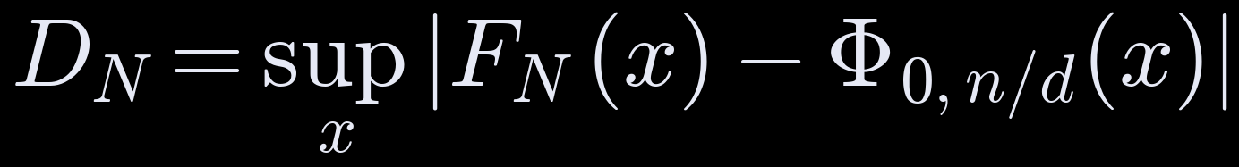
04 · SIMULATION METHOD
From model to evidence: the Monte Carlo pipeline
01 Random step
02 Parallel update
03 Return detection
04 Checkpoint stats
05 Compare to theory
›
›
›
›
choose axis i ∼ U{1..d}, sign ±1
advance all N walkers together, chunked in time
flag walkers with Xₜ = 0 at even t
⟨|X|²⟩, ⟨|X|⟩, Var Xᵢ every k steps
errors, 95 % CIs, fits, goodness-of-fit tests
Core algorithm · simulation engine
Estimators & statistical tests
def generate_steps(n_steps, d, rng):
axis = rng.integers(0, d, size=n_steps) # one axis
sign = rng.choice([+1, -1], size=n_steps) # +/-1, prob 1/2
steps = zeros((n_steps, d))
steps[arange(n_steps), axis] = sign # 2d moves
return steps
X = cumsum(steps, axis=0) # X_n = sum of xi_k
# ensemble: N walkers advanced together
for t in range(1, n + 1):
pos[walkers, axis[t]] += sign[t]
returns += all(pos == 0, axis=1) # Polya check
(continuity-corrected for lattice data)
▸ Distinct sites Sₙ via a hash set of visited points; first-passage times with right-censoring
▸ Fixed seeds ⇒ reproducible; memory O(N·d) by streaming statistics
▸ 94 automated tests: one axis per step, uniform axis choice, Var = n/d, E|X|² = n, seeds
RANDOM WALK LABORATORY · IDC612 · IIT KANPUR
05 / 10
Notes:
The engine draws, for every step and every walker, a random axis and a random sign. All N walkers are advanced simultaneously as one array, in chunks of time steps, so only the current positions are stored (memory O(N d)). At checkpoints we accumulate the MSD, mean distance and per-coordinate variance; at every step we flag walkers sitting at the origin. Statistics: MSD estimator with standard error and 95% CI, log-log least squares for alpha, and a Kolmogorov-Smirnov test against N(0, n/d). 94 unit tests verify the model rules and theoretical formulas.

Slide 6
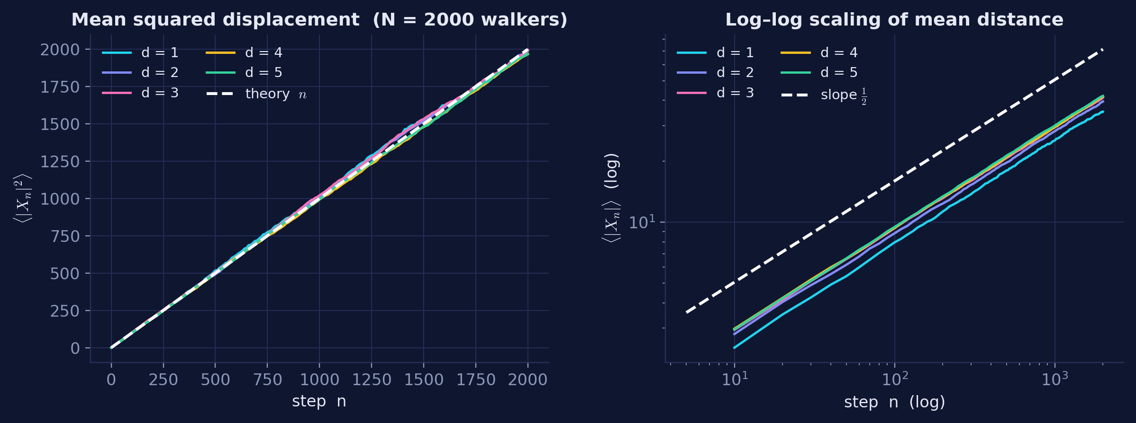
05 · RESULT I
Mean squared displacement: E|Xₙ|² = n in every dimension
n = 2,000 · N = 2,000 walkers
d
⟨|X|²⟩ ± SE
error
α̂
1D
1968 ± 62
1.6 %
0.505
2D
1989 ± 44
0.5 %
0.502
3D
1995 ± 36
0.2 %
0.498
4D
1970 ± 30
1.5 %
0.497
5D
1967 ± 28
1.7 %
0.500
theory: n = 2000 · all within 1.2 SE
≈ 1.00
α̂ ≈ 0.50
d-independent
slope of MSD vs n
diffusive exponent
total spread is the same
fitted 0.984 – 1.004 across d = 1…5
log–log fit: 0.497 – 0.505, R² > 0.999
variance n/d is shared among d axes — the sum is always n
RANDOM WALK LABORATORY · IDC612 · IIT KANPUR
06 / 10
Notes:
Left: ensemble MSD for d = 1 to 5 lies on the single theoretical line y = n. Right: the mean distance grows as n^(1/2) on log-log axes. The table gives the final MSD with standard errors: every dimension agrees with n = 2000 within about one standard error, and the fitted exponent is 0.50 to within 0.005. Key insight: going to higher dimension does not make the walk spread faster; it only splits the same total variance n across more axes.

Slide 7
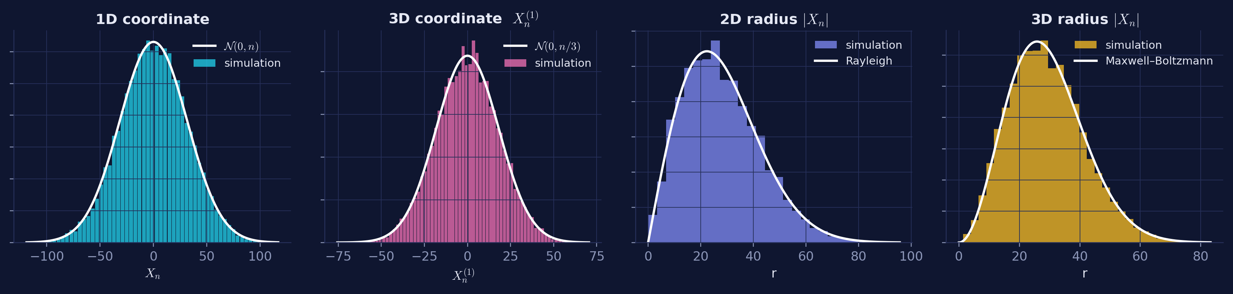
06 · RESULT II
Distributions: the Central Limit Theorem in action
n = 1,000 steps · N = 20,000 walkers · white curves are exact theory, not fits
Coordinate variance
Mean radius (Γ formula)
Goodness of fit
Lattice subtlety
1D: 994 vs n = 1000
3D: 332.7 vs n/3 = 333.3
2D: 27.94 vs 28.02
3D: 29.03 vs 29.13
KS p = 0.18 (1D), 0.78 (3D)
χ² p = 0.39, 0.72 → Gaussian not rejected
A naive KS test rejects at large N because walk positions are integers.
Correcting for the lattice step removes this artefact.
RANDOM WALK LABORATORY · IDC612 · IIT KANPUR
07 / 10
Notes:
Histograms are the simulation, white curves are the exact limiting densities with no fitted parameters. Each coordinate is Gaussian with variance n/d, and the radius follows the chi distribution: Rayleigh in 2D and Maxwell-Boltzmann in 3D. Variances and mean radii agree to better than 0.5%. A subtle point: with 20,000 samples, a raw KS test against a continuous Gaussian rejects simply because walk positions are integers (and in 1D have fixed parity). After a lattice continuity correction, p = 0.18 and 0.78, and a binned chi-square test gives p = 0.39 and 0.72: the Gaussian is not rejected.

Slide 8
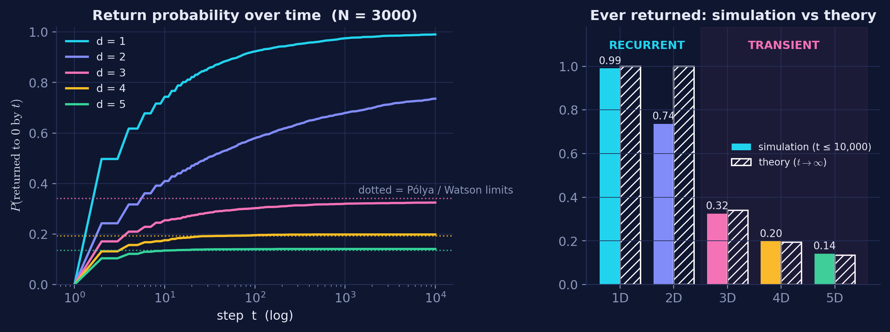
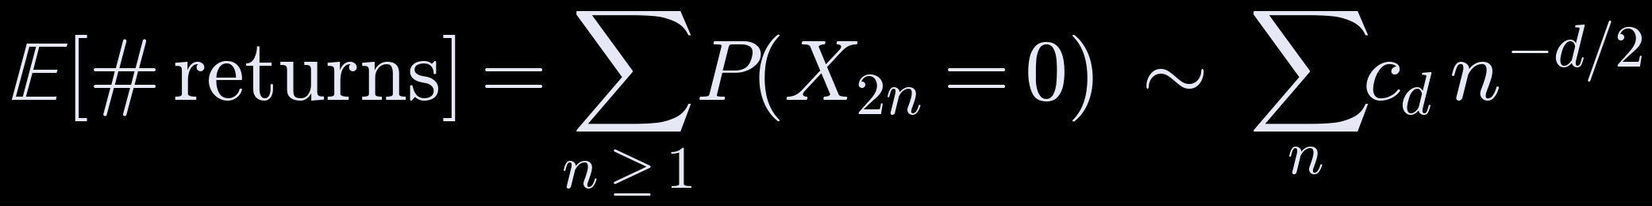
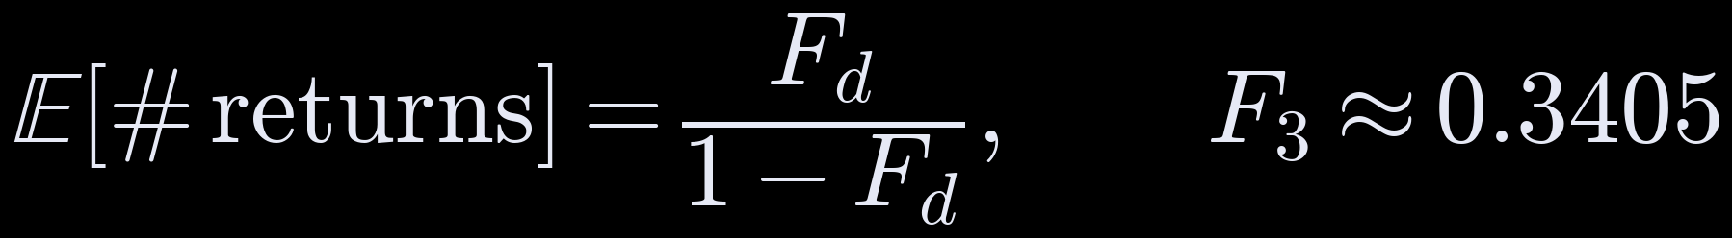
07 · RESULT III
Pólya's theorem: recurrent for d ≤ 2, transient for d ≥ 3
Theory · Pólya (1921)
Will the walker ever come back to the origin?
P(X₂ₙ = 0) ∼ c_d n^(−d/2) since after 2n steps the walk is spread over ∼ n^(d/2) sites
F_d = probability of ever returning; known values F₃ ≈ 0.3405, F₄ ≈ 0.1932, F₅ ≈ 0.1351 (Watson integrals)
1D
2D
3D
4D
5D
0.990
0.736
0.325
0.198
0.141
“A drunk man will find his way home, but a drunk bird may get lost forever.”
— Shizuo Kakutani
theory 1
theory 1
theory 0.3405
theory 0.1932
theory 0.1351
RECURRENT
RECURRENT
TRANSIENT
TRANSIENT
TRANSIENT
Finite horizon t ≤ 10⁴: in 2D the approach to 1 is only logarithmic, 1 − P ∼ π / ln t, so 0.74 < 1 is expected.
RANDOM WALK LABORATORY · IDC612 · IIT KANPUR
08 / 10
Notes:
Polya's question: does the walk surely return? The expected number of returns is the sum of P(X_2n = 0), which behaves like n^(-d/2). That series diverges for d = 1, 2 (recurrent) and converges for d >= 3 (transient). In the plot, 1D approaches 1 quickly, 2D creeps up only logarithmically, and 3D, 4D, 5D saturate exactly at the Watson constants shown dotted: 0.325 vs 0.3405, 0.198 vs 0.193, 0.141 vs 0.135. Remember a finite simulation can estimate but never prove an infinite-time statement.

Slide 9
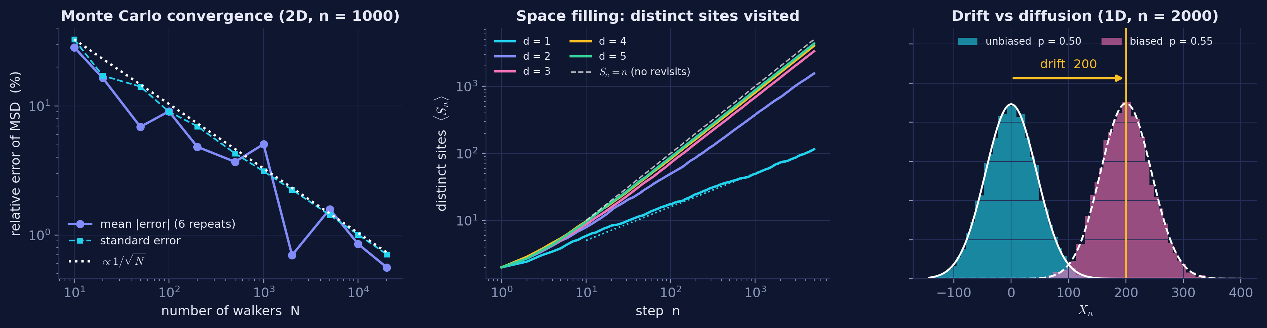
08 · RESULT IV
Monte Carlo convergence, space-filling and drift
Monte Carlo error ∝ 1/√N
Distinct sites visited Sₙ
Biased walk p = 0.55
Fitted log–log slope -0.49 (theory −½)
Error 28 % at N = 10 → 0.56 % at N = 20,000
100× more walkers ⇒ 10× smaller error
d ≥ 3: Sₙ ≈ (1 − F_d) n — transience ⇒ few revisits
3D 3336 vs 3298 · 4D 4024 vs 4034 · 5D 4323 vs 4324
1D: 115 vs √(8n/π) = 113; 2D grows like n / ln n
Mean 198.8 vs n(2p−1)/d = 200
Variance 1999 vs 4np(1−p) = 1980
Drift ∝ n overtakes diffusion ∝ √n
RANDOM WALK LABORATORY · IDC612 · IIT KANPUR
09 / 10
Notes:
Left: the relative error of the MSD estimate falls with a log-log slope of about -0.49, the 1/sqrt(N) law of Monte Carlo. Middle: distinct sites visited. In 1D the walk keeps revisiting, S_n ~ sqrt(8n/pi); in d >= 3 it is transient, so S_n is linear with slope equal to the escape probability 1 - F_d, matching to within about 1%. Right: adding a bias p = 0.55 shifts the distribution by n(2p-1)/d = 200 while the width stays about sqrt(n): drift grows like n, diffusion only like sqrt(n).

Slide 10
09 · CONCLUSIONS
What we established
Key findings
Limitations
✓
E|Xₙ|² = n holds for every d = 1…5
▸ A finite simulation can estimate, but never prove, infinite-time theorems
▸ Monte Carlo noise; uncertainty shrinks only as 1/√N
▸ 4D / 5D can only be visualised through 2-D projections
▸ CLT is asymptotic: finite-n and lattice corrections remain
errors ≤ 1.7 %, all within 1.2 standard errors
✓
Diffusive scaling R ∼ n^½
fitted α̂ = 0.497 – 0.505
✓
CLT shapes confirmed
Gaussian coordinates N(0, n/d); χ_d radii (Rayleigh, Maxwell)
Future work
✓
Pólya transition at d = 3
Self-avoiding walks · Lévy flights (α ≠ ½) · walks on graphs and networks · exact return probabilities via Green's functions
3D return 0.325 vs 0.3405; 1D/2D keep climbing towards 1
✓
Monte Carlo error ∝ 1/√N
measured slope -0.49
References
Pólya (1921) Math. Ann. 84 · Watson (1939) Q. J. Math. 10
Feller (1968) Probability Theory, Vol. 1 · Spitzer (1964)
Lawler & Limic (2010) Random Walk: A Modern Introduction
Simple microscopic randomness → precise, predictable macroscopic laws
RANDOM WALK LABORATORY · IDC612 · IIT KANPUR
10 / 10
Notes:
Summary: all five predictions were reproduced quantitatively, each within Monte Carlo error. Limitations: finite horizons, statistical noise, projections for high dimensions, and asymptotic approximations. Natural extensions are self-avoiding walks, Levy flights with anomalous scaling, and walks on networks. Thank you - happy to take questions.

