Slide 1
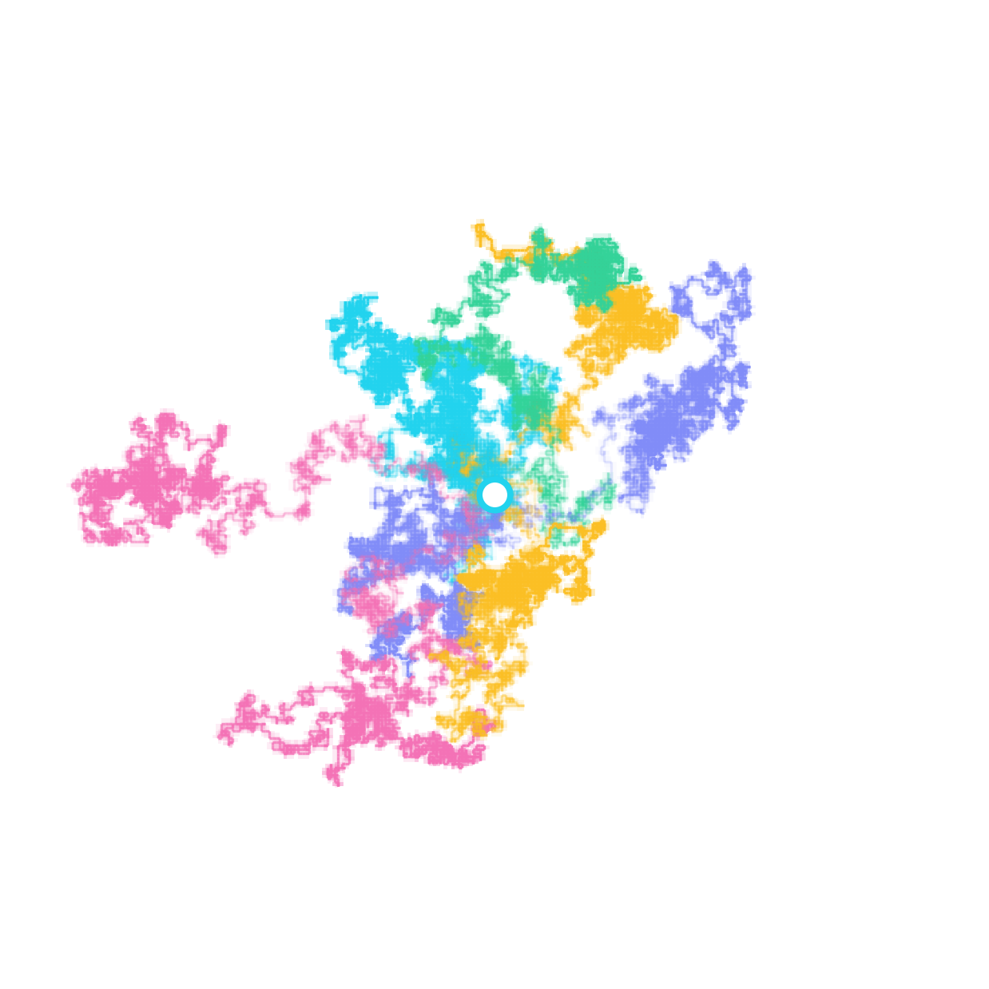
Random Walk
Laboratory
Simulation, results and implemented features
Subhankar | IDC612 | IIT Kanpur
1 / 10
Notes:
Current project: React and Three.js frontend, FastAPI backend, NumPy simulation engine. Source: frontend/src/App.jsx; backend/main.py; src/simulation/. Cover image: presentation/assets/hero_walks.png.

Slide 2
How one walk is generated
Start at zero. At each step, choose one axis and move +1 or -1.
d: number of dimensions | rng: random-number generator
axis = rng.integers(0, d, size=n_steps)
direction = rng.choice([1, -1], size=n_steps)
steps = np.zeros((n_steps, d))
steps[np.arange(n_steps), axis] = direction
path = np.cumsum(steps, axis=0)
Only one coordinate changes per step. The same rule works from 1D to 5D.
2 / 10
Notes:
Source: src/simulation/random_walk.py, generate_steps and simulate_walk. Code is a shortened equivalent of the existing implementation; names axis and direction replace coord_idx and directions. np.cumsum forms the path after the starting point.

Slide 3
All ensemble walkers are calculated
Each row of positions belongs to one walker. Every row is updated at every step.
N: number of walkers | chunk: steps processed together
axis = rng.integers(0, d, size=(chunk, N))
direction = rng.integers(0, 2, size=(chunk, N)) * 2 - 1
positions[np.arange(N), axis[t]] += direction[t]
Python + NumPy calculate positions and statistics.
React + Three.js display the results and selected paths.
Displayed sample walkers are generated separately from the ensemble.
3 / 10
Notes:
Source: src/simulation/ensemble.py, simulate_ensemble. Shortened code preserves the chunked array update; t is the local step within a chunk. frontend/src/App.jsx sends separate simulate and ensemble requests. Visual sample paths are not a subset of the statistical ensemble.

Slide 4
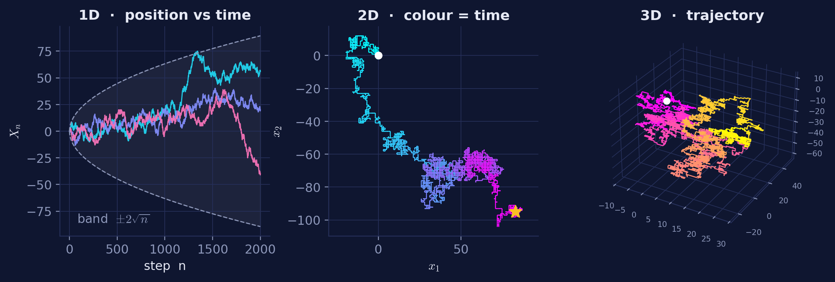
Paths and coordinate views
For 4D and 5D, choose any three coordinates for the 3D view.
All coordinates still contribute to distance and statistics.
4 / 10
Notes:
Sources: presentation/assets/trajectories.png; frontend/src/components/WalkerCanvas.jsx; frontend/src/components/Controls.jsx. The asset shows example 1D-3D paths, not a capture of the latest web UI. Current 4D/5D views allow any ordered selection of three distinct coordinates.

Slide 5
Mean squared displacement results
MSD = average squared distance from the starting point.
Saved run | 2,000 steps | 2,000 walkers | Expected MSD: 2,000
Dimension | Measured MSD | Error
1D | 1,968 | 1.6%
2D | 1,989 | 0.5%
3D | 1,995 | 0.2%
4D | 1,970 | 1.5%
5D | 1,967 | 1.7%
The measured values were close to the expected value in all five dimensions.
5 / 10
Notes:
Source: presentation/assets/results.json, msd. Saved experiment: 2,000 walkers, 2,000 steps, dimensions 1-5. Values are rounded for readability. MSD is the mean of the sum of squared endpoint coordinates; the expected value is the step count for this unit lattice walk.

Slide 6
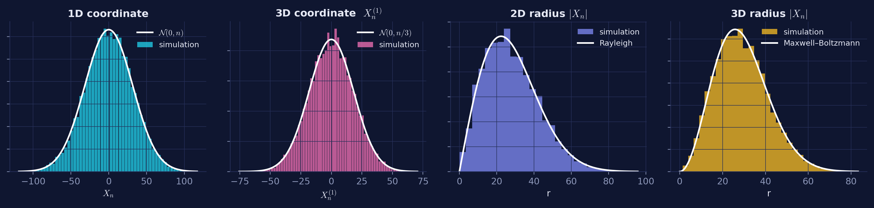
Distributions of final positions
Each histogram uses the final positions of all ensemble walkers.
Coordinate values cluster around zero. Distance from the origin is always non-negative.
Saved run | 1,000 steps | 20,000 walkers | Curves: theoretical approximations
6 / 10
Notes:
Source: presentation/assets/distributions.png and results.json, dist. Saved experiment: 1,000 steps and 20,000 walkers. The theoretical curves are continuous large-step approximations, not exact finite-step lattice probabilities. Raw KS test conclusions from the original deck are intentionally omitted.

Slide 7
Returns to the starting point
Count a return when every coordinate becomes zero again.
3,000 walkers | 10,000 steps per walker
Dimension | Walkers that returned at least once
1D | 99.0%
2D | 73.6%
3D | 32.5%
4D | 19.8%
5D | 14.1%
Returns were less common in higher dimensions during this run.
A finite run cannot tell whether a walker will return much later.
7 / 10
Notes:
Source: presentation/assets/results.json, rec. 3,000 walkers, 10,000 steps per walker. Percentages are finite-run observations of at least one return. They are not proof of infinite-time recurrence. Return detection checks that every coordinate equals zero at a step.

Slide 8
Checking the ensemble data
The evidence ZIP contains one endpoint row for every ensemble walker.
r2 = np.sum(positions.astype(float)**2, axis=1)
msd = np.mean(r2)
Average the exported R_squared column to reproduce the MSD.
Select a walker ID to inspect its path and check its endpoint.
All-path export reproduces every step using the recorded seed.
8 / 10
Notes:
Sources: src/simulation/ensemble.py, _record; src/analysis/statistics.py, compute_ensemble_statistics; frontend/src/App.jsx; backend/main.py, inspect_ensemble_walker and export_ensemble. Code is a shortened equivalent of the MSD calculation. Full ensemble paths are replayed from the recorded seed for export rather than retained during a normal run.

Slide 9
Watching the estimate converge
3D | 2,000 steps | Same ensemble, seed 42 | Expected MSD: 2,000
Walkers included | MSD estimate | Error
10 | 1,527.80 | 23.61%
50 | 2,526.16 | 26.31%
200 | 2,161.83 | 8.09%
500 | 2,115.19 | 5.76%
2,000 | 2,007.82 | 0.39%
The final error was 0.39%. Error can rise before it falls.
Play, pause, reset or choose an exact walker count in the Convergence tab.
9 / 10
Notes:
New reproducible example generated with backend.main.ensemble: dimension=3, n_steps=2000, n_walkers=2000, seed=42. Values use prefixes of the same completed ensemble, preserving walker-ID order. Raw values are saved in presentation/.build/simple-deck/demo-results.json. UI implementation: frontend/src/components/ConvergencePanel.jsx and lib/ensemble.js. Uncertainty is estimated by sample standard error; the normal interval is approximate.

Slide 10
Building distributions live
Add walkers from the same completed ensemble, at a fixed final time.
Choose a coordinate or distance from the origin.
Play one walker at a time, or use fast playback.
Bins stay fixed; the amber bar marks the last added walker.
The endpoint cloud follows the same included walker count.
Open the bin-count table or export a CSV to check how the histogram was formed.
10 / 10
Notes:
Sources: frontend/src/components/LiveDistributionPanel.jsx; EnsembleCountControls.jsx; lib/ensemble.js, prefixHistogram. Distributions use endpoint prefixes at a fixed final time; they do not advance individual walker trajectories in time. Counts use fixed backend histogram edges and density normalization by count times bin width. Endpoint cloud, distributions and convergence share the included walker count. CSV export includes bin boundaries, counts, densities and included count.

