Slide 1
Netflix Dataset Analysis
Uncovering Trends in Content Type, Duration, Ratings, and More

Slide 2
Objective
Perform exploratory data analysis (EDA) on Netflix content
Understand patterns in content type, ratings, durations, release trends, and more
Visualize findings using Python and data visualization libraries

Slide 3

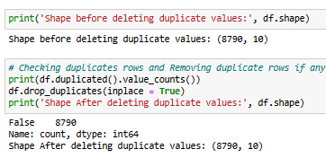
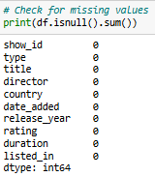
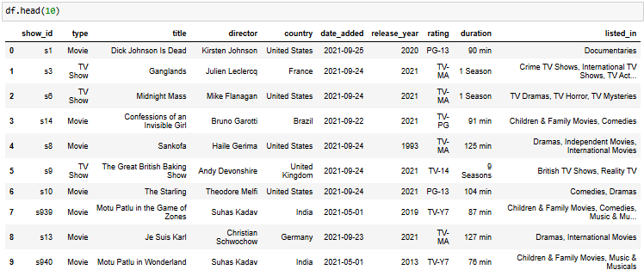
Dataset Overview
Loaded using pandas Duplicates removed
Missing values checked date_added converted to datetime
head(10)

Slide 4
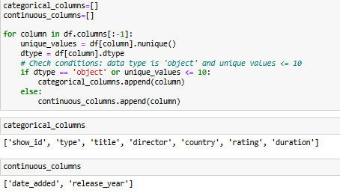
Column Classification
Categorical Columns: show_id, type, title, director, country, rating, duration
Continuous Columns: date_added, release_year

Slide 5
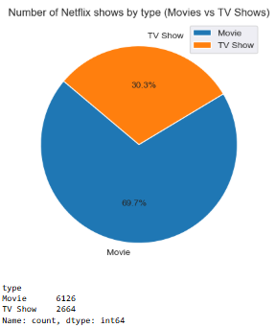
Content Type Distribution
Chart: Pie Chart – Number of Netflix Shows by Type (Movies vs TV Shows)
Observation: The majority of titles on Netflix are Movies, accounting for 69.7%, while TV Shows make up 30.3%

Slide 6
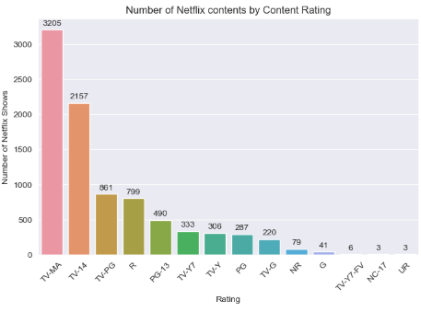
Rating Distribution
Chart: Column chart of content ratings
Observation: TV-MA most common, followed by TV-14 and TV-PG

Slide 7
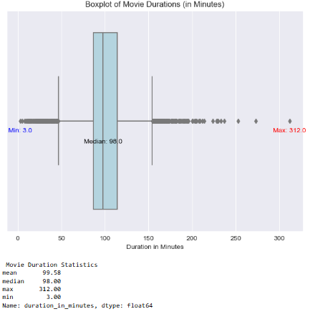
Movie Duration Analysis
Chart: Boxplot of Movie Duration (in min)
Observation: The duration of Netflix movies shows significant variation, with a mean of 99.58 minutes, a maximum of 312 minutes, and a minimum of 3 minutes. The median duration is 98 minutes, indicating that most movies are around the 1.5-hour mark.

Slide 8
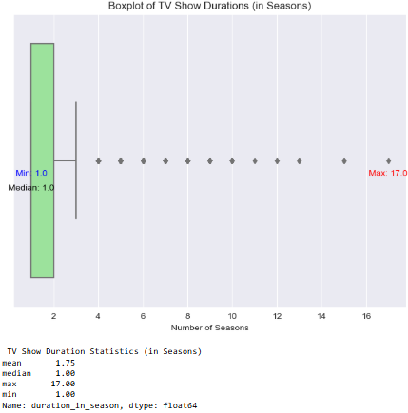
TV Show Duration Analysis
Chart: Boxplot of TV Show Duration (in seasons)
Observation: The duration of TV shows on Netflix varies widely, with a mean of 1.75 seasons, a maximum of 17 seasons, and a minimum of 1 season. The median duration is 1 season, indicating most TV shows are relatively short.

Slide 9
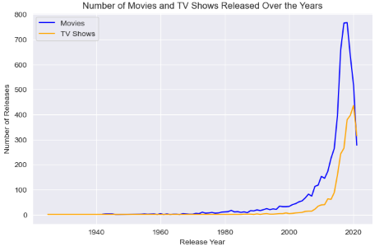
Trend Analysis: Movies and TV Shows Released Over the Years
Chart: Line Plot – Movies & TV Shows Released Over Time
Observation: The top 5 years with the highest number of releases were during 2016–2020, while the bottom 6 years with the least number of releases were 1946, 1947, 1959, 1961, 1963, and 1966. The top 5 years for TV show releases were 2017–2021, while the bottom 5 years with the least releases were 1963, 1967, 1979, 1981, and 1989.

Slide 10
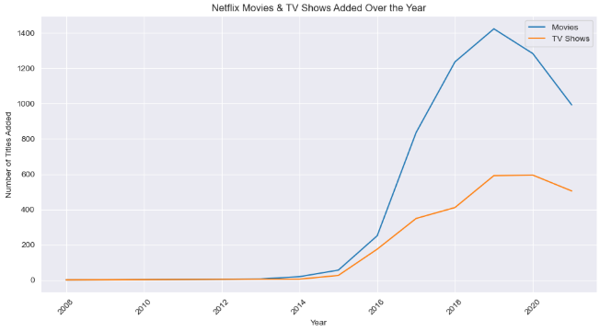
Trend Analysis: Netflix Movies & TV Shows Added Over the Year
Chart: Line Plot – Yearly Additions of Movies & TV Shows on Netflix
Observation: From 2017 to 2021, Netflix experienced significant growth in both movies and TV shows added. However, there was a decline in movie additions between 2008 and 2013, and TV shows saw a steady drop from 2003 to 2016, with a sharp dip in 2008.

Slide 11
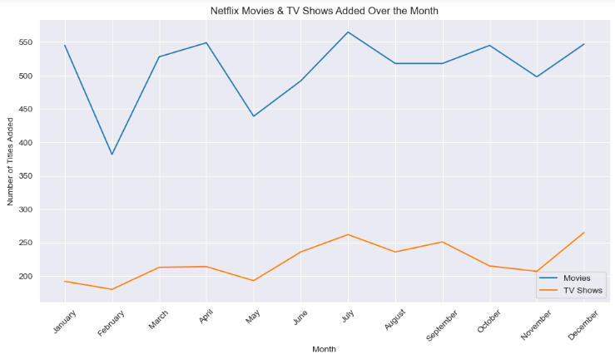
Trend Analysis: Netflix Movies & TV Shows Added Over the Month
Chart: Line Plot – Monthly Additions of Movies & TV Shows on Netflix
Observation: Netflix sees a seasonal trend in its content additions. Movies are typically added in higher numbers during July and April, while additions drop in February and May. Similarly, TV shows experience an increase in December and July, but see a decline in February and January.

Slide 12
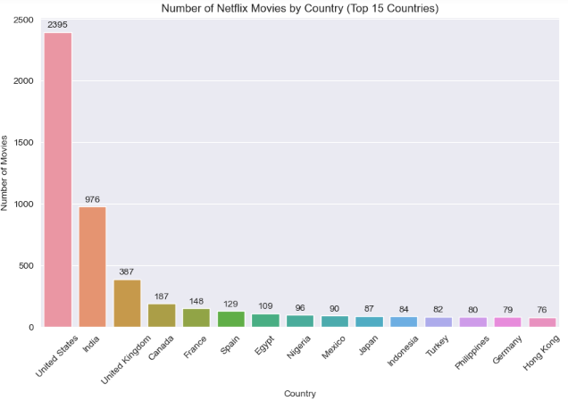
Top Countries Producing the Most Netflix Movies
Chart: Column chart – Number of Netflix Movies by Country (Top 15)
Observation : The USA produces the highest number of Netflix movies, followed by India and the UK.

Slide 13
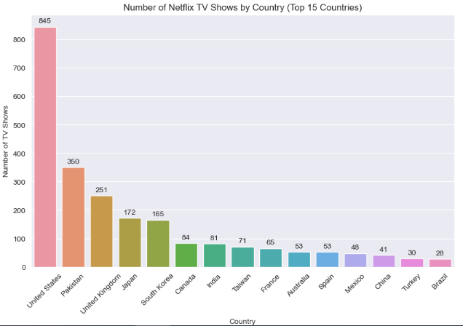
Top Countries Producing the Most Netflix TV Shows
Chart: Column chart – Number of Netflix TV Shows by Country (Top 15)
Observation : The USA leads in producing the highest number of Netflix TV Shows, followed by Pakistan and the UK.

Slide 14
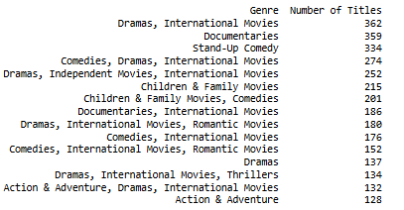
Top 15 Popular Genres or Categories for Movies on Netflix
• Observation: Dramas, International Movies, Documentaries and Stand-Up Comedy are the most dominant genres.

Slide 15
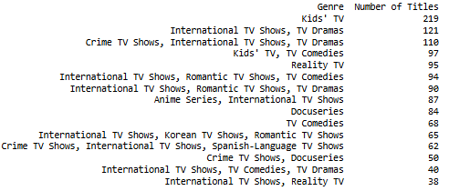
Top 15 Popular Genres or Categories for TV Shows on Netflix
• Observation: Kids' TV, International TV Shows, TV Dramas, Crime TV Shows and International TV Shows are the most dominant categories.

Slide 16
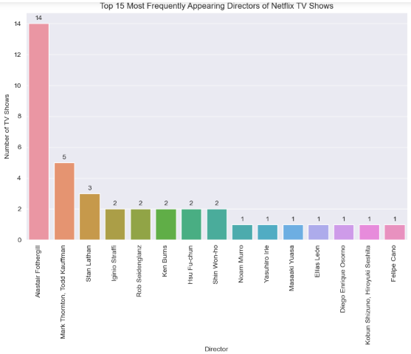
Top Directors Producing the Most Netflix TV Shows
Chart: Column Chart – Frequency of Directors in Netflix TV Shows
Observation : The top director with the most Netflix TV Shows is Alastair Fothergill leads in producing Netflix TV Shows, followed by Mark Thornton, Todd Kauffman, and Stan Lathan.

Slide 17
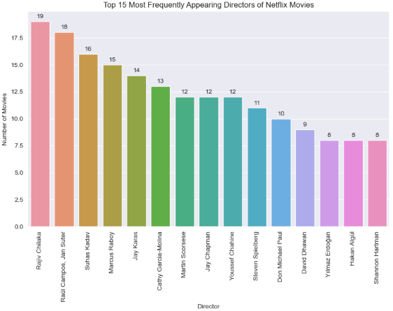
Top Directors Producing the Most Netflix Movies
Chart: Column Chart – Frequency of Directors in Netflix Movies
Observation : The top director with the most Netflix Movies is Rajiv Chilaka leads in producing Netflix Movies, followed by Raul Campos, Jan Suter, and Suhas Kadav.

Slide 18
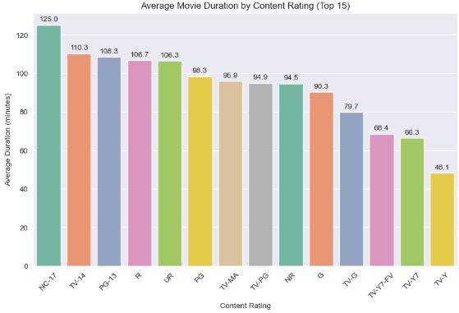
Average Duration by Movie Rating
Chart: Column Chart – Average Movie Duration by Content Rating
Observation : The content rating with the highest average movie duration is NC-17, followed by TV-14 and PG-13.

Slide 19
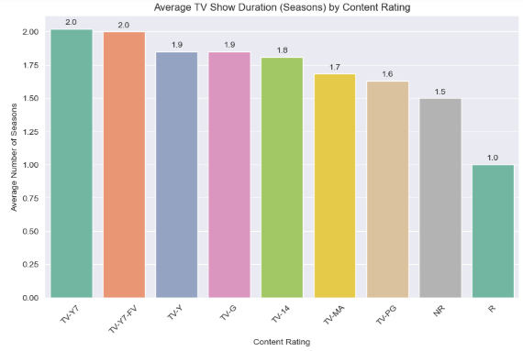
Average Duration by TV Show Rating
Chart: Column Chart – Average TV Show Duration by Content Rating
Observation : The content rating with the highest average duration is TV-17, followed by TV-Y7-FV and TV-Y.

Slide 20

Word Cloud – Movie Titles
Observation: Common themes in movie titles include words like Christmas, Love, Movie, Life, and Man.

Slide 21
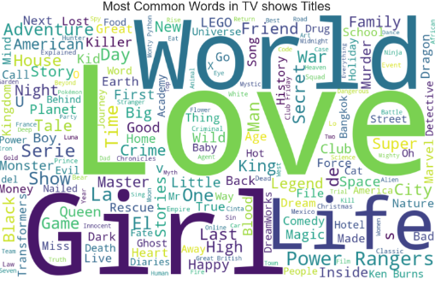
Word Cloud – TV shows Titles
Observation: Common themes in TV show titles include words like World, Love, Girl, and Life.

Slide 22
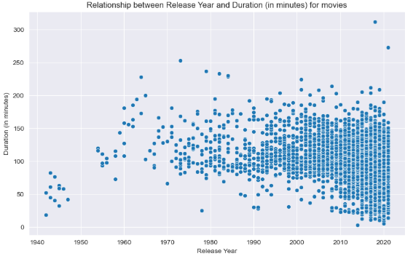
Relation between duration and release year – Movies
• Chart: Scatter Plot – Release Year vs. Duration (in Minutes)
• Observation: The number of longer movies has noticeably increased after the year 2000, showing a trend toward extended runtimes in recent years.

Slide 23
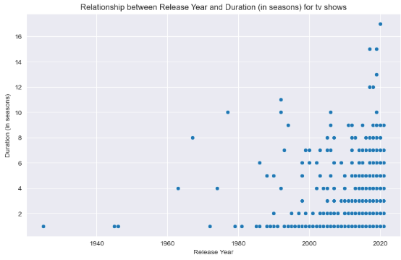
Relation between duration and release year – TV shows
• Chart: Scatter Plot - Release Year vs. Duration (in Seasons)
• Observation: The number of longer TV shows has increased significantly after 2010, indicating a trend toward extended series in recent years.

Slide 24
Final Observations & Storyline
Netflix’s content library is heavily skewed toward Movies, which make up nearly 70% of all titles, while TV Shows account for the remaining 30%. Among all content, TV-MA emerges as the most common rating, suggesting a preference for mature themes, followed by TV-14 and TV-PG.
When analyzing durations, Netflix Movies typically run around 98–100 minutes, though some stretch up to 312 minutes. TV Shows, on the other hand, are mostly short-form, with a median duration of just 1 season, though a few span up to 17 seasons.
From a historical perspective, Netflix saw a surge in new content releases between 2016 and 2021, with the USA dominating production in both Movies and TV Shows. India and the UK also lead in Movies, while Pakistan ranks surprisingly high for TV Shows. On a monthly cycle, Movie additions peak in July and April, while TV Shows spike in December and July, reflecting seasonal content strategies.
Genre-wise, Dramas, International Films, Documentaries, and Stand-Up Comedy dominate the Movie catalog, while Kids' TV, International TV, Dramas, and Crime Shows lead in the TV domain. Common title themes for Movies include Christmas, Love, and Life, while World, Girl, and Love are frequent in TV titles.
Looking at key contributors, Alastair Fothergill leads as the top director for TV Shows, while Rajiv Chilaka tops the Movie director list. Interestingly, NC-17-rated movies have the longest average durations, while TV-17-rated shows run the longest on average.
Finally, over time, there’s a clear upward trend in the duration of both Movies (post-2000) and TV Shows (post-2010), reflecting Netflix’s shift toward longer, more in-depth storytelling as viewer demand evolves.

