Slide 1
Laptop Price Analysis & Machine Learning
Exploratory Data Analysis | Regression & Classification | ML Model

Slide 2
Objective
Perform exploratory data analysis (EDA) on laptop dataset
Understand how features like RAM, Storage, and Display influence pricing
Build machine learning models to predict price and classify price categories
Visualize key insights using graphs and statistical tests

Slide 3
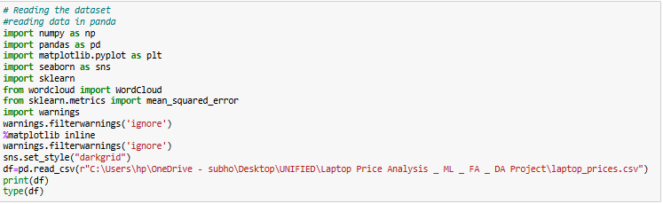
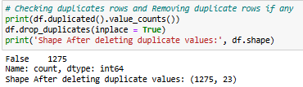

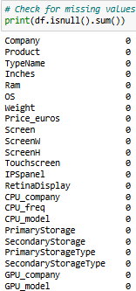
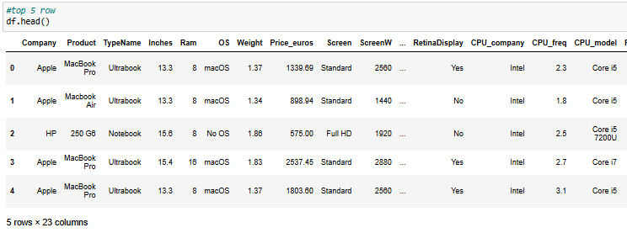
Dataset Overview
Loaded using pandas Duplicates removed
Number of rows and columns present
Missing values checked
head(5)

Slide 4
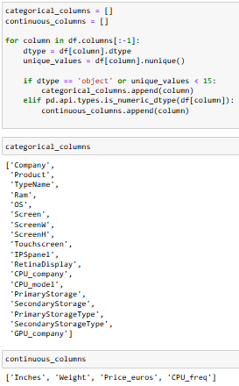
Column Classification
Categorical Columns: Company, Product, TypeName, Ram, OS, Screen, ScreenW,
ScreenH, Touchscreen, IPSpanel, RetinaDisplay, CPU_company, CPU_model,
PrimaryStorage, SecondaryStorage, PrimaryStorageType, SecondaryStorageType,
GPU_company
Continuous Columns: Inches, Weight, Price_euros, CPU_freq

Slide 5
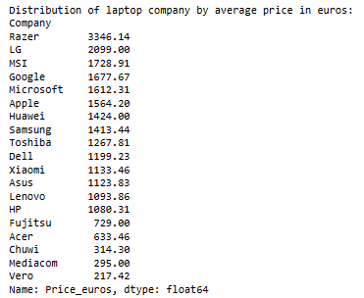
Average Laptop Price (€) by Company
Observation: Razer laptops have the highest average price (€3346.14), indicating a premium positioning. In contrast, brands like Mediacom, Vero, and Chuwi offer the most budget-friendly options, averaging below €320.

Slide 6
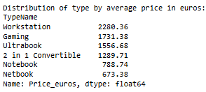
Average Price (€) by Laptop Type
Observation: Workstations and Gaming laptops command the highest average prices, reflecting their high-performance specifications. In contrast, Netbooks and Notebooks are the most affordable, catering to basic usage needs.

Slide 7
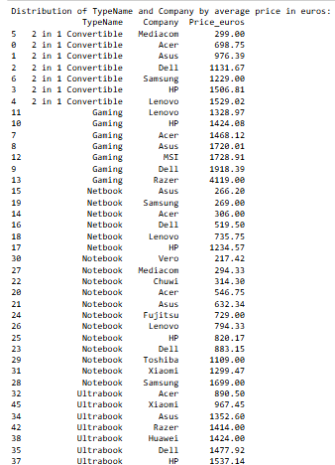
Combined Distribution: Type & Brand vs. Average Price (€)
Observation: 2 in 1 Convertibles and Netbooks offer more affordable options, while Gaming laptops, especially from Razer, command significantly higher prices. Ultrabooks and Workstations consistently show premium pricing across brands, indicating their high-end features.

Slide 8
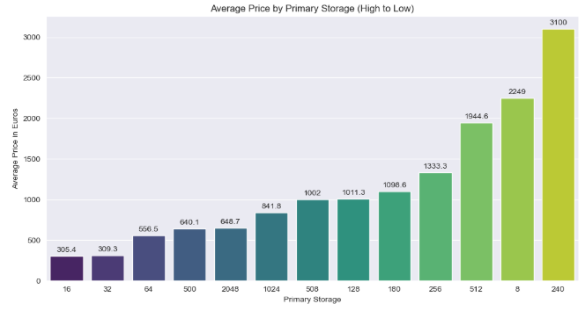
Primary Storage Option Offering the Best Value
Chart: Column chart of Average Laptop Price by Primary Storage Size (in Euros)
Observation: Primary storage options with lower capacities (16–64 GB) offer the best value, having significantly lower average prices. Conversely, higher storage options like 240 GB and 512 GB are priced much higher, with 240 GB showing an unusually steep price spike.

Slide 9

Impact of Retina Display on Laptop Pricing
Observation: Laptops with Retina Displays have a significantly higher average price (€1657.85) compared to non-Retina models (€1127.90). Statistical testing confirms this difference is significant (t = 3.569, p = 0.0024).

Slide 10

Top GPU Brands in High-End Laptops
Observation: Intel and Nvidia dominate the GPU market in high-end laptops, together accounting for over 94% of units. AMD holds a smaller share at just over 5%.

Slide 11
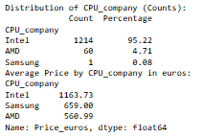
CPU Brand Distribution and Its Impact on Price
Observation: Intel dominates the CPU market with over 95% share and commands the highest average laptop price (€1163.73). AMD, while more affordable (€560.99), holds a much smaller market share.

Slide 12
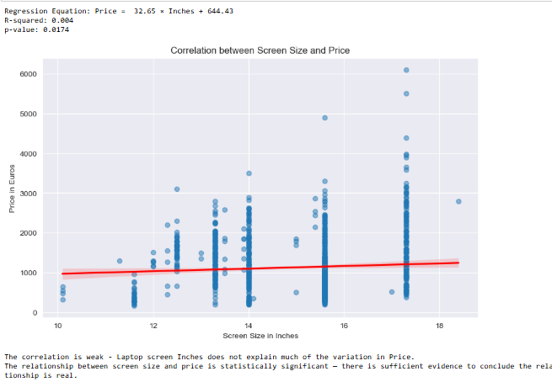
Correlation Between Screen Size and Price
Chart: Scatter plot with regression line showing correlation between Screen Size and Price
Observation : There is a weak positive correlation between screen size and price — larger screens tend to cost slightly more, but screen size alone doesn't strongly explain price variation.

Slide 13
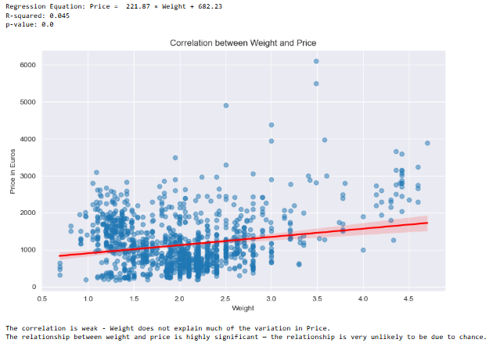
Relationship Between Laptop Weight and Cost
Chart: Scatter plot with regression line showing correlation between Laptop Weight and Price
Observation : There is a weak positive correlation between laptop weight and price — heavier laptops tend to cost slightly more, but weight alone does not significantly explain price variation.

Slide 14
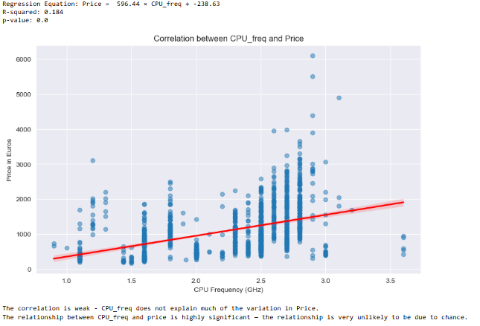
How CPU Frequency Affects Laptop Price
• Chart: Scatter plot with regression line showing correlation between CPU Frequency and Price
• Observation: There is a moderate positive correlation between CPU frequency (GHz) and laptop price. As CPU frequency increases, price tends to rise, suggesting that higher-performing processors are associated with more expensive laptops. However, CPU frequency alone does not fully explain price variation.

Slide 15
Effect of RAM and Storage on Price
• Observation: RAM has a strong positive impact on laptop price, while Primary Storage has a slight negative effect. The model explains about 56.7% of the price variation, indicating a moderate correlation.

Slide 16
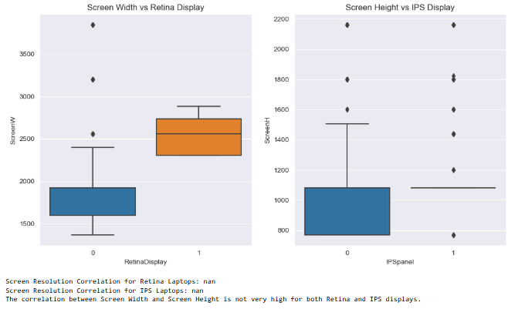
High-Resolution Screens with Retina and IPS Displays
Chart: The box plots and correlation analysis reveal insights into how Retina and IPS display technologies relate to screen resolution dimensions.
Observation : Laptops with Retina and IPS displays generally have higher screen resolutions, as shown by wider screen dimensions in box plots. However, the correlation between screen width and height is not consistently very high, indicating variability in aspect ratios.

Slide 17
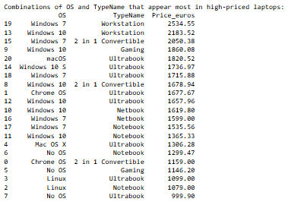
Top OS & Type Combinations in Premium Laptops
Observation : Premium laptops are mostly Ultrabooks, Workstations, and Gaming types paired with Windows 7/10 or macOS. Workstations with Windows and Ultrabooks with macOS or Windows have the highest average prices.

Slide 18

Price Impact of Touchscreen Laptops
Observation : Touchscreen laptops have a significantly higher average price (€1453.12) compared to non-touchscreen models (€1079.94). Statistical evidence (t = 6.149, p = 0.0) confirms this price difference is highly significant.

Slide 19
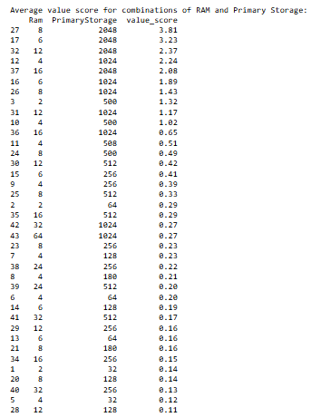
Best RAM and Storage Combinations for Value per Euro
Observation : Laptops with 8GB RAM and 2048GB (2TB) storage offer the best value per euro (value score: 3.81), followed by 6GB + 2TB (3.23) and 12GB + 2TB (2.37).Higher RAM and storage do not always guarantee better value — balance matters more than raw specs for price efficiency.

Slide 20
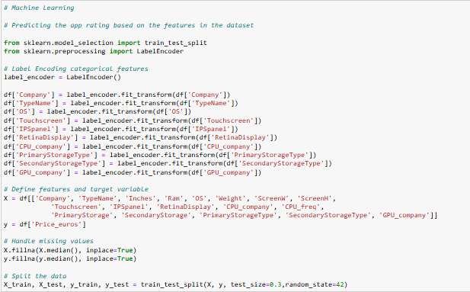
Machine Learning – Feature engineering

Slide 21
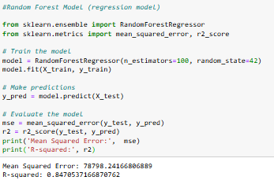
Random Forest Regression: Laptop Price Prediction
Observation: Random Forest Regression achieved high accuracy with R² = 0.85, explaining 85% of price variation.Mean Squared Error of ~78,798 indicates a reasonably good fit for predicting laptop prices.

Slide 22
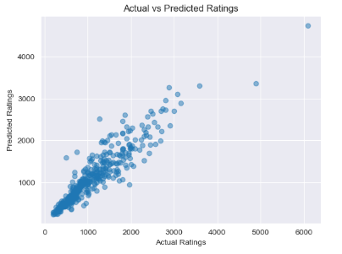
Actual vs. Predicted Laptop Prices
• Observation: The scatter plot shows how closely the predicted prices match the actual laptop prices. Ideally, points should lie along the diagonal, indicating accurate predictions.

Slide 23
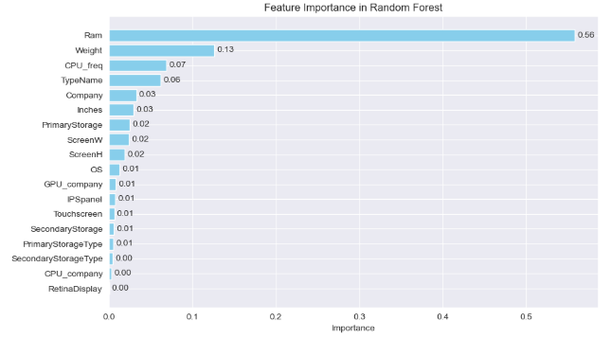
Most Influential Features in Random Forest Model
• Observation: RAM is the most influential feature in the model with an importance of 56%, followed by Weight (13%) and CPU Frequency (7%). These features play a key role in predicting the target variable accurately.

Slide 24
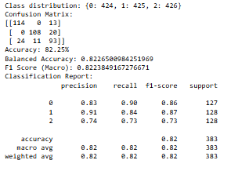
Random Forest Classification: Price Category Prediction
Observation: Random Forest Classification predicted laptop price categories with 82.25% accuracy and 0.82 macro F1-score.Performance was balanced across all three price classes with minimal misclassification.

Slide 25
Final Observations & Storyline (left)
Razer laptops average €3346.14, positioning them at the top of the premium market. In contrast, Mediacom, Vero, and Chuwi offer entry-level models under €320. Gaming and Workstation laptops are the priciest types, while Netbooks and Notebooks remain the most affordable.
RAM is the strongest price driver, with a 56% feature importance in prediction models. Laptops with 8GB RAM + 2TB storage offer the best value (score: 3.81), outperforming higher-spec options. Surprisingly, 240 GB storage shows a price spike despite mid-tier capacity.
Retina displays boost average prices to €1657.85 vs. €1127.90 for non-Retina models (p = 0.0024). Touchscreen laptops also cost more on average (€1453.12 vs. €1079.94; p = 0.0). These premium features drive up manufacturing costs and consumer price points.
Intel holds over 95% CPU share and dominates GPU use alongside Nvidia (combined 94%+). AMD trails in both markets, reflected in its lower average laptop price of €560.99. This shows a clear divide between high-performance and cost-effective computing segments.
Random Forest Regression achieved R² = 0.85, with RAM, CPU frequency, and weight as top predictors. Screen size and weight show weak price correlation, highlighting their limited impact. Overall, balanced mid-range specs deliver the best value in a price-sensitive market.

