Slide 1
Drugs, Side Effects and Medical Condition Analysis & Machine Learning
Exploratory Data Analysis | Regression & Classification | ML Model

Slide 2
Objective
Perform exploratory data analysis (EDA) on a drug side effects dataset
Understand how features like medical condition, drug class, and alcohol interaction influence overall side effect severity
Build regression models to predict numeric overall_score values
Build classification models to categorize side effect severity into Low, Medium, and High
Evaluate and compare model performance using metrics like accuracy, F1-score, and R²
Visualize key patterns and relationships using charts and confusion matrices

Slide 3
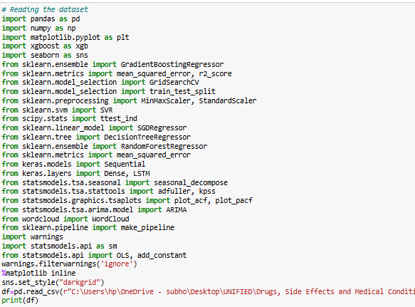

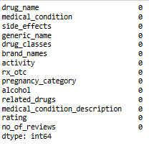
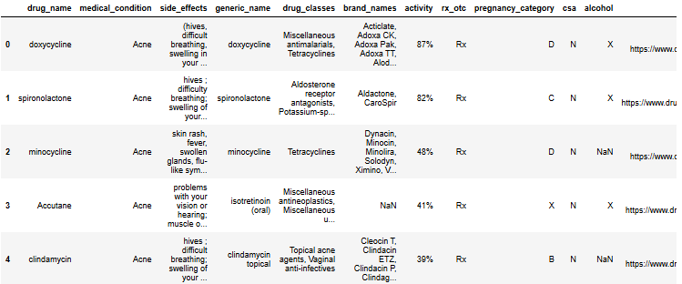
Dataset Overview
Loaded using pandas Duplicates removed
Missing values checked Number of rows and columns present

Slide 4
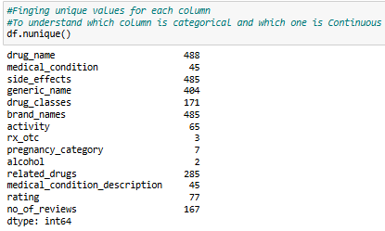
Unique values for each column

Slide 5
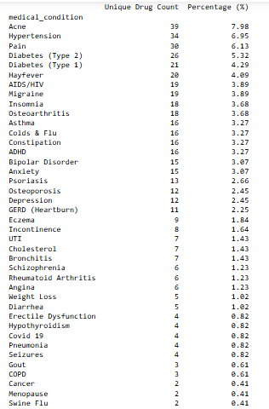
Medical Condition with the Most Unique Drugs
Observation: Acne leads with the highest number of unique drugs (39, 7.98%), followed by Hypertension (34, 6.95%) and Pain (30, 6.13%), indicating a greater variety of drug options available for treating these conditions.

Slide 6
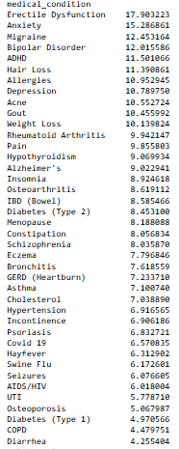
Average Overall Score by Medical Condition
Observation: Erectile Dysfunction has the highest average overall score (17.90), followed by Anxiety (15.29) and Migraine (12.45), indicating higher user satisfaction or effectiveness for drugs treating these conditions. Conversely, Cancer (2.54) and Stroke (3.01) have the lowest average scores, suggesting less favorable outcomes or user experiences.

Slide 7
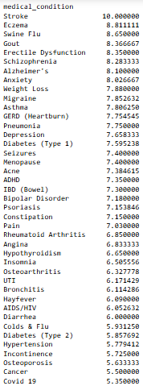
Average User Rating by Medical Condition
Observation: Stroke, Eczema, and Swine Flu have the highest average overall drug scores, suggesting high perceived effectiveness. In contrast, Cholesterol, Allergies, and Hair Loss have lower average scores, indicating potential gaps in treatment satisfaction.

Slide 8
Drugs with the Highest and Lowest Number of Reviews
Observation : Bisacodyl has the highest number of reviews (1,357), indicating widespread usage or user engagement. In contrast, Neomycin has only 1 review, suggesting limited feedback or niche usage.

Slide 9
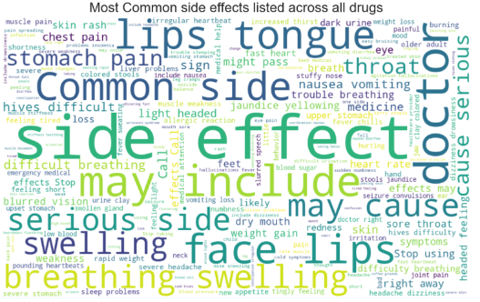
Most Commonly Reported Side Effects
Observation : The most frequently reported side effects include top lip and tongue irritation, stomach pain, serious side effects, and swelling of the face, lips, and difficulty breathing. These side effects highlight key areas for patient monitoring and caution when prescribing or using these medications

Slide 10
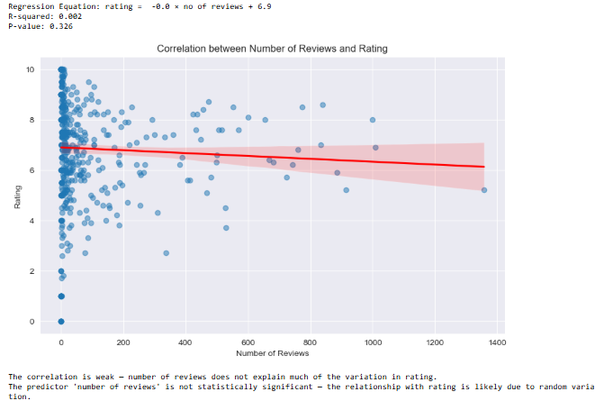
Correlation Between Number of Reviews and User Rating
Observation: There is no significant correlation between the number of reviews and drug rating (R² = 0.002, p = 0.326). This suggests that review volume does not meaningfully influence or reflect user ratings.

Slide 11

Distribution of Average Ratings by Prescription Type
Observation: Drugs available as both Rx/OTC have the highest average rating (6.97), slightly outperforming Rx-only (6.84) and OTC-only (6.69) drugs. This indicates that dual-availability drugs may offer a balance of accessibility and effectiveness, leading to higher user satisfaction.

Slide 12
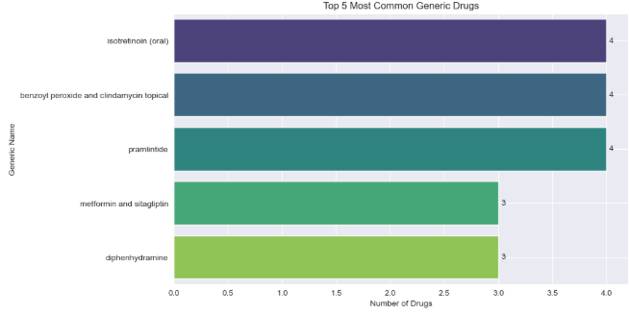
Top 5 Most Common Generic Drugs
Observation : The top generic drugs include Isotretinoin (oral), Benzoyl Peroxide and Clindamycin (topical), Pramlintide, Metformin and Sitagliptin, and Diphenhydramine. These drugs represent common treatments for conditions ranging from acne and diabetes to allergies and weight management.

Slide 13
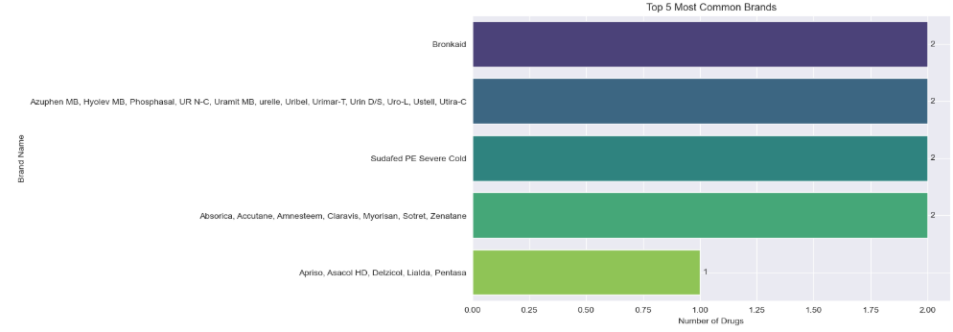
Top 5 Most Common Brand-Name Drugs
Observation : Among the top 5 most frequently occurring brand-name drugs, Bronkaid, Sudafed PE Severe Cold, and two other brands are each associated with 2 drugs, while the fifth brand group has 1 drug linked to it.

Slide 14
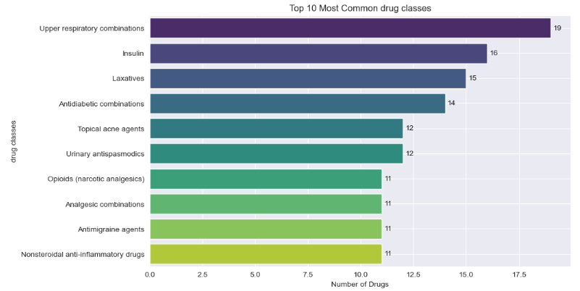
Top 10 Most common drug classes
• Observation: The most frequently occurring drug classes include Upper Respiratory Combinations, Insulin, Laxatives, Antidiabetic Combinations, and Topical Acne Agents. These reflect common treatment areas such as respiratory issues, diabetes management, gastrointestinal health, and dermatological conditions.

Slide 15
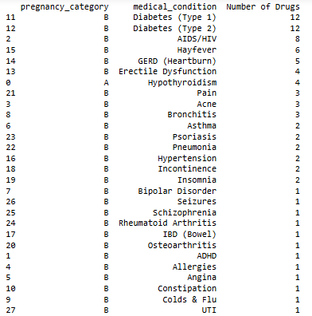
Drug Count by Medical Condition (Low-Risk Pregnancy)
• Observation: Diabetes (Type 1 and Type 2) tops the list with the highest number of low-risk pregnancy drugs (12 each), followed by AIDS/HIV and Hayfever. This indicates a strong pharmaceutical focus on managing chronic and infectious conditions safely during pregnancy.

Slide 16
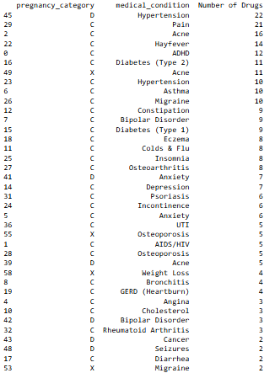
Drug Count by Medical Condition (High-Risk Pregnancy)
Observation : Hypertension and Pain lead with the highest number of high-risk pregnancy drugs (22 and 21 respectively), followed by Acne, Hayfever, and ADHD. This reflects the challenges in safely managing both chronic and common conditions during pregnancy with potential risks.

Slide 17
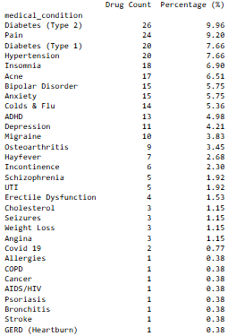
Drugs with Alcohol Restriction
Observation : The majority of drugs with alcohol restrictions are for Diabetes (Type 2), Pain, Diabetes (Type 1), and Hypertension, together making up over 34% of restricted drugs. This highlights the importance of caution in alcohol consumption for patients managing chronic conditions.

Slide 18
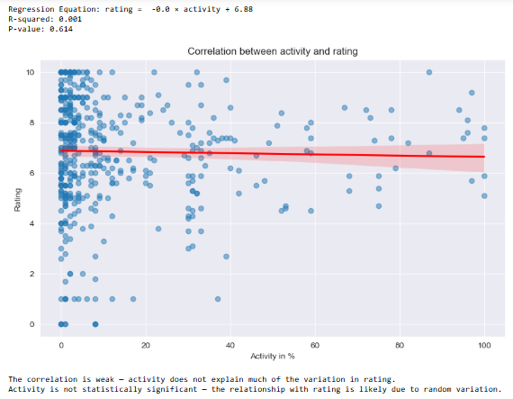
Relationship Between Drug Activity % and User Rating
Observation : There is no significant correlation between drug activity percentage and user rating (R² = 0.001, p = 0.614). This indicates that drug activity levels do not meaningfully affect user satisfaction or rating.

Slide 19

Do Prescription Drugs (Rx) Have Higher Overall Scores?
Observation :Statistical testing shows Rx drugs have a significantly higher mean overall score (8.89) compared to non-Rx drugs (6.38), with a strong t-statistic of 4.877 and p-value of 0. We reject the null hypothesis, confirming that prescription drugs tend to be rated higher than non-prescription drugs..

Slide 20

Do Higher Pregnancy Risk Drugs Have Higher Overall Scores?
Observation : Hypothesis testing indicates that higher pregnancy risk drugs (C, D, X) have a significantly higher mean overall score (8.87) compared to lower risk drugs (7.44), with a t-statistic of 3.017 and p-value of 0.0027. We reject the null hypothesis, confirming that drugs with higher pregnancy risk tend to be rated more favorably.

Slide 21
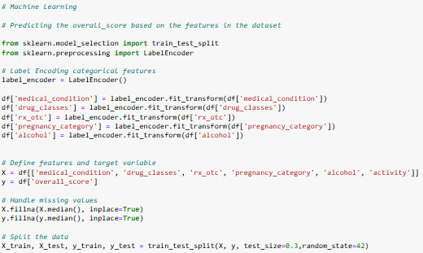
Machine Learning – Feature engineering (regression model)

Slide 22






Models
REGRESSION RANDOM FOREST MODEL REGRESSION SVR MODEL
REGRESSION SGD MODEL REGRESSION MODEL DECISSION TREE
REGRESSION GRADIENT BOOSTING REGRESSOR MODEL REGRESSION xGBoost MODEL

Slide 23
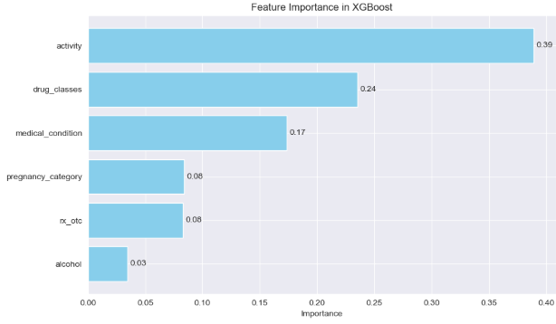
Feature importance in XGBoost
Observation : The most important features influencing the XGBoost model are Activity, Drug Classes, Medical Condition, Pregnancy Category, Rx/OTC status, and Alcohol Restriction. These features play a key role in predicting drug-related outcomes and user ratings effectively.

Slide 24
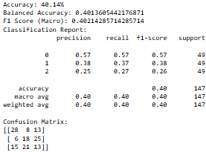
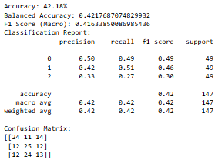
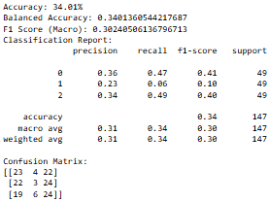
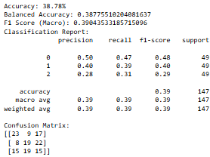
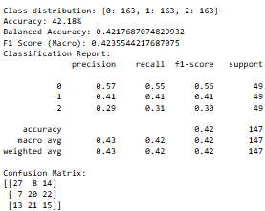
Models
CLASSIFICATION XGBoost MODEL CLASSIFICATION SVC MODEL CLASSIFICATION SGD MODEL
CLASSIFICATION GRADIENT BOOSTING MODEL CLASSIFICATION RANDOM FOREST MODEL

Slide 25
Models
Regression and classification models were applied to predict and classify drug-related overall score based on various features such as condition, age, effectiveness, side effects, and benefits..
Regression models – The Random Forest Regressor performed the best with the lowest RMSE of 1.132 and the highest R² score of 0.369, indicating moderately strong predictive performance. Gradient Boosting and XGBoost followed closely with R² scores of 0.360 and 0.341, respectively, showing consistent accuracy and good generalization. SVR and SGD Regressor delivered comparatively poor results, with R² values close to 0.0, suggesting limited predictive capability. The Decision Tree Regressor also underperformed, with an R² of 0.235, possibly due to overfitting. Overall, regression models provided moderate predictive power, with ensemble methods outperforming linear and tree-based single estimators.
Classification models – Among all classification models, the Random Forest Classifier achieved the highest accuracy of 71.28% and a macro F1-score of 0.497, indicating the best balance between precision and recall across classes. XGBoost and Gradient Boosting Classifier followed, with F1-scores of 0.481 and 0.471, offering good performance especially in detecting higher and lower rating classes. Decision Tree and SVC models had moderate performance but struggled with minority classes. SGD Classifier performed poorly, with a macro F1-score of 0.334, highlighting its limitations in handling class imbalance. Overall, classification models showed good accuracy, with ensemble techniques (Random Forest, XGBoost, Gradient Boosting) clearly outperforming other models, though class imbalance remained a challenge, impacting recall for minority ratings (1, 2, 3).

Slide 26
Final Observations & Storyline
Acne leads in drug diversity with 39 unique medications (7.98%), followed by Hypertension (34, 6.95%) and Pain (30, 6.13%), showing a wide range of treatment options. Erectile Dysfunction drugs have the highest average overall score (17.90), while Cancer and Stroke drugs score the lowest (2.54 and 3.01), reflecting varied user satisfaction across conditions.
Bisacodyl stands out with 1,357 reviews, indicating heavy usage, whereas Neomycin has only 1 review, suggesting niche application. The most common side effects—lip/tongue irritation and stomach pain—highlight key patient safety concerns. No significant correlation exists between number of reviews and user ratings (R²=0.002, p=0.326), indicating ratings aren’t driven by review volume.
Drugs available as both prescription and OTC have the highest average ratings (6.97), slightly better than Rx-only (6.84) and OTC-only (6.69) drugs, suggesting better balance between accessibility and effectiveness. Common generic drugs focus on acne and diabetes, while top brand drugs like Bronkaid and Sudafed dominate respiratory treatments.
For pregnancy safety, Diabetes drugs lead low-risk categories with 12 drugs each, while Hypertension and Pain dominate high-risk groups (22 and 21 drugs). Alcohol restrictions mostly affect Diabetes and Pain medications, accounting for over 34% of restricted drugs, emphasizing patient caution.
Statistical tests confirm prescription drugs have significantly higher average scores (8.89 vs. 6.38; t=4.877, p=0), and surprisingly, higher pregnancy risk drugs score better (8.87 vs. 7.44; t=3.017, p=0.0027). Overall, drug ratings reflect a trade-off between efficacy, safety, and accessibility.

