Slide 1

Netflix Data Analysis Using Power BI, Power Automate & PowerApps
A Data-Driven Approach to Content Strategy
-Subhapratha

Slide 2
Project Overview
This project integrates Power BI, PowerApps, and Power Automate to analyze Netflix data, enhance user interaction, and automate reporting.

Slide 3
Dataset Overview
Data Source: Netflix dataset
Key Features:
Show ID, Type, Title, Director, Cast, Country, Date Added, Release Year, Rating, Duration, Listed in (Genre), Description
Purpose of Dataset:
Identify content trends
Analyze regional preferences
Support business decisions

Slide 4
Data Preparation
Data Source: CSV file imported into Power BI
Splitting multi valued columns: Columns like Country, Genre, Cast had multiple values in a single cell which was separated into separate tables keeping Show ID as the primary key.
Handling Missing and Inconsistent Data: Removed rows that had excessive missing values, removed duplicates, and ensured proper data types.

Slide 5
Power BI Implementation
The cleaned dataset was imported into Power BI, where interactive visuals were created to analyze key metrics.
Filters and slicers were added to enhance data exploration, allowing users to gain insights into trends, ratings, and regional distributions.
Visualizations Created:
Type by Country
Shows Trends Over Time
Count of countries by Rating
Top Genres by Rating

Slide 6
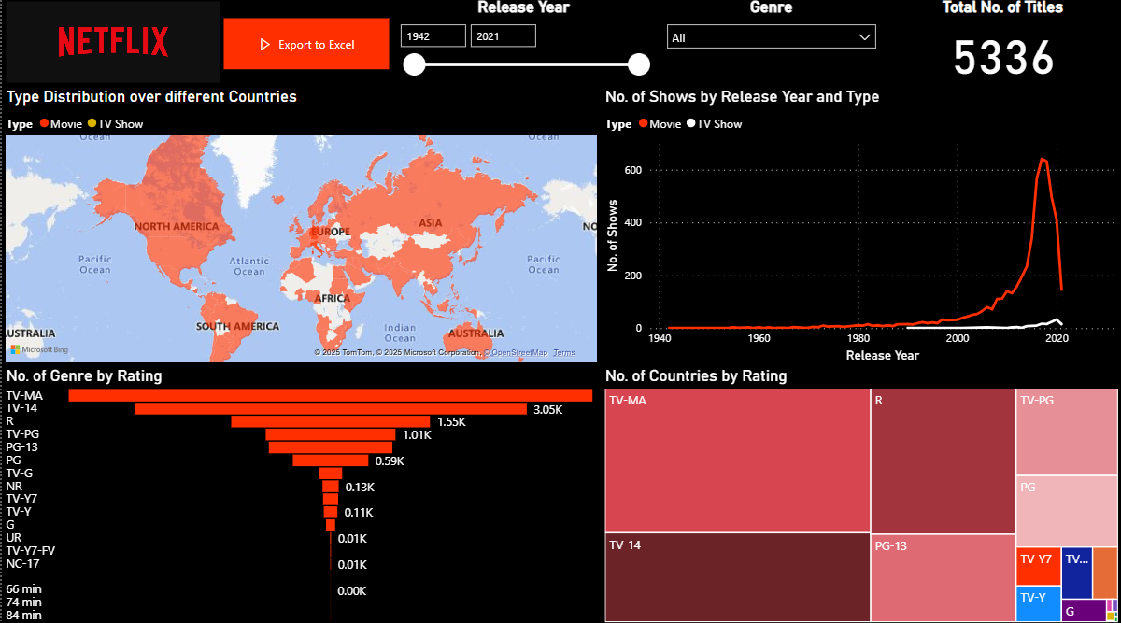
Power BI Dashboard

Slide 7
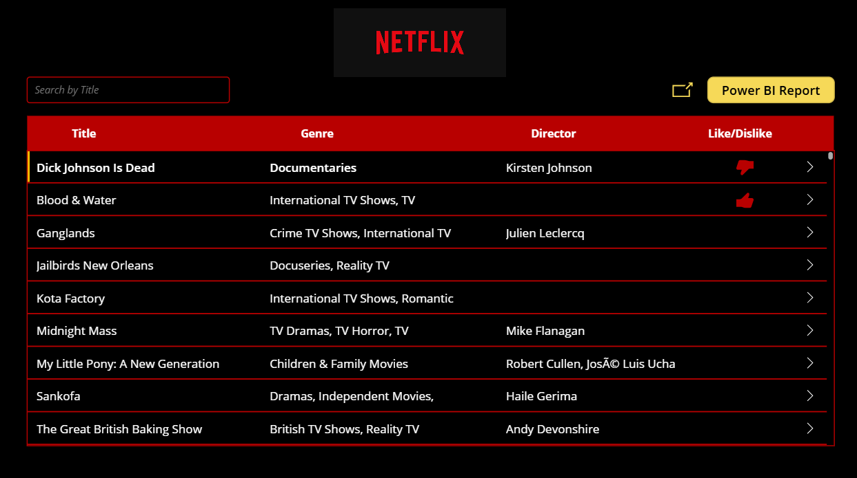
PowerApps Application

Slide 8
Power Automate & PowerApps Integration
Power Automate Use Case:
Power Automate generates Excel reports from Power BI and sends them via email automatically, ensuring seamless data distribution.
PowerApps Use Case:
Allows users to search and filter Netflix content dynamically.
Clicking on a record displays detailed insights on a separate screen.
Seamlessly integrates an embedded Power BI dashboard for data-driven exploration.

Slide 9
Workflow Overview
1. PowerApps: Users search and filter Netflix content.
2. Power BI: Provides insights with interactive dashboards.
3. Power Automate: Automates report generation and email delivery.

Slide 10
Conclusion & Q&A
Summary of Findings:
USA has the highest number of Netflix titles.
TV-MA is the most common content rating.
Growth in Netflix content peaked around 2018-2020.
Thank You! Any Questions?

Slide 11
Shows Based on Country
Objective: Identify the distribution of shows by country
Visualization: Interactive world map highlighting content volume by country
Insights:
Identify top content-contributing countries
Guide content acquisition and localization efforts

Slide 12
Content Evolution Over Time
Objective: Understand the number of shows/movies released per year
Visualization: Time-series chart of content release trends
Insights:
Peak content release years
Changes in production trends over time
Forecasting future content strategies

Slide 13
Genre Popularity Analysis
Objective: Identify the most-watched and available genres
Visualization: Pie chart or bar graph showing genre distribution
Insights:
Most popular genres based on availability
Helps in content acquisition and recommendations

Slide 14
Key Insights & Business Impact
- Major Findings:
• Content is highly concentrated in specific regions
• Increasing demand for certain genres
• Significant shifts in content production over time
- Impact:
• Supports Netflix in making data-driven content investments
• Enhances user engagement through targeted content strategies

