Slide 1

Maisammaguda, Kompally,
Medchal - Malkajgiri District Hyderabad - 500100, Telangana State
www.mallareddyuniversity.
(Telangana State Private Universities Act No. 13 of 2020 &
G.O.Ms. No. 14, Higher Education (UE) Department)
Department of Computer Science & Engineering
“ Clever Dash ”
Batch No : AD – 141 1. 2211CS010547(SUBHAPREET PATRO)
2. 2211CS010557(T. SANTHOSHI)
3. 2211CS010390(MUNIMANDA SNEHA)
4. 2211CS010620(DUBBAKA PRASANNA)
Guide Name: Mrs. P. Sabitha

Slide 2
Overview
Title Explanation
Abstract of the Application
Introduction of the Application
Problem Statement
Objectives
Data Model
Methodology
Conclusion
Future Enhancement
References

Slide 3
Title Explanation
Clever-Dash implies that it's clever because it utilizes advanced technologies and libraries like Material UI, Material UI Data Grid, Nivo Charts, Redux Toolkit, Redux Toolkit Query, Node.js, Express.js, Mongoose, and MongoDB to provide users with an intelligent and insightful dashboard experience. So, essentially, "Clever-Dash" signifies a smart and sophisticated dashboard solution powered by cutting-edge tools and frameworks.

Slide 4
Abstract
“Clever Dash” is a sophisticated admin dashboard application built from scratch using the MERN stack (MongoDB, Express, React, Node.js), and Redux Toolkit for state management and API calls. This application includes setting up the backend and frontend environments, configuring themes and colors, creating components such as navbar, sidebar, user profile menu, and product pages, handling user data and authentication, , and integrating data visualization components using libraries like Nivo. This application servers as a great tool for managing financial data.

Slide 5
Introduction
Clever-Dash is more than just a dashboard app; it's your gateway to smart data visualization. With sleek Material UI design and powerful Nivo Charts, it transforms raw data into actionable insights. Powered by Redux Toolkit and Redux Toolkit Query, it ensures real-time updates with ease. Built on Node.js and Express.js, it offers unmatched performance and scalability. Backed by Mongoose and MongoDB, your data is secure and accessible. Experience the future of dashboarding with Clever-Dash.

Slide 6
Problem Statement
Clever-Dash addresses the challenge of efficiently visualizing and managing large volumes of data across various domains. It aims to streamline data interpretation and decision-making processes for businesses, organizations, and individuals who grapple with complex datasets and seek intuitive solutions for data analysis and presentation. By providing a unified platform with advanced visualization tools and seamless data management capabilities, Clever-Dash aims to empower users to extract valuable insights, identify trends, and make informed decisions based on their data.

Slide 7
Objectives
1. Enhanced Data Visualization:
Develop advanced visualization techniques using Nivo Charts to provide users with clear and insightful representations of complex datasets.
2. Seamless Data Management:
Implement efficient data management functionalities utilizing Redux Toolkit and Redux Toolkit Query to ensure real-time updates and smooth interactions with the dashboard.
3. Filtering Options:
Allow users to filter data based on the built-in features provided by Material-UI library.

Slide 8
4. Data Download:
Enable users to download necessary data in a CSV or excel format.

Slide 9
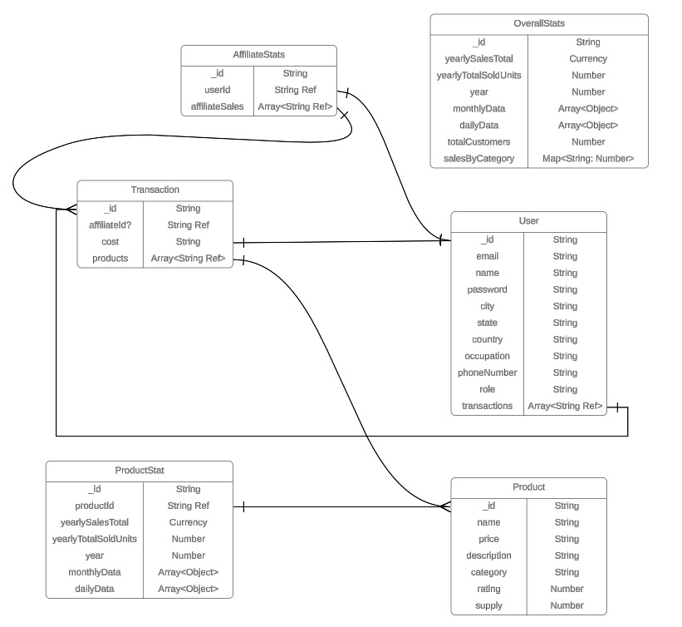
Data Model

Slide 10
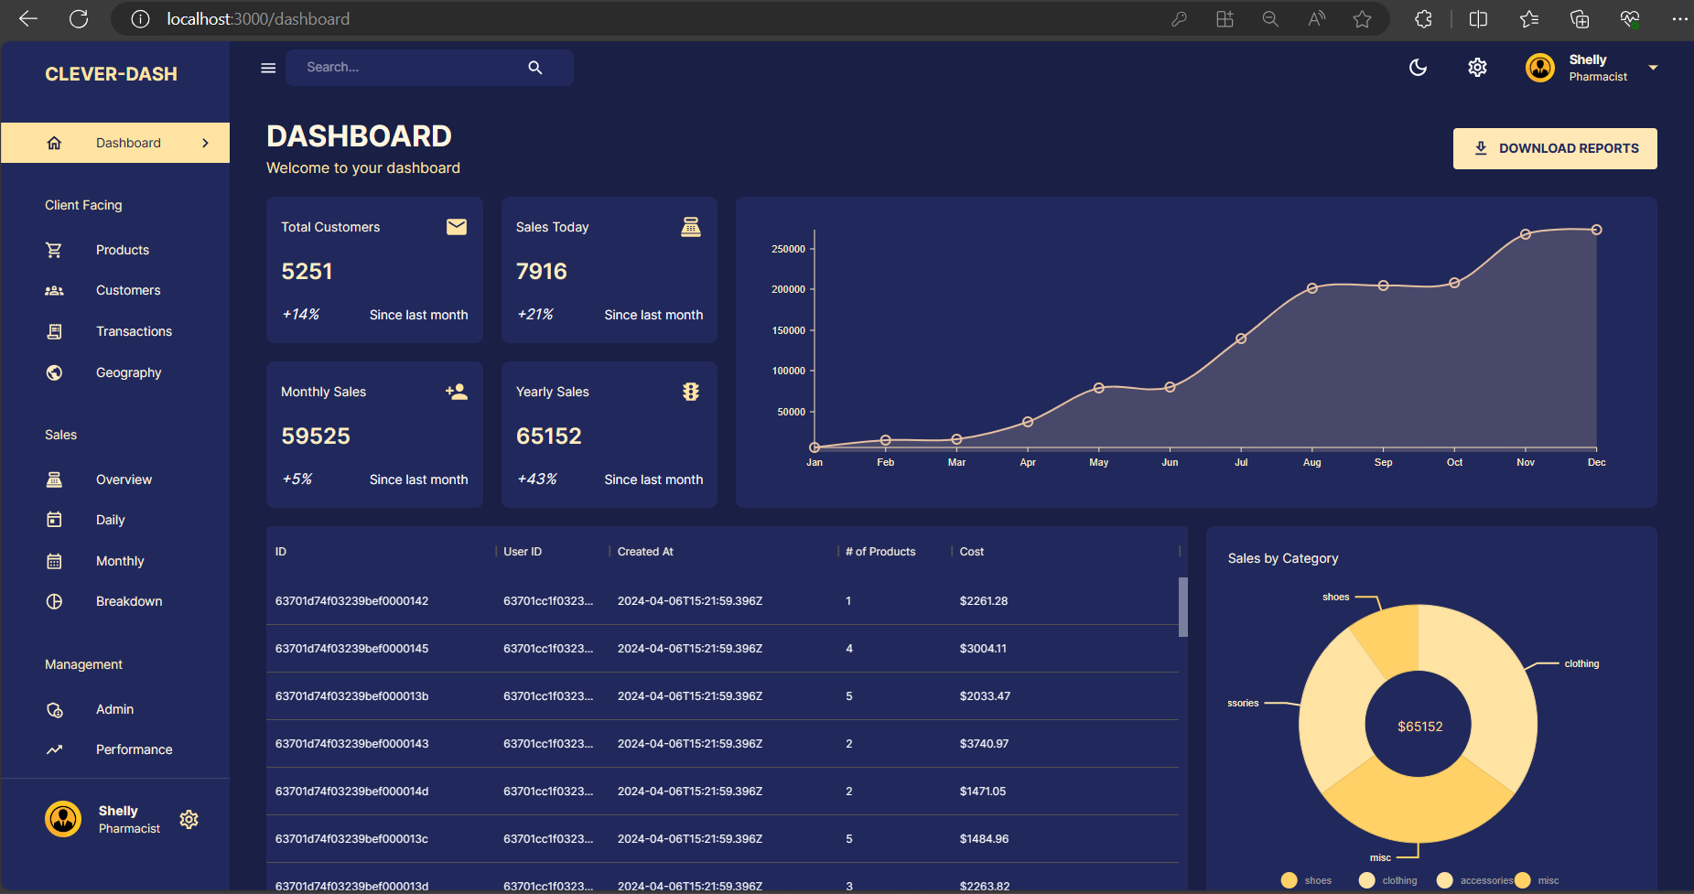
Screenshots
Fig-1 Dashboard

Slide 11
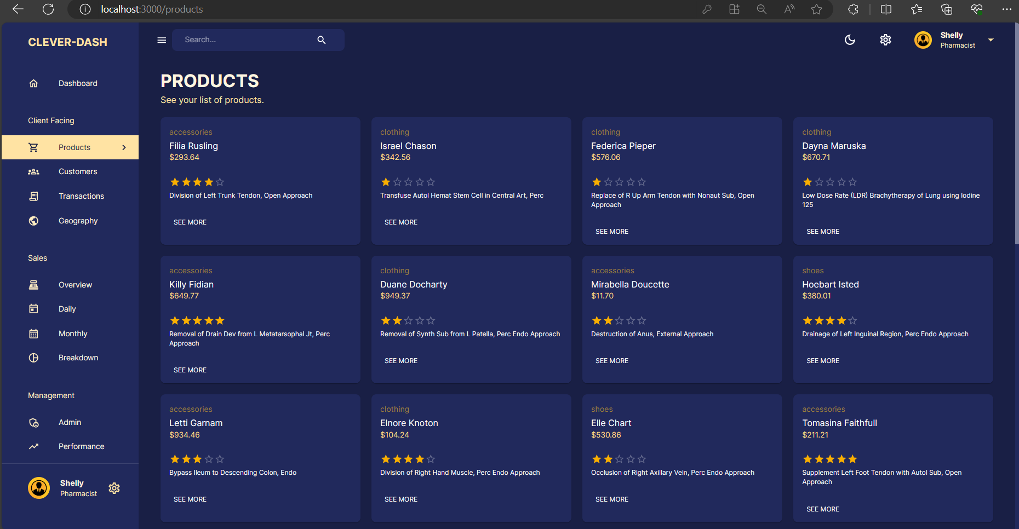
Fig-2 Products Page

Slide 12
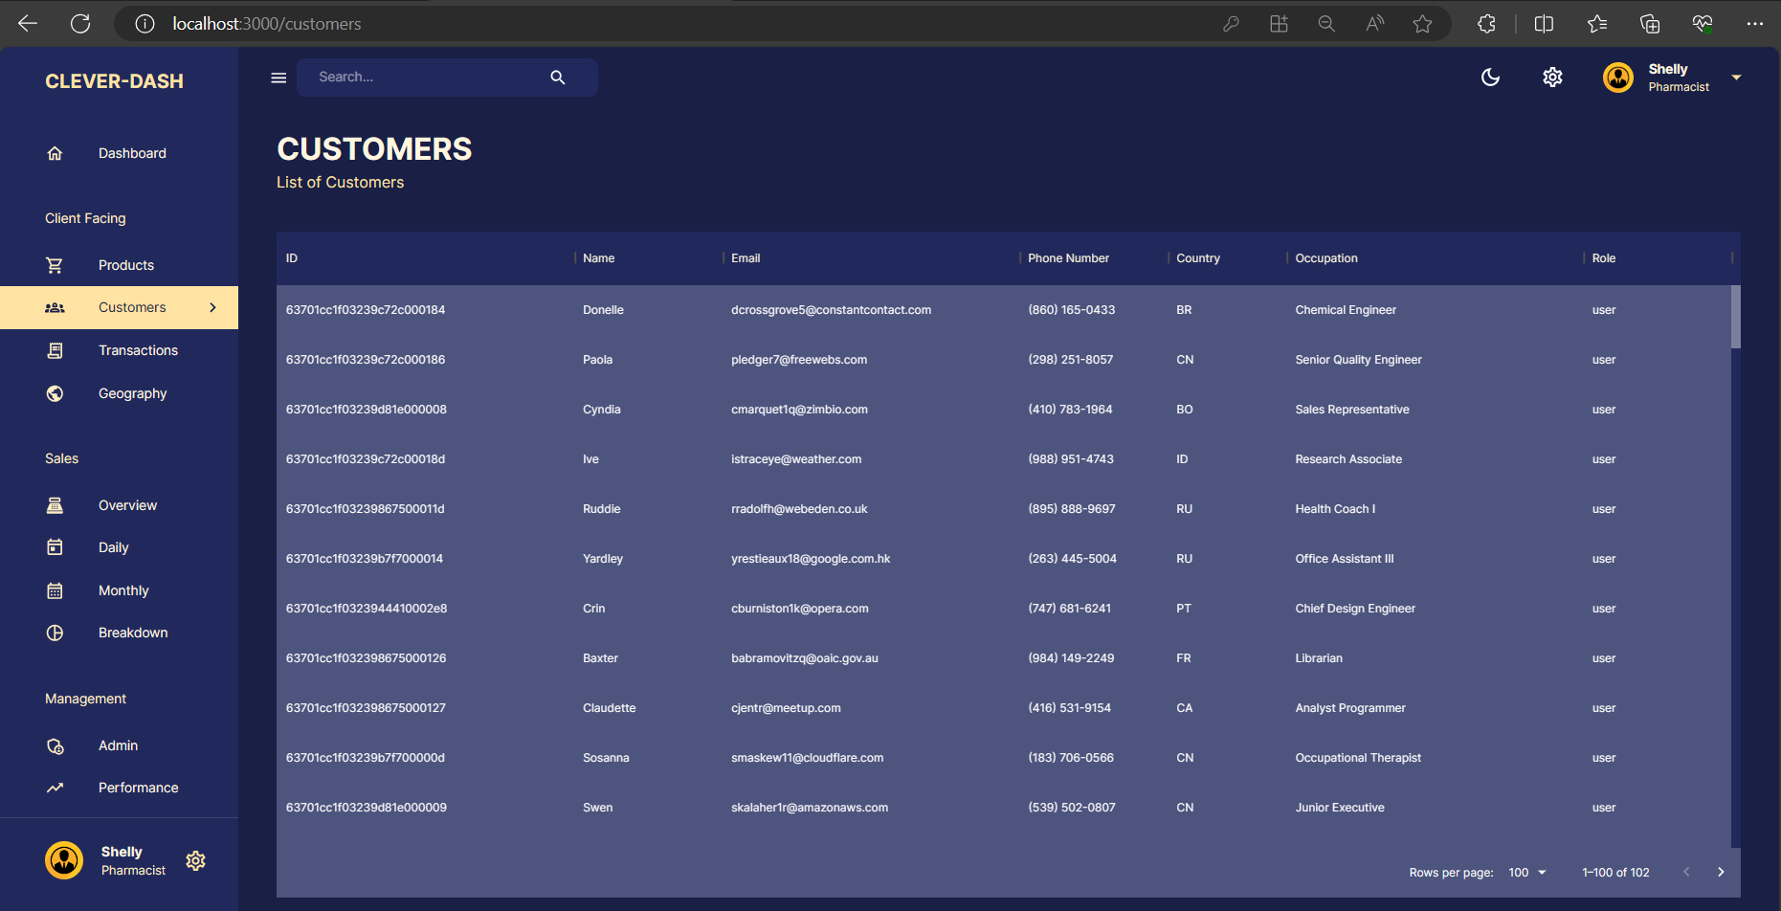
Fig-3 Customers Page

Slide 13
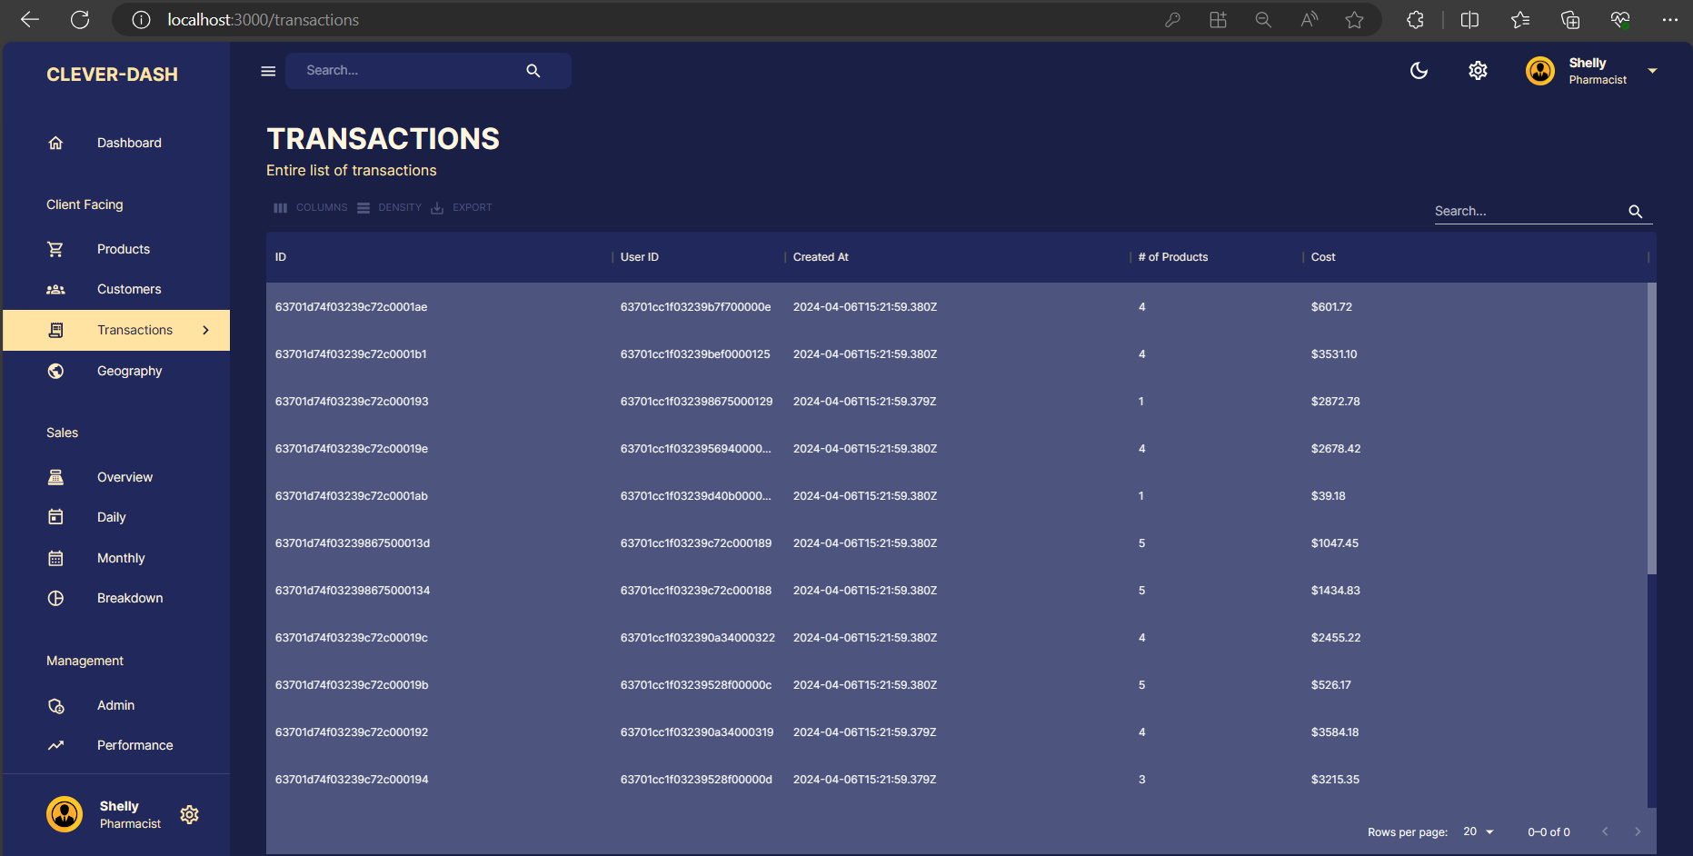
Fig-4 Transactions Page

Slide 14
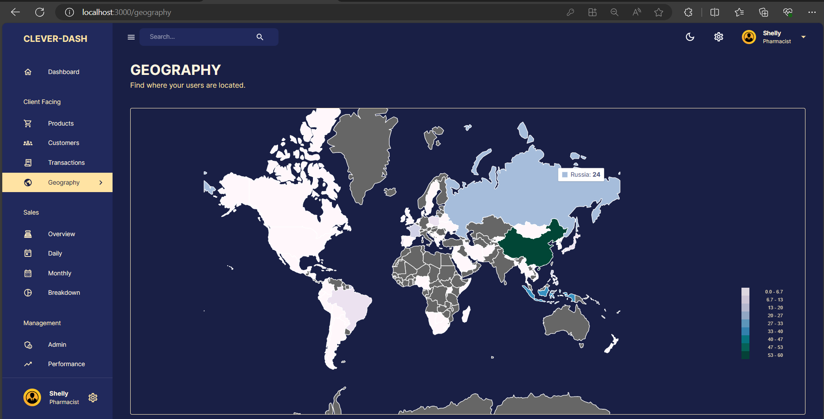
Fig-5 Geography Page

Slide 15
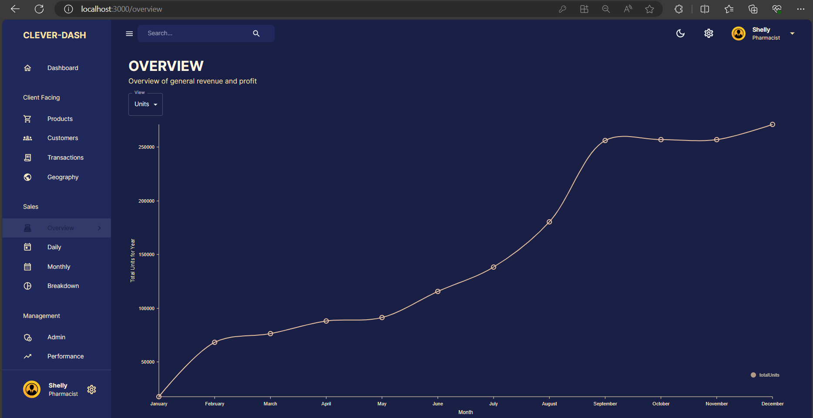
Fig-6 Overview Page

Slide 16
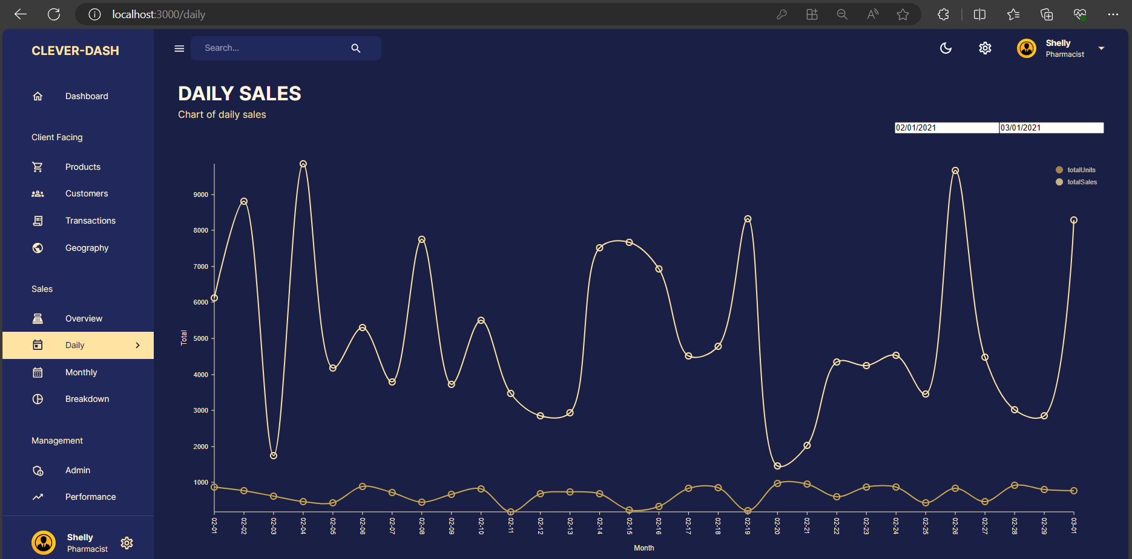
Fig-7 Daily Sales Page

Slide 17
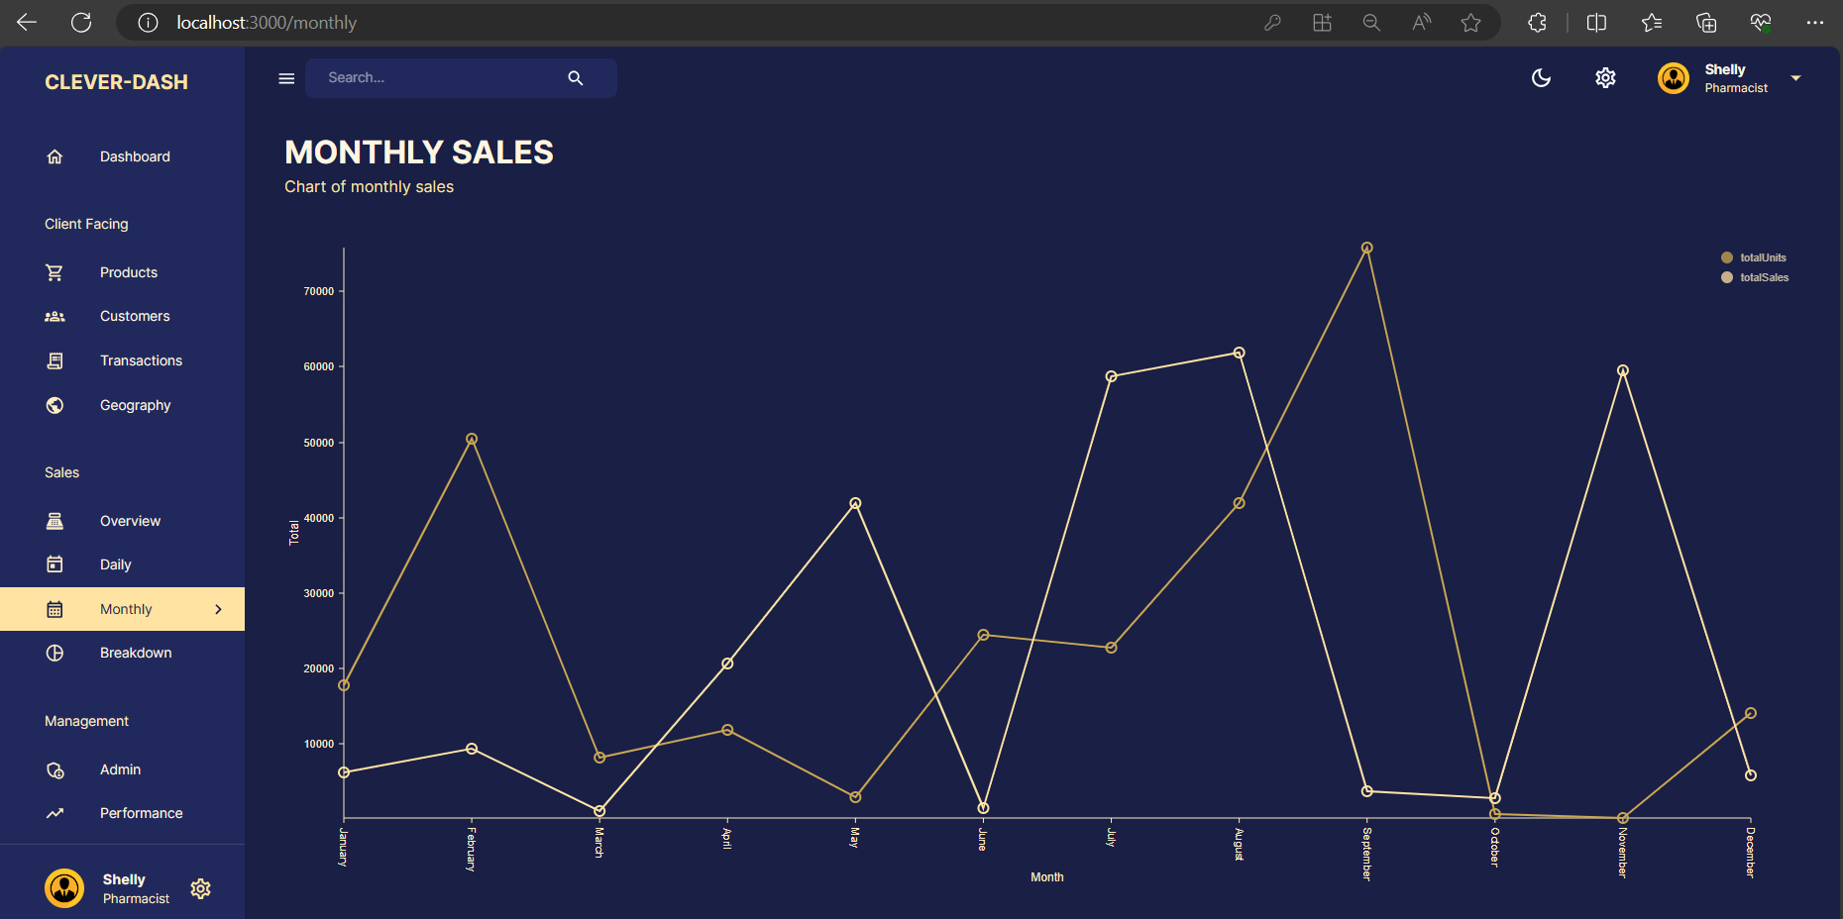
Fig-8 Monthly Sales Page

Slide 18
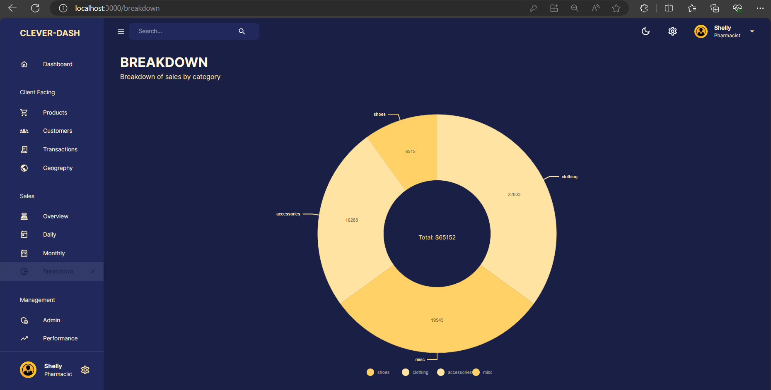
Fig-9 Breakdown Page

Slide 19
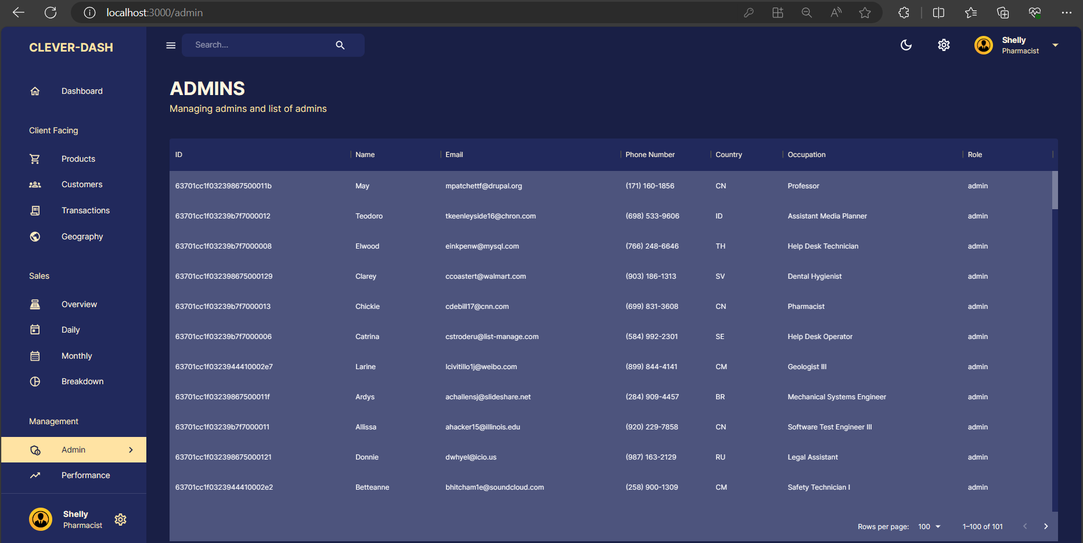
Fig-10 Admins Page

Slide 20
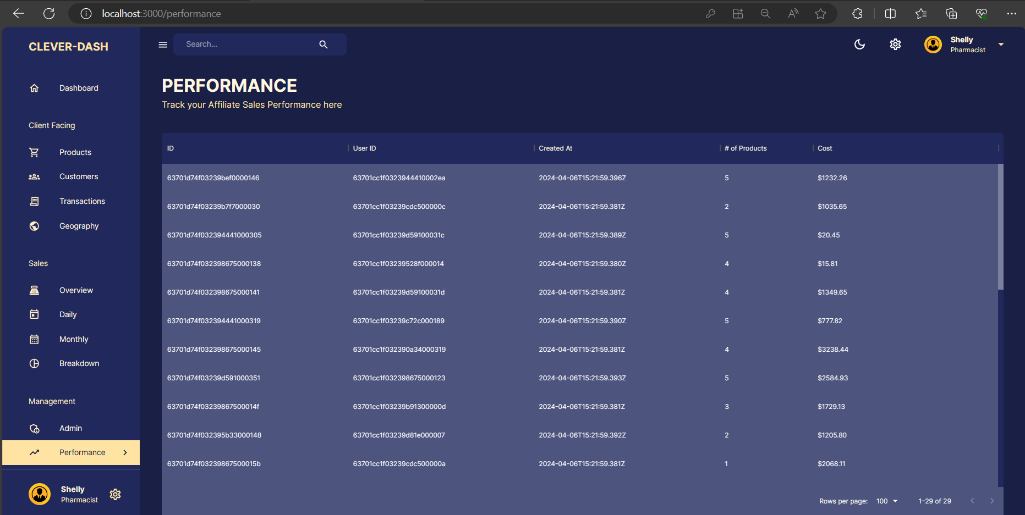
Fig-11 Performance Page

Slide 21
Methodology
1. Project Setup:
Set up the Clever-Dash project using Create React App or Next.js for frontend development. Install Node.js and npm (or yarn) for managing dependencies.
2. Design Phase:
Sketch out the layout of the Clever-Dash dashboard application, identifying key components and data visualization areas. - Decide on the overall style and appearance of the dashboard interface, ensuring it aligns with Clever-Dash branding and user preferences.
3. Component Architecture:
Break down the Clever-Dash application into modular components such as Dashboard, DataGrid, Charts, Sidebar, etc. - Design reusable components to promote a clean and maintainable codebase, enhancing scalability and flexibility.

Slide 22
4. State Management:
Choose a suitable state management solution like React Context or Redux for managing application-wide state, including user data and dashboard settings. Ensure that user data and other relevant information are stored appropriately in the application state.
5. Backend Setup:
Set up a backend server using Node.js with Express.js to handle user authentication, data storage, and API endpoints.Implement APIs for user authentication, fetching/sending data, and managing user profiles, including avatars.
6. User Authentication:
Implement user authentication functionality using libraries like JSON Web Tokens (JWTs) to secure Clever-Dash user accounts.Create endpoints for register, login, and logout functionalities, ensuring data security and user privacy.

Slide 23
7. Styling:
Apply styles to Clever-Dash components using CSS, Material UI and styled-components to enhance visual appeal and user engagement.Implement responsive design principles to ensure Clever-Dash looks and functions seamlessly across various devices and screen sizes.

Slide 24
Requirements
React JS and Material UI for the user interface
Nivo Charts for displaying various charts and to also display geographical information.
Redux ToolKit for efficient state management.
Redux Query Toolkit for simplified data fetching and caching.
Node JS as a runtime environment for the app to run outside of browser.
Express JS as a backend framework for Node JS.
Mongoose for a schema-based solution to model application data.
MongoDB for database.

Slide 25
Conclusion
Clever-Dash offers a user-friendly platform for data visualization and management. With its advanced features and seamless integration capabilities, Clever-Dash empowers users to unlock insights and make informed decisions. It serves as a tool that can be intuitive and also is minimal in complexity that makes it easy for a wider range of users to use

Slide 26
Future Enhancement
1.Expanded Data Visualization Options :
Introduce more chart types and advanced visualization techniques.
2.Personalized Dashboards :
Enhance customization features for tailored user experiences.

Slide 27
References
Material UI Documentation (https://material-ui.com/): Material-UI is a popular React UI framework that provides pre-designed components following Google's Material Design principles
Nivo Charts Documentation (https://nivo.rocks/): Nivo is a rich collection of customizable React components for building data visualization charts.
Node.js Documentation (https://nodejs.org/en/docs/): Node.js is a popular runtime environment for building server-side applications in JavaScript
Express.js Documentation (https://expressjs.com/): Express.js is a minimalist web framework for Node.js, designed for building web applications and APIs.
MongoDB Documentation (https://docs.mongodb.com/): MongoDB is a popular NoSQL database that provides flexibility and scalability for storing and managing data. Its document-oriented nature and rich query capabilities make it suitable for MERN Applications

Slide 28
T H A N K Y O U

