Slide 1

Maisammaguda, Kompally, Medchal - Malkajgiri District
Hyderabad - 500100, Telangana State www.mallareddyuniversity.
(Telangana State Private Universities Act No. 13 of 2020 & G.O.Ms. No. 14, Higher Education (UE) Department)
Department of Computer Science & Engineering
“ Clever Dash ”
Batch No : AD – 141
1. 2211CS010547(SUBHAPREET PATRO) 2. 2211CS010557(T. SANTHOSHI)
2211CS010390(MUNIMANDA SNEHA)
2211CS010620(DUBBAKA PRASANNA)
Guide Name: Mrs. P. Sabitha

Slide 2
Overview
Title Explanation
Abstract of the Application
Reviewers Comments in Previous Review
Introduction
Problem Statement
Objectives
Methodology
Implementation
Results & Discussion
Conclusions & Future Scope
References

Slide 3
Title Explanation
Clever-Dash implies that it's clever because it utilizes advanced technologies and libraries like Material UI, Material UI Data Grid, Nivo Charts, Node.js, Express.js, Mongoose, and MongoDB to provide users with an intelligent and insightful dashboard experience. So, essentially, "Clever-Dash" signifies a smart and sophisticated dashboard solution powered by cutting-edge tools and frameworks.

Slide 4
Abstract
“Clever Dash” is a sophisticated admin dashboard application built from scratch using the MERN stack (MongoDB, Express, React, Node.js). This application includes setting up the backend and frontend environments, configuring themes and colors, creating components such as navbar, sidebar, user profile menu, and product pages, handling user data and authentication, ,and integrating data visualization components using libraries like Nivo. This application servers as a great tool for managing financial data. Clever Dash introduces a groundbreaking approach to navigation efficiency with its innovative smart navbar integration. Designed to cater to the modern user's dynamic needs, Clever Dash offers a seamless and intuitive navigation experience across diverse applications and platforms.

Slide 5
Introduction
Clever Dash, the ultimate solution for optimizing your navigation experience across various digital platforms. In today's fast-paced world, efficient navigation is paramount, and Clever Dash is here to revolutionize the way you interact with your devices. At the heart of Clever Dash lies its innovative smart navbar integration. Say goodbye to cluttered screens and cumbersome menus. Clever Dash's navbar , ensures that the tools and features you need are always at your fingertips. Gone are the days of endless scrolling and searching for essential functions. With Clever Dash, you can navigate between tasks seamlessly, access frequently used tools with a single tap. Clever Dash empowers you to take control of your digital environment. Say hello to productivity, simplicity, and convenience – welcome to Clever Dash..

Slide 6
Problem Statement
Clever-Dash addresses the challenge of efficiently visualizing and managing large volumes of data across various domains. It aims to streamline data interpretation and decision-making processes for businesses, organizations, and individuals who grapple with complex datasets and seek intuitive solutions for data analysis and presentation. By providing a unified platform with advanced visualization tools and seamless data management capabilities, Clever-Dash aims to empower users to extract valuable insights, identify trends, and make informed decisions based on their data.

Slide 7
Objectives
Enhanced Data Visualization: Develop advanced visualization techniques using Nivo Charts to provide users with clear and insightful representations of complex datasets.
Scalability and Performance: Utilize Node.js and Express.js to create a robust backend infrastructure that can handle large volumes of data while maintaining high performance and scalability.

Slide 8
3. Data Security and Reliability: Employ Mongoose and MongoDB to establish a secure and reliable data storage solution, safeguarding sensitive information and ensuring data integrity.
4. Performance Analytics: Offer built-in analytics features to track dashboard usage and monitor performance metrics

Slide 9
Methodology
Problem Definition and Objectives: - Identify the Problem: Understand the specific issues the navbar aims to solve (e.g., user navigation efficiency, accessibility). - Set Objectives: Define clear objectives, such as improving user experience, optimizing performance, or ensuring cross-device compatibility.
Requirement Analysis: - User Requirements: Gather user requirements through surveys, interviews, or through referring similar projects to understand their needs and preferences. - Technical Requirements: Define technical requirements, including performance, responsiveness, and integration with the rest of the MERN stack.

Slide 10
3. Design and Prototyping: - Wireframing: Create wireframes to visualize the layout and functionality of the navbar. - Prototyping: Develop interactive prototypes using tools like Figma or Sketch to refine the design based on user feedback and refer to documentation of component design libraries like Material UI.
4. Technology Stack Analysis: - MongoDB: Assess the data storage needs for user preferences and settings related to the navbar. - Express.js: Determine how server-side logic will manage and serve navbar-related data. - React.js: Plan the implementation of the navbar as a React component along with the components of other pages, considering state management and reusability. - Node.js: Outline how backend services will support the navbar’s functionality, including API endpoints.
5. Implementation Strategy: - Development Plan: Create a detailed development plan with milestones and deliverables. - Component Design: Design React components for the navbar, ensuring modularity and maintainability. - Integration: Plan the integration of the navbar with other parts of the application, ensuring consistency and coherence.

Slide 11
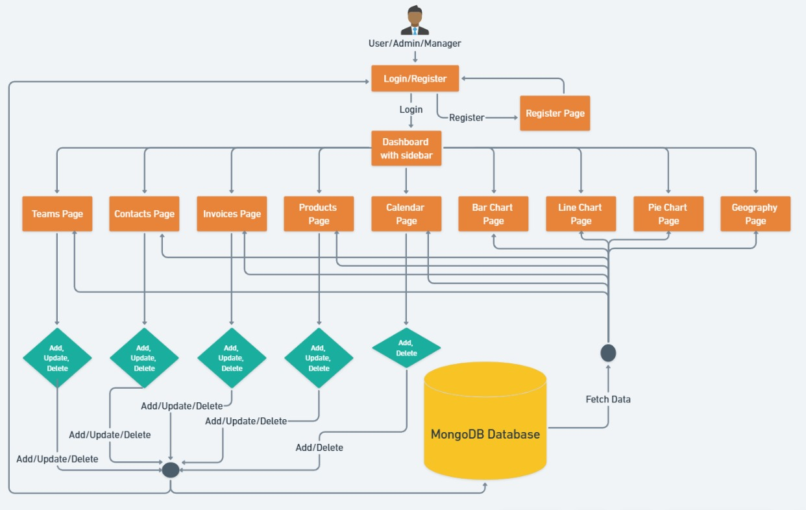
Design

Slide 12
Implementation
CleverDash is a comprehensive business management application that provides various features to streamline operations and facilitate decision-making. Below are the implementation details for each page of CleverDash:
Dashboard Page: The dashboard serves as the central hub for accessing key metrics, insights, and summaries of business performance. The features Displays customizable widgets and cards for monitoring important KPIs such as sales, revenue, and customer acquisition.
Teams Page: The teams page provides tools for managing team members, assignments ,and collaboration within the organization. It has User management functionalities such as adding, editing, and removing team members.
Contacts Page: The contacts page enables users to manage customer and client information, facilitating relationship management and communication. It has Contact databases for storing customer details including names, contact information, and interaction history.

Slide 13
4. Invoices Page: The invoices page allows users to create, send, and manage
invoices for billing and payment processing. It has Invoice generation with customizable templates and fields.
5. Products Page: The products page provides tools for managing inventory,
product catalogs, and sales tracking. The Product catalog is for storing product details such as descriptions, prices, and inventory levels.
6. Calendar Page: The calendar page allows users to schedule, manage, and
track events, appointments, and important dates. Has Integration with
FullCalendar library for interactive calendar functionality with various views (month, week, day, list).
7. Bar Chart Page: The bar chart page displays data visualization in the
form of a bar chart, allowing users to analyze sales quantity by product
category. It Utilizes the ResponsiveBar component from the Nivo library for responsive and interactive bar chart rendering.
8. Pie Chart Page: The pie chart page visualizes product demand data using
a pie chart, providing insights into 13 the distribution of demand across
product categories. It Implements the ResponsivePie component from the Nivo library for creating responsive and interactive pie charts.

Slide 14
9. Line Chart Page: The line chart page visualizes revenue data over time using a line chart, enabling users to track revenue trends and performance. It Utilizes the ResponsiveLine component from the Nivo library for creating responsive and interactive line charts.
10. Geography Page: The geography page displays geographical data using a choropleth map, allowing users to visualize user distribution or other geographical metrics. It Implements the ResponsiveChoropleth component from the Nivo library for creating responsive and interactive choropleth maps.
CleverDash provides a user-friendly interface with robust functionalities tailored to meet the diverse needs of businesses, offering efficiency, insights, and control across various aspects of operations and management.

Slide 15
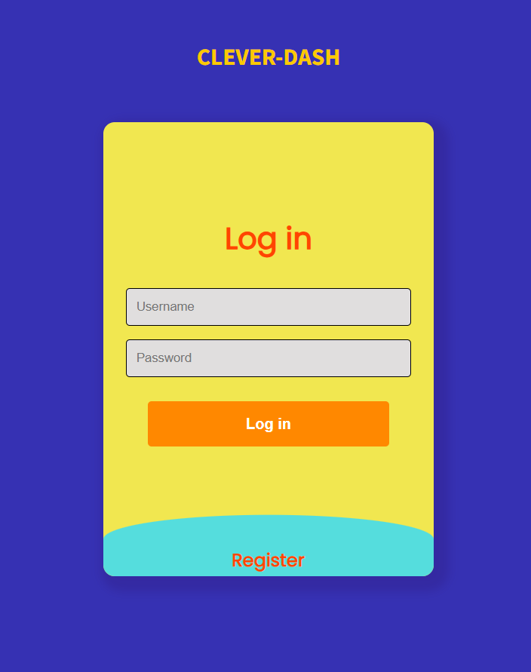
Screenshots
Login Page

Slide 16
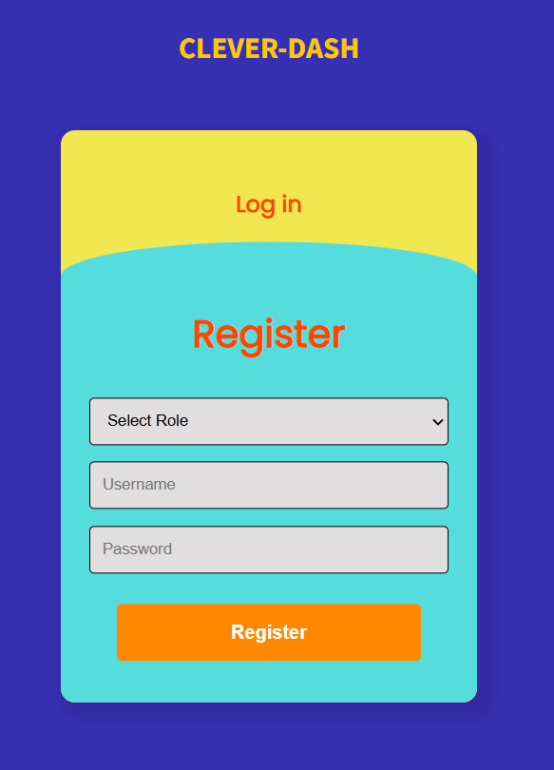
Register Page

Slide 17
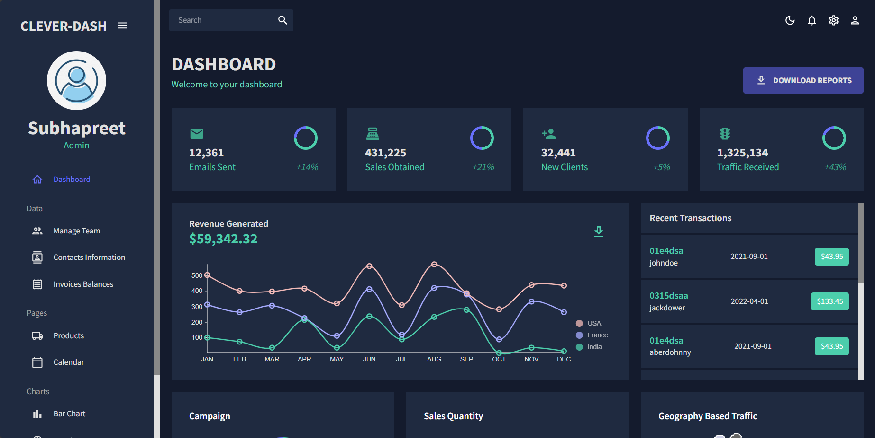
Dashboard Page

Slide 18
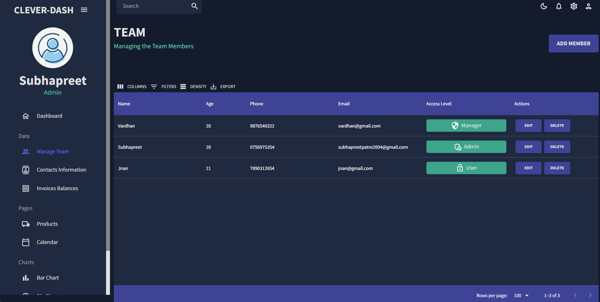
Teams Page

Slide 19
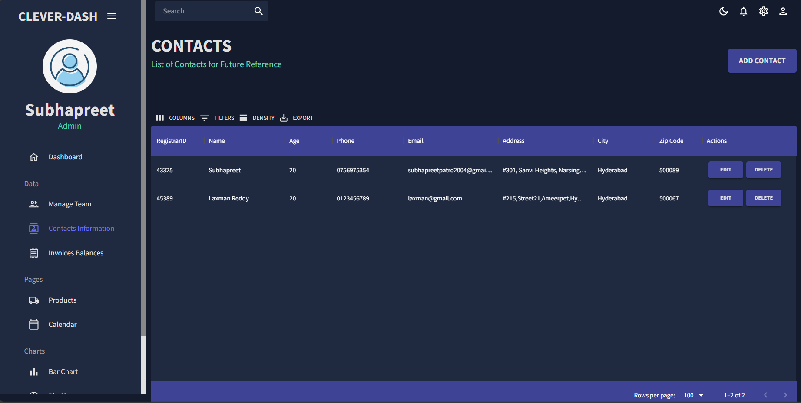
Contacts Page

Slide 20
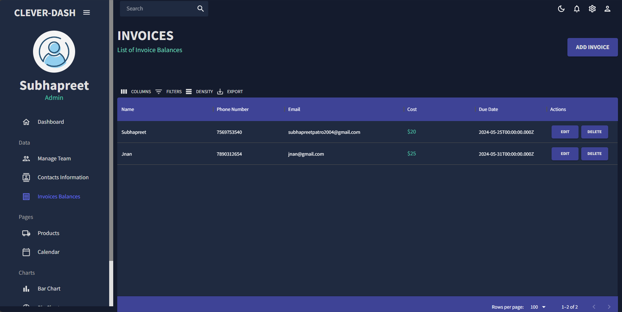
Invoices Page

Slide 21
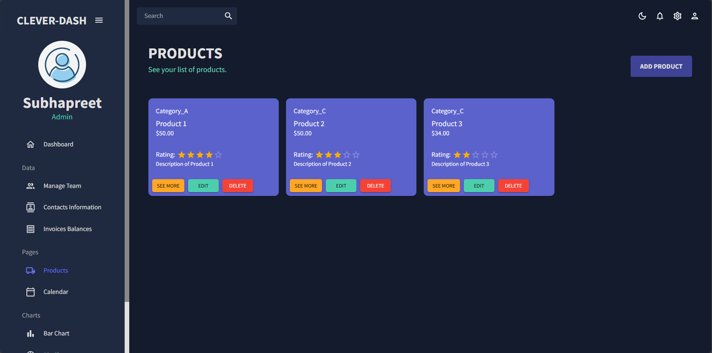
Products Page

Slide 22
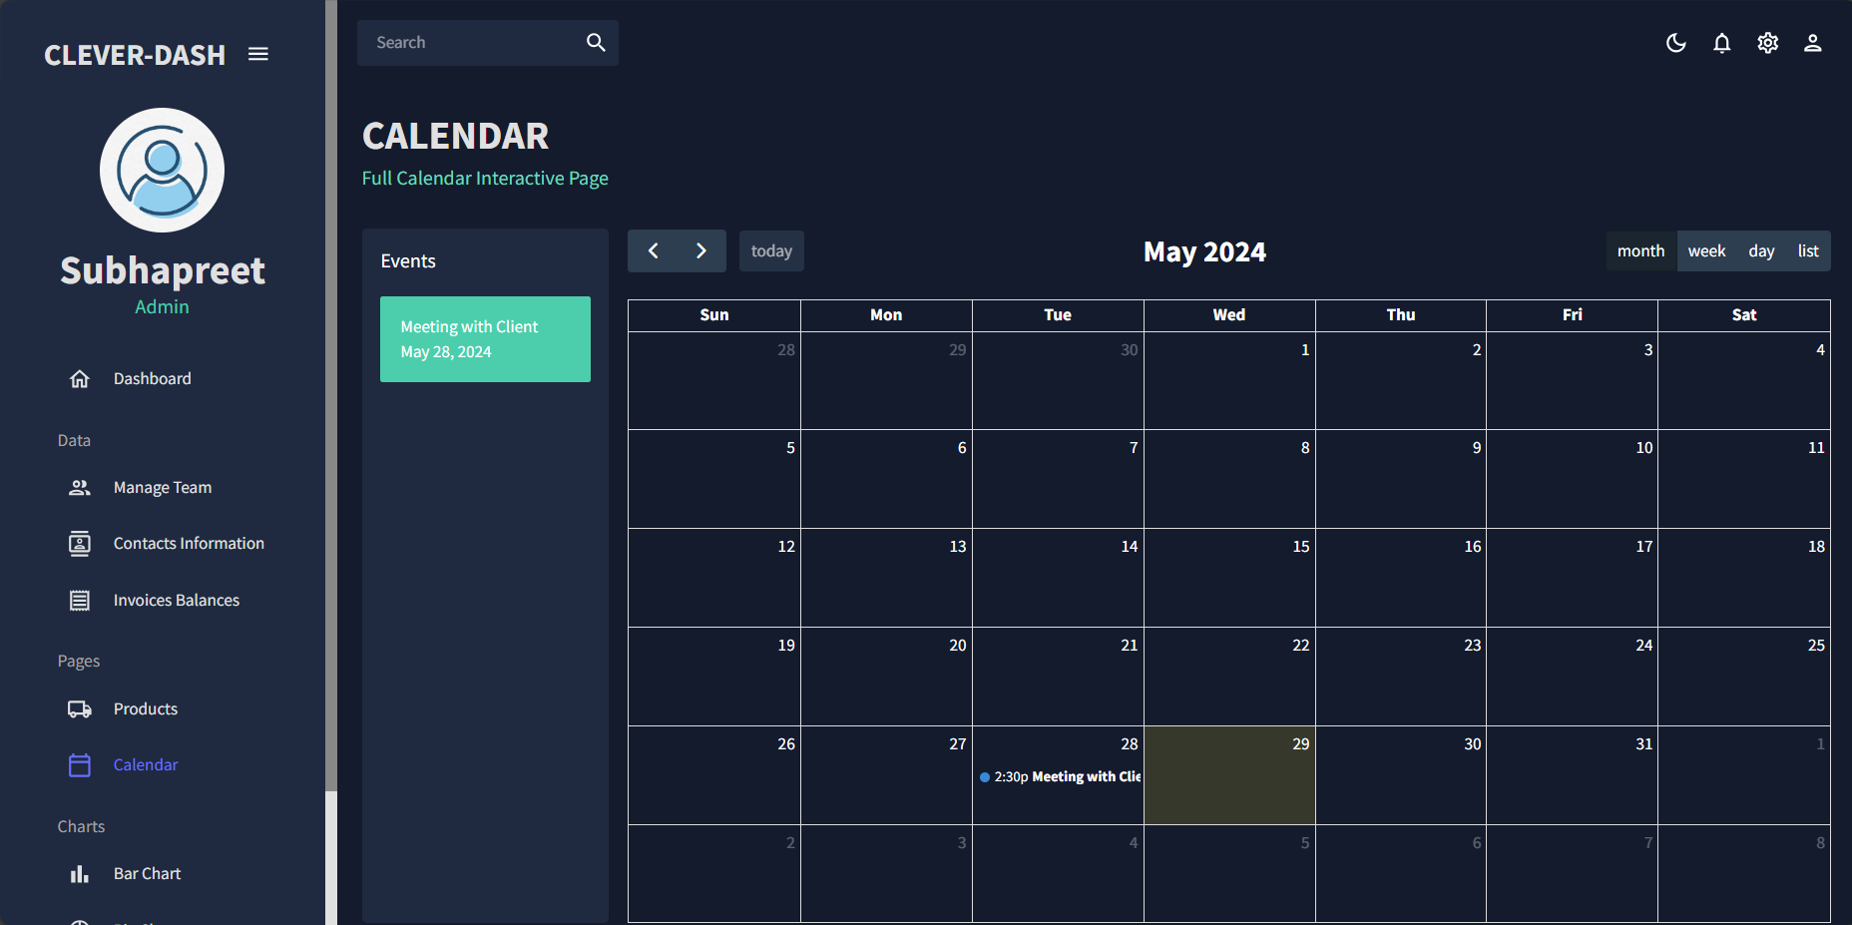
Calendar Page

Slide 23
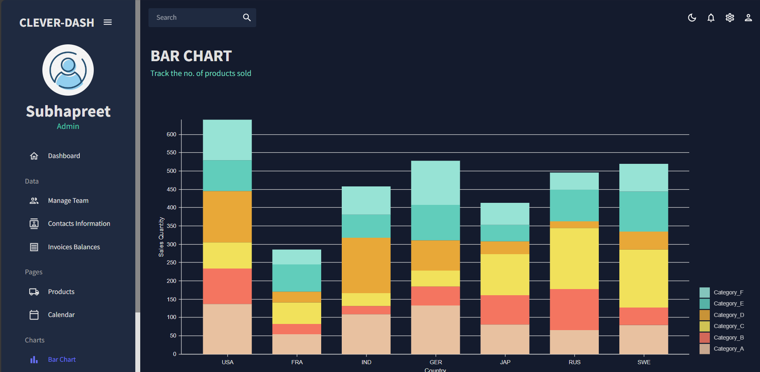
Bar Chart Page

Slide 24
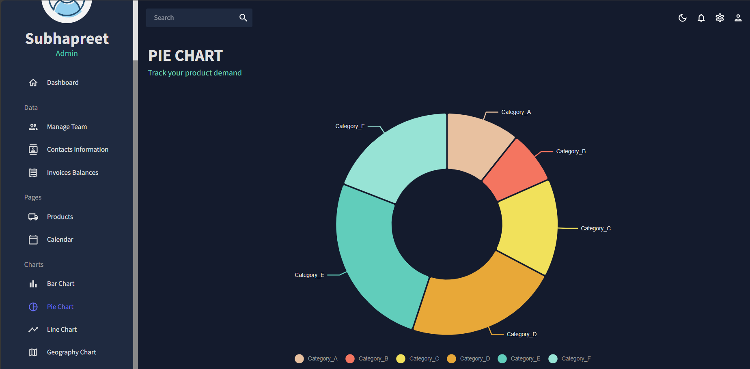
Pie Chart Page

Slide 25
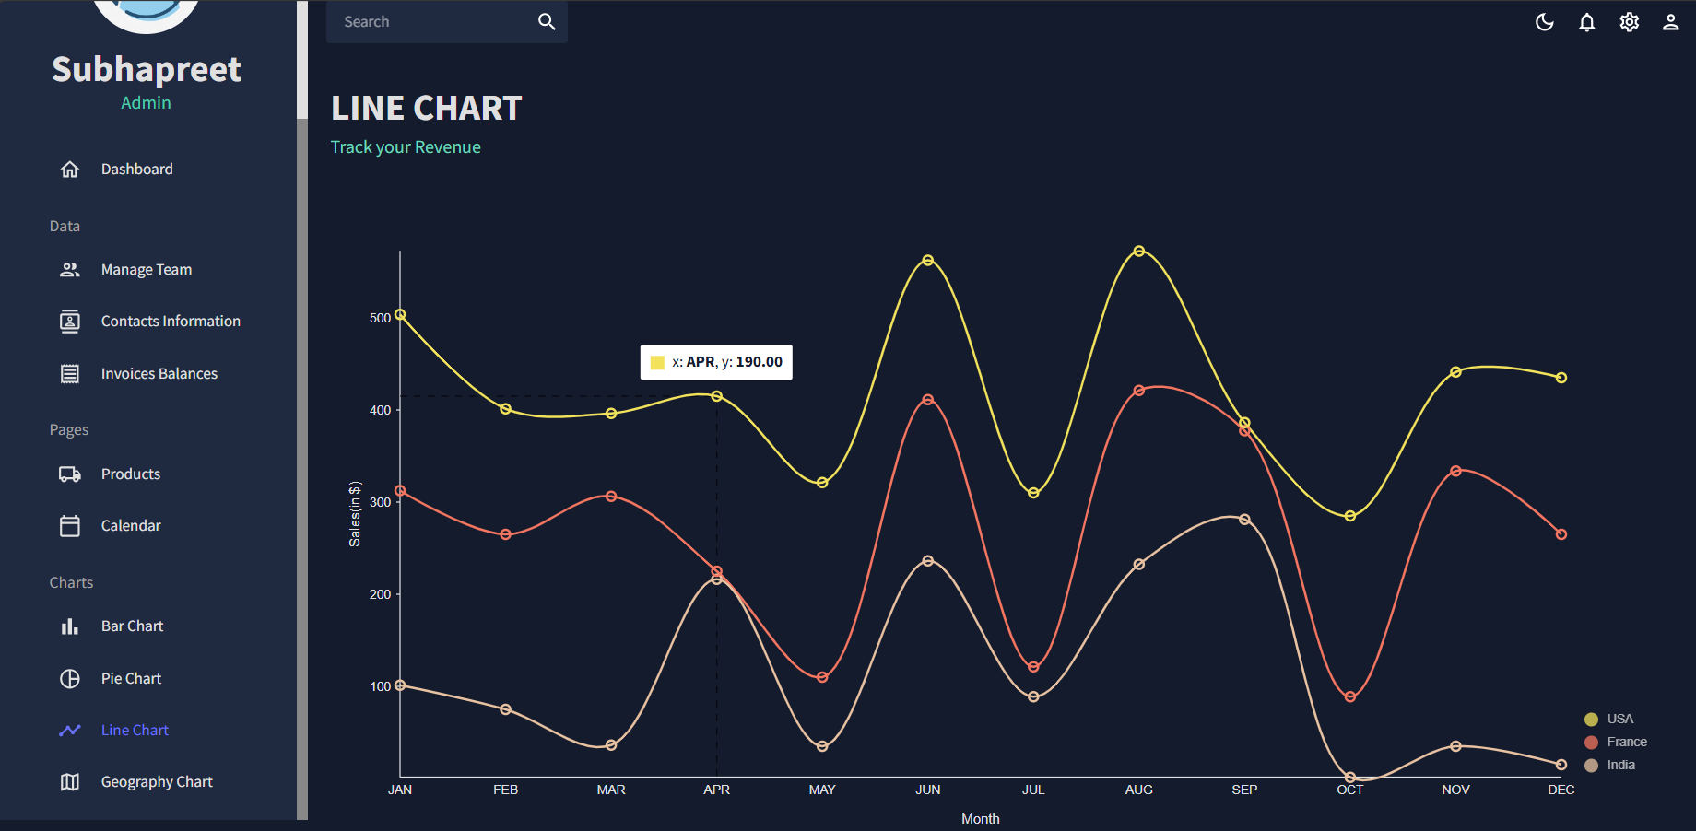
Line Chart Page

Slide 26
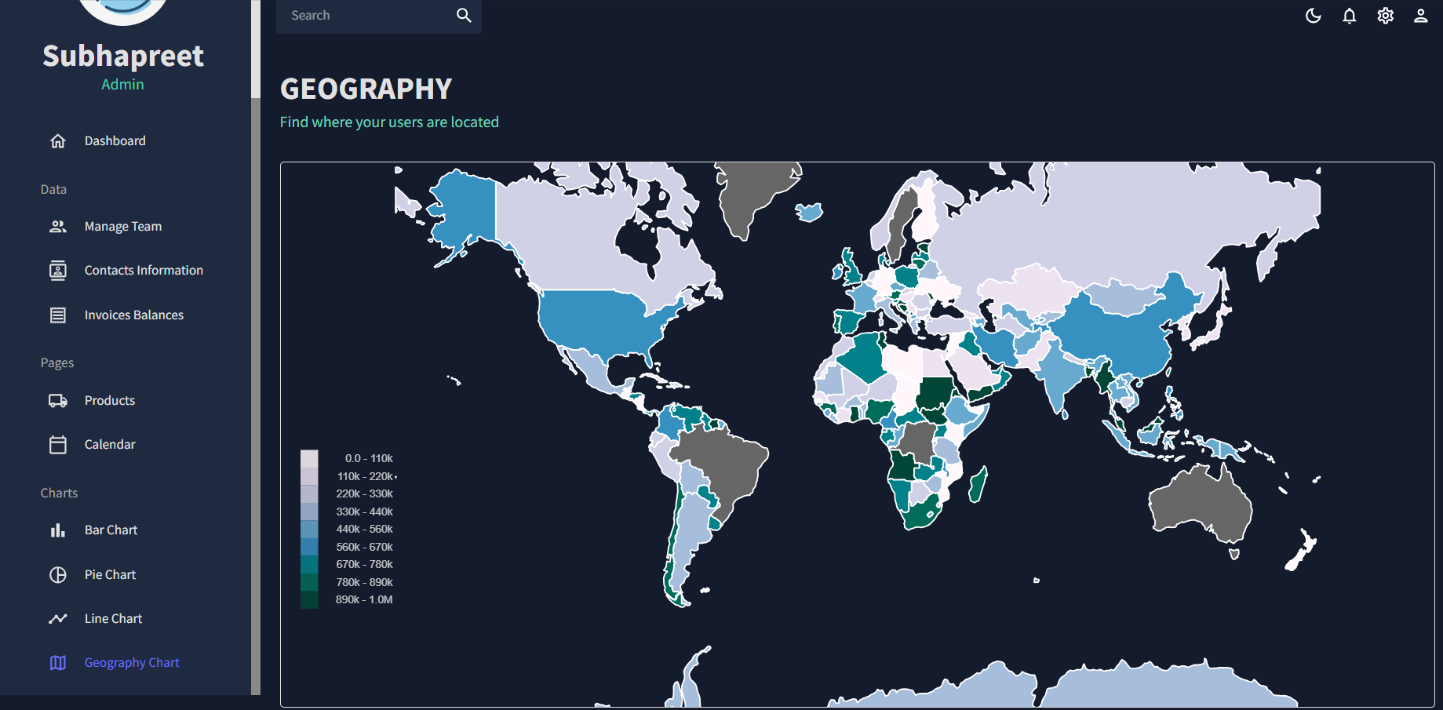
Geography Page

Slide 27
Result & Discussion
Implementing the navbar in the CleverDash app using the MERN stack yields a responsive, scalable, and maintainable solution. The combination of React's efficient rendering, Node.js's robust backend capabilities, Express.js's flexible routing, and MongoDB's scalable database infrastructure ensures that the navbar performs well under varying loads while providing a great user experience. The results of developing and implementing the CleverDash app's navbar using the MERN stack (MongoDB, Express.js, React.js, Node.js) can be assessed across various dimensions such as performance, user experience, scalability, and maintainability.

Slide 28
Conclusion
Clever-Dash offers a user-friendly platform for data visualization and management. With its advanced features and seamless integration capabilities, Clever-Dash empowers users to unlock insights and make informed decisions. It serves as a tool that can be intuitive and also is minimal in complexity that makes it easy for a wider range of users to use

Slide 29
Future Enhancement
Cross-Platform Compatibility :
Ensure Clever-Dash works seamlessly across desktop, web, and mobile devices.
Expanded Data Visualization Options :
Introduce more chart types and advanced visualization techniques.
Personalized Dashboards :
Enhance customization features for tailored user experiences.
Enhanced Data Fetching :
Strengthen integration capabilities with external data sources.

Slide 30
References
Material UI Documentation (https://material-ui.com/): Material-UI is a popular React UI framework that provides pre-designed components following Google's Material Design principles
Nivo Charts Documentation (https://nivo.rocks/): Nivo is a rich collection of customizable React components for building data visualization charts.
Node.js Documentation (https://nodejs.org/en/docs/): Node.js is a popular runtime environment for building server-side applications in JavaScript
Express.js Documentation (https://expressjs.com/): Express.js is a minimalist web framework for Node.js, designed for building web applications and APIs.
MongoDB Documentation (https://docs.mongodb.com/): MongoDB is a popular NoSQL database that provides flexibility and scalability for storing and managing data. Its document-oriented nature and rich query capabilities make it suitable for MERN Applications

Slide 31
T H A N K Y O U

