Slide 1


State-wise Voters Information during 2024
Indian Government Dataset Analysis
Source: https://www.data.gov.in/ Dataset: State-wise Voters’ information 📧Email: subhapreetpatro2004@gmail.com 📞Phone : +91-7569753540 LinkedIn : https://www.linkedin.com/in/subhapreet-patro-444a02277/

Slide 2
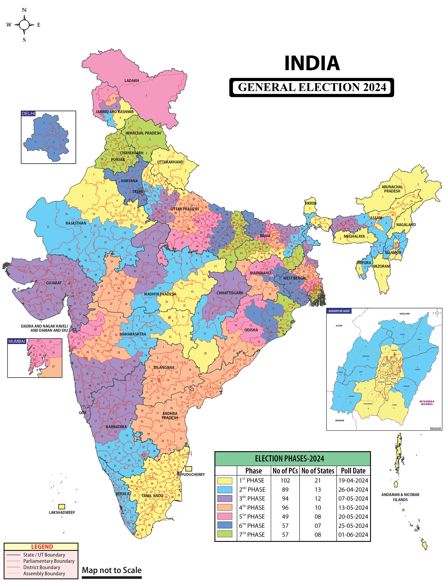
Indian Elections 2024
The 2024 Indian general election, conducted from April 19 to June 1, 2024, was a landmark event in India's democratic history. With over 968 million registered voters, it marked the largest-ever election globally. Approximately 642 million individuals cast their ballots, including a record 312 million women voters.
The incumbent Prime Minister, Narendra Modi of the Bharatiya Janata Party (BJP), sought a third consecutive term. The BJP-led National Democratic Alliance (NDA) secured 293 seats in the 543-member Lok Sabha. Notably, the BJP won 240 seats, a decrease from their 303 seats in 2019, resulting in the loss of their single-party majority.
The opposition coalition, known as the Indian National Developmental Inclusive Alliance (INDIA), made significant gains. The Indian National Congress (INC), a key member of this alliance, increased its parliamentary presence to 99 seats, nearly doubling its previous count.

Slide 3
Initial Analysis of the Dataset
Number of entries: 93
Columns and their explanations:
State Name – Name of the Indian state or union territory.
Constituency Type – Type of constituency: General (GEN), Scheduled Caste (SC), Scheduled Tribe (ST), or Total.
No Of Seats – Number of parliamentary seats in that constituency type.
Electors - Male – Total number of registered male electors.
Electors - Female – Total number of registered female electors.
Electors - Third Gender – Total number of electors identifying as third gender.
Electors - Total – Combined total of all registered electors.
Electors - NRIs – Number of Non-Resident Indian electors.
Electors - Service – Number of service electors (e.g., armed forces).
Voters - Male – Number of male voters who cast their votes.
Voters - Female – Number of female voters who cast their votes.
Voters - Third Gender – Number of third-gender voters who cast their votes.
Voters - Postal – Number of votes received via postal ballots.
Voters - Total – Total number of votes cast.
Voters - NRIs – Number of NRI voters who voted.
Voters - Poll % – Voter turnout percentage.
Rejected Votes (Postal) – Number of rejected postal ballots.
Evm Rejected Votes – Number of rejected EVM (Electronic Voting Machine) votes.
NOTA Votes – Number of votes for "None of the Above" option.
Valid Votes Polled – Number of valid votes cast.
Tendered Votes – Number of tendered votes (votes cast under special circumstances).

Slide 4
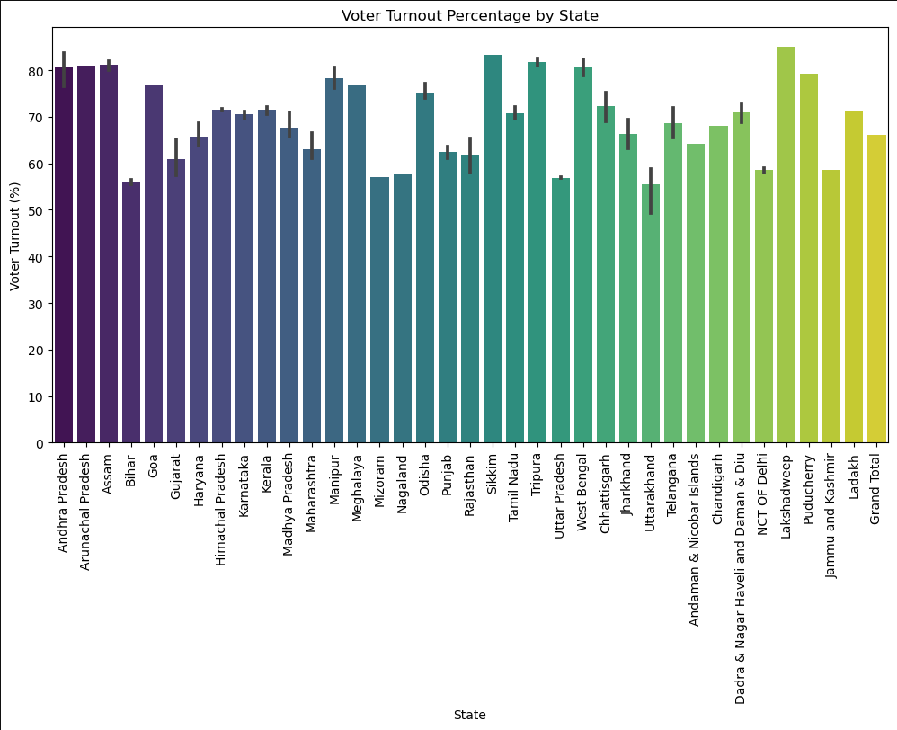
Voter Turnout Percentage by State
This graph shows voter turnout percentage for each state during the 2024 Indian general election.
Each bar represents a state, and its height indicates the percentage of eligible voters who actually voted.
Some states like Nagaland, Lakshadweep, or West Bengal might show very high voter turnout.
Others like Bihar or Uttar Pradesh could show relatively lower turnout.

Slide 5
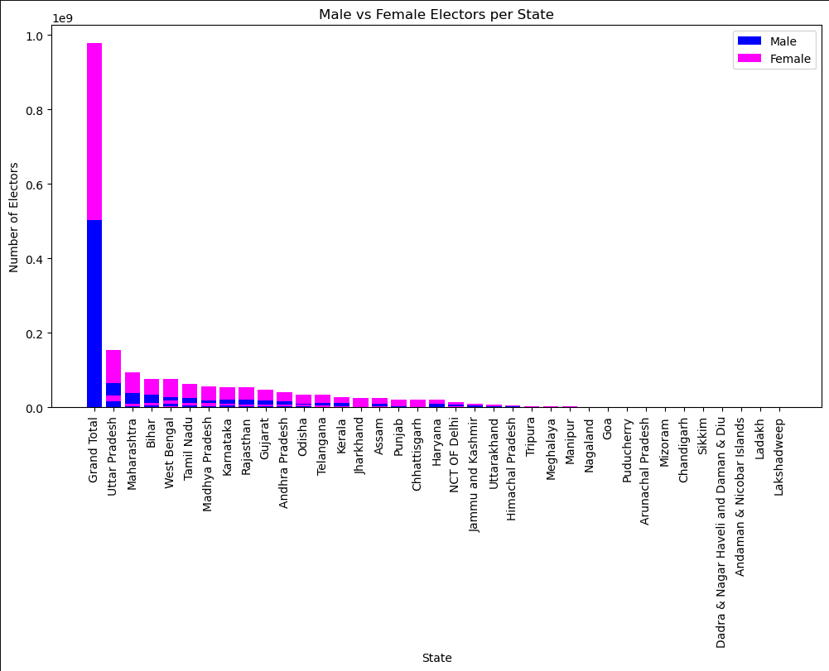
Male vs Female Electors per State
This is a stacked bar chart comparing the number of male and female electors across different states.
The states are sorted in descending order by total number of electors, so the largest voting populations appear first.
Each bar's height shows the total number of electors, split into:
Blue section: Male electors.
Magenta section: Female electors.
Uttar Pradesh, Maharashtra, and Bihar probably have the largest electorate sizes.
The gap between male and female electors varies by state — in many states, the number of female electors is catching up to or exceeding male electors.
Some smaller states/UTs like Lakshadweep or Sikkim have very short bars (i.e., small electorates).

Slide 6
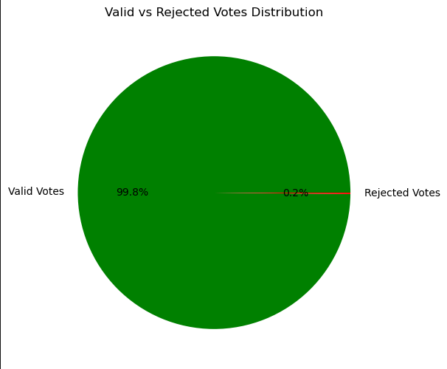
Valid vs Rejected Votes Distribution
This pie chart shows the proportion of valid and rejected votes in the 2024 Indian general election (based on the dataset).
The total values are calculated across all states:
Valid Votes from the column Valid Votes Polled.
Rejected Votes are the sum of Rejected Votes (Postal) and EVM Rejected Votes.
The majority of the votes are valid — usually well over 98%.
Rejected votes (both postal and EVM) account for a small fraction, often due to technical errors, mismatches, or improper markings.
This visualization reinforces the efficiency of the voting system while also showing the scale of vote rejection.

Slide 7
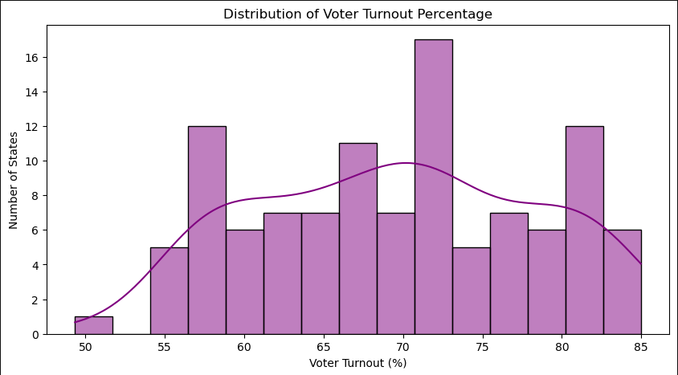
Distribution of Voter Turnout Percentage
This is a histogram with a Kernel Density Estimate (KDE) curve showing how voter turnout percentages are distributed across states.
The X-axis represents voter turnout percentage (from 0% to 100%), and the Y-axis shows how many states fall within each percentage range.
Most states probably have a turnout between 70% and 85%, forming a noticeable peak in that range.
Very few states have extreme turnout (either below 60% or above 90%).
The KDE curve helps visualize the smooth distribution — likely showing a slightly right-skewed or bell-shaped curve.
This graph highlights the consistency in voter engagement across most Indian states during the 2024 election.

Slide 8
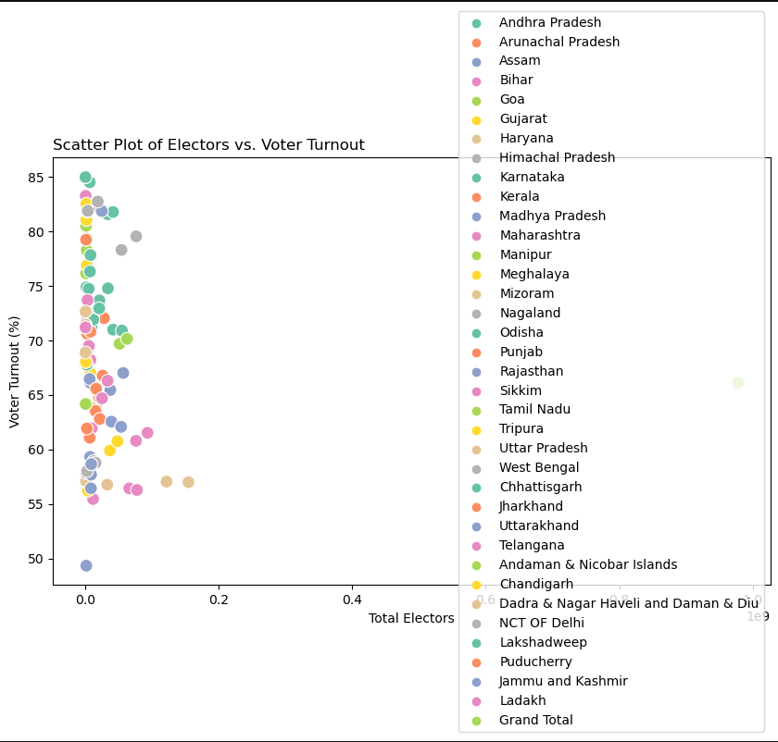
Electors vs Voter Turnout
This scatter plot shows the relationship between the total number of electors in a state and the voter turnout percentage in that state.
Each point represents a state, and colors differentiate them using the hue="State Name" parameter.
No strong linear correlation is likely — meaning just because a state has more electors doesn’t guarantee higher or lower turnout.
Some smaller states/UTs with fewer electors may have very high turnout percentages (e.g., Lakshadweep, Nagaland).
Larger states like Uttar Pradesh or Maharashtra may have moderate to slightly lower turnout despite having large elector bases.
This plot helps identify outliers — states that defy the trend, e.g., very high elector count but low turnout or vice versa.

Slide 9
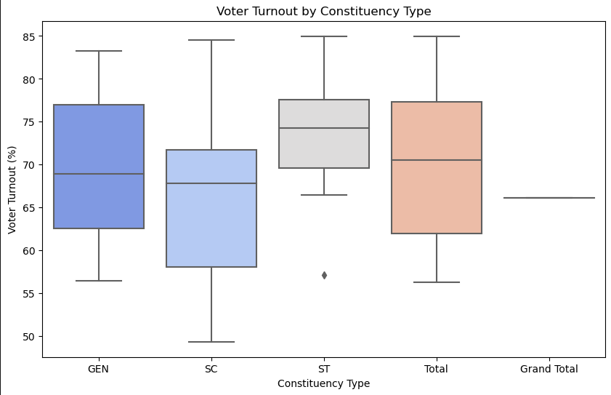
Voter Turnout by Constituency Type
This box plot compares voter turnout percentages across different constituency types:
GEN (General),
SC (Scheduled Castes),
ST (Scheduled Tribes),
Possibly Total as well (aggregated values).
Median turnout for each type is shown by the horizontal line inside the box.
The interquartile range (IQR) shows where the middle 50% of the data lies.
Outliers (unusually high or low turnouts) may appear as dots.
ST constituencies may show higher voter engagement, which is a trend seen in past Indian elections.
GEN constituencies might show more spread or variability in turnout.

Slide 10
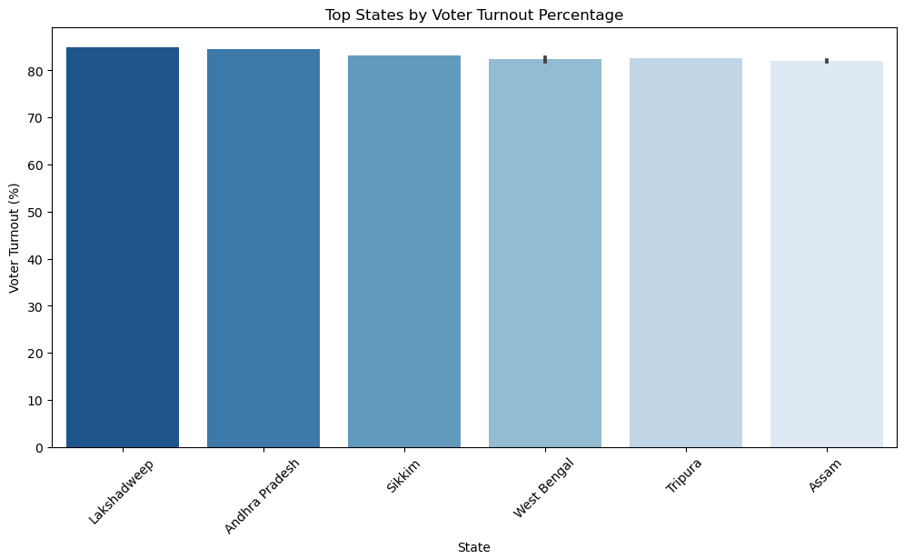
Top States by Voter Turnout Percentage
This bar chart highlights the top 10 states/UTs with the highest voter turnout in the 2024 Indian general election.
The chart uses a reversed blue palette (Blues_r) to visually emphasize higher values with darker shades.
States like Nagaland, Lakshadweep, Meghalaya, and Mizoram often feature in high-turnout lists due to strong local political engagement.
These states might show turnout above 85–90%, which is significantly higher than the national average.
The graph offers a quick view of where voter participation was most enthusiastic.

Slide 11
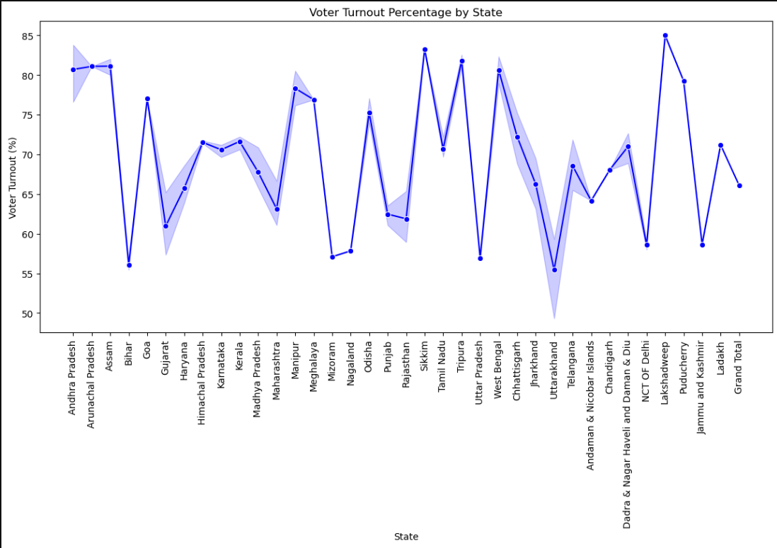
Voter Turnout Percentage by State
This line plot visualizes the voter turnout percentage for each state in a connected and continuous manner.
Each state is represented along the X-axis, and the corresponding voter turnout percentage is plotted on the Y-axis.
Markers (o) highlight exact points for better visibility.
You’ll observe fluctuations in voter turnout as you move from one state to another.
Peaks in the plot indicate states with exceptionally high turnout, while dips show states with lower civic participation.
Helps quickly spot outliers or unusual patterns, like consistently high turnout in northeastern states or lower turnout in some northern regions.

Slide 12
Conclusion
Voter turnout across most states ranged between 65–85%, with northeastern states and UTs like Nagaland and Lakshadweep showing the highest participation.
Male electors slightly outnumber female electors, but the gap is narrowing in many states.
Valid votes made up the vast majority, with very few rejected votes, reflecting an efficient election process.
ST constituencies had higher median turnout, while General constituencies showed greater variability.
No strong link was found between elector size and turnout, meaning larger states didn’t always vote more.
Overall, the data shows strong voter engagement, with scope for improvement in some larger states.

