Slide 1

Smart Bengal Hackthon (SBH-Sr)-2025
Team Name: EncryptedOmega
PS No. : SBHRCCIIT020
Area/Theme: AI/ML and NLP
AI mentor platform for personalized career guidance and professional development.
Category: Software

Slide 2
Objective:
Empower individuals with AI-driven career guidance, job recommendations, and resume enhancement to bridge the gap between skills and market demands.
Provide personalized insights, interview coaching, and networking opportunities to help users make informed career decisions and achieve professional growth.
Major Societal Benefit:
Bridging the Employment Gap
Enhancing Career Readiness
Target Community:
Students & Fresh Graduates
Job Seekers & Professionals
Career Switchers & Freelancers
Other Application Areas:
Educational Institutions
Corporate HR & Recruitment
Upskilling & Reskilling Platforms

Slide 3














Market/Literature Survey :
Technology Trends in Career Guidance :
Competitor Analysis :
Market Need & Differentiation :
Existing platforms lack personalized AI-driven feedback.
No unified platform integrating resume enhancement, job search, and networking.
Our AI-powered solution offers end-to-end career support at free of cost.
Platform | Key Features | Pricing
LinkedIn Career Explorer | Job suggestions, skill gap analysis, networking | Free/Premium($29.99/month)
Glassdoor | Salary insights, company reviews, job search | Free
VMock | Resume feedback, career coaching | University Subscription

Slide 4
Novelty (comparative study between proposal & survey):
End-to-End AI-Powered Career Assistance → Unlike traditional job portals, our platform integrates AI-driven career guidance, resume enhancement, job recommendations, and networking opportunities in a single ecosystem.
Real-Time Job Market Insights → While existing platforms rely on static databases, our solution uses Google Search API and web scraping to fetch the latest job openings and industry trends dynamically.
Personalized AI Mentor & Skill Development → Unlike platforms that only provide job listings, our AI mentor analyzes strengths, suggests skill-building exercises, and offers interview coaching for continuous career growth.

Slide 5
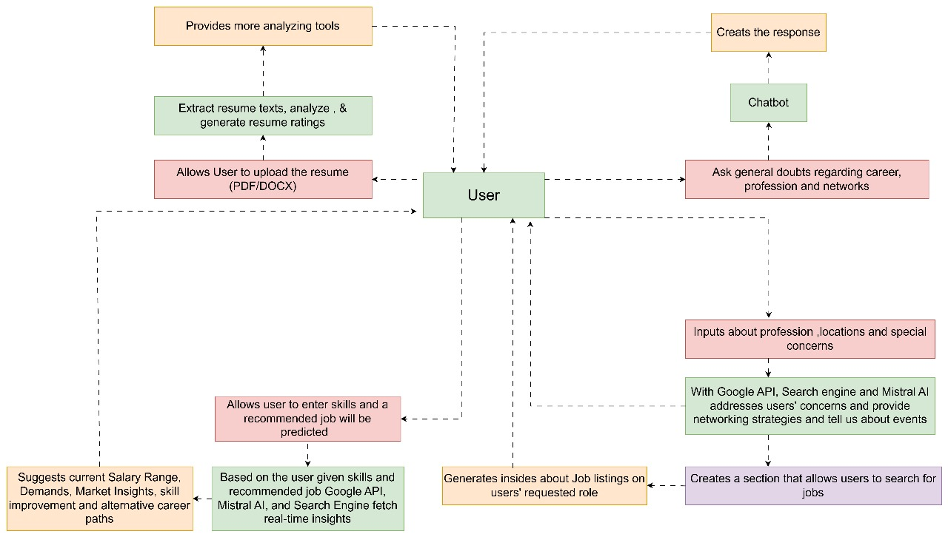
Architecture/Block diagram (in brief):

Slide 6
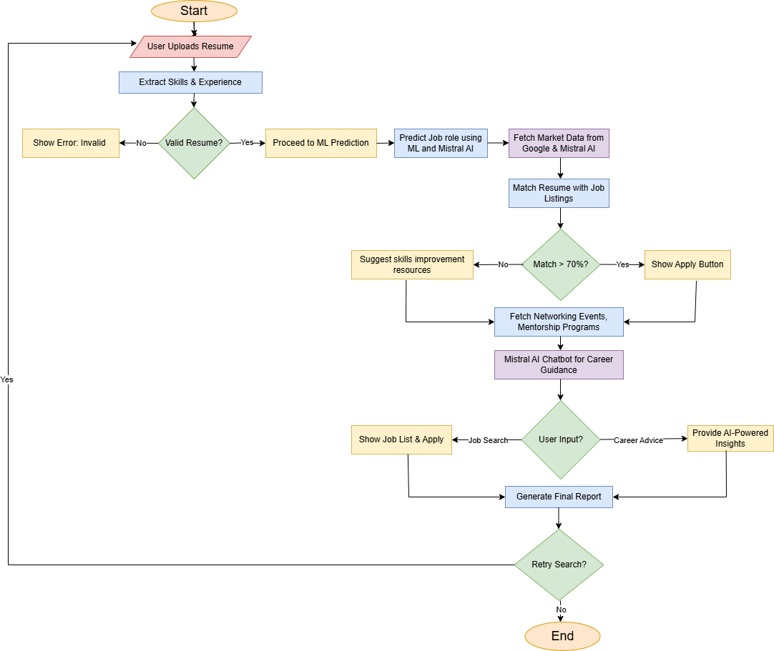
Data flow diagram/ Signal flow diagram:

Slide 7
Software used (whether open source, mention):
Programming & Development:
Python (Open Source) - Backend logic and AI processing
Streamlit (Open Source) - Web-based UI for job recommendations
pdfplumber (Open Source) - Extracting text from PDFs
Python-docx (Open Source) - Handling DOCX resume files
Artificial Intelligence & Machine Learning:
Mistral AI - AI-based resume analysis and job matching
Google API - Fetching job listings
Google Search Engine – Feasible search operation
Database & Storage:
Streamlit's inbuilt features
Deployment & Hosting (Planned not Excuted yet):
Render (Cloud-based )
GitHub (Open Source)

Slide 8
Features (highlight keywords):
AI-Based Resume Analysis – Extracts key skills, experiences, and strengths from resumes.
Automated Resume Rating & Suggestions – Provides improvement tips for a stronger resume.
Job Matching with AI – Matches user skills with real-time job listings using Mistral AI.
Alternative Career Recommendations – Suggests career paths based on skills and interests.
Personalized Job Recommendations – Fetches jobs from Google API tailored to user profiles.
Networking Insights – Provides suggestions for LinkedIn connections and industry contacts.
Interactive User Interface – Simple and user-friendly dashboard built with Streamlit.
Data Storage – Handled by Streamlit's inbuilt features for smooth management.
Cloud Deployment – Hosted on Render for seamless access and updates.
🚀 The project is still ongoing, with continuous improvements being made to enhance accuracy, user experience, and the range of career guidance features.

Slide 9
Team details
Name | College/ University Name | Department | Degree | Year | Univ Roll No | Position
Subharjun Bose | Guru Nanak Institute of Technology | CSE | B.Tech | 3rd | 500122010031 | Team Leader
Swayam Bhargava | Guru Nanak Institute of Technology | CSE | B.Tech | 3rd | 500122010033 | Member
Sahbaj Khan | Guru Nanak Institute of Technology | CSE | B.Tech | 3rd | 500122010040 | Member
Ipsita Jana | Guru Nanak Institute of Technology | CSE | B.Tech | 3rd | 500122020147 | Member
Mentor details
Name | College/University Name | Department
Moloy Dhar | Guru Nanak Institute of Technology | CSE

