Slide 1
User Analytics in the Telecommunication Industry
TellCo Investment Analysis
Presented by: SUBHARSHI DAS PURKAYASTHA

Slide 2
Business Need & Objectives
Evaluate TellCo acquisition
Identify growth opportunities
Four pillars: Overview, Engagement, Experience, Satisfaction

Slide 3
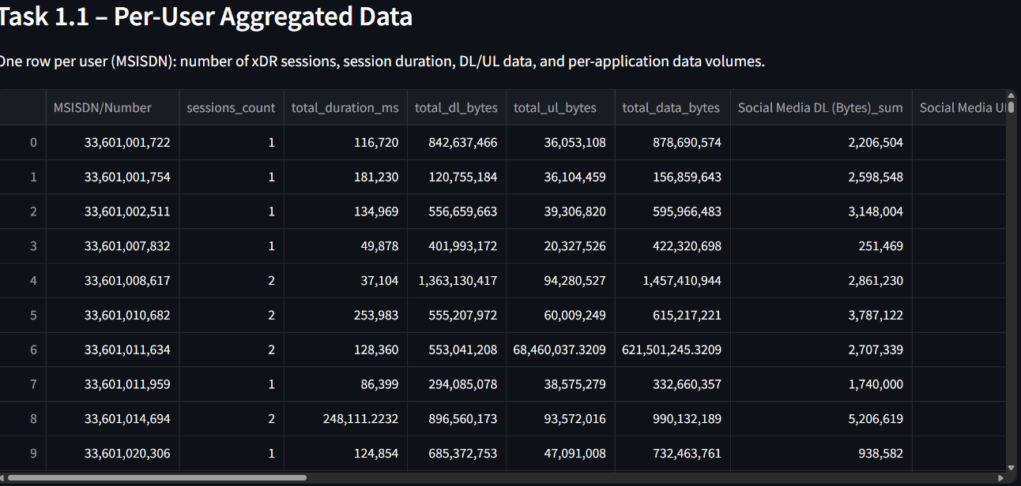
Data Overview
xDR dataset (1 month)
Session data, usage, apps, network metrics

Slide 4
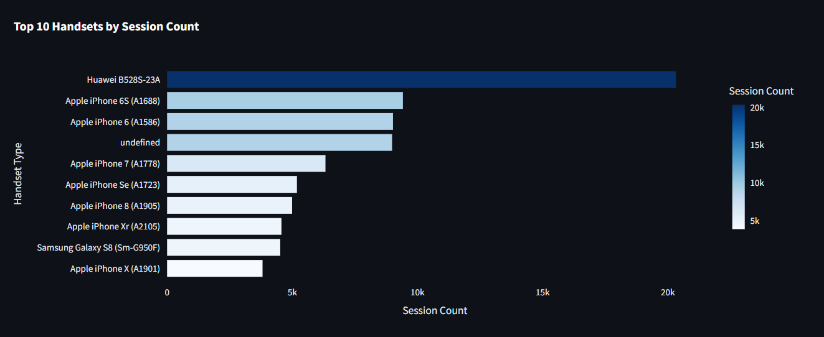
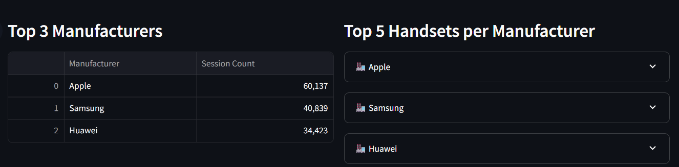
Handset & Manufacturer Trends
Top 10 handsets
Top 3 manufacturers
Top devices per manufacturer

Slide 5
Application Usage
Apps: Social Media, Google, Email, YouTube, Netflix, Gaming
Metrics: data usage & sessions

Slide 6
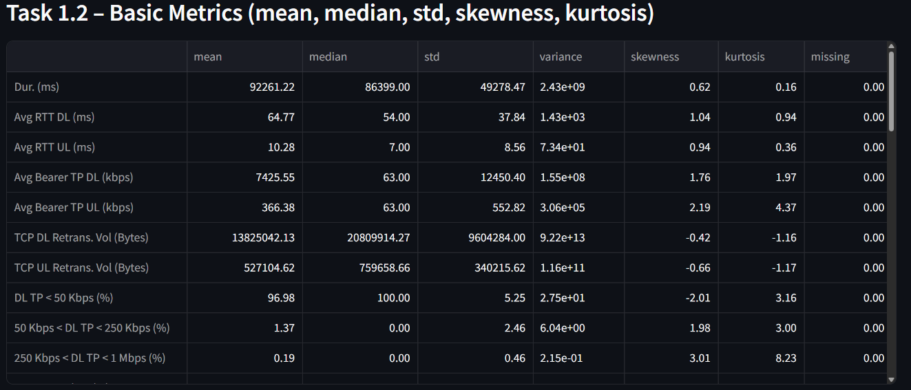
Univariate & Bivariate Insights
Stats: mean, median, std
Outliers handled
App usage vs total traffic

Slide 7
Marketing Recommendations
Target high-usage devices
Focus on heavy users
Promote streaming & gaming

Slide 8
Engagement Metrics
Session frequency
Session duration
Total traffic

Slide 9
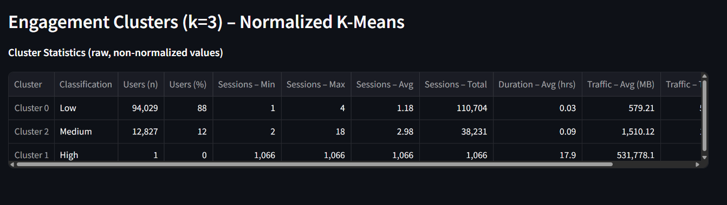
Customer Segmentation (K-Means)
K=3 clustering
Elbow method used

Slide 10
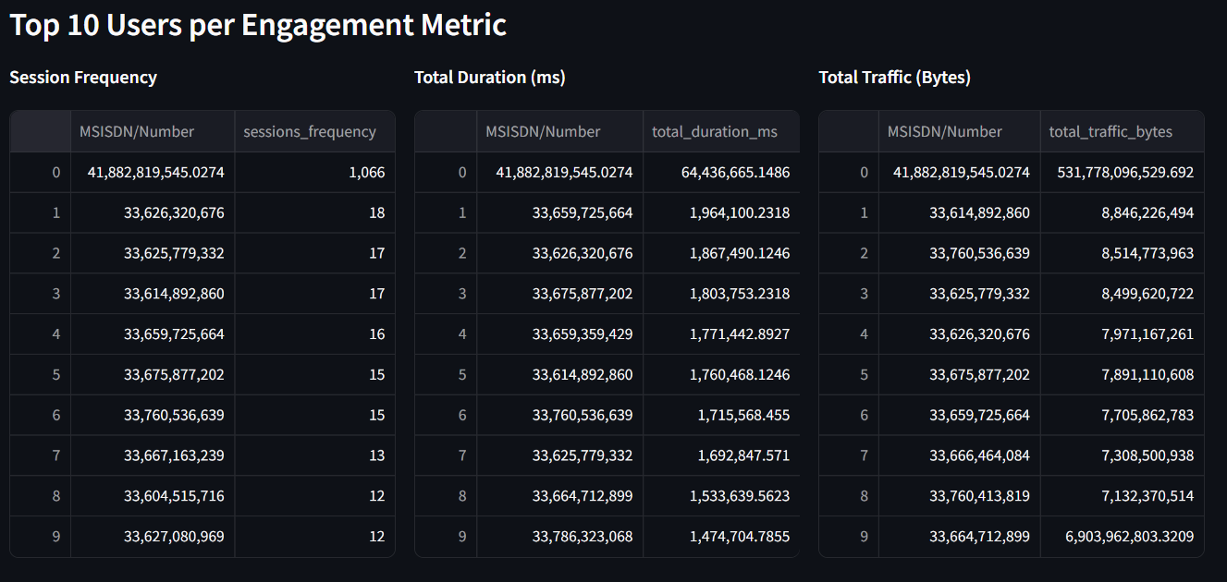
Top Engaged Users
Top 10 users per metric
Top users per app

Slide 11
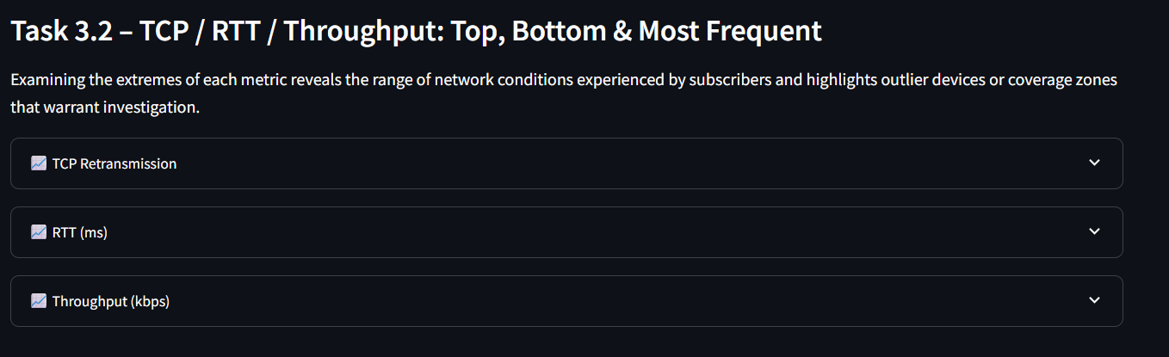
Network Performance
TCP retransmissions
RTT
Throughput

Slide 12
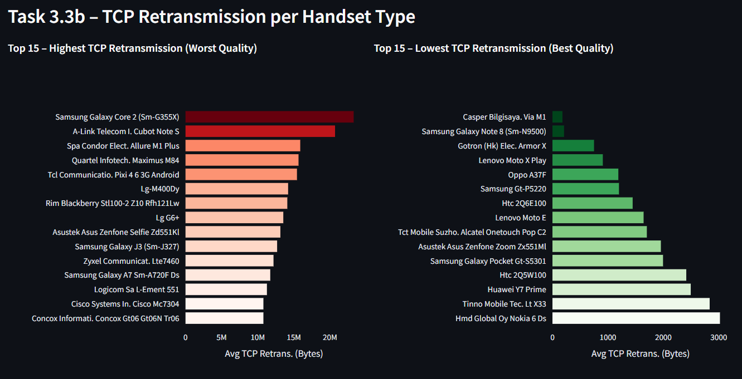
Device Experience
Performance by handset
Throughput distribution
TCP trends

Slide 13
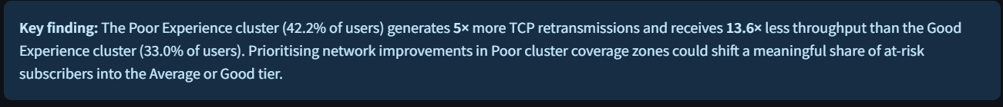
Experience Clusters
Cluster 1: High performance
Cluster 2: Average
Cluster 3: Poor

Slide 14
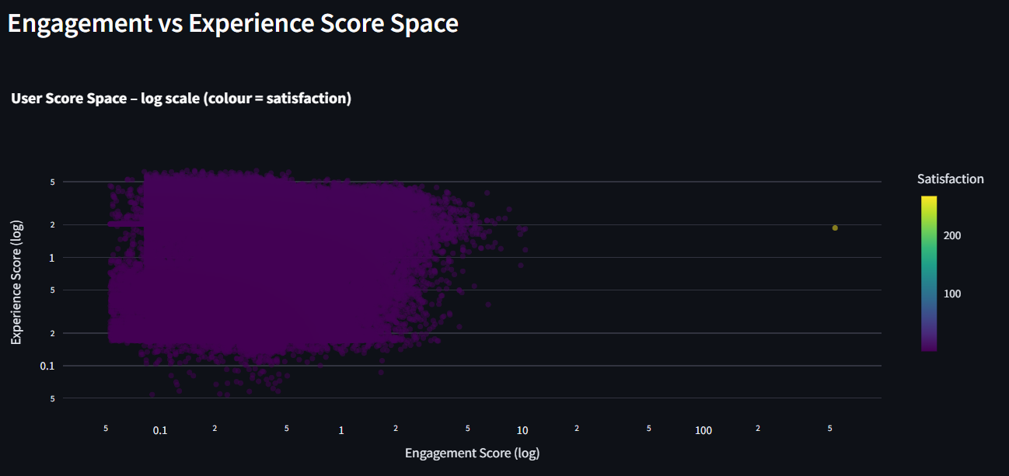
Scoring Methodology
Engagement score: distance from low cluster
Experience score: distance from worst cluster
Method: Euclidean

Slide 15
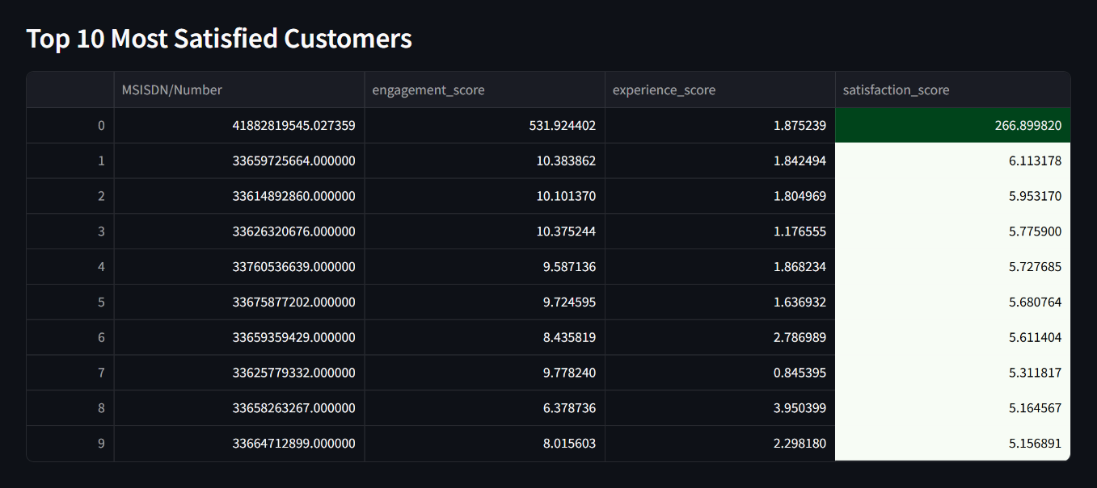
Satisfaction Ranking
Satisfaction = avg(engagement, experience)
Top 10 users

Slide 16
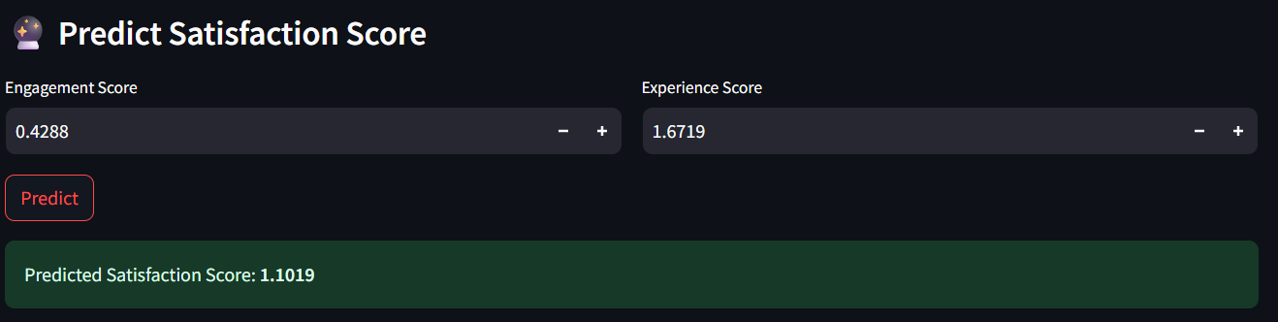
Predictive Modeling
Regression model
Inputs: engagement & experience
Output: satisfaction

Slide 17
Growth Potential
High data usage
Strong engagement
Optimization opportunities

Slide 18
Final Verdict
BUY and Target 25-30% profitability increase via optimization.

Slide 19
Limitations
Only 1 month data
No revenue data
Model assumptions

Slide 20
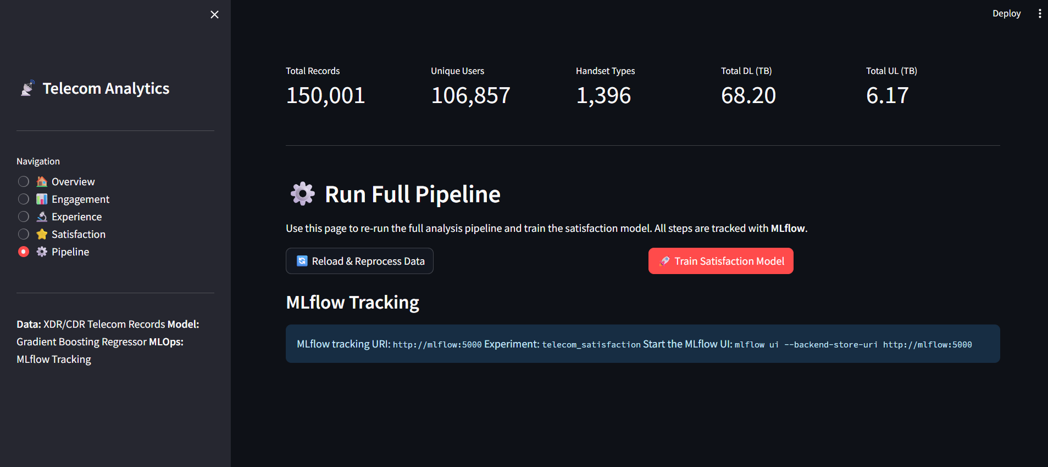
Dashboard & References
Streamlit link: http://localhost:8501/ (Local File)
GitHub link: https://github.com/Subharshi1997/Telecom-Analytics-Project-4.git

