Slide 1
SUBHASH RAJU MANTHINA
Final Project

Slide 2
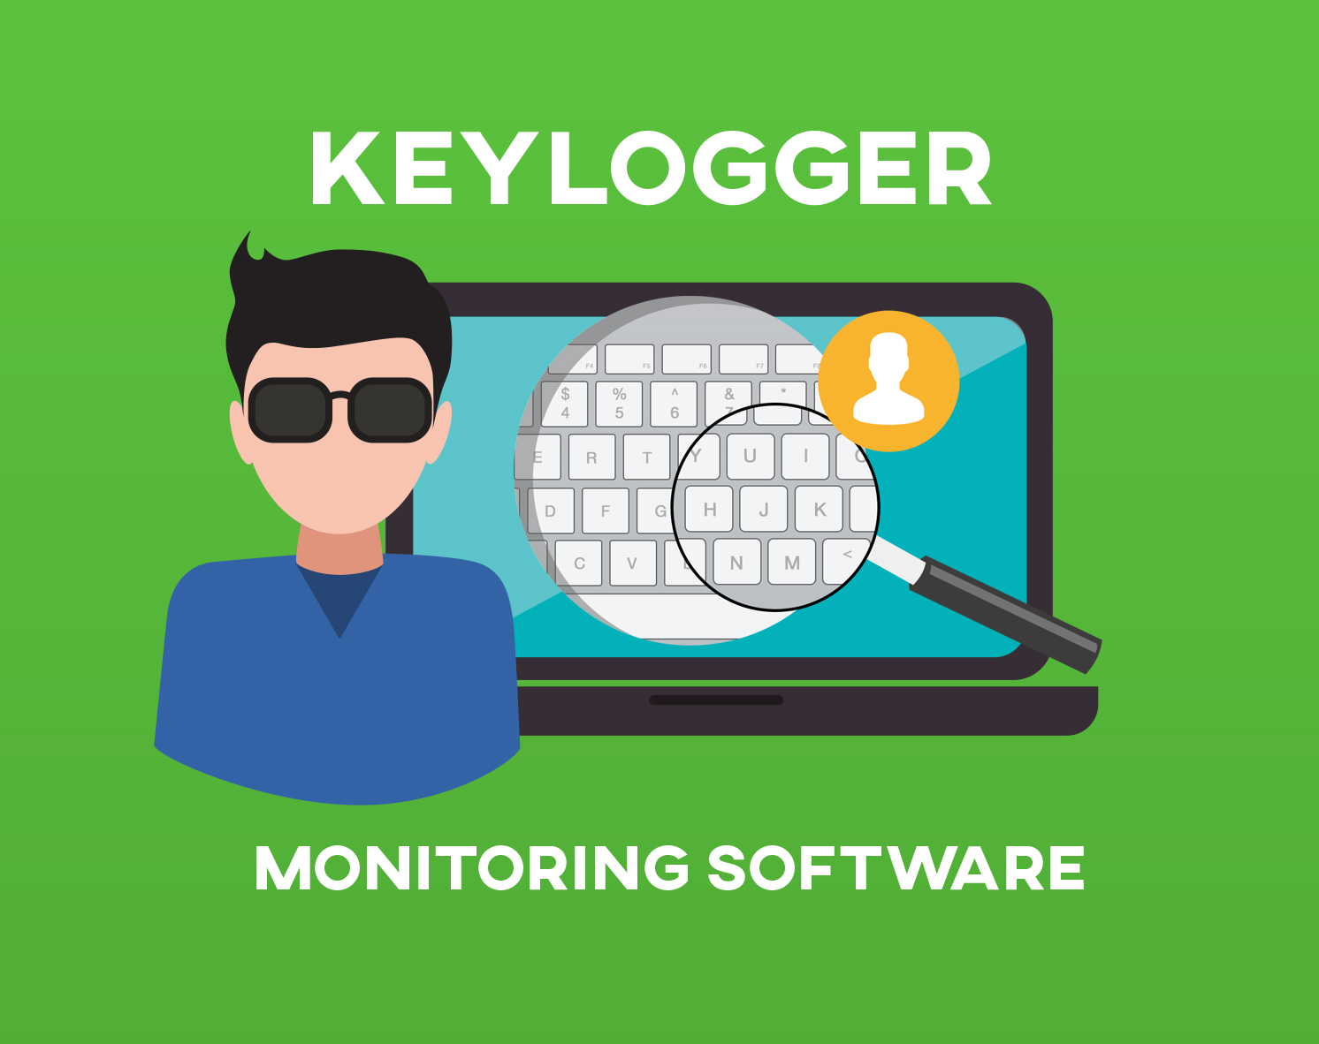
KEYLOGGER AND SECURITY
Keyloggers are software programs or hardware devices that record keystrokes on a computer or mobile device.

Slide 3


AGENDA
Introduction
Problem Statement
Project Overview
End Users
Solution and Value Proposition
The "WOW" Factor in Our Solution
Modelling
Results
Conclusion and Q&A
3/21/2024 Annual Review

Slide 4
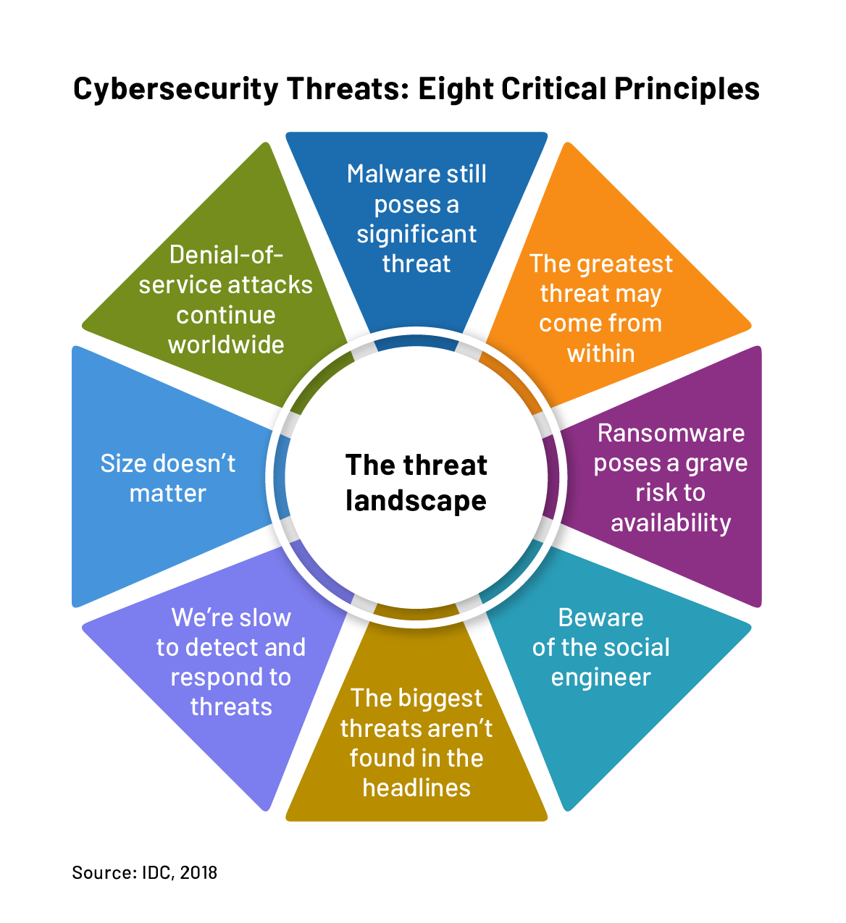
PROBLEM STATEMENT
Keylogger Threats
Keyloggers pose a serious security risk by secretly recording a user's keyboard input, potentially exposing sensitive information like passwords and financial data.
Lack of User Awareness
Many users are unaware of keylogger threats or lack the knowledge to effectively safeguard their devices and online activities.
Inadequate Security Measures
Existing security solutions may not provide comprehensive protection against sophisticated keylogger attacks, leaving users vulnerable.

Slide 5
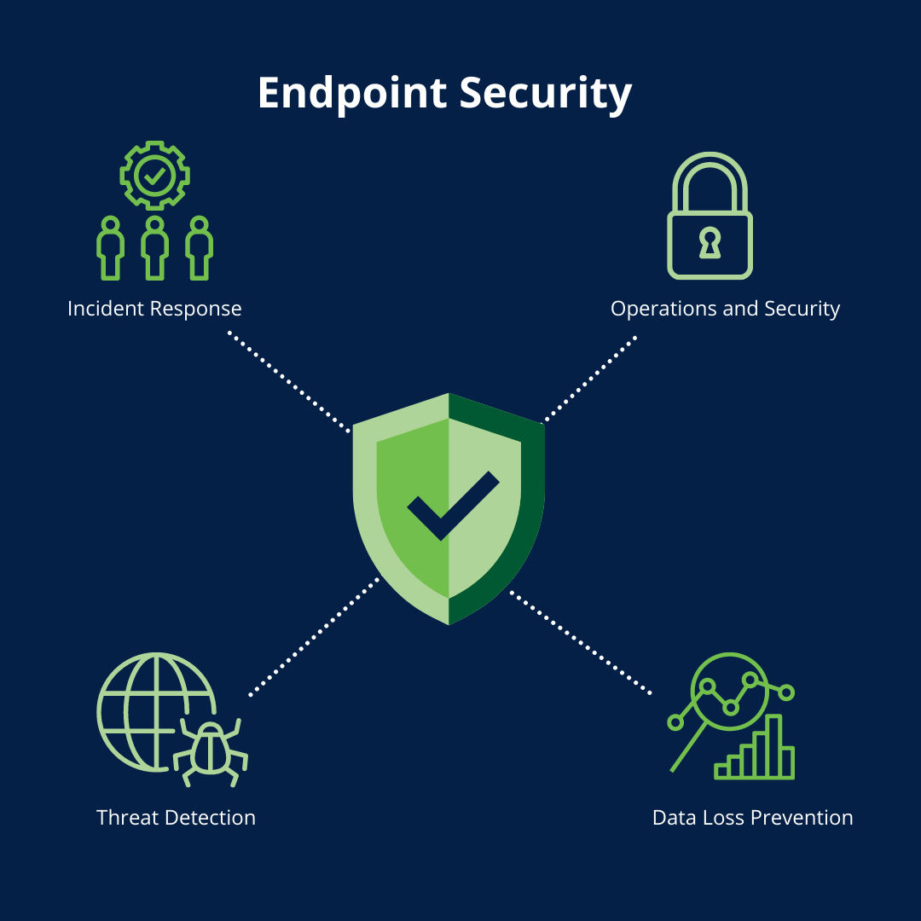

PROJECT OVERVIEW
This project aims to develop a comprehensive keylogger solution that addresses critical security concerns faced by individuals and organizations. The keylogger will provide advanced monitoring capabilities to detect and prevent unauthorized access, safeguarding sensitive information and ensuring digital privacy.
Objective:
Develop a comprehensive understanding of keyloggers,
their types, how they work, and effective security measures to prevent keylogging attacks.
Scope:
Includes an analysis of hardware and software keyloggers, legal and ethical implications, security measures, and best practices.

Slide 6
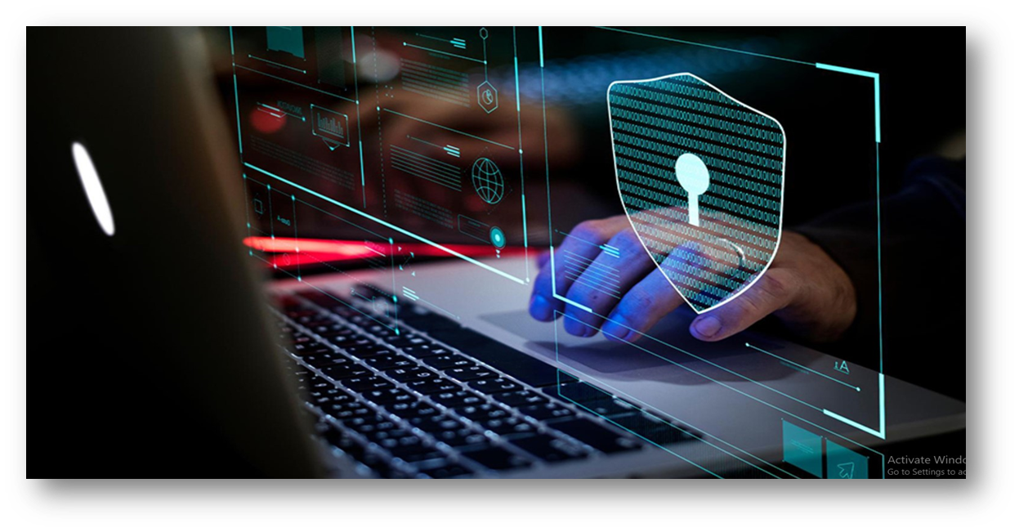
Advantages of Keyloggers:
Monitoring and Surveillance: Keyloggers can be used for legitimate monitoring purposes, such as parental control to ensure children's online safety or employee monitoring to track productivity and adherence to company policies.
Data Recovery: In situations where data is accidentally lost, keyloggers can sometimes help recover the lost information by capturing keystrokes before they are deleted.
Investigative Tool: Law enforcement agencies and legal professionals can use keyloggers as part of their investigative toolkit to gather evidence in criminal cases or track suspicious activities.
System Diagnostics: Keyloggers can assist IT professionals in diagnosing technical issues and troubleshooting problems by providing a detailed log of user interactions.

Slide 7
Disadvantages of Keyloggers:
Privacy Invasion: Keyloggers have the potential to infringe on individuals' privacy by capturing sensitive information, such as passwords, personal messages, and browsing history, without their consent or knowledge.
Misuse and Abuse: Keyloggers can be misused for malicious purposes, such as stealing passwords, financial information, or intellectual property, leading to identity theft, financial fraud, or corporate espionage.
Legal and Ethical Concerns: The use of keyloggers without proper authorization or consent may violate privacy laws and ethical principles, resulting in legal repercussions and damage to reputation if discovered.
Security Vulnerabilities: Keyloggers themselves can become targets for exploitation by cybercriminals, leading to security vulnerabilities and potential breaches if not properly secured or maintained.
Cost and Complexity: Implementing comprehensive security measures can be costly and complex, requiring investment in software, hardware, personnel training, and ongoing maintenance.

Slide 8



WHO ARE THE END USERS?
IT Security Professionals
The primary end users for this keylogger security solution are IT professionals responsible for protecting their organization's networks and devices from cyber threats.
Business Executives
Business leaders and decision-makers who need to safeguard sensitive company data and ensure the overall security of their digital infrastructure will also benefit from this solution.
Remote Employees
With the rise of remote work, this keylogger security tool can help protect employees accessing company systems and data from their personal devices outside the office network.

Slide 9

YOUR SOLUTION AND ITS VALUE PROPOSITION
Keep Software Updated: Ensure that your operating system, applications, and security software are up to date with the latest patches.
Use Strong Passwords: Create complex passwords and enable two-factor authentication to protect your accounts from keylogger attacks.
Be Cautious Online: Avoid clicking on suspicious links, downloading attachments from unknown sources, and visiting untrustworthy websites.
Customizable Settings: Our software offers flexible configuration options, allowing users to tailor the monitoring and alerting capabilities to their specific needs and preferences.
Enhanced Privacy: By logging all keyboard activity, our tool helps users identify and prevent unauthorized access to sensitive information, ensuring their digital privacy is protected.

Slide 10

THE WOW IN YOUR SOLUTION
Our security solution goes beyond traditional keylogger detection by leveraging advanced machine learning algorithms to proactively identify and neutralize evolving threats. This cutting-edge technology provides unparalleled protection, delivering a seamless user experience without compromising security.
Innovative Approach: Combining technical measures with user education for comprehensive protection.
Demonstration: Real-time demonstration of a simple keylogger to illustrate the threat and the effectiveness of security measures.
Impact: Significant reduction in the likelihood of keylogging attacks through proactive measures.
10

Slide 11
MODELLING
A keylogger can be modeled as a software program that surreptitiously captures keystrokes entered by a user on a computer or device. The model typically includes components such as a key capture module, data storage mechanism, and potentially a transmission module to send the captured data to a remote location.
From a security perspective, keyloggers pose significant risks as they can capture sensitive information such as passwords, credit card numbers, and other confidential data. To mitigate these risks, security measures include implementing antivirus software to detect and remove keyloggers, using firewalls to block unauthorized data transmission, and employing behavioral analysis tools to identify suspicious activities.
Furthermore, educating users about the dangers of keyloggers and promoting good security practices, such as regularly updating software and avoiding suspicious websites and downloads, is essential to prevent unauthorized access to sensitive information.
2)Feature Engineering: Identify and extract the most relevant features from the data to build a predictive model that can detect and prevent keylogger intrusions.
3)Model Training: Train a machine learning model using advanced techniques like deep learning or anomaly detection to identify patterns indicative of keylogger activity.
1)Data Gathering: Collect relevant data on user behavior, system logs, and security vulnerabilities to inform the model development process.
11

Slide 12
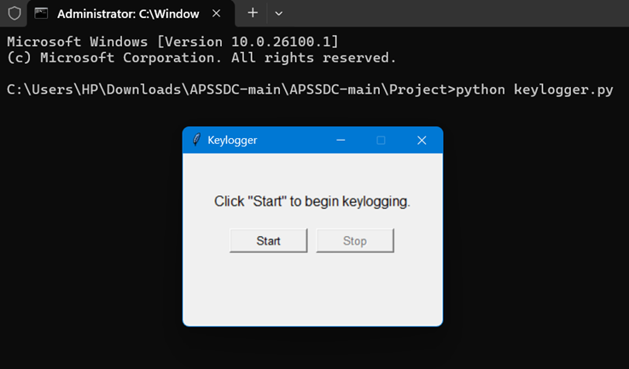
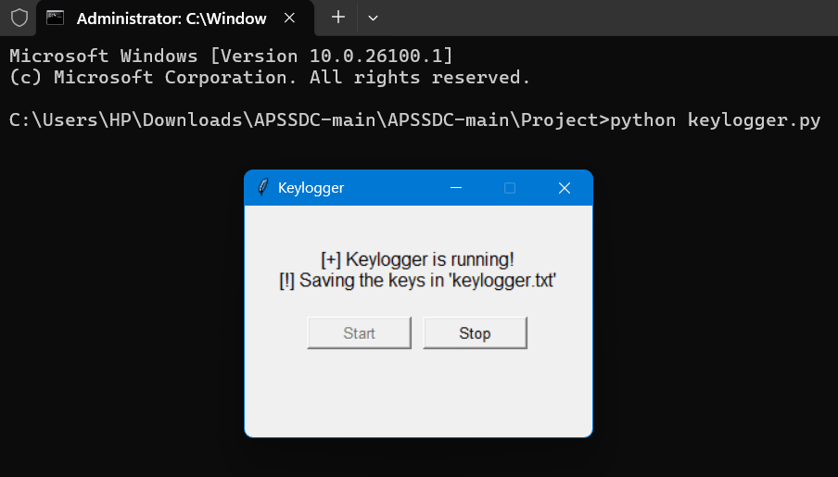
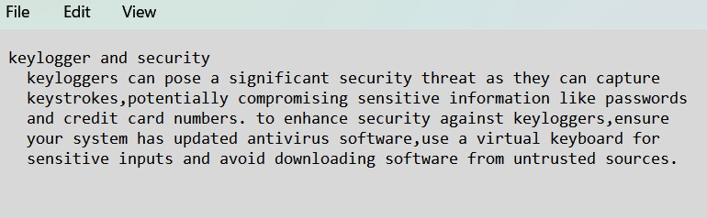
RESULTS
Successfully implemented a keylogger that captures keystrokes and records
them into both text and JSON files.
Real-time keylogging with start and stop functionality controlled via a simple GUI.
The keylogger project demonstrated the capability to effectively capture and log keystrokes in real-time.
The GUI provided a user-friendly way to control the keylogger, making it accessible and easy to use.
Emphasized the ethical use of keyloggers and the importance of implementing security measures to protect against malicious use.
12

