Slide 1


Department of
Computer Science & Engineering
LyASC: Lyapunov-Aware Skip Connections for Stability-Driven Residual Networks
Amrita School of Computing
Amrita Vishwa Vidyapeetham, Chennai Campus
Student Members
1: Subhash R – CH.SC.U4AIE23054
2: Veena Sundari A – CH.SC.U4AIE23060
Guide Details
Dr. Rithani M

Slide 2

Project Title
Project Title
Motivation and Problem Statement
Literature Review
Significance of the Project
Analysis of Base Paper
Insights from Base Paper
Research Gap
Objectives, Scope of the Project
Implementation & Methodology
Architecture Diagram
Workflow Diagram
Results and Conclusion
Limitations
Reference (18 Papers)
Project Plan (Gantt Chart)
Project Title: Lyapunov-Aware Skip Connections for Stability-Driven Residual Networks
Domain: Deep Learning, Residual Networks, Optimization and Stability Analysis
Core Focus: LyASC uses a Lyapunov-inspired local-instability estimate to adapt skip strength in residual blocks.
Final Review Progress:
Base-paper reproduction completed → LyASC gate implemented → LN/BN and scaling ablations evaluated → checkpoints and tests verified → results and limitations consolidated.

Slide 3
Motivation and Problem Statement
Project Title
Motivation and Problem Statement
Literature Review
Significance of the Project
Analysis of Base Paper
Insights from Base Paper
Research Gap
Objectives, Scope of the Project
Implementation & Methodology
Architecture Diagram
Workflow Diagram
Results and Conclusion
Limitations
Reference (18 Papers)
Project Plan (Gantt Chart)
• Skip connections support gradient flow in deep residual networks, but their strength is commonly fixed.
• The reproduced base model showed large error increases under imbalanced skip/residual scaling.
• Normalization alone does not explicitly measure local instability in each residual block.
• Existing gated approaches show that adaptivity is possible, but the control signal differs from LyASC.
Problem statement:
Can a local Lyapunov-inspired instability signal adapt skip strength and reduce failure under scaling stress?

Slide 4
Literature Review
Project Title
Motivation and Problem Statement
Literature Review
Significance of the Project
Analysis of Base Paper
Insights from Base Paper
Research Gap
Objectives, Scope of the Project
Implementation & Methodology
Architecture Diagram
Workflow Diagram
Results and Conclusion
Limitations
Reference (18 Papers)
Project Plan (Gantt Chart)
The literature is grouped into three themes:
1. Residual learning and skip paths — ResNet, Identity Mappings, Stochastic Depth and ResNeXt.
2. Normalization and optimization dynamics — BatchNorm, LayerNorm, Fixup and edge-of-stability analyses.
3. Adaptive routing and stability-aware control — Highway Networks, SkipNet, adaptive inference graphs, Lyapunov-inspired learning and stable neural dynamics.
Literature takeaway: adaptive/gated skips are established; LyASC’s research focus is using a local Lyapunov-inspired instability proxy as the gate-control signal.
The complete 18-paper list appears on the References slide.

Slide 5
Significance of the Project
Project Title
Motivation and Problem Statement
Literature Review
Significance of the Project
Analysis of Base Paper
Insights from Base Paper
Research Gap
Objectives, Scope of the Project
Implementation & Methodology
Architecture Diagram
Workflow Diagram
Results and Conclusion
Limitations
Reference (18 Papers)
Project Plan (Gantt Chart)
Aspect | Significance
Stability-Driven Design | Makes training stability an explicit architectural objective rather than an indirect outcome.
Adaptive Skip Control | Dynamically adjusts skip contribution according to local block behaviour instead of using only fixed scaling.
Gradient Regulation | Targets vanishing, exploding and highly uneven gradient propagation across network depth.
Research Contribution | Connects Lyapunov-inspired dynamical analysis with adaptive residual-network architecture.
Falsifiable Evaluation | Directly compares LyASC against fixed-skip, normalization and gradient-driven adaptive gates.
• Stability-aware design: treats local training dynamics as an explicit control signal.
• Adaptive skip control: adjusts the identity/residual balance per block rather than using only fixed coefficients.
• Experimental contribution: directly compares against reproduced fixed-skip, normalization and learned-gate baselines.
• Evidence-led evaluation: includes multiple seeds and explicit stress tests.
Scope of claim: results demonstrate strong recovery in two stress regimes, but do not establish universal stability or superior clean accuracy.

Slide 6
Analysis of Base Paper
Experimental Setup Reproduced:PreAct-ResNet-110 + CIFAR-10 with the paper's skip/normalization variants and layer-wise gradient analysis. The paper formulates residual blocks approximately as:
y=G(λx+F(x,W))
where λ controls skip strength.
Project Title
Motivation and Problem Statement
Literature Review
Significance of the Project
Analysis of Base Paper
Insights from Base Paper
Research Gap
Objectives, Scope of the Project
Implementation & Methodology
Architecture Diagram
Workflow Diagram
Results and Conclusion
Limitations
Reference (18 Papers)
Project Plan (Gantt Chart)
Configuration | Reproduced Gradient Behaviour
1×Skip | Gradual gradient decrease with depth
2×Skip | Rapid gradient decay → vanishing tendency
0.5×Skip | Irregular propagation + strong final-block spike
2×Skip + BN | Relatively uniform gradient magnitudes
1×Skip + LN | Controlled gradients with late-depth increase
2×Skip + LN | More controlled depth-wise gradient behaviour
2rSkip + LN | Controlled growth but strong final-layer spike
Experimental setup reproduced
• PreAct-ResNet-110 on CIFAR-10; standard skip/normalization configurations evaluated across seeds.
• 1× Skip: 6.27% test error; 1× Skip + LayerNorm: 7.92%.
• 2rSkip + LayerNorm: 6.15% — strongest reproduced fixed-schedule baseline.
• Learned scalar gate + LayerNorm: 8.16%.
• Stress failures: 0.5× skip reached 37.14%; 3× residual scaling reached 49.27%.
Conclusion: skip strength and normalization interact substantially; a learned gate is not automatically stable.

Slide 7
Insights from Base Paper
Project Title
Motivation and Problem Statement
Literature Review
Significance of the Project
Analysis of Base Paper
Insights from Base Paper
Research Gap
Objectives, Scope of the Project
Implementation & Methodology
Architecture Diagram
Workflow Diagram
Results and Conclusion
Limitations
Reference (18 Papers)
Project Plan (Gantt Chart)
Observation | Insight for LyASC
2×Skip → rapid decay | Larger skip strength can produce unstable gradient propagation.
0.5×Skip → irregular profile | Smaller fixed scaling can also create non-uniform dynamics.
LN improves several configurations | Normalization can regulate gradients but is not an explicit stability controller.
Late-layer gradient spikes | Average gradient magnitude alone is insufficient; depth-wise stability must be monitored.
2rSkip+LN performs strongly | Adaptive/effective skip ratios can improve optimization, motivating dynamic skip control.
wSkip+LN underperforms recursive scaling | Simply learning the skip weight is not equivalent to stability-aware adaptation.
Key insights from the reproduced base paper
• Skip scaling changes the information/gradient balance across residual depth.
• LayerNorm helps some configurations, but does not prevent collapse under every scaling stress.
• A learned gate alone (8.16%) did not match the best fixed schedule (6.15%).
• The 0.5× skip and 3× residual cases expose measurable failure regimes for stability-aware control.
LyASC’s focused claim is the use of a local stability estimate to control skip strength—not the general idea of gated skips.

Slide 8
Research Gap
Project Title
Motivation and Problem Statement
Literature Review
Significance of the Project
Analysis of Base Paper
Insights from Base Paper
Research Gap
Objectives, Scope of the Project
Implementation & Methodology
Architecture Diagram
Workflow Diagram
Results and Conclusion
Limitations
Reference (18 Papers)
Project Plan (Gantt Chart)
Existing Approach | Control Signal | Limitation
ResNet | Fixed identity skip | No adaptive stability control
Base Paper | Fixed/recursive skip + LN | Improves gradient behaviour but does not explicitly estimate local instability
Highway / Gated Residual Networks | Learned/feature-based gates | Feature-driven, not stability-driven
SkipNet / Dynamic Routing | Activation/content information | Primarily targets computational efficiency
CosineGate | Branch activation geometry | Geometric signal, not local dynamical stability
LyASC (Proposed) | Lyapunov-inspired local instability estimate | Stability-driven adaptive skip control
Identified Gap:
Existing research:Feature / Activation → Gate
Proposed LyASC:
Local Dynamical Stability → Gate
This is the project's specific and testable novelty, rather than the broader claim that adaptive skip connections are new.

Slide 9
Objectives, Scope of the Project
Project Title
Motivation and Problem Statement
Literature Review
Significance of the Project
Analysis of Base Paper
Insights from Base Paper
Research Gap
Objectives, Scope of the Project
Implementation & Methodology
Architecture Diagram
Workflow Diagram
Results and Conclusion
Limitations
Reference (18 Papers)
Project Plan (Gantt Chart)
Objectives — completed/evaluated
• Reproduce base-paper skip-scaling and normalization baselines.
• Implement a bounded Lyapunov-inspired adaptive skip gate.
• Compare LayerNorm vs BatchNorm and gate cold-start strategies.
• Evaluate scaling-stress recovery, seed variation and runtime overhead.
• Re-evaluate checkpoints and verify automated tests.
Scope of completed experiments
• CIFAR-10 + PreAct-ResNet-110; multi-seed evaluation.
• Metrics: test error, run-to-run variability, convergence behaviour and iteration latency.
• CIFAR-100, smaller/deeper backbones and large-scale datasets remain future validation.

Slide 10
Implementation & Methodology
Project Title
Motivation and Problem Statement
Literature Review
Significance of the Project
Analysis of Base Paper
Insights from Base Paper
Research Gap
Objectives, Scope of the Project
Implementation & Methodology
Architecture Diagram
Workflow Diagram
Results and Conclusion
Limitations
Reference (18 Papers)
Project Plan (Gantt Chart)
LyASC residual-block formulation
yₗ = Norm( αₗ · xₗ + (1 − αₗ) · Fₗ(xₗ ) )
1. Estimate local instability with a finite-time Lyapunov-inspired/Jacobian-based proxy.
2. Convert the proxy into a bounded gate αₗ ∈ [0,1] that controls the skip/residual mix.
3. Apply post-gate normalization (LayerNorm2d or BatchNorm2d).
4. Train with matched settings and compare test error, seed spread, gradient behaviour and runtime.
Experiment matrix: fixed/recursive skip baselines; learned-gate baseline; LyASC+LN; LyASC+BN; cold-start and scaling-stress ablations.
Implementation validation: 78 unit tests passed; 9 checkpoints re-evaluated on the 10,000-image CIFAR-10 test set; CPU demo available.

Slide 11
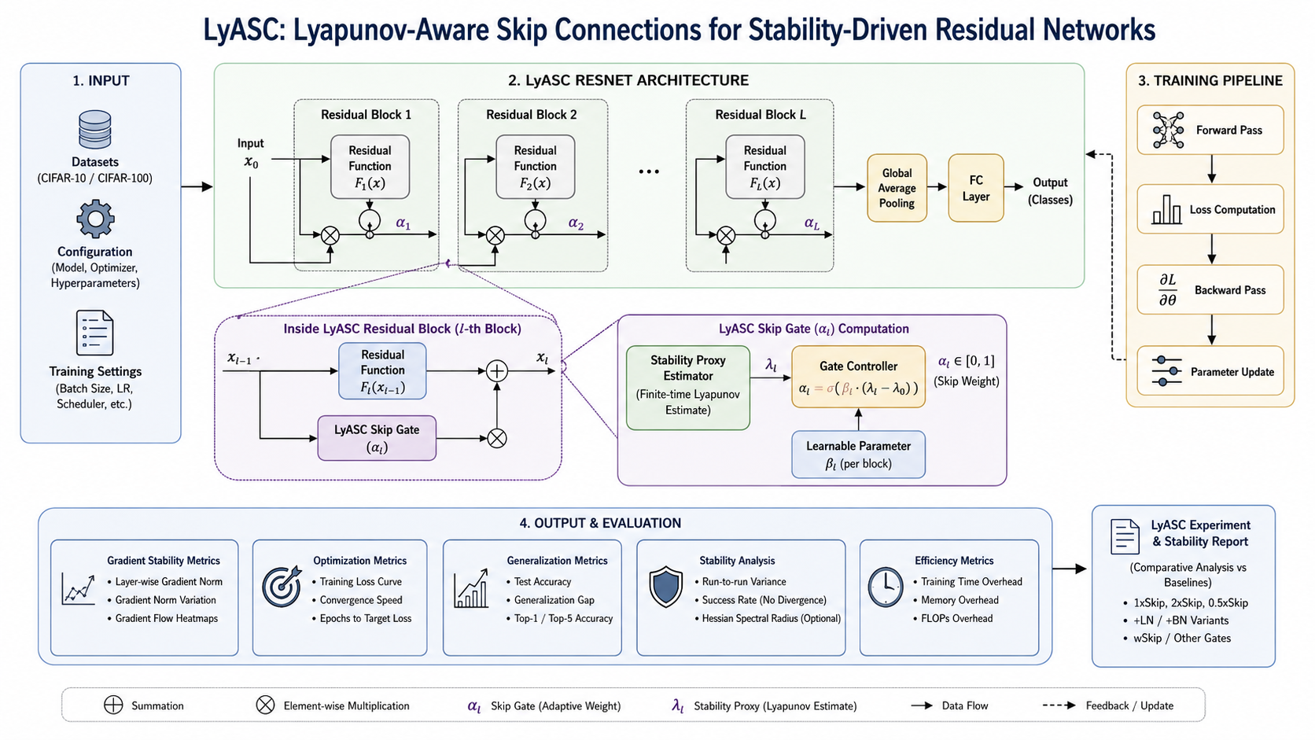
Architecture Diagram
Project Title
Motivation and Problem Statement
Literature Review
Significance of the Project
Analysis of Base Paper
Insights from Base Paper
Research Gap
Objectives, Scope of the Project
Implementation & Methodology
Architecture Diagram
Workflow Diagram
Results and Conclusion
Limitations
Reference (18 Papers)
Project Plan (Gantt Chart)

Slide 12
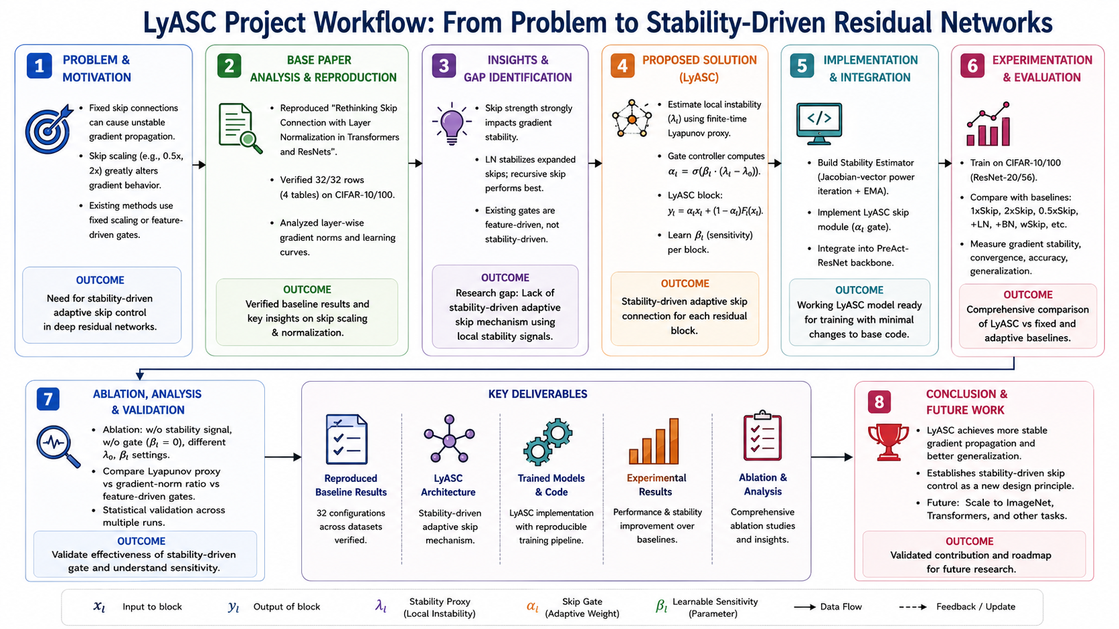
Workflow Diagram
Project Title
Motivation and Problem Statement
Literature Review
Significance of the Project
Analysis of Base Paper
Insights from Base Paper
Research Gap
Objectives, Scope of the Project
Implementation & Methodology
Architecture Diagram
Workflow Diagram
Results and Conclusion
Limitations
Reference (18 Papers)
Project Plan (Gantt Chart)

Slide 13
Results and Conclusion
Experimental Setup Reproduced:PreAct-ResNet-110 + CIFAR-10 with the paper's skip/normalization variants and layer-wise gradient analysis. The paper formulates residual blocks approximately as:
y=G(λx+F(x,W))
where λ controls skip strength.
Project Title
Motivation and Problem Statement
Literature Review
Significance of the Project
Analysis of Base Paper
Insights from Base Paper
Research Gap
Objectives, Scope of the Project
Implementation & Methodology
Architecture Diagram
Workflow Diagram
Results and Conclusion
Limitations
Reference (18 Papers)
Project Plan (Gantt Chart)
Main results (CIFAR-10 / PreAct-ResNet-110)
• Best reproduced fixed schedule: 2rSkip + LN — 6.15% test error.
• LyASC + LN — 7.17%; above the best fixed schedule by 1.02 percentage points.
• LyASC + BN — 6.32%; within 0.17 percentage points of the best fixed schedule.
Scaling-stress recovery
• 0.5× skip: 37.14% → 8.38% test error (−28.76 percentage points).
• 2× residual scaling: 37.59% → 8.44% (−29.15 percentage points).
• 3× residual scaling: 49.27% baseline; LyASC pooled mean 21.88%, with high seed variation (one seed reached 8.75%).
Conclusion: LyASC substantially recovered performance in two stress settings, but clean accuracy, runtime and extreme-stress variability remain limitations.

Slide 14
Limitations
Project Title
Motivation and Problem Statement
Literature Review
Significance of the Project
Analysis of Base Paper
Insights from Base Paper
Research Gap
Objectives, Scope of the Project
Implementation & Methodology
Architecture Diagram
Workflow Diagram
Results and Conclusion
Limitations
Reference (18 Papers)
Project Plan (Gantt Chart)
• Clean accuracy: LyASC+LN (7.17%) does not beat the best fixed schedule (6.15%).
• Seed sensitivity: under 3× residual scaling, one seed reached 8.75%, while the pooled mean was 21.88% across five seeds.
• Runtime overhead: measured iteration latency was about 0.50 s for LyASC+LN and 0.35 s for LyASC+BN, versus 0.18 s for the plain model.
• Incomplete stress coverage: LyASC+BN stress resilience has not been fully evaluated.
• Generalization scope: experiments currently focus on CIFAR-10 and PreAct-ResNet-110.
Next steps: extend to CIFAR-100 and additional backbones; improve the estimator’s efficiency; repeat extreme-stress experiments with more seeds.

Slide 15
Reference (18 Papers)
Project Title
Motivation and Problem Statement
Literature Review
Significance of the Project
Analysis of Base Paper
Insights from Base Paper
Research Gap
Objectives, Scope of the Project
Implementation & Methodology
Architecture Diagram
Workflow Diagram
Results and Conclusion
Limitations
Reference (18 Papers)
Project Plan (Gantt Chart)
1. He et al. (2016). Deep Residual Learning for Image Recognition. CVPR.
2. Srivastava et al. (2015). Highway Networks. arXiv:1505.00387.
3. Wang et al. (2018). SkipNet: Learning Dynamic Routing in Convolutional Networks. ECCV.
4. Veit & Belongie (2018). Convolutional Networks with Adaptive Inference Graphs. ECCV.
5. Dhayalkar (2024). Dynamic Context Adaptation and Information Flow Control in Transformers.
6. Joseph et al. (2024). λ-Skip Connections: Formal Bounds Preventing Rank Collapse in Deep Networks. arXiv:2410.10609.
7. Thota (2025). CosineGate: Semantic Dynamic Routing via Cosine Incompatibility in Residual Networks. arXiv:2512.22206.
8. Cohen et al. (2021). Gradient Descent on Neural Networks Typically Occurs at the Edge of Stability. ICLR.
9. Arora, Li & Panigrahi (2022). Understanding Gradient Descent on the Edge of Stability in Deep Learning. ICML.
10. Damian, Nichani & Lee (2022). Self-Stabilization: The Implicit Bias of Gradient Descent at the Edge of Stability.
11. Andreyev & Beneventano (2024/25). Edge of Stochastic Stability. arXiv:2412.20553.
12. Mittra (2024). Utilizing Lyapunov Exponents in Designing Deep Neural Networks. arXiv:2410.05988.
13. On the Weight Dynamics of Learning Networks (2024). arXiv:2405.00743.
14. Chu et al. (2024). Lyapunov-Stable Deep Equilibrium Models. AAAI.
15. Rodriguez, Ames & Yue (2022). LyaNet: A Lyapunov Framework for Training Neural ODEs. ICML.
16. Lyapunov-Based Deep Residual Neural Network Adaptive Control (2024/25). arXiv:2404.07385; IEEE Access DOI:10.1109/ACCESS.2025.3584253.
17. Ioffe & Szegedy (2015). Batch Normalization. ICML.
18. Hendrycks & Dietterich (2019). Benchmarking Neural Network Robustness to Common Corruptions. ICLR.

Slide 16
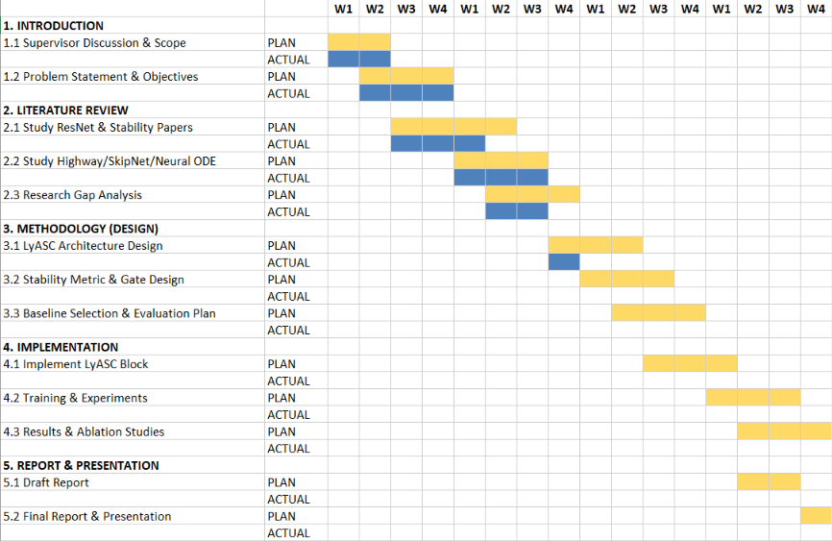
Project Plan (Gantt Chart)
Project Title
Motivation and Problem Statement
Literature Review
Significance of the Project
Analysis of Base Paper
Insights from Base Paper
Research Gap
Objectives, Scope of the Project
Implementation & Methodology
Architecture Diagram
Workflow Diagram
Results and Conclusion
Limitations
Reference (18 Papers)
Project Plan (Gantt Chart)
Project timeline: July–14 October 2026 | Grey = planned Maroon = completed/actual
Jul
W1
Jul
W2
Jul
W3
Jul
W4
Aug
W1
Aug
W2
Aug
W3
Aug
W4
Sep
W1
Sep
W2
Sep
W3
Sep
W4
Oct
W1
Oct
W2
Problem definition
Literature + gap
Base-paper reproduction
LyASC implementation
LN/BN + cold-start ablations
Scaling-stress experiments
Checkpoint audit + tests
Report + final review
Planned
Completed/actual
Actual bars are reconstructed from completed deliverables; exact daily timestamps were not logged.

