Slide 1


Department of
Computer Science & Engineering (AI)
RL-Based Self-Adapting Virtual Keyboard for Personalized Typing
Amrita School of Computing
Amrita Vishwa Vidyapeetham, Chennai Campus
Guide Details
Dr. G Bharathi Mohan
Asst. Professor
Student Members [BATCH ID: 01 ]
1. N Bhargav - CH.SC.U4CSE23037
2. Subhash R – CH.SC.U4CSE23055

Slide 2

Domain Introduction
Domain Introduction
Problem Identification
Problem Statement
Significance
Objectives & Scope
Proposed Methodology
Project Plan
References
Healthcare Technology and Medication Management
Medication management involves identifying medicines, understanding prescriptions, following dosage schedules, and monitoring treatment.
Incorrect medicine usage, missed doses, and incomplete antibiotic courses can create healthcare risks.
Antimicrobial resistance (AMR) occurs when microorganisms develop resistance to medicines designed to treat infections.
Families and caregivers need a reliable way to coordinate medication schedules and monitor adherence.
MedSentry combines mobile technology, OCR, AI assistance, and cloud-based data management to support safer medication practices.

Slide 3
Problem Formulation
Domain & Project Overview
Problem Formulation
Problem Statement
Significance
Objectives & Scope
Proposed Methodology
Project Plan
References
Problem Statement
People often struggle to interpret prescriptions, identify medicines, remember dosage schedules, and complete prescribed antibiotic courses.
Limitations of existing approaches
Manual reading of prescriptions can be difficult.
Separate reminder applications may not provide medication analysis or antibiotic awareness.
Family members may lack a shared medication-monitoring system.
Missed doses and early treatment discontinuation may go unnoticed.
Medication-related questions may be difficult for users to understand without accessible guidance.
Intended users
Individuals managing daily medications.
Families and caregivers.
Users who need help understanding medicine and prescription information.

Slide 4
Motivation and Objectives
Domain & Project Overview
Problem Identification
Motivation and Objectives
Significance
Objectives & Scope
Proposed Methodology
Project Plan
References
Motivation
To make medication management easier, improve treatment adherence, and encourage responsible antibiotic usage through an intelligent, family-oriented application.
Objectives
Develop OCR-based extraction of medicine and prescription information.
Provide AI-powered assistance for medication-related queries.
Support medication schedules, adherence tracking, and reminders.
Identify antibiotics and promote responsible antibiotic usage.
Enable family-based medication management through controlled permissions.

Slide 5
Proposed System
Domain & Project Overview
Problem Identification
Proposed System
Significance
Objectives & Scope
Proposed Methodology
Project Plan
References
Proposed Solution: MedSentry
MedSentry is an AI-powered medication management application designed to help users understand medicines, manage schedules, and coordinate medication care with family members.
Major modules
Medicine Scanning: Capture medicine strips, boxes, bottles, or prescriptions.
OCR Extraction: Extract relevant text from scanned images.
Drug Information Analysis: Match medicine information against drug reference data.
AI Chatbot and Consultant: Provide conversational assistance for medication-related questions.
Medication Tracking: Maintain medication courses and dose records.
Notifications: Support scheduled reminders and missed-dose alerts.
Family Circle: Provide owner, caregiver, and viewer permissions.
The intended system connects these modules through a mobile application and a cloud backend.

Slide 6
Full Stack Technologies Used
Domain & Project Overview
Problem Identification
Problem Statement
Full Stack Technologies used
Objectives & Scope
Proposed Methodology
Project Plan
References
Layer | Technology
Frontend | React Native, Expo, TypeScript (.tsx)
Backend | Supabase Edge Functions
Database | Supabase PostgreSQL
Authentication | Supabase Auth
File storage | Supabase Storage
Realtime services | Supabase Realtime
OCR | Expo Camera and on-device Google ML Kit OCR
AI integration | Multi-provider AI router through Edge Functions
AI providers in the plan | On-device model, Google Gemini, Groq, OpenRouter, Hugging Face
Navigation | React Navigation and native stack
Notifications | Expo Notifications
Development environment | Android Studio and Expo prebuild

Slide 7
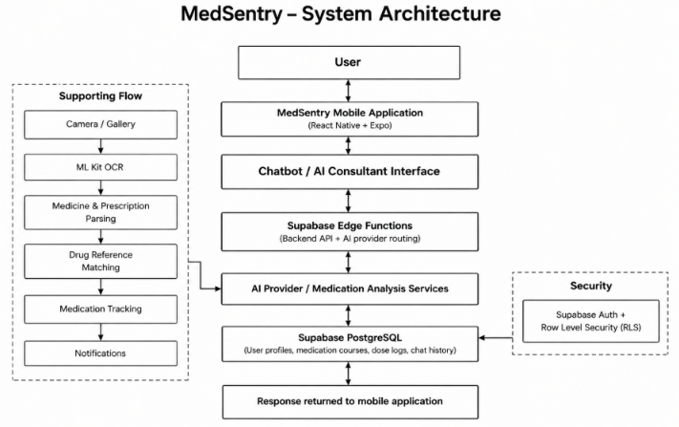
System Architecture
Domain & Project Overview
Problem Identification
Problem Statement
System Architecture
Objectives & Scope
Proposed Methodology
Project Plan
References

Slide 8
Chatbot / AI Agent Interaction
Domain & Project Overview
Problem Identification
Problem Statement
Significance
Chatbot / AI Agent Interaction
Proposed Methodology
Project Plan
References
Conversational Medication Assistance
How the interaction works
The user enters a medication-related question or submits a medicine image.
The application sends the request to the backend.
The AI routing layer selects an available provider.
The system applies medication-safety guardrails.
The response is returned to the user, with appropriate precautions.
Representative Interaction Examples
Query 1: “What information should I check on my medicine strip?”
Expected response: Check the medicine name, strength, expiry date, and prescribed instructions. Ask a pharmacist if any information is unclear.
Query 2: “Why is it important to complete a prescribed antibiotic course?”
Expected response: Follow your prescriber's instructions. Do not stop or change an antibiotic course on your own; contact your healthcare professional if you experience problems.
Query 3: “Can I take two medicines together?”
Expected response: Provide the names and strengths of both medicines and consult a pharmacist or doctor to check for interactions before combining them.

Slide 9
Implementation and Key Modules
Domain & Project Overview
Problem Identification
Problem Statement
Motivation
Objectives & Scope
Implementation and Key Modules
Project Plan
References
Implementation Overview
1. Frontend
Mobile application built using React Native and Expo.
TypeScript-based application structure.
Navigation between application screens.
2. Backend and API
Supabase Edge Functions are specified for backend operations.
AI requests are routed through a backend provider-routing layer.
3. Database
PostgreSQL schema is defined for profiles, family groups, medications, dose logs, consultations, and chatbot conversations.
4. OCR and AI
Camera-based scanning and ML Kit OCR are specified.
AI chatbot and consultant flows are described in the implementation plan.
5. Supporting modules
Medication reminders and notification handling.
Family roles and permission-based access.

Slide 10
Results and Discussion
Domain & Project Overview
Problem Identification
Problem Statement
Motivation
Objectives & Scope
Proposed Methodology
Project Plan
Results and Discussion
Results and Current Project Status
Repository evidence
The GitHub repository contains dedicated folders for mobile-app/, supabase/, datasets/, scripts/, and docs/.
A consolidated project plan defines the technology stack, database schema, AI-routing design, and intended medication-management workflow.
The planned data model includes medication courses, dose logs, chatbot threads, chatbot messages, and AI consultation records.
Intended outcomes
Easier access to medication information.
Improved visibility into medication adherence.
Conversational assistance for medication-related questions.
Better coordination between family members and caregivers.
Testing and evaluation
Live application execution and end-to-end test results have not been established from the project plan alone.
Do not report accuracy percentages, successful OCR counts, chatbot response metrics, or adherence improvements without actual test evidence.

Slide 11
Conclusion and Future Enhancement
Domain & Project Overview
Problem Identification
Problem Statement
Motivation
Objectives & Scope
Conclusion and Future Enhancement
Project Plan
References
Conclusion
MedSentry aims to combine full stack mobile development, OCR, AI assistance, medication tracking, and family-based management in one application.
The project architecture provides a foundation for improving medication understanding, supporting adherence, and promoting responsible antibiotic usage.
Future Enhancements
Improve OCR performance for handwritten prescriptions.
Expand drug interaction analysis using validated medical data.
Add multilingual voice assistance.
Integrate with doctors, hospitals, and digital prescription systems.
Enhance family alerts and adherence analytics.
Develop anonymized public-health insights into medication misuse.
Limitation: AI-generated information should support, not replace, advice from qualified healthcare professionals.

Slide 12
GitHub Repository
Domain & Project Overview
Problem Identification
Problem Statement
Motivation
Objectives & Scope
Proposed Methodology
Github Repository
References
Project Repository
GitHub:
https://github.com/Subhash-777/MedSentry
Important folders and files
mobile-app/ — Mobile application source.
supabase/ — Backend and database-related project files.
datasets/ — Dataset directories.
scripts/ — Supporting scripts.
docs/plan.md — Master implementation plan.
README.md — Repository introduction; currently contains only the project title.
Project documentation:
https://github.com/Subhash-777/MedSentry/blob/main/docs/plan.md
.

Slide 13

Thank You

