Slide 1


Department of
Computer Science & Engineering
LyASC: Lyapunov-Aware Skip Connections for Stability-Driven Residual Networks
Amrita School of Computing
Amrita Vishwa Vidyapeetham, Chennai Campus
Student Members
1: Subhash R – CH.SC.U4AIE23054
2: Veena Sundari A – CH.SC.U4AIE23060
Guide Details
Dr. Rithani M

Slide 2

Project Title
Project Title
Motivation and Problem Statement
Significance of the Project
Analysis on Base Paper
Insights from Base Paper
Research Gap
Objectives, Scope of the Project
Architecture Diagram
Workflow Diagram
Literature Review
Project Plan (Gantt Chart)
Project Title: Lyapunov-Aware Skip Connections for Stability-Driven Residual Networks
Domain of Work: Deep Learning, Residual Networks, Optimization & Stability Analysis
Core Focus: LyASC introduces a stability-driven adaptive skip connection that dynamically controls the contribution of the identity pathway based on a local Lyapunov-inspired instability signal. The project investigates whether stability-aware skip control can provide more reliable gradient propagation, optimization stability and generalization than fixed skip-scaling and normalization strategies.
Current Progress:
Base-paper architecture reproduced → Gradient behaviour analysed → Research gap identified → LyASC mechanism formulation in progress

Slide 3
Motivation and Problem Statement
Project Title
Motivation and Problem Statement
Significance of the Project
Analysis on Base Paper
Insights from Base Paper
Research Gap
Objectives, Scope of the Project
Architecture Diagram
Workflow Diagram
Literature Review
Project Plan (Gantt Chart)
Skip connections are fundamental to deep residual networks, but their contribution is generally controlled using fixed scaling factors.
Our reproduction of the base paper shows that changing skip strength from 0.5× to 1× and 2× can substantially alter layer-wise gradient propagation.
Layer Normalization can mitigate some unstable gradient behaviour, but it does not explicitly measure or control the underlying local stability of each residual block.
Existing adaptive/gated skip methods already exist, but their gates are primarily feature/content-driven, rather than driven by an explicit stability signal.
This motivates the question: How can skip connections be dynamically controlled to maintain stable information and gradient propagation throughout a deep residual network?
Current limitation:
Existing approaches mainly use fixed skip coefficients and/or normalization, rather than explicitly optimizing skip behaviour according to a stability criterion.

Slide 4
Significance of the Project
Project Title
Motivation and Problem Statement
Significance of the Project
Analysis on Base Paper
Insights from Base Paper
Research Gap
Objectives, Scope of the Project
Architecture Diagram
Workflow Diagram
Literature Review
Project Plan (Gantt Chart)
Aspect | Significance
Stability-Driven Design | Makes training stability an explicit architectural objective rather than an indirect outcome.
Adaptive Skip Control | Dynamically adjusts skip contribution according to local block behaviour instead of using only fixed scaling.
Gradient Regulation | Targets vanishing, exploding and highly uneven gradient propagation across network depth.
Research Contribution | Connects Lyapunov-inspired dynamical analysis with adaptive residual-network architecture.
Falsifiable Evaluation | Directly compares LyASC against fixed-skip, normalization and gradient-driven adaptive gates.
Note: the project does not claim that adaptive or gated skip connections are new; the proposed contribution is the stability-driven control signal used to actuate the skip strength.

Slide 5
Analysis on Base Paper
Experimental Setup Reproduced:PreAct-ResNet-110 + CIFAR-10 with the paper's skip/normalization variants and layer-wise gradient analysis. The paper formulates residual blocks approximately as:
y=G(λx+F(x,W))
where λ controls skip strength.
Project Title
Motivation and Problem Statement
Significance of the Project
Analysis on Base Paper
Insights from Base Paper
Research Gap
Objectives, Scope of the Project
Architecture Diagram
Workflow Diagram
Literature Review
Project Plan (Gantt Chart)
Configuration | Reproduced Gradient Behaviour
1×Skip | Gradual gradient decrease with depth
2×Skip | Rapid gradient decay → vanishing tendency
0.5×Skip | Irregular propagation + strong final-block spike
2×Skip + BN | Relatively uniform gradient magnitudes
1×Skip + LN | Controlled gradients with late-depth increase
2×Skip + LN | More controlled depth-wise gradient behaviour
2rSkip + LN | Controlled growth but strong final-layer spike
The reproduction therefore confirms the central observation that skip scaling and normalization substantially affect gradient dynamics.

Slide 6
Insights from Base Paper
Project Title
Motivation and Problem Statement
Significance of the Project
Analysis on Base Paper
Insights from Base Paper
Research Gap
Objectives, Scope of the Project
Architecture Diagram
Workflow Diagram
Literature Review
Project Plan (Gantt Chart)
Observation | Insight for LyASC
2×Skip → rapid decay | Larger skip strength can produce unstable gradient propagation.
0.5×Skip → irregular profile | Smaller fixed scaling can also create non-uniform dynamics.
LN improves several configurations | Normalization can regulate gradients but is not an explicit stability controller.
Late-layer gradient spikes | Average gradient magnitude alone is insufficient; depth-wise stability must be monitored.
2rSkip+LN performs strongly | Adaptive/effective skip ratios can improve optimization, motivating dynamic skip control.
wSkip+LN underperforms recursive scaling | Simply learning the skip weight is not equivalent to stability-aware adaptation.
Key Insight:
The base paper establishes that skip strength is a critical control variable; LyASC investigates whether this variable can be controlled using an explicit stability signal.
The base paper's experiments therefore become the experimental foundation and baseline family for LyASC rather than merely serving as background literature.

Slide 7
Research Gap
Project Title
Motivation and Problem Statement
Significance of the Project
Analysis on Base Paper
Insights from Base Paper
Research Gap
Objectives, Scope of the Project
Architecture Diagram
Workflow Diagram
Literature Review
Project Plan (Gantt Chart)
Existing Approach | Control Signal | Limitation
ResNet | Fixed identity skip | No adaptive stability control
Base Paper | Fixed/recursive skip + LN | Improves gradient behaviour but does not explicitly estimate local instability
Highway / Gated Residual Networks | Learned/feature-based gates | Feature-driven, not stability-driven
SkipNet / Dynamic Routing | Activation/content information | Primarily targets computational efficiency
CosineGate | Branch activation geometry | Geometric signal, not local dynamical stability
LyASC (Proposed) | Lyapunov-inspired local instability estimate | Stability-driven adaptive skip control
Identified Gap:
Existing research:Feature / Activation → Gate
Proposed LyASC:
Local Dynamical Stability → Gate
This is the project's specific and testable novelty, rather than the broader claim that adaptive skip connections are new.

Slide 8
Objectives, Scope of the Project
Project Title
Motivation and Problem Statement
Significance of the Project
Analysis on Base Paper
Insights from Base Paper
Research Gap
Objectives, Scope of the Project
Architecture Diagram
Workflow Diagram
Literature Review
Project Plan (Gantt Chart)
Objectives:
Establish the base-paper reproduction as the experimental baseline for skip-scaling and normalization.
Develop LyASC-S, using a lightweight scalar stability-aware gate per residual block.
Estimate local block instability using a finite-time Lyapunov-inspired/Jacobian-based stability proxy.
Dynamically regulate the skip strength according to the estimated stability condition.
Compare LyASC against fixed-skip, LN/BN and adaptive-control baselines.
Evaluate gradient, optimization and generalization stability.
Scope: Phase 1:
CIFAR-10 & CIFAR-100 → ResNet-20/56 → mechanism validation.
Evaluation:
Gradient norm • Gradient variation • Convergence • Run-to-run stability • Test accuracy • Generalization gap.
Mandatory Ablation:
Lyapunov proxy vs gradient-norm-ratio gate vs feature-driven gate.
Future:
Tiny ImageNet / ImageNet → deeper-scale validation.

Slide 9
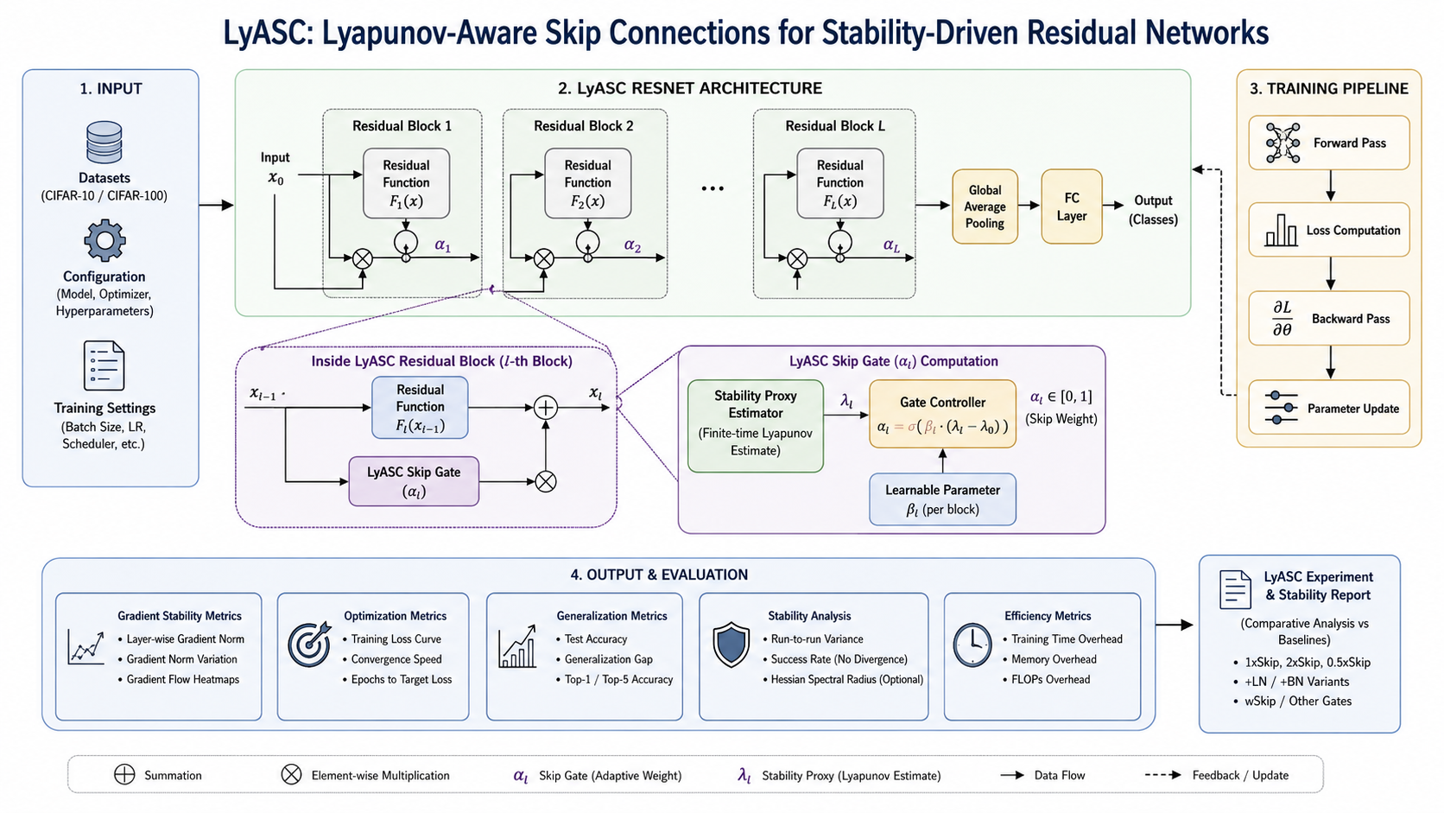
Architecture Diagram
Project Title
Motivation and Problem Statement
Significance of the Project
Analysis on Base Paper
Insights from Base Paper
Research Gap
Objectives, Scope of the Project
Architecture Diagram
Workflow Diagram
Literature Review
Project Plan (Gantt Chart)

Slide 10
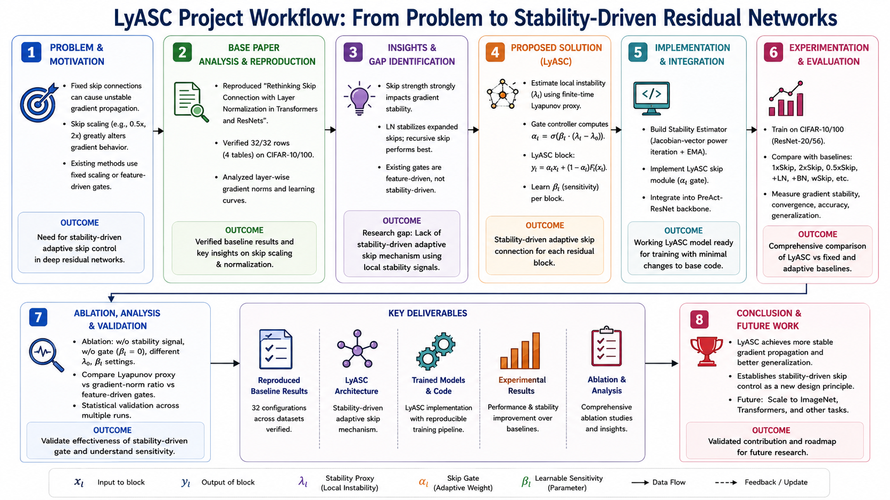
Workflow Diagram
Project Title
Motivation and Problem Statement
Significance of the Project
Analysis on Base Paper
Insights from Base Paper
Research Gap
Objectives, Scope of the Project
Architecture Diagram
Workflow Diagram
Literature Review
Project Plan (Gantt Chart)

Slide 11
Literature Review
Project Title
Motivation and Problem Statement
Significance of the Project
Analysis on Base Paper
Insights from Base Paper
Research Gap
Objectives, Scope of the Project
Architecture Diagram
Workflow Diagram
Literature Review
Project Plan (Gantt Chart)
Deep neural networks have achieved remarkable success in computer vision.
However, increasing network depth introduces several training challenges:
Vanishing gradients
Optimization instability
Slow convergence
Residual Networks (ResNet) improve gradient flow using fixed identity skip connections.
Although effective, every residual block uses the same shortcut strength throughout training, even though different layers may experience different optimization dynamics.
Can skip connections adapt according to the stability of each layer during training?

Slide 12


S.NO | Title | Author Journal year | Methodology | Merits | Demerits | Research gap
01 | Deep Residual Learning for Image Recognition | Kaiming He, Xiangyu Zhang, Shaoqing Ren & Jian Sun | CVPR, 2016 | DOI: 10.1109/CVPR.2016.90 | Introduces ResNet by reformulating layers to learn residual functions F(x) with identity shortcuts x. Evaluates deep networks up to 152 layers on ImageNet and up to 1000 layers on CIFAR-10. | Makes very deep networks easier to optimize; improves accuracy with increased depth; establishes identity skip connections as a fundamental deep-network architecture. |  | Skip strength remains fixed. LyASC investigates whether shortcut strength can be dynamically controlled using a local stability signal.
Uses a fixed identity shortcut without adapting its strength to local network dynamics; does not explicitly analyze Lyapunov-based stability control.

Slide 13
S.NO | Title | Author Journal year | Methodology | Merits | Demerits | Research gap
02 | Identity Mappings in Deep Residual Networks | Kaiming He, Xiangyu Zhang, Shaoqing Ren & Jian Sun | ECCV, 2016 | DOI: 10.1007/978-3-319-46493-0_38 |  | Demonstrates improved gradient and information propagation; provides theoretical motivation for identity shortcuts; enables effective training of 1001-layer ResNets.
Assumes the identity path is fixed; does not adapt shortcut contribution according to training or block-level stability.
Analyses forward and backward signal propagation in residual blocks and proposes PreAct-ResNet using identity mappings and post-addition activation. Evaluated using very deep CIFAR and ImageNet models.
Establishes the importance of identity mappings but does not determine when the identity path should be strengthened or weakened.

Slide 14
S.NO | Title | Author Journal year | Methodology | Merits | Demerits | Research gap
03 | Rethinking Skip Connection with Layer Normalization in Transformers and ResNets | Fenglin Liu, Xuancheng Ren, Zhiyuan Zhang, Xu Sun & Yuexian Zou | arXiv, 2021 |DOI: 10.48550/arXiv.2105.07205 |  | Shows that skip scaling can cause gradient explosion/vanishing; demonstrates that LayerNorm can stabilize scaled shortcuts; proposes recursive skip scaling with LN.
Skip scaling is manually designed rather than determined from an explicit dynamical stability signal; adaptation is not based on Lyapunov analysis.
Models residual blocks as y=G(λx+F(x,W)) and studies different skip scales, normalization strategies and recursive skip structures using gradient analysis and image/translation experiments
Base paper for LyASC. It establishes that skip strength affects gradient stability; LyASC asks whether stability itself can determine skip strength dynamically.

Slide 15
S.NO | Title | Author Journal year | Methodology | Merits | Demerits | Research gap
04 | Norm-Preservation: Why Residual Networks Can Become Extremely Deep? | Alireza Zaeemzadeh, Nazanin Rahnavard & Mubarak Shah | IEEE TPAMI, 2021 | DOI: 10.1109/TPAMI.2020.2990339 |  | Provides theoretical explanation for stable gradient propagation; links skip connections with norm preservation; supports training extremely deep residual architectures.
Focuses mainly on norm preservation rather than dynamically controlling shortcut strength; requires architectural/regularization modifications.
Theoretically analyses how identity shortcuts preserve gradient norms and investigates singular-value regularization to improve norm preservation in very deep residual networks.
Provides stability evidence but not a stability-driven controller. LyASC uses local stability measurements to adapt the residual shortcut itself..

Slide 16
S.NO | Title | Author Journal year | Methodology | Merits | Demerits | Research gap
05 | On Skip Connections and Normalisation Layers in Deep Optimisation | Lachlan E. MacDonald, Jack Valmadre, Hemanth Saratchandran & Simon Lucey | NeurIPS, 2023 | DOI: 10.52202/075280-0647 |  | Provides a theoretical explanation of how skip connections accelerate optimization; connects architectural choices with loss-landscape properties.
Primarily analyses existing architectures rather than dynamically controlling residual pathways during training.
Develops a theoretical framework for analysing curvature and regularity of deep networks containing normalization and skip connections. Validates the framework on ResNets across several datasets.
Provides optimization theory for skip connections but does not introduce a local stability-based adaptive skip controller.

Slide 17
S.NO | Title | Author Journal year | Methodology | Merits | Demerits | Research gap
06 | Highway Networks | Rupesh Kumar Srivastava, Klaus Greff & Jürgen Schmidhuber | arXiv, 2015 | DOI: 10.48550/arXiv.1505.00387 |  | Establishes learnable control of information flow; enables very deep networks; provides an important foundation for gated residual architectures..
Gate is learned from network features rather than an explicit stability measure; introduces additional parameters and does not target Lyapunov stability.
Introduces transform and carry gates to learn the balance between nonlinear transformation and information-preserving shortcut pathways in very deep feed-forward networks.
Adaptive gating is established, but stability-driven gating is unexplored. LyASC replaces generic feature-based control with a local dynamical-stability signal.

Slide 18
S.NO | Title | Author Journal year | Methodology | Merits | Demerits | Research gap
07 | SkipNet: Learning Dynamic Routing in Convolutional Networks | Xin Wang, Fisher Yu, Zi-Yi Dou, Trevor Darrell & Joseph E. Gonzalez | ECCV, 2018 | DOI: 10.1007/978-3-030-01261-8_25 |  | Achieves substantial computational savings while preserving accuracy; demonstrates practical dynamic residual routing.
Gate is input/activation-driven and primarily targets inference efficiency; routing decisions are not based on local dynamical stability.
Uses a gating network to selectively skip residual blocks on a per-input basis. Combines supervised and reinforcement learning to learn non-differentiable routing decisions.
Dynamic skipping is established, but stability-driven continuous control of shortcut strength remains unexplored.

Slide 19
S.NO | Title | Author Journal year | Methodology | Merits | Demerits | Research gap
08 | Convolutional Networks with Adaptive Inference Graphs | Andreas Veit & Serge Belongie | IJCV, 2020 | DOI: 10.1007/s11263-019-01190-4 |  | Reduces unnecessary computation; learns different inference paths for different inputs; demonstrates adaptive network topology.
Optimizes computational efficiency rather than training stability; decisions depend on input characteristics rather than local dynamical behavior.
Dynamically constructs input-dependent inference graphs by deciding which network layers need to be evaluated for each image.
Adaptive topology does not address whether a residual block is dynamically stable or unstable during optimization.

Slide 20
S.NO | Title | Author Journal year | Methodology | Merits | Demerits
09 | Deep Networks with Stochastic Depth | Gao Huang, Yu Sun, Zhuang Liu, Daniel Sedra & Kilian Q. Weinberger | ECCV, 2016 | DOI: 10.1007/978-3-319-46493-0_39 |  | Reduces training cost; improves optimization of very deep networks; enables successful training beyond 1200 layers.
Layer selection is stochastic rather than stability-aware; does not continuously modulate shortcut strength according to network dynamics.
Randomly drops residual layers during training and bypasses them through identity mappings, while using the full network during inference.
Provides dynamic bypassing but no measured stability criterion for deciding residual-path strength.

Slide 21
S.NO | Title | Author Journal year | Methodology | Merits | Demerits | Research gap
10 | Lambda-Skip Connections: The Architectural Component That Prevents Rank Collapse | Federico Arangath Joseph, Jerome Sieber, Melanie N. Zeilinger & Carmen Amo Alonso | ICLR, 2025 | DOI: 10.48550/arXiv.2410.10609 |  | Provides formal bounds for skip-strength selection; connects shortcut scaling with representation preservation and training stability.
Focuses on rank collapse and provides essentially static/theoretical λ conditions; does not use a local Lyapunov signal for dynamic control.
Introduces parameterized λ-skip connections and derives analytical conditions under which skip strength prevents rank collapse in Transformers and State Space Models.
λ is analytically constrained but not dynamically controlled from measured local stability. LyASC makes λ an adaptive stability-aware variable.

Slide 22
S.NO | Title | Author Journal year | Methodology | Merits | Demerits | Research gap
11 | CosineGate: Semantic Dynamic Routing via Cosine Incompatibility in Residual Networks | Yogeswar Reddy Thota | arXiv, 2025 | DOI: 10.48550/arXiv.2512.22206 |  | Provides a self-supervised routing signal; reduces FLOPs while maintaining competitive accuracy; represents a recent dynamic residual-routing approach.
Uses feature geometry rather than training-dynamics stability; primarily targets computational efficiency and semantic redundancy.
Computes cosine incompatibility between identity and residual features and uses a differentiable Gumbel-Softmax gate for per-sample, per-block residual routing.
Closest architectural comparator. It asks “Is the residual useful?”; LyASC asks “Is the residual dynamics stable?”

Slide 23
S.NO | Title | Author Journal year | Methodology | Merits | Demerits | Research gap
12 | Residual Networks: Lyapunov Stability and Convex Decomposition | Kamil Nar & Shankar Sastry | arXiv, 2018 | DOI: 10.48550/arXiv.1803.08203 |  | Establishes a formal connection between ResNets and Lyapunov stability; provides theoretical insight into stable gradient-descent dynamics and generalization.
Primarily theoretical; Lyapunov stability is used for analysis rather than as an online architectural control signal.
Analyses residual-network training using dynamical-systems and Lyapunov-stability concepts and develops a convex/concave residual decomposition architecture.
Lyapunov theory is applied to understand ResNet stability, but not to dynamically regulate each residual shortcut.l.

Slide 24
S.NO | Title | Author Journal year | Methodology | Merits | Demerits | Research gap
13 | Gradient Descent on Neural Networks Typically Occurs at the Edge of Stability | Jeremy M. Cohen, Simran Kaur, Yuanzhi Li, J. Zico Kolter & Ameet Talwalkar | ICLR, 2021 | DOI: 10.48550/arXiv.2103.00065 |  | Establishes Edge-of-Stability as an important training regime; provides a measurable connection between curvature and optimization dynamics.
Focuses on global training sharpness rather than individual residual blocks; does not modify network architecture based on stability.
Studies training dynamics of full-batch gradient descent and observes that the maximum Hessian eigenvalue often approaches the stability threshold 2/η.
Provides a stability diagnostic but not block-wise stability-aware architectural control, which is the target of LyASC.

Slide 25
S.NO | Title | Author Journal year | Methodology | Merits | Demerits | Research gap
14 | Understanding Gradient Descent on the Edge of Stability in Deep Learning | Sanjeev Arora, Zhiyuan Li & Abhishek Panigrahi | ICML, 2022 | DOI: 10.48550/arXiv.2205.09745 |  | Strengthens theoretical understanding of stability boundaries; explains implicit regularization mechanisms associated with Edge-of-Stability training.
Analyses optimizer dynamics rather than residual architecture; does not provide an adaptive shortcut mechanism.
Provides a mathematical analysis of Edge-of-Stability dynamics and studies how gradient descent evolves along low-loss manifolds under high-curvature conditions.
Stability is characterized globally in optimization, leaving an opportunity for local block-level stability sensing and control.

Slide 26
S.NO | Title | Author Journal year | Methodology | Merits | Demerits | Research gap
15 | Self-Stabilization: The Implicit Bias of Gradient Descent at the Edge of Stability | Alex Damian, Eshaan Nichani & Jason D. Lee | ICLR, 2023 | DOI: 10.48550/arXiv.2209.15594 |  | Explains why training can remain effective despite temporary instability; connects curvature dynamics with implicit regularization.
Stability is an emergent optimizer phenomenon rather than an explicit architectural control mechanism.
Analyses how gradient descent near the stability boundary naturally reduces curvature and exhibits self-stabilizing behavior using local Taylor/Hessian analysis.
Demonstrates self-stabilization, but does not actively use a stability measurement to regulate residual shortcut strength.

Slide 27
S.NO | Title | Author Journal year | Methodology | Merits | Demerits | Research gap
16 | Edge of Stochastic Stability: Revisiting the Edge of Stability for SGD | Arseniy Andreyev & Pierfrancesco Beneventano | arXiv, 2024/25 | DOI: 10.48550/arXiv.2412.20553 |  | Extends stability analysis from full-batch GD to realistic SGD; highly relevant to noisy mini-batch training dynamics.
Focuses on optimizer-level stochastic stability; does not modify residual architecture or introduce block-wise shortcut control.
Analyses how gradient descent near the stability boundary naturally reduces curvature and exhibits self-stabilizing behavior using local Taylor/Hessian analysis.
Establishes stochastic stability dynamics but leaves open how local stability information can be used to actively control network architecture.

Slide 28
S.NO | Title | Author Journal year | Methodology | Merits | Demerits | Research gap
17 | Utilizing Lyapunov Exponents in Designing Deep Neural Networks | Tirthankar Mittra | arXiv, 2024 | DOI: 10.48550/arXiv.2410.05988 |  | Directly demonstrates that Lyapunov exponents can characterize training dynamics; links negative exponents with improved convergence behavior.
Uses Lyapunov information primarily for hyperparameter/initialization selection; does not control residual architecture during training.
Computes Lyapunov exponents during gradient-descent training under different learning rates, activations and initializations to relate stability indicators with convergence.
Diagnostic Lyapunov analysis exists, but Lyapunov-driven residual skip control remains unexplored.

Slide 29
S.NO | Title | Author Journal year | Methodology | Merits | Demerits | Research gap
18 | On the Weight Dynamics of Learning Networks | Nahal Sharafi, Christoph Martin & Sarah Hallerberg | arXiv, 2024 | DOI: 10.48550/arXiv.2405.00743 |  | Provides a practical methodology for monitoring finite-time Lyapunov exponents; directly supports the feasibility of using Lyapunov indicators during training.
Demonstrates Lyapunov indicators mainly as diagnostic/predictive tools; experiments focus on feed-forward regression networks rather than residual architectures.
Uses local stability analysis and tangent operators to study learning dynamics and demonstrates that finite-time Lyapunov exponents can correlate with final training loss.
Provides the measurement methodology that LyASC can transform into an architectural control signal for residual blocks.

Slide 30
S.NO | Title | Author Journal year | Methodology | Merits | Demerits | Research gap
19 | Norm-Preservation: Why Residual Networks Can Become Extremely Deep? | Alireza Zaeemzadeh, Nazanin Rahnavard & Mubarak Shah | IEEE TPAMI, 2021 | DOI: 10.1109/TPAMI.2020.2990339 |  | Provides theoretical explanation for stable gradient propagation; links skip connections with norm preservation; supports training extremely deep residual architectures.
Focuses mainly on norm preservation rather than dynamically controlling shortcut strength; requires architectural/regularization modifications.
Theoretically analyses how identity shortcuts preserve gradient norms and investigates singular-value regularization to improve norm preservation in very deep residual networks.
Provides stability evidence but not a stability-driven controller. LyASC uses local stability measurements to adapt the residual shortcut itself..

Slide 31
S.NO | Title | Author Journal year | Methodology | Merits | Demerits | Research gap
20 | Lambda-Skip Connections: The Architectural Component That Prevents Rank Collapse | Federico Arangath Joseph, Jerome Sieber, Melanie N. Zeilinger & Carmen Amo Alonso | ICLR, 2025 | DOI: 10.48550/arXiv.2410.10609 |  | Provides formal bounds for skip-strength selection; connects shortcut scaling with representation preservation and training stability.
Focuses on rank collapse and provides essentially static/theoretical λ conditions; does not use a local Lyapunov signal for dynamic control.
Introduces parameterized λ-skip connections and derives analytical conditions under which skip strength prevents rank collapse in Transformers and State Space Models.
λ is analytically constrained but not dynamically controlled from measured local stability. LyASC makes λ an adaptive stability-aware variable.

Slide 32
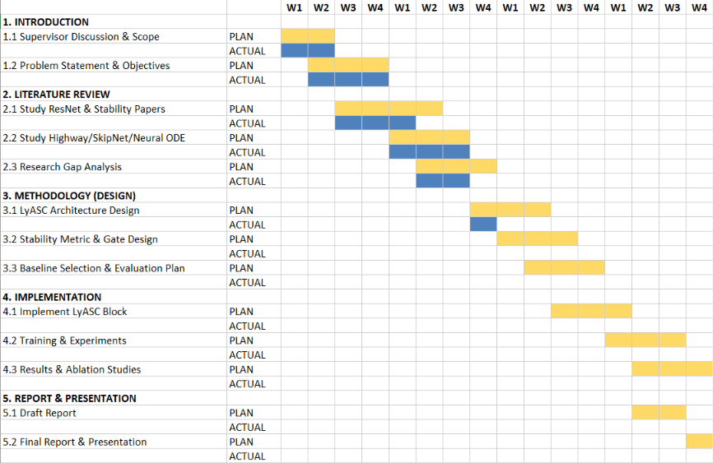
Gantt Chart
Project Title
Motivation and Problem Statement
Significance of the Project
Analysis on Base Paper
Insights from Base Paper
Research Gap
Objectives, Scope of the Project
Architecture Diagram
Workflow Diagram
Literature Review
Project Plan (Gantt Chart)
Proposed Time Line For the Events in Project Phase 1

Slide 33

Thank You

