Slide 1
Web Performance Audit
https://oralb.com.au

Slide 2
Audit Overview
This presentation summarizes the performance audit of the Oral-B Australia website. It includes an analysis of key performance metrics, tools used for auditing, detailed findings, and actionable recommendations to improve the site's speed, accessibility, and security.

Slide 3
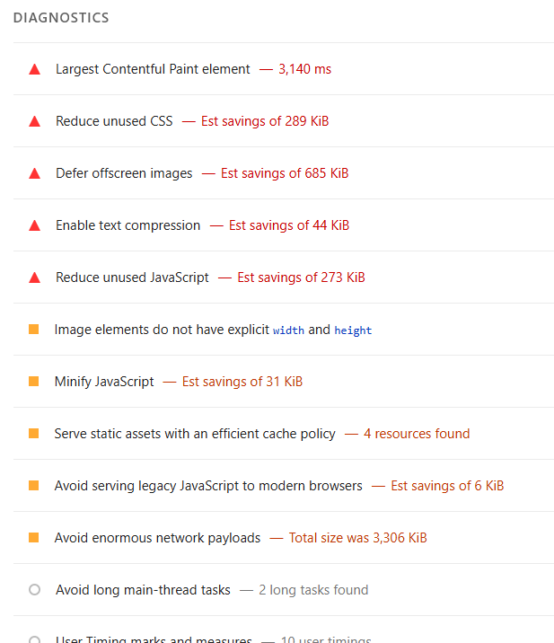
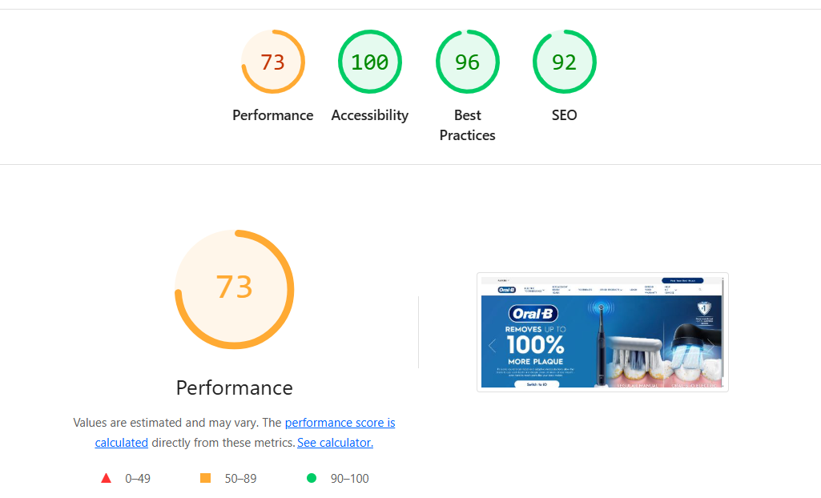
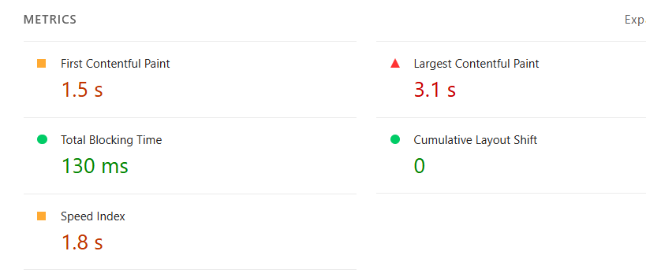

Slide 4
Tools Used for Audit
Google Lighthouse
WebPageTest
GTmetrix
Chrome DevTools
PageSpeed Insights
Pingdom Tools
BuiltWith
Web Vitals Extension
Request Map Generator
SecurityHeaders.com

Slide 5
Detailed Findings
Category | Issue/Observation | Impact | Recommendation
Page Load Speed | Initial load time exceeds 3 seconds on mobile networks | High bounce rate, poor user experience | Optimise image sizes, enable lazy loading, reduce render-blocking resources
Core Web Vitals | LCP and FID above recommended thresholds | SEO ranking and user engagement may suffer | Use CDN, preconnect to required origins, optimise critical rendering path
JavaScript Usage | Heavy use of third-party scripts | Increased load time and potential security risks | Audit and remove unused scripts, defer non-critical JS
Image Optimization | Images not consistently served in next-gen formats | Slower page rendering | Convert images to WebP or AVIF, use responsive image techniques
Caching Strategy | Inconsistent cache headers across assets | Repeated downloads, slower repeat visits | Implement strong caching policies for static assets
Accessibility | Missing alt attributes and ARIA labels | Poor experience for users with disabilities | Conduct full accessibility audit and apply WCAG 2.1 standards
Mobile Responsiveness | Layout shifts and overflow issues on small screens | Frustrating mobile experience | Use media queries and test across multiple devices
Security Headers | Lacks Content-Security-Policy and X-Frame-Options | Vulnerable to clickjacking and XSS attacks | Add recommended HTTP security headers
Third-Party Requests | High number of external requests | Performance bottlenecks and privacy concerns | Limit third-party integrations and load asynchronously
Server Response Time | TTFB is relatively high | Delayed initial rendering | Optimize backend processing and consider edge caching

Slide 6
Recommendations
Optimize images and serve in next-gen formats
Implement lazy loading and reduce render-blocking resources
Audit and minimize third-party scripts
Improve caching strategy for static assets
Enhance accessibility and mobile responsiveness
Add missing security headers
Optimize server response time and backend performance

