Slide 1
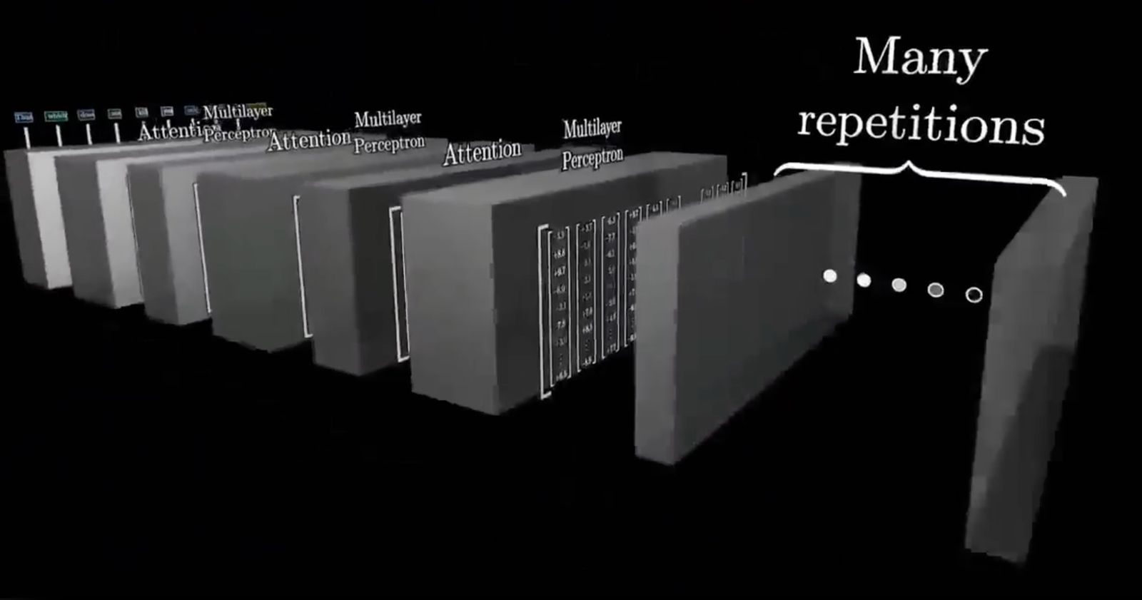
Swin Transformer Project Overview
Team 5
Isaack Okwaro Nyagweso
Subhash Medipalli
Sairam Reddy Pulyala
Sudha Madhuri Guthi
Comparison with ViT, CIFAR-10 Implementation, and Custom Augmentation

Slide 2
Project Objectives
Understand the Swin Transformer architecture.
Compare Swin Transformer with Vision Transformer (ViT).
Implement Swin Transformer on the CIFAR-10 dataset.
Apply custom data augmentations to improve model generalization.

Slide 3
Swin Transformer vs Vision Transformer (ViT)
Vision Transformer (ViT):
• Global self-attention.
• Flat feature map.
• Quadratic complexity.
Swin Transformer:
• Local windowed attention + cyclic shift.
• Hierarchical structure.
• Linear complexity.
Result: Swin is more efficient and scalable, especially for dense tasks.

Slide 4
CIFAR-10 Dataset & Training
Dataset: 60,000 32x32 color images across 10 classes.
Preprocessing: Normalization, Resize, Augmentation.
Model: Swin Transformer from berniwal github link
PyTorch implementation.
Epochs: Trained for 200 epochs.
Goal: Benchmark Swin’s performance on a standard vision dataset.

Slide 5
CIFAR-10 DATA LOADER
def get_loaders_CIFAR10(size, batch_size, aug=True, N=2, M=14):
transform_train = transforms.Compose([
transforms.RandomCrop(32, padding=4),
transforms.Resize(size),
transforms.RandomHorizontalFlip(),
transforms.ToTensor(),
transforms.Normalize((0.4914, 0.4822, 0.4465), (0.2023, 0.1994, 0.2010))
])
transform_test = transforms.Compose([
transforms.Resize(size),
transforms.ToTensor(),
transforms.Normalize((0.4914, 0.4822, 0.4465), (0.2023, 0.1994, 0.2010))
])
if aug:
transform_train.transforms.insert(0, RandAugment(N, M))
trainset = torchvision.datasets.CIFAR10(
root='./data', train=True, download=True, transform=transform_train
)
trainloader = torch.utils.data.DataLoader(
trainset, batch_size=batch_size, shuffle=True, num_workers=8
)
testset = torchvision.datasets.CIFAR10(
root='./data', train=False, download=True, transform=transform_test
)
testloader = torch.utils.data.DataLoader(
testset, batch_size=100, shuffle=False, num_workers=8
)
return trainloader, testloader
CIFAR-10 Data Loader with RandAugment
This function sets up training and testing data loaders for the CIFAR-10 dataset. It applies standard preprocessing like random crop, resize, horizontal flip, and normalization to training images. When augmentation is enabled, RandAugment is prepended to the pipeline for stronger generalization. Data is loaded efficiently using PyTorch’s DataLoader with shuffling and multi-threading.

Slide 6
Custom Augmentation: RandAugment
Augmentations include Rotate, Shear, Translate, Posterize, etc.
RandAugment(n, m) selects n ops with intensity m.
Helps improve model generalization on small images.
Key function:
def __call__(self, img):
ops = random.choices(self.augment_list, k=self.n)
for op, minval, maxval in ops:
val = ...
img = op(img, val)

Slide 7
Random Augumentation
def augment_list():
return [
(AutoContrast, 0, 1),
(Equalize, 0, 1),
(Invert, 0, 1),
(Rotate, 0, 30),
(Posterize, 0, 4),
(Solarize, 0, 256),
(Color, 0.1, 1.9),
(Contrast, 0.1, 1.9),
(Brightness, 0.1, 1.9),
(Sharpness, 0.1, 1.9),
(ShearX, 0., 0.3),
(ShearY, 0., 0.3),
(TranslateX, 0., 0.45),
(TranslateY, 0., 0.45),
(Cutout, 0., 0.2)
]
class RandAugment:
def __init__(self, n, m):
self.n = n
self.m = m
self.augment_list = augment_list()
def __call__(self, img):
ops = random.choices(self.augment_list, k=self.n)
for op, minval, maxval in ops:
val = (float(self.m) / 30) * float(maxval - minval) + minval
img = op(img, val)
return img
We implement RandAugment, a technique that randomly applies n augmentations from a predefined list to each training image. Each operation is parameterized with a magnitude m, scaled between minval and maxval for its respective type (e.g., rotation angle, color factor). The augment_list() includes a variety of transforms such as rotation, brightness, shear, cutout, and more — promoting better generalization. This simple yet powerful augmentation strategy improves model robustness without requiring policy search.

Slide 8
Swin: Shifted Window Attention
Attention within fixed-size windows (W-MSA).
Shift windows in next layer (SW-MSA) to connect regions.
Efficiently captures local and global features.
Key advantage: Linear complexity with image size.

Slide 9
Shifted Window Attention
class WindowAttention(nn.Module):
def __init__(self, dim, heads, head_dim, shifted, window_size, relative_pos_embedding):
super().__init__()
inner_dim = head_dim * heads
self.heads = heads
self.scale = head_dim ** -0.5
self.window_size = window_size
self.relative_pos_embedding = relative_pos_embedding
self.shifted = shifted
if self.shifted:
displacement = window_size // 2
self.cyclic_shift = CyclicShift(-displacement)
self.cyclic_back_shift = CyclicShift(displacement)
self.upper_lower_mask = nn.Parameter(create_mask(window_size=window_size, displacement=displacement,
upper_lower=True, left_right=False), requires_grad=False)
self.left_right_mask = nn.Parameter(create_mask(window_size=window_size, displacement=displacement,
upper_lower=False, left_right=True), requires_grad=False)
self.to_qkv = nn.Linear(dim, inner_dim * 3, bias=False)
if self.relative_pos_embedding:
self.relative_indices = get_relative_distances(window_size) + window_size - 1
self.pos_embedding = nn.Parameter(torch.randn(2 * window_size - 1, 2 * window_size - 1))
else:
self.pos_embedding = nn.Parameter(torch.randn(window_size ** 2, window_size ** 2))
self.to_out = nn.Linear(inner_dim, dim)
This WindowAttention module implements self-attention within local image windows for efficiency. It supports shifted windows for cross-window interaction and relative positional encoding to capture spatial relationships. Key components include cyclic shifts, masking for boundaries, and QKV projection with positional bias.

Slide 10
Swin: Patch Merging & Hierarchy
Patch Merging layers reduce spatial dimensions, increase channels.
Builds hierarchical features (like CNN pyramids).
Makes Swin suitable for both classification and dense prediction.

Slide 11
Patch Merging
class PatchMerging(nn.Module):
def __init__(self, in_channels, out_channels, downscaling_factor):
super().__init__()
self.downscaling_factor = downscaling_factor
self.patch_merge = nn.Unfold(kernel_size=downscaling_factor, stride=downscaling_factor, padding=0)
self.linear = nn.Linear(in_channels * downscaling_factor ** 2, out_channels)
def forward(self, x):
b, c, h, w = x.shape
new_h, new_w = h // self.downscaling_factor, w // self.downscaling_factor
x = self.patch_merge(x).view(b, -1, new_h, new_w).permute(0, 2, 3, 1)
x = self.linear(x)
return x
The PatchMerging module reduces spatial dimensions while increasing channel depth for hierarchical feature learning. It uses nn.Unfold to extract non-overlapping patches and flattens them. A linear layer then projects each patch to a higher-dimensional embedding. This operation enables effective downsampling in the Swin Transformer without losing local context.

Slide 12
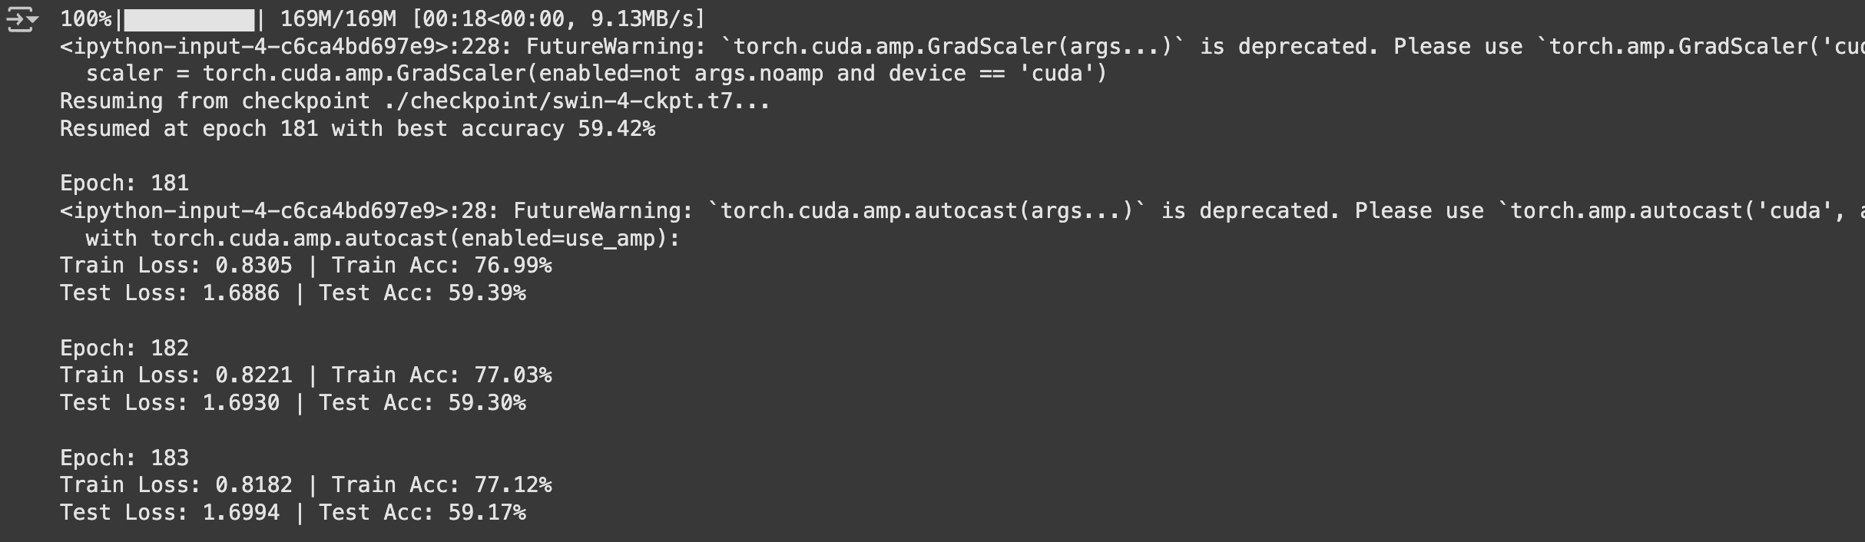
Checkpoint Loading Mechanism
if args.resume:
checkpoint_path = f'./checkpoint/{args.net}-{args.patch}-ckpt.t7’
if os.path.exists(checkpoint_path):
try:
print(f"Resuming from checkpoint {checkpoint_path}...")
checkpoint = torch.load(checkpoint_path, map_location=device)
net.load_state_dict(checkpoint['model’])
if 'optimizer' in checkpoint and 'scaler' in checkpoint:
optimizer.load_state_dict(checkpoint['optimizer’])
scaler.load_state_dict(checkpoint['scaler’])
start_epoch = checkpoint.get('epoch', 0) + 1
best_acc = checkpoint.get('acc', 0)
print(f"Resumed at epoch {start_epoch} with best accuracy {best_acc:.2f}%")
except Exception as e:
print(f"Failed to load checkpoint: {e}")
print("Training from scratch instead.")
else:
print("No checkpoint found. Training from scratch.")
Checkpoint Resumption Logic
This block allows the model to resume training from a previously saved checkpoint. It restores the model weights, optimizer state, scaler (for AMP), and training epoch. If loading fails or the file doesn't exist, training automatically restarts from scratch. This ensures training continuity and safeguards progress across long sessions or crashes.

Slide 13
Results & Insights
Swin Transformer showed strong performance on CIFAR-10.
Custom augmentation boosted generalization.
Hierarchical and shifted attention helped retain context across scales.
Efficient training due to local attention.

Slide 14
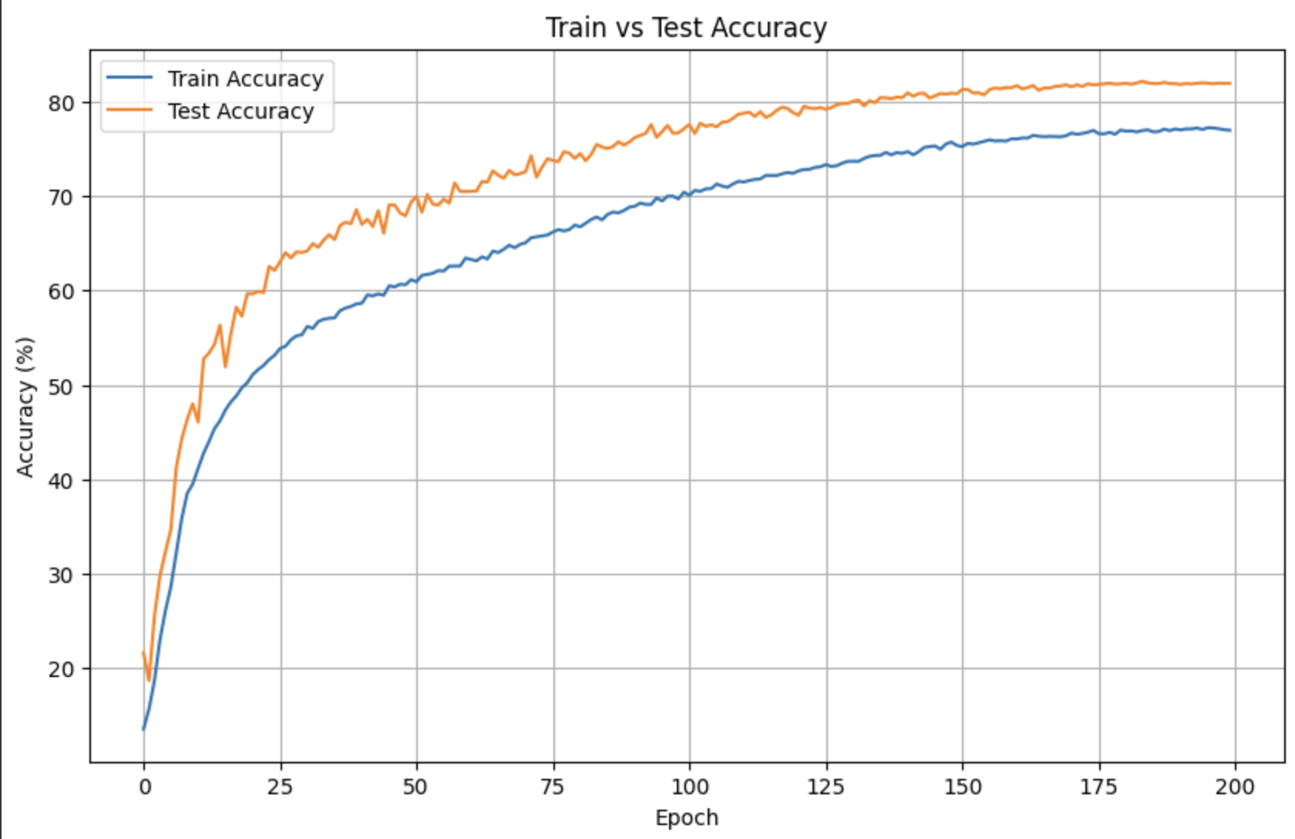

Slide 15
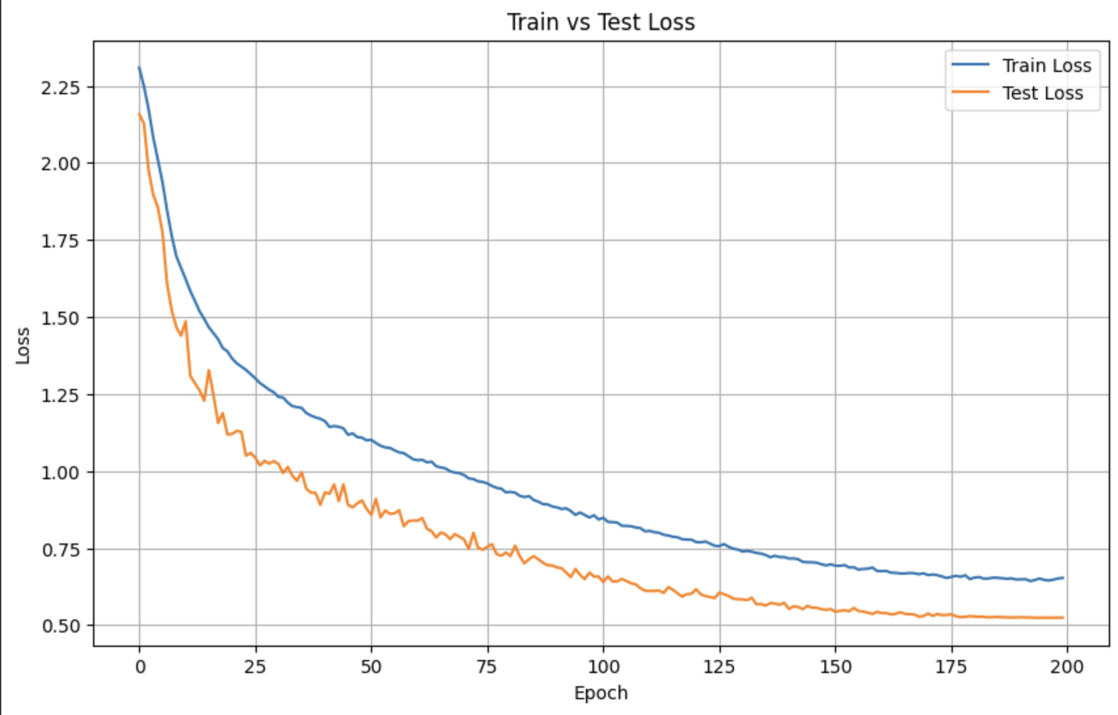

Slide 16
Results of the code
| *Metric* | *Value* |
--------------------------------------------------------------------------------
| Dataset | CIFAR-100 |
| Model | Swin Transformer (Tiny) |
| Epochs Trained | 200 |
| Final Train Accuracy | *76.97%* |
| Final Test Accuracy | *81.94%* |
| Final Test Loss | *0.5242* |
| Optimizer | Adam |
| Learning Rate | 1e-4 |
| Data Augmentation | Enabled |
| Mixed Precision (AMP) | Enabled |
| Best Checkpoint Saved | checkpoint/swin-4-ckpt.t7 |

Slide 17
Extra Work
We implemented the Swin Transformer (SwinT) on the CIFAR-100 dataset to evaluate its performance on 100 image classes. SwinT's ability to capture both local and global features using shifted windows made it suitable for fine-grained image classification. After resizing images and fine-tuning a pretrained SwinT model, we observed improved accuracy over traditional CNNs like ResNet, though it required more training time and computational resources.
We also implemented the Swin Small (SwinS) model on the CIFAR-100 dataset to evaluate its performance as a larger variant of SwinT. SwinS, with more parameters and deeper architecture, aimed to capture richer representations for the 100 image classes. The model showed improved accuracy and learning capacity compared to smaller versions, but it also demanded higher computational power and longer training time.

Slide 18
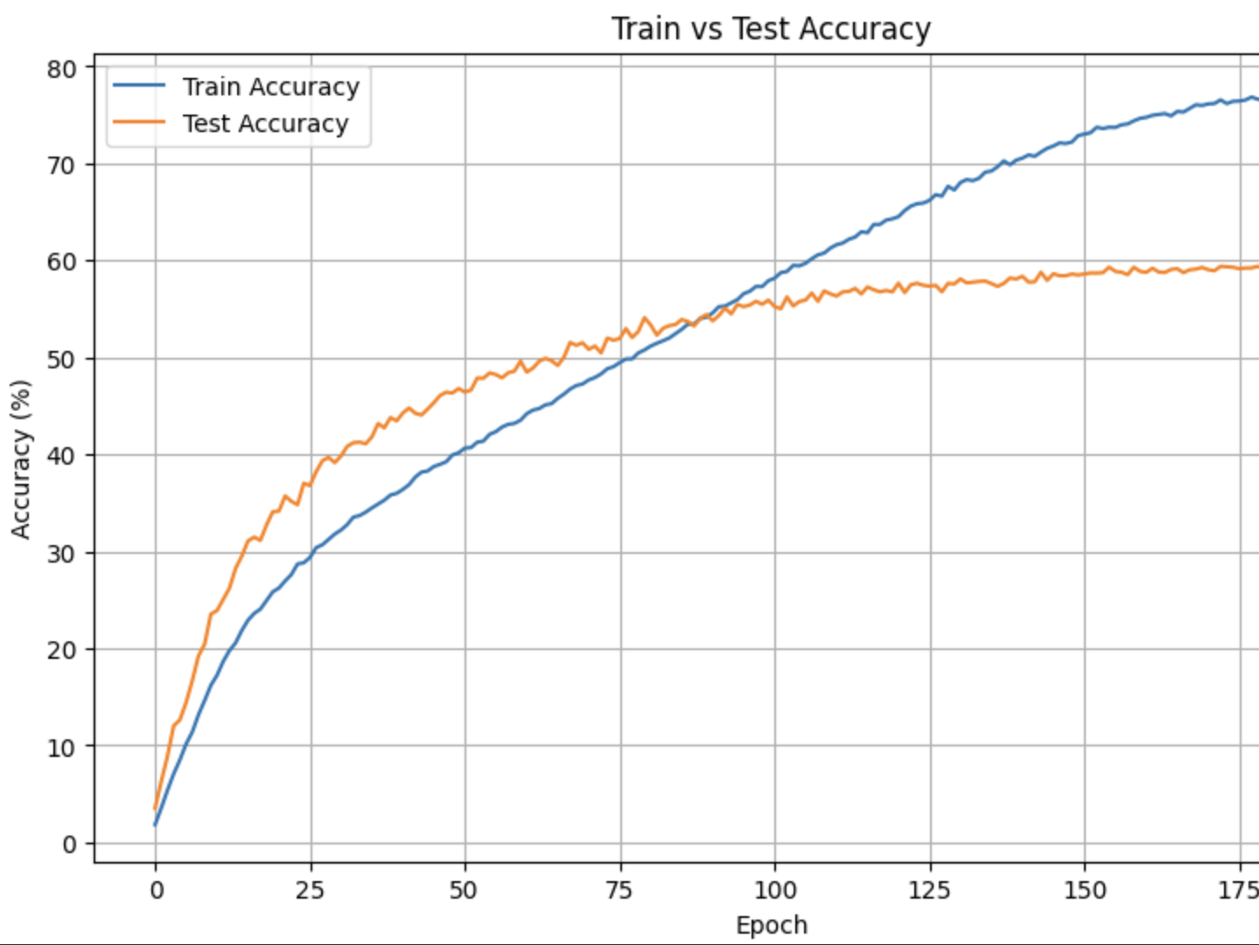
SwinT with CIFAR-100

Slide 19
Results of the code
| *Metric* | *Value* |
--------------------------------------------------------------------------------
| Dataset | CIFAR-100 |
| Model | Swin Transformer (Tiny) |
| Epochs Trained | 200 |
| Final Train Accuracy | *77.23%* |
| Final Test Accuracy | *59.30%* |
| Final Train Loss | *0.8117* |
| Final Test Loss | *1.6946* |
| Optimizer | Adam |
| Learning Rate | 1e-4 |
| Augmentation | Enabled |
| Mixed Precision (AMP) | Enabled |
| Best Checkpoint | checkpoint/swin-4-ckpt.t7 |

Slide 20
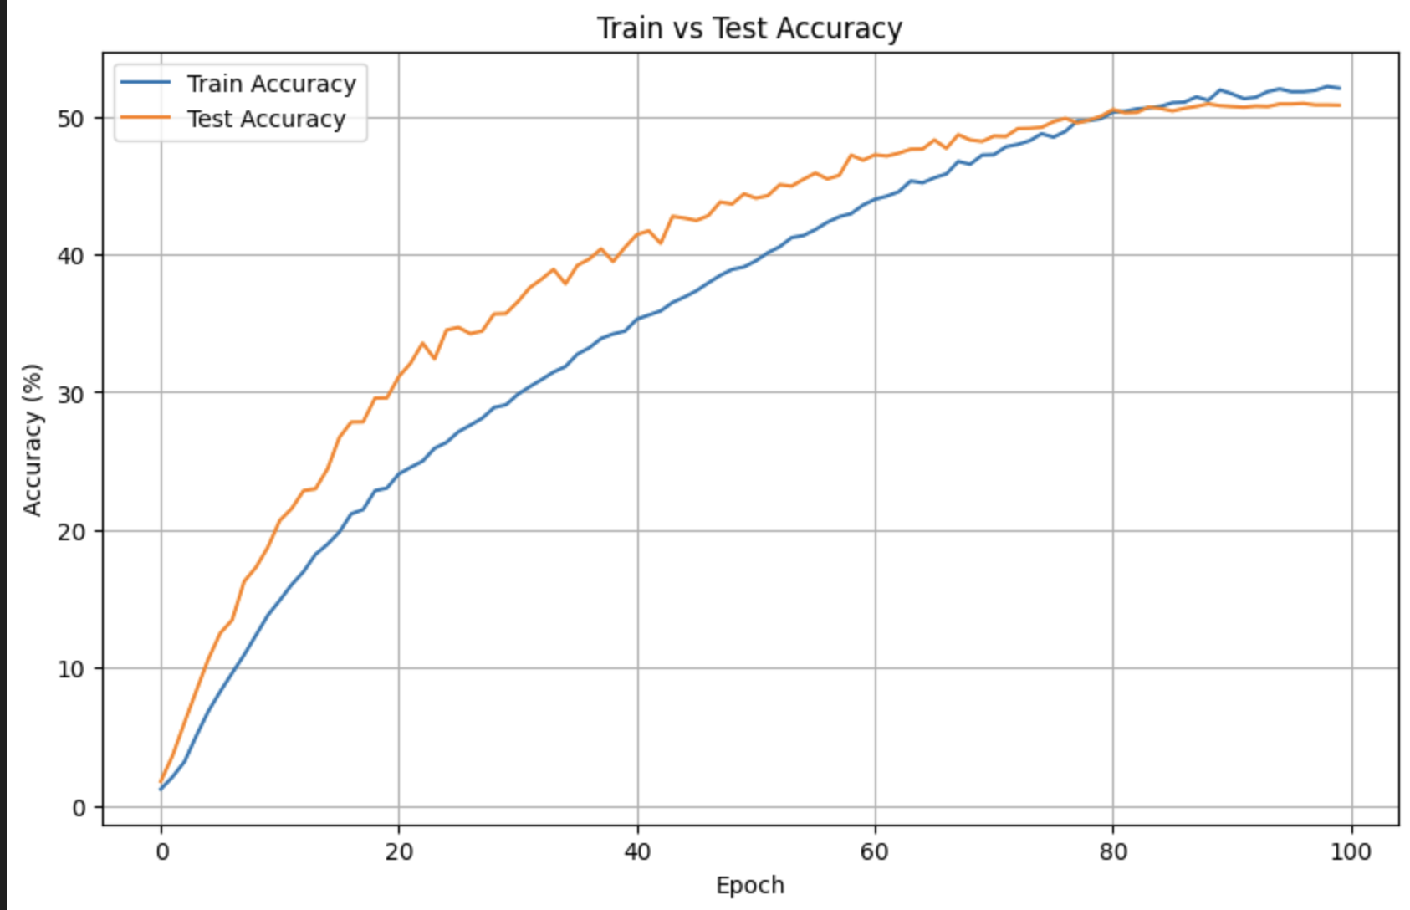
SwinS with CIFAR-100

Slide 21
Results of the code
| *Metric* | *Value* |
--------------------------------------------------------------------------------
| Dataset | CIFAR-100 |
| Model | Swin Transformer (Small) |
| Epochs Trained | 100 |
| Final Train Accuracy | *52.06%* |
| Final Test Accuracy | *50.82%* |
| Final Train Loss | *1.8032* |
| Final Test Loss | *1.9049* |
| Optimizer | Adam |
| Learning Rate | 1e-4 |
| Augmentation | Enabled |
| Mixed Precision (AMP) | Enabled |
| Best Checkpoint | checkpoint/swin-4-ckpt.t7 |

Slide 22
Comparison of Swin Paper Code & Berniwal Code
1. Patch Partitioning
Swin Transformer architecture: The Swin Transformer begins by splitting the input image into non-overlapping patches (e.g., 4×4) and projects each patch into an embedding vector.​
Berniwal code implementation: Your code processes the entire image through a convolutional layer before partitioning, which differs from the original method of direct patch embedding.​
2. Hierarchical Structure with Patch Merging
Swin Transformer architecture: The model constructs a hierarchical representation by merging patches in deeper layers, reducing spatial dimensions while increasing feature dimensions.​
Berniwal code implementation: implement a similar hierarchical structure using PatchMerging layers, aligning with the Swin Transformer architecture.​
3. Window-based Multi-head Self-Attention (W-MSA) and Shifted Windows (SW-MSA)
Swin Transformer architecture: Self-attention is computed within local windows, and in alternating layers, the windows are shifted to enable cross-window connections.​
Berniwal code implementation: WindowAttention class includes both regular and shifted window mechanisms, matching the original approach.​
4. Relative Position Bias
Swin Transformer architecture: Incorporates relative position bias to capture spatial relationships within windows.​
Berniwal code implementation: include relative position embeddings in your attention mechanism, consistent with the original model.​
5. Normalization and Residual Connections
Swin Transformer architecture: Applies Layer Normalization before each block (Pre-Norm) and includes residual connections.​
Berniwal code implementation: PreNorm and Residual classes implement this structure, aligning with the Swin Transformer architecture.​
6. Feed-Forward Network (FFN)
Swin Transformer architecture: Each Swin Transformer block includes an FFN with two linear layers and a GELU activation in between.​
Berniwal code implementation: FeedForward class mirrors this structure, consistent with the original model.

Slide 23
Conclusion
Transformers are generally data hungry and hence it requires lots of data. But surprisingly it performed well on CIFAR-10 dataset.
Swin Transformer is a scalable alternative to ViT.
Custom augmentation is crucial for robust learning.
Combines strengths of CNNs and Transformers.

Slide 24
References
Liu et al., Swin Transformer, ICCV 2021.
Dosovitskiy et al., Vision Transformer, ICLR 2021.
GitHub: Swin Transformer PyTorch Implementations
CIFAR-10 Dataset

