Slide 1
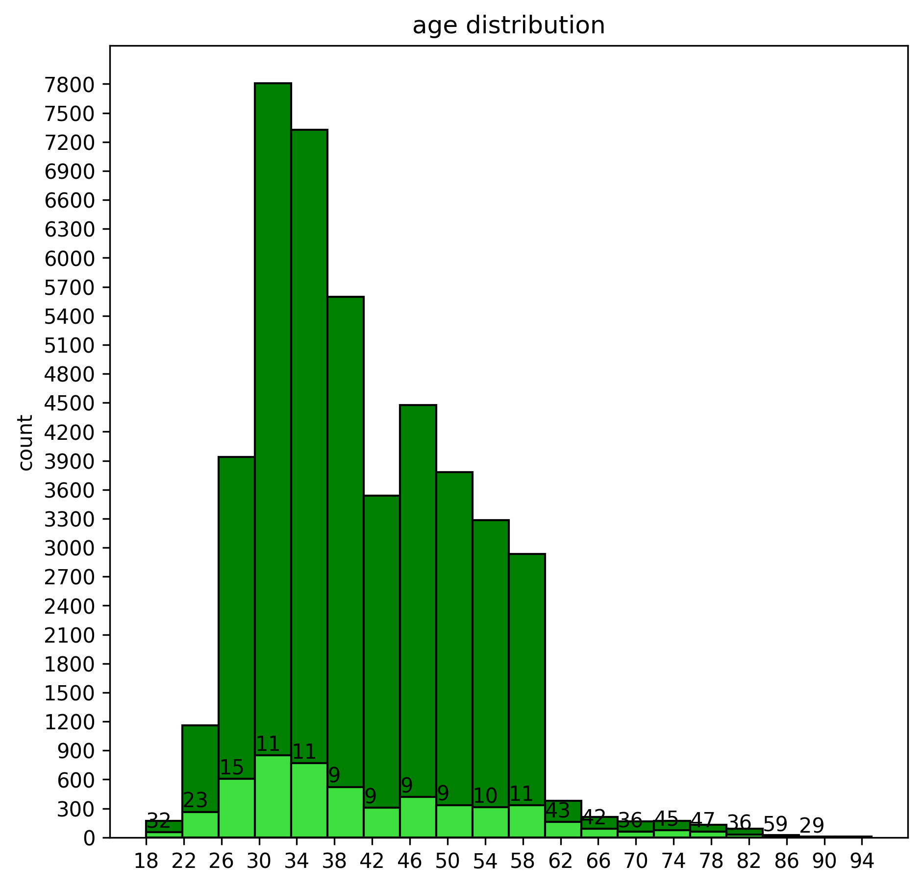
AGE DISTRIBUTION AMONG CLIENTs
The dark green histogram represents age distribution of clients and light green histogram indicates the percentage of clients who subscribed for the term deposit.
From this we can make an assumption that most of the clients between age 60 to 90 are subscribing for term deposit and targeting them can be useful for the bank.

Slide 2

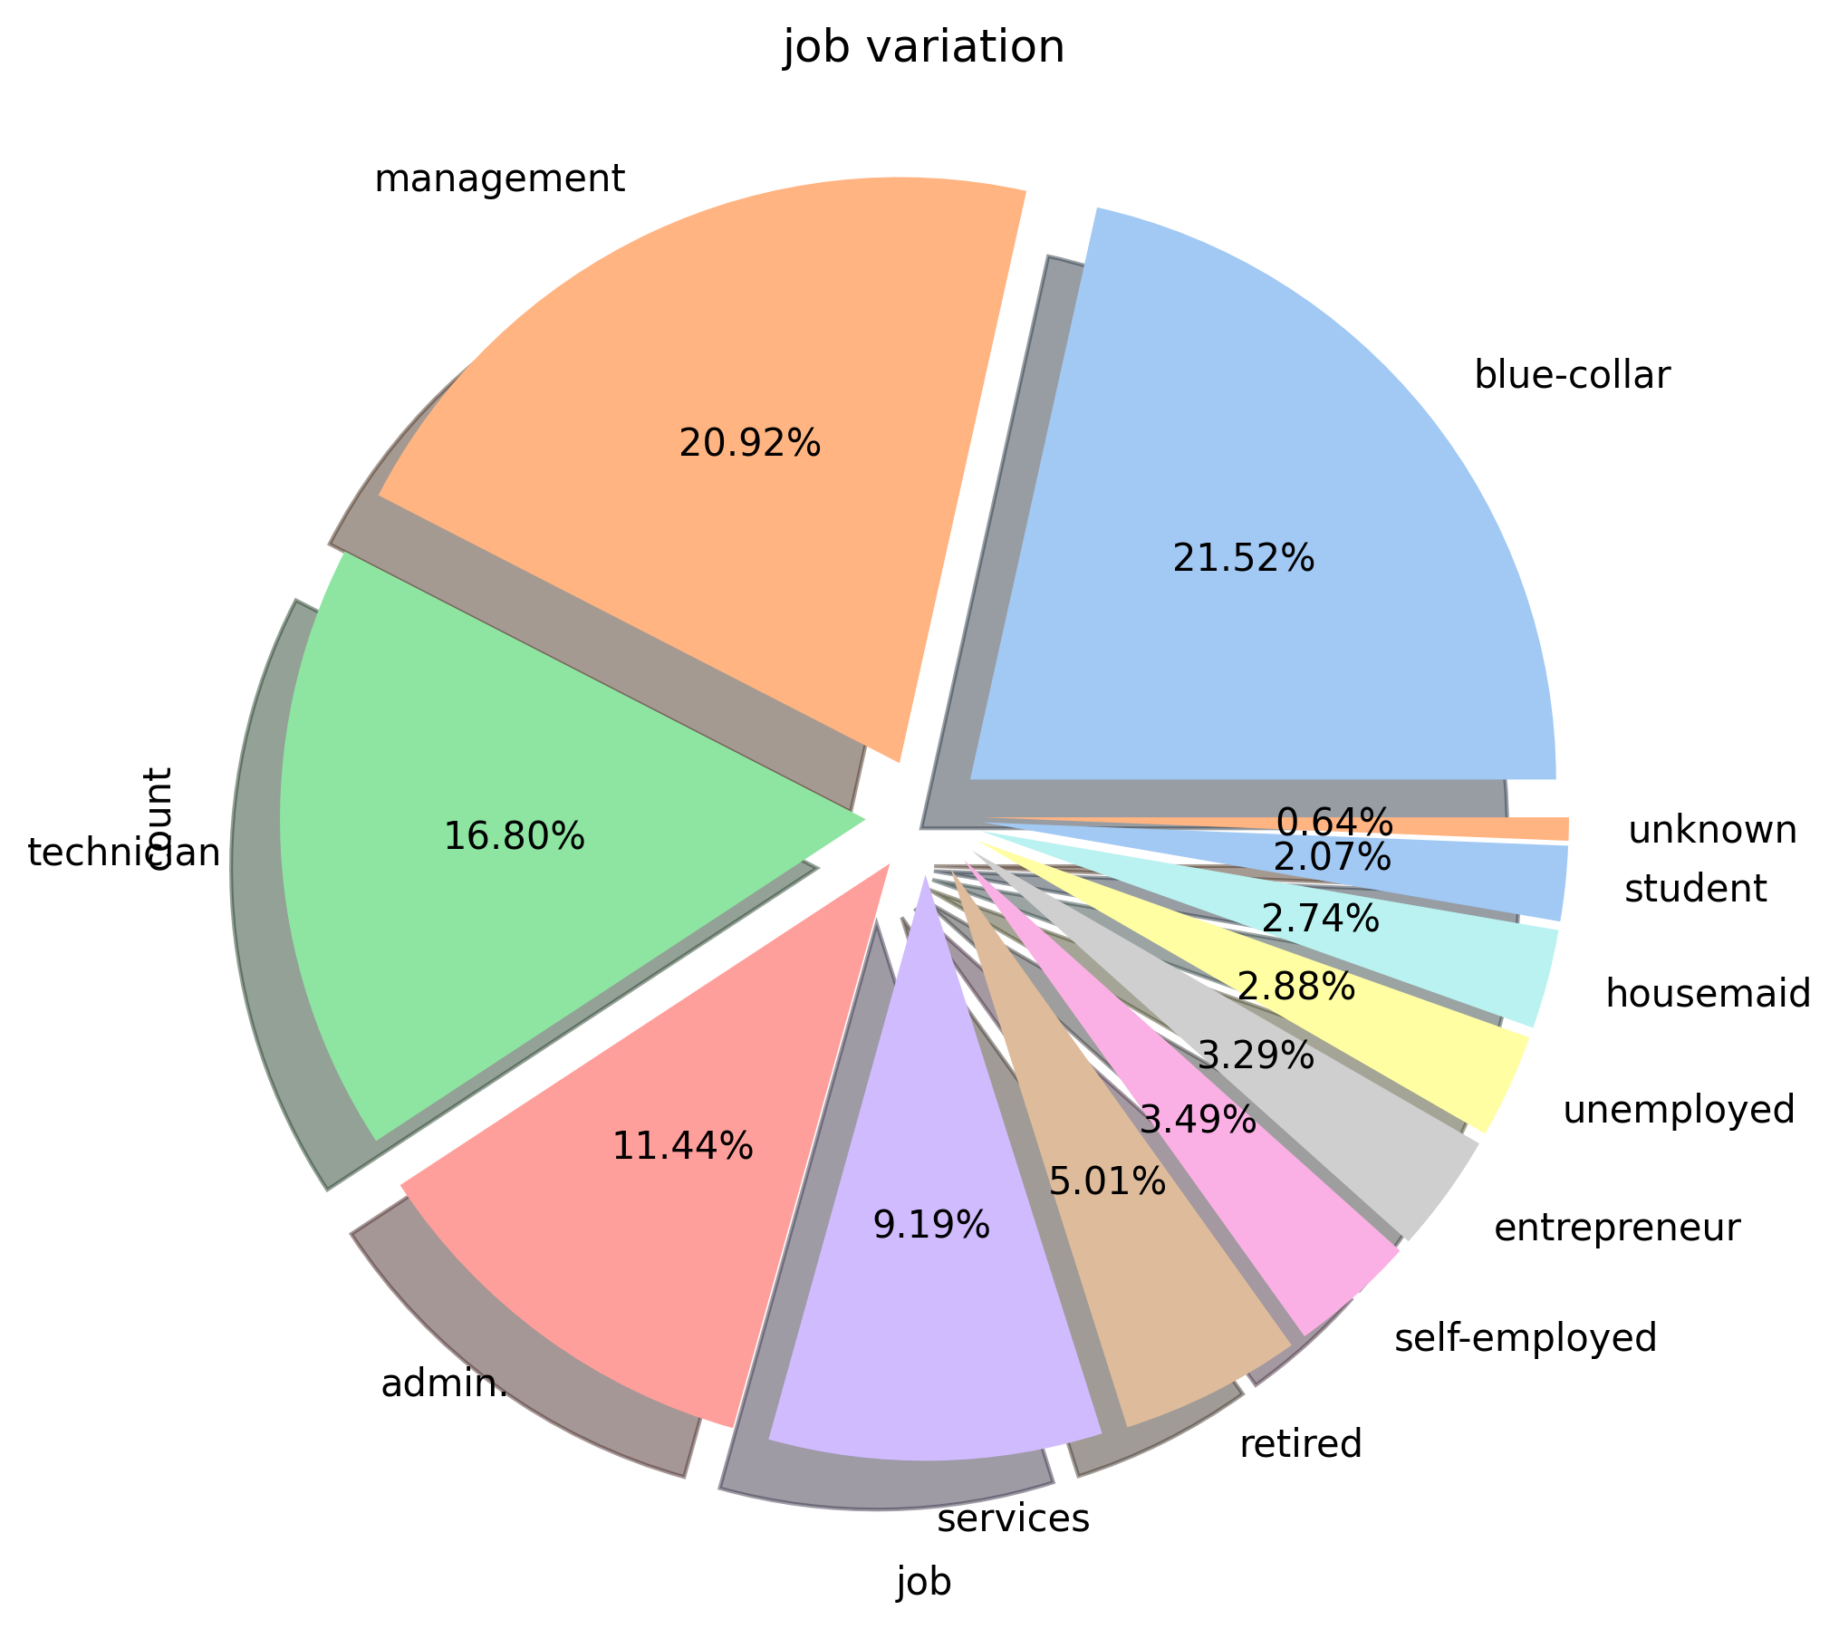
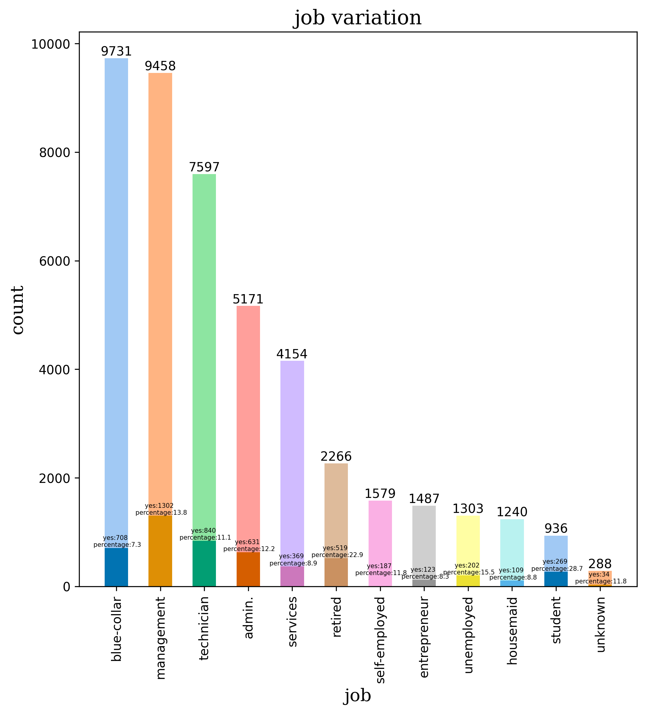
Representation of job variation among clients and percentage of clients subscribed for term deposit
This representation of job variation tells that mostly people from blue collar jobs have been contacted and second place is occupied by management sector but as we can see ,clients in sectors like students,retired,unemployed,management,admin etc are having more subscription percentage respectively.

Slide 3
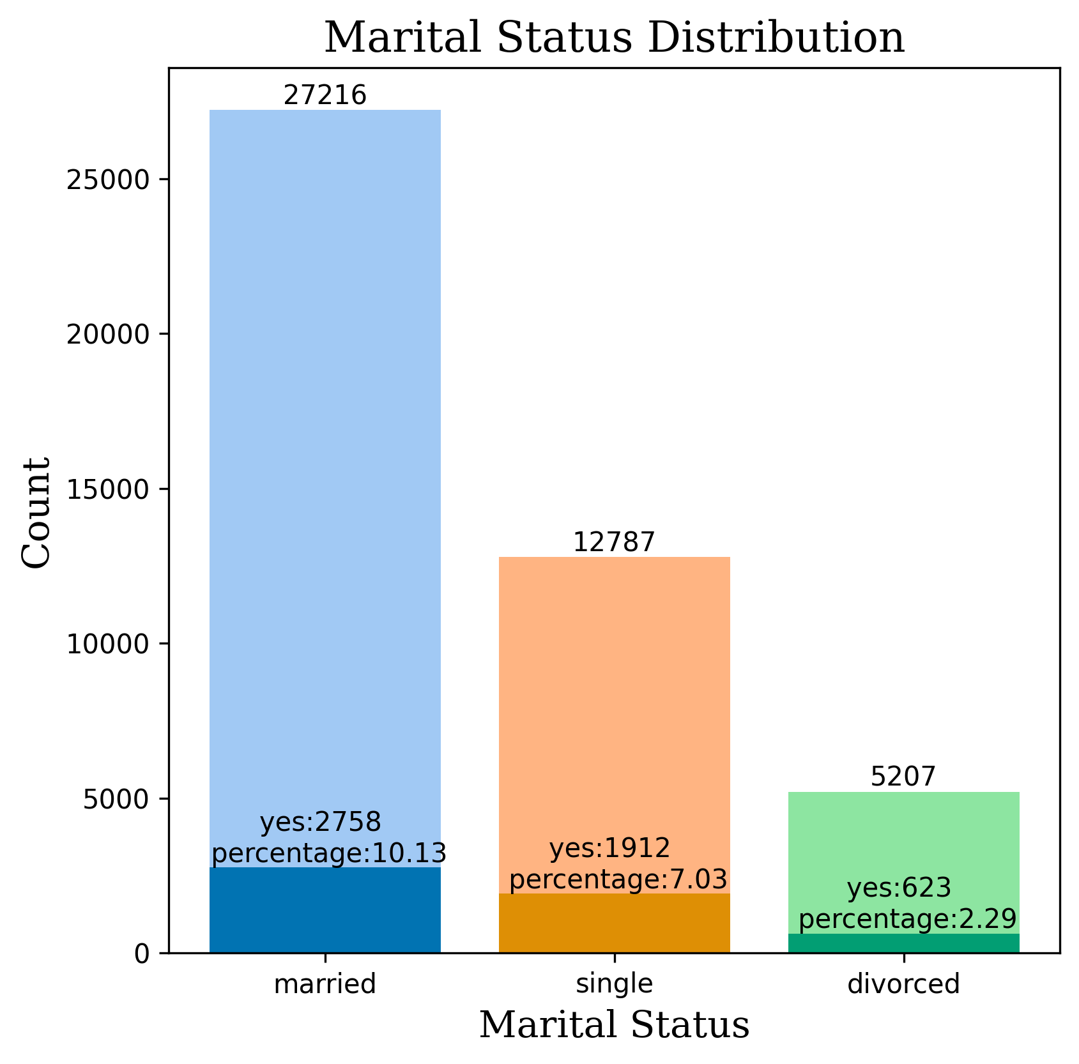
Marital status distribution and percentage of them subscribed for term deposit
Most of the married people have been contacted (27216 people) and 10% of them subscribed.
Coming second single people have been contacted with a count of 12787 and 7% have subscribed among them.
Lastly divorced people count comes with 5207 with a subscription rate of 2%.

Slide 4
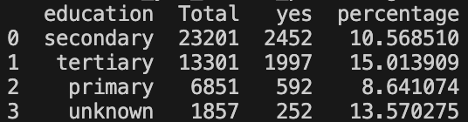
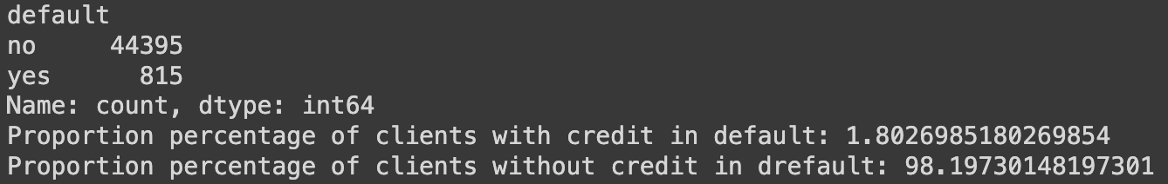
Education level among clients
Proportion of clients having credit in default

Slide 5
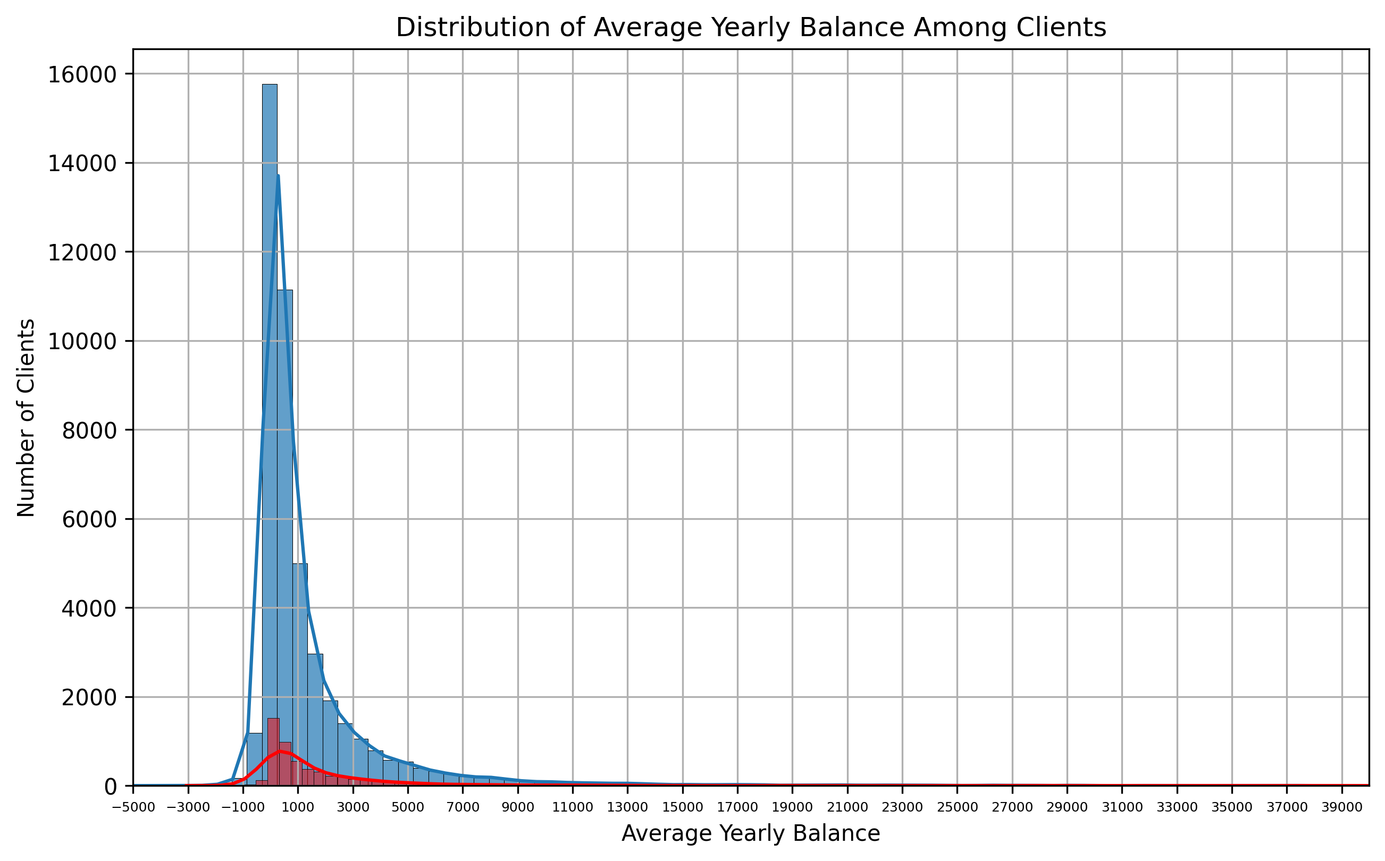
distribution of average yearly balance among clients
as we can see in the graph as we go towards right blue line and green line are intersection that means people having more balance are subscribing more and the call made to 0 balance accounts have the most subscription because 0 balance people are contacted mostly . similarly the graph keeps on going.

Slide 6

How many clients have housing loans?
No of clients having housing loans are 25130.
No of clients having housing loans subscribed to term deposit are 1935
No of clients not having housing loans subscribed to term deposit 3358
How many clients have personal loans?
No of clients having personal loans are 7244
No of clients having personal loan subscribed to term deposit are 484
No of clients not having personal loan subscribed to term deposit 4809
What are the communication types used for contacting clients during the campaign?
Communication types used for contacting clients during the campaign: ['cellular', 'unknown', 'telephone']

Slide 7
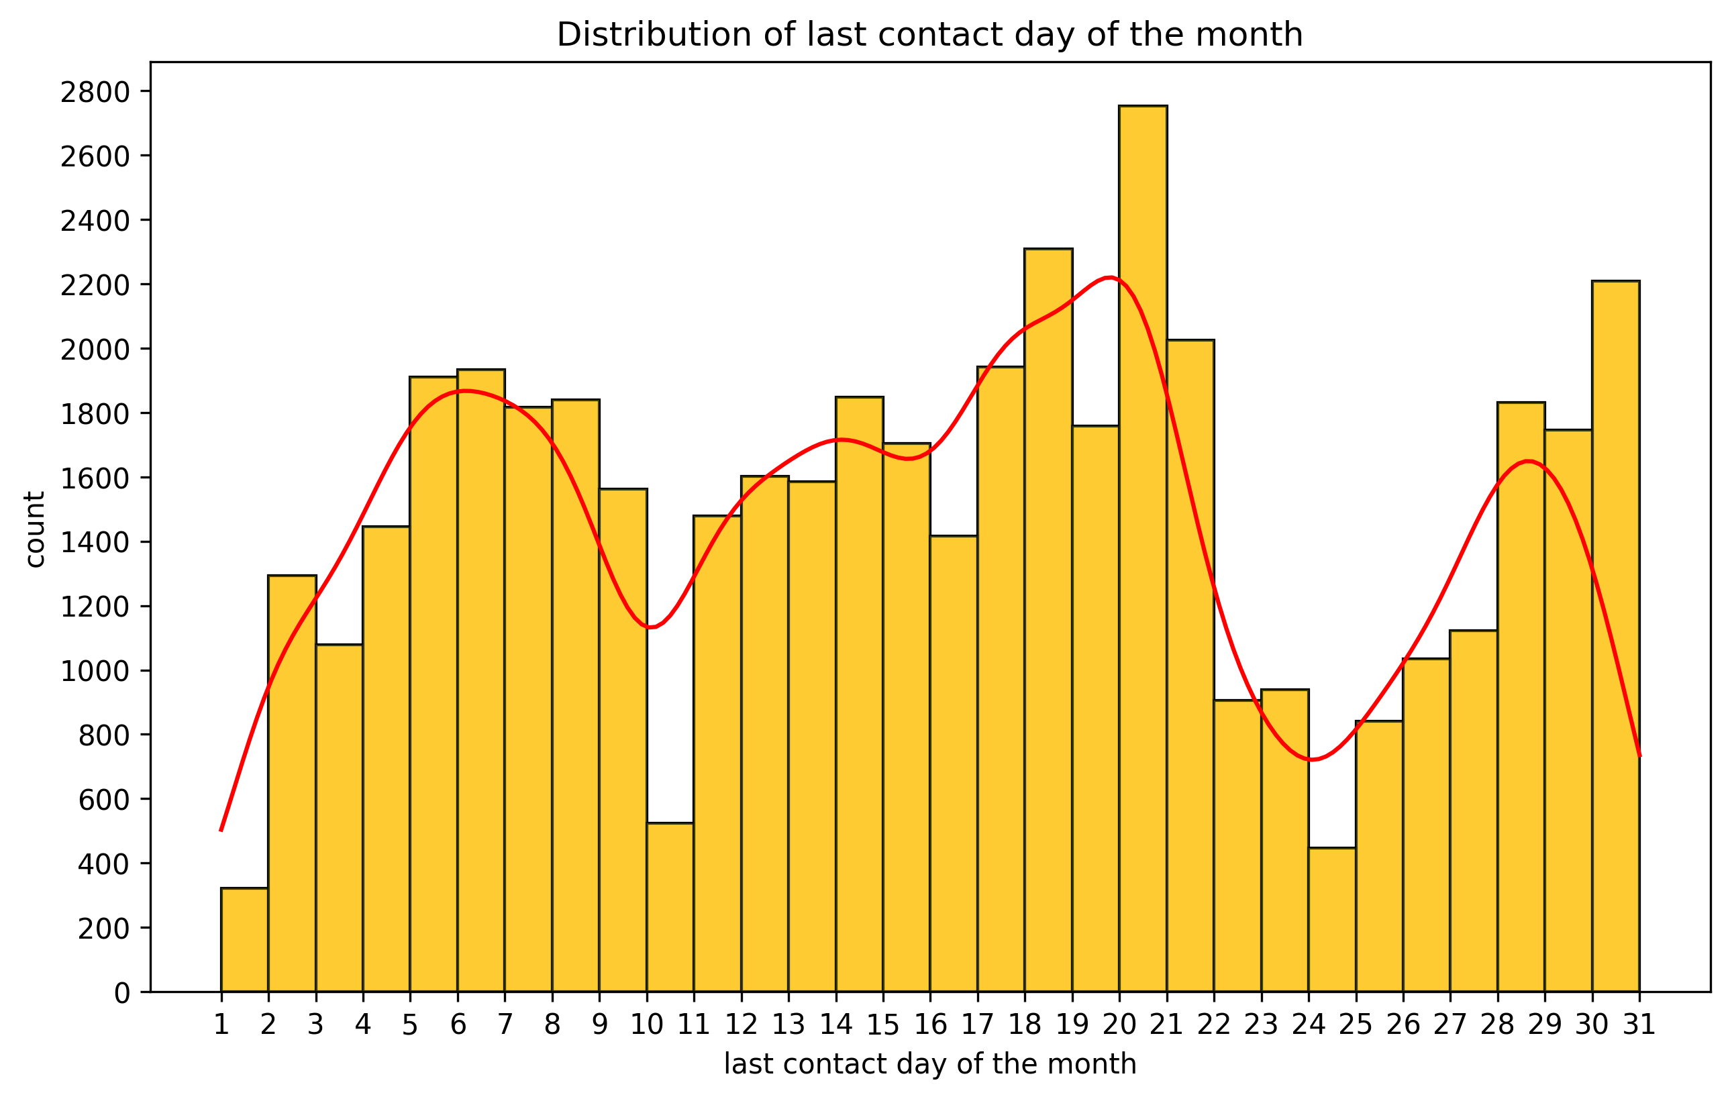
This shows the distribution of last contact day of the month (every month is included)
The count of last contact day is maximum in 20th day of the month
Most no of contacts have been performed on the days 4th to 8th , 13th to 21st and 28th to 29th
Remaining days are least contacted.

Slide 8
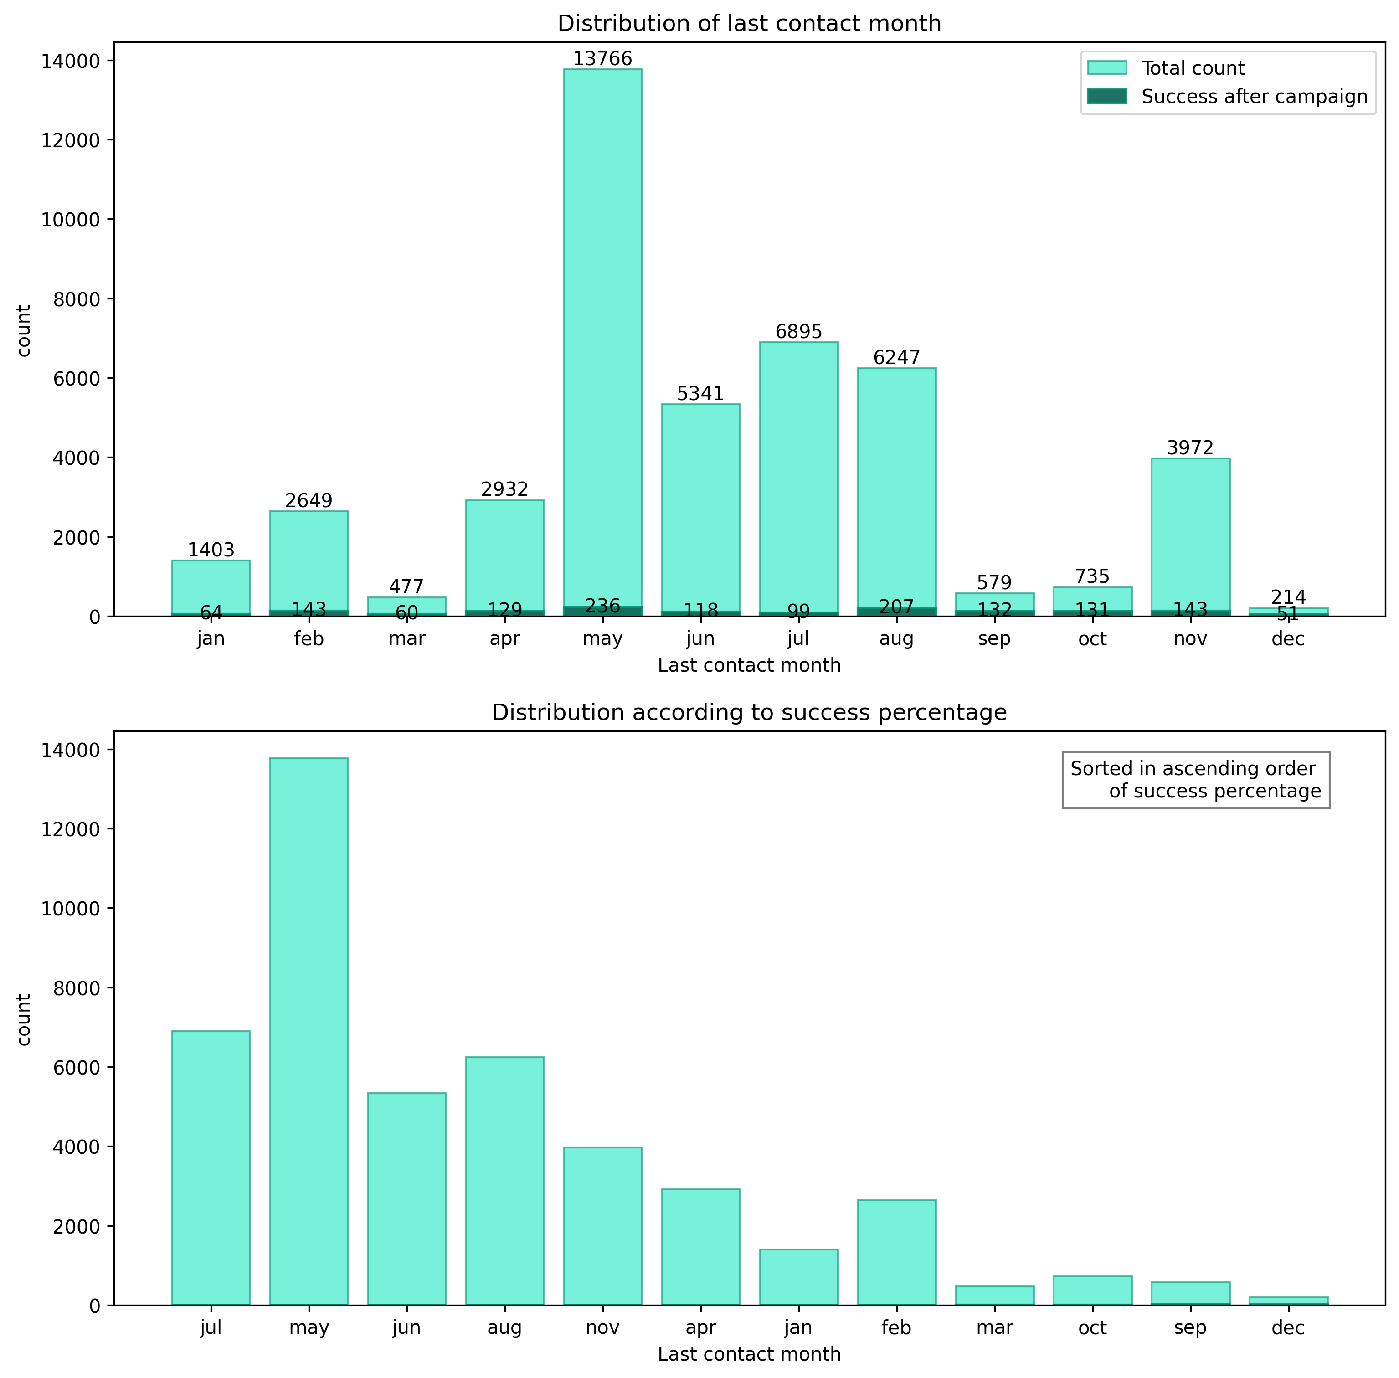
The following represents the distribution of last contact month for clients and distribution of last contact month according to ‘poutcome’ and is sorted in ascending order . That is December have most percentage of people subscribing after the campaign.

Slide 9
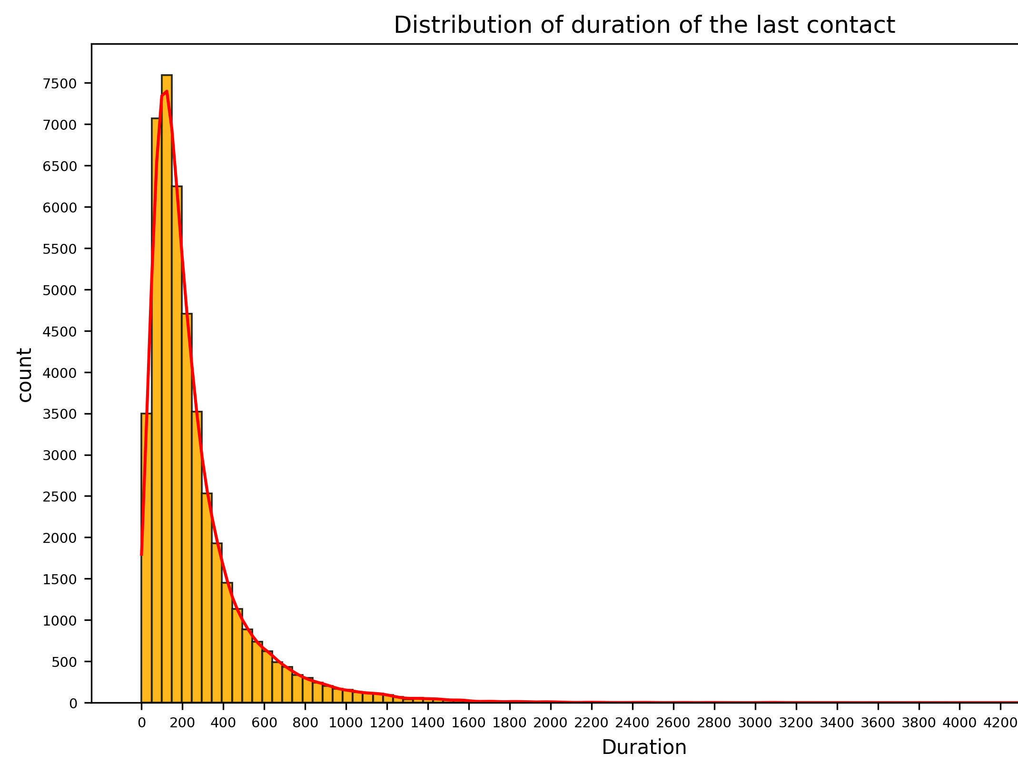
Distribution of duration of last contact
Most clients have had a conversation in the range of 0 to 300sec .
Very less no of clients have been engaged more than 800sec

Slide 10
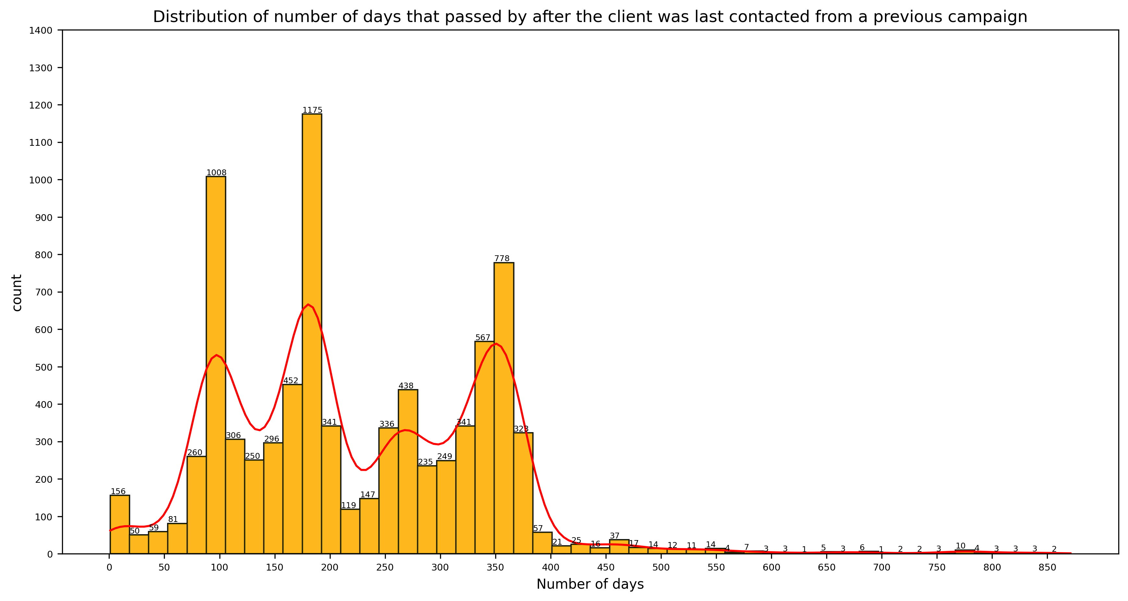
AS WE CAN SEE MORE THAN 75 DAYS HAVE PASSED FOR MOST OF THE CLIENTS .
SO WE CAN CONCLUDE THAT THESE CLIENTS CAN BE CONTACTED AGAIN WHICH CAN INCREASE THE SUBSCRIPTION RATE .

Slide 11
What were the outcomes of the previous marketing campaigns?
unknown : 36959
failure : 4900
other : 1838
success : 1513

Slide 12
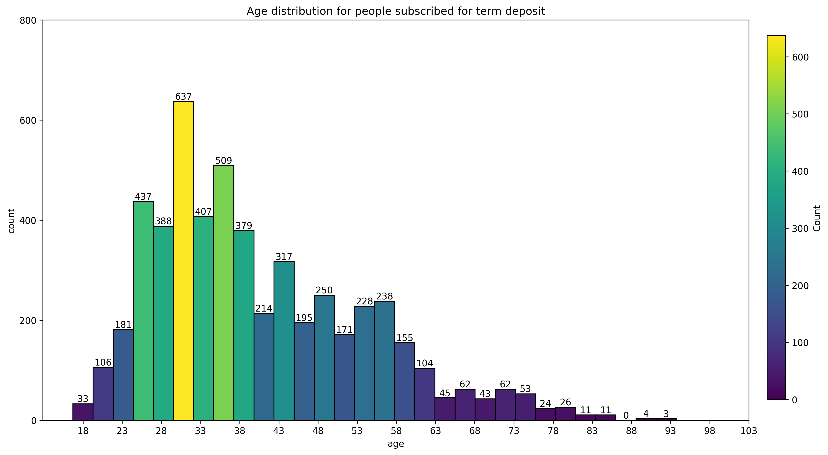
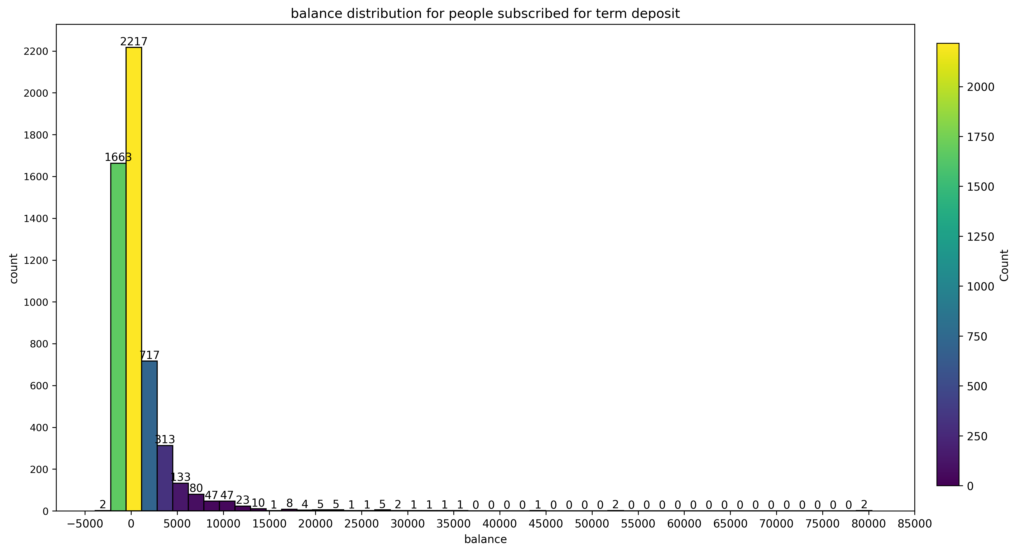
MOST OF THE CLIENTS WHO SUBSCRIBED FOR TERM DEPOSIT ARE HAVING BALANCE OF -2000 TO 2000 EUROS.
MOST OF THE CLIENTS WHO SUBSCRIBED FOR TERM DEPOSIT IS AGED BETWEEN 20 TO 35 YEARS.

Slide 13
