Slide 1
CUSTOMER SUPPORT CHATBOT WITH ML
PIP2001 Capstone Project
Review-1
Batch Number: 115
Roll Number | Student Name
Under the Supervision of,
Dr. Joseph Michael Jerard V,
Professor,
School of Computer Science and Engineering,
Presidency University.
20211CSE0877 | Shaik Nihal Basha
20211CSE0571 | Manya A J
20211CSE0684 | Subhash N
20211CSE0663 | Abhishek A
20211CSE0829 | N Sultan Basha
Name of the Program: CSE
Name of the HoD: Dr. Asif Mohammed H.B
Name of the Program Project Coordinator: Mr. Amarnath J.L & Dr. Jayanthi K
Name of the School Project Coordinators: Dr. Sampath A K / Dr. Abdul Khadar A / Mr. Md Ziaur Rahman

Slide 2
Introduction
In today's digital age, customer service is crucial for maintaining customer loyalty and satisfaction. As the volume of customer inquiries grows, businesses face challenges in providing timely and effective support. Automation, particularly through chatbots, has emerged as a solution to enhance service quality and efficiency.
Importance of Chatbots: Chatbots are becoming integral to customer interactions, providing instant responses and support. They help streamline processes, reduce wait times, and ensure that customer complaints are addressed promptly.
Overview of the Chatbot: This research presents the design and development of an intelligent chatbot specifically aimed at automating customer complaint resolution. It leverages Natural Language Processing (NLP) to understand customer queries and improve service delivery.

Slide 3
Literature Review
Chatbot Technologies: Previous research highlights the effectiveness of chatbot technologies in various customer service applications. They can significantly improve response times and enhance overall customer satisfaction by providing immediate assistance.
Natural Language Processing (NLP): Key NLP techniques such as intent recognition, sentiment analysis, and entity extraction play vital roles in how chatbots interpret and respond to user queries. These techniques help ensure that customer inquiries are accurately understood and addressed.
Challenges in Existing Systems: Despite advancements, many existing chatbot systems struggle with understanding complex queries and adapting to new situations, often resulting in customer frustration and unresolved issues.

Slide 4
Existing method Drawback
Inefficiency: Traditional customer service methods heavily rely on human agents, leading to inefficiencies such as long response times and inconsistencies in service quality. This approach can overwhelm support teams during peak times.
Limited Learning: Many current chatbots lack a self-learning mechanism, which means they do not improve their performance based on past interactions. This stagnation limits their effectiveness over time.
Inflexibility: Existing systems often find it challenging to adapt to new types of queries or learn from unique customer interactions, resulting in missed opportunities to enhance service and improve customer satisfaction.

Slide 5
Proposed Method
Self-Learning Chatbot: The proposed solution is a self-learning chatbot that combines NLP capabilities with a mechanism for learning from customer interactions. This allows the chatbot to evolve and improve its responses over time.
Automation of Complaint Resolution: The chatbot automates the process of interpreting customer queries, searching a pre-existing database for solutions, and escalating unresolved issues to human support staff. This ensures that customers receive timely assistance.
Continuous Improvement: By learning from interactions between customers and support staff, the chatbot continually updates its database, preparing it to handle similar queries more effectively in the future.

Slide 6
Objectives
Primary Goals: The main objectives of this research are to enhance query resolution efficiency and improve overall customer satisfaction by reducing wait times and increasing the accuracy of responses.
Learning from Interactions: The chatbot is designed to learn from each interaction, allowing it to refine its responses and solutions based on real-world experiences with customers.
Reduction of Human Dependency: By automating common queries, the system aims to reduce the reliance on human agents for routine issues, freeing them to focus on more complex cases.

Slide 7
Methodology/Modules
Data Collection: Data was gathered from customer queries and resolutions to train the chatbot effectively. This dataset includes a variety of common complaints and corresponding solutions.
NLP Model Selection: The research utilizes advanced NLP models (e.g., BERT or GPT) for processing customer inputs, chosen for their ability to understand context and intent accurately.
Learning Mechanism: The system incorporates new solutions from staff interactions to update its knowledge base, ensuring that the chatbot remains relevant and effective in resolving customer issues.

Slide 8
Architecture
System Overview: The architecture of the chatbot includes:
NLP Engine: Responsible for interpreting and processing customer queries effectively.
Database: A structured repository where solutions and resolutions are stored.
Escalation Mechanism: Defines criteria for when unresolved issues should be handed over to support staff.
Feedback Loop: Allows the system to learn and update based on customer and staff interactions.

Slide 9
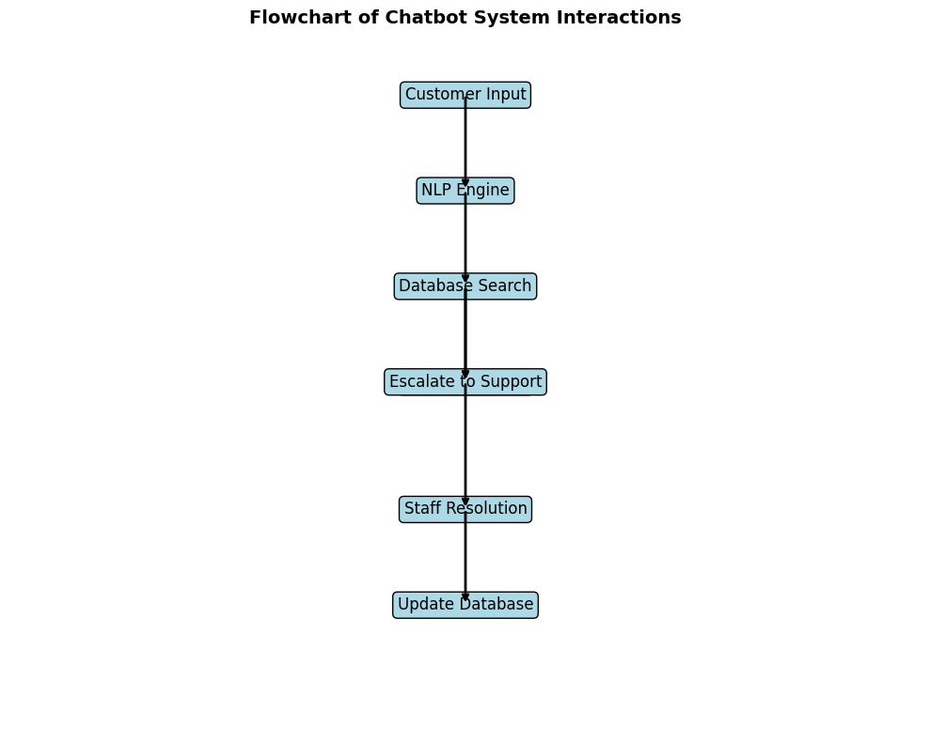
Flowchart:

Slide 10
Hardware requirements:
Processor: A multi-core processor (e.g., Intel Core i5 or AMD Ryzen 5) is recommended for handling the computational demands of NLP and machine learning algorithms.
RAM: At least 8GB of RAM is suggested to ensure smooth performance, especially when dealing with large datasets or complex models.
Storage: A solid-state drive (SSD) is preferable for faster data access and improved overall system responsiveness.
Graphics Card: While not strictly necessary for most chatbot applications, a dedicated graphics card can accelerate certain deep learning operations, especially if you're working with large-scale models.

Slide 11
Software requirements:
Operating System: Windows, macOS, or Linux (e.g., Ubuntu) can all be used for chatbot development.
Programming Language: Python is a popular choice for NLP and machine learning due to its extensive libraries and community support.
Development Environment: Consider using an integrated development environment (IDE) like Jupyter Notebook, PyCharm, or Visual Studio Code to streamline your workflow.
Machine Learning Frameworks:
TensorFlow
PyTorch

Slide 12
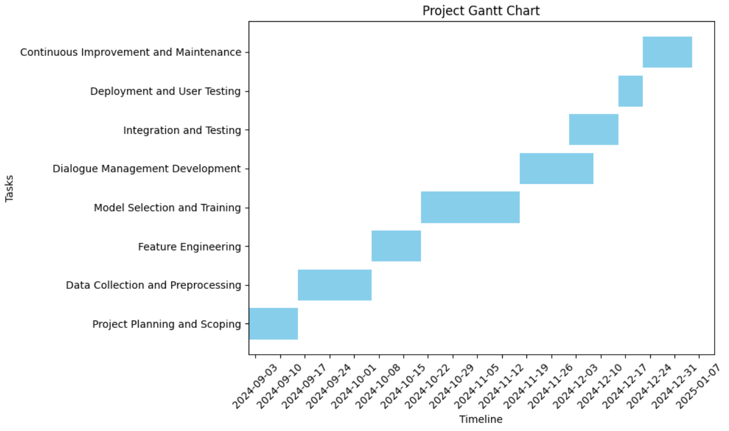
Timeline of Project

Slide 13
Expected Outcomes
Improved Query Resolution Rates: Anticipated higher resolution rates for customer queries, leading to better service outcomes.
Reduced Response Time: Significant reductions in the time taken to resolve customer complaints, enhancing overall customer satisfaction.
Enhanced Learning: Expectation of continuous improvement, with the chatbot becoming increasingly adept at handling a wide range of queries.

Slide 14
Conclusion
Summary of Findings: The development of the self-learning chatbot demonstrates its effectiveness in improving customer complaint resolution and streamlining service processes.
Impact on Customer Service: The implementation of this chatbot could lead to significant enhancements in business efficiency, enabling organizations to better meet customer needs.
Future Research Directions: Suggestions for further research include exploring more advanced NLP techniques, integrating sentiment analysis for improved escalation decisions, and examining additional use cases for the chatbot.

Slide 15
Github Link
The Github link provided should have public access permission.
Github Link
https://github.com/SubhashNagendra/customer-support-chatbot

Slide 16
References
Katragadda, V. (2023). Automating customer support: A study on the efficacy of machine learning-driven chatbots and virtual assistants. IRE Journals, 7(1), 600. https://www.irejournals.com/formatedpaper/17048601.pdf
Suta, P., Lan, X., Wu, B., Mongkolnam, P., & Chan, J. H. (2020). An overview of machine learning in chatbots. International Journal of Mechanical Engineering and Robotics Research, 9(4), 1-7. https://www.ijmerr.com/uploadfile/2020/0312/20200312023706525.pdf
Misischia, C. V., Poecze, F., & Strauss, C. (2022). Chatbots in customer service: Their relevance and impact on service quality. In The 13th International Conference on Ambient Systems, Networks and Technologies (ANT), March 22-25, 2022, Porto, Portugal. University of Vienna, Austria & Institute of Information Systems, Vienna University of Technology.

Slide 17
Darapaneni, N., Singh, G., Paduri, A. R., D'souza, D., Kumar, G., & De, S. (n.d.). Customer Support Chatbot for Electronic Components. IEEE.
Ngai, E. W. T., Lee, M. C. M., Luo, M., Chan, P. S. L., & Liang, T. (n.d.). An intelligent knowledge-based chatbot for customer service.
Begum, S. S., Vishal, R., Gowda, D. G., Dheeraj, J., Vishwas, B., & Reddy, S. (2023). Customer Support Chatbot with Machine Learning. International Research Journal of Engineering and Technology (IRJET), 10(12), 688.
Iyambo, H. N., & Iyawa, G. (n.d.). A Customer Support Chatbot to Enhance Customer Support Experience Using Machine Learning Techniques: A Review. Namibia University of Science and Technology, Namibia.

Slide 18
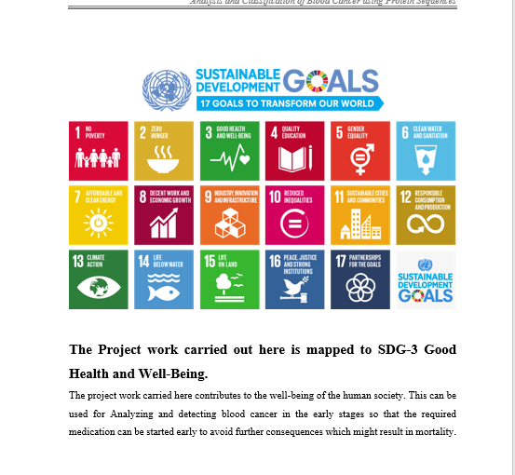
Project work mapping with SDG

Slide 19
Thank You

