Slide 1
Securing Military Communications
Using LSB Steganography

Slide 2
Group 13
Solleti Krishna Chaitanya Subhash
Kumar Sashank
AP20110010232
AP20110010229
K Prahlad Reddy
D Yogesh
AP20110010242
AP20110010240

Slide 3
Introduction
The military uses steganography in a variety of ways, including covert communication, secure data storage, and hiding classified information.
For example, a soldier may use steganography to securely communicate a message to another soldier by hiding it in a seemingly innocent image or audio file. Similarly, classified data can be hidden within an image or audio file, making it difficult to detect without the proper tools.
Overall, steganography is a powerful and important tool for the military, allowing it to securely communicate and store sensitive and classified information.

Slide 4
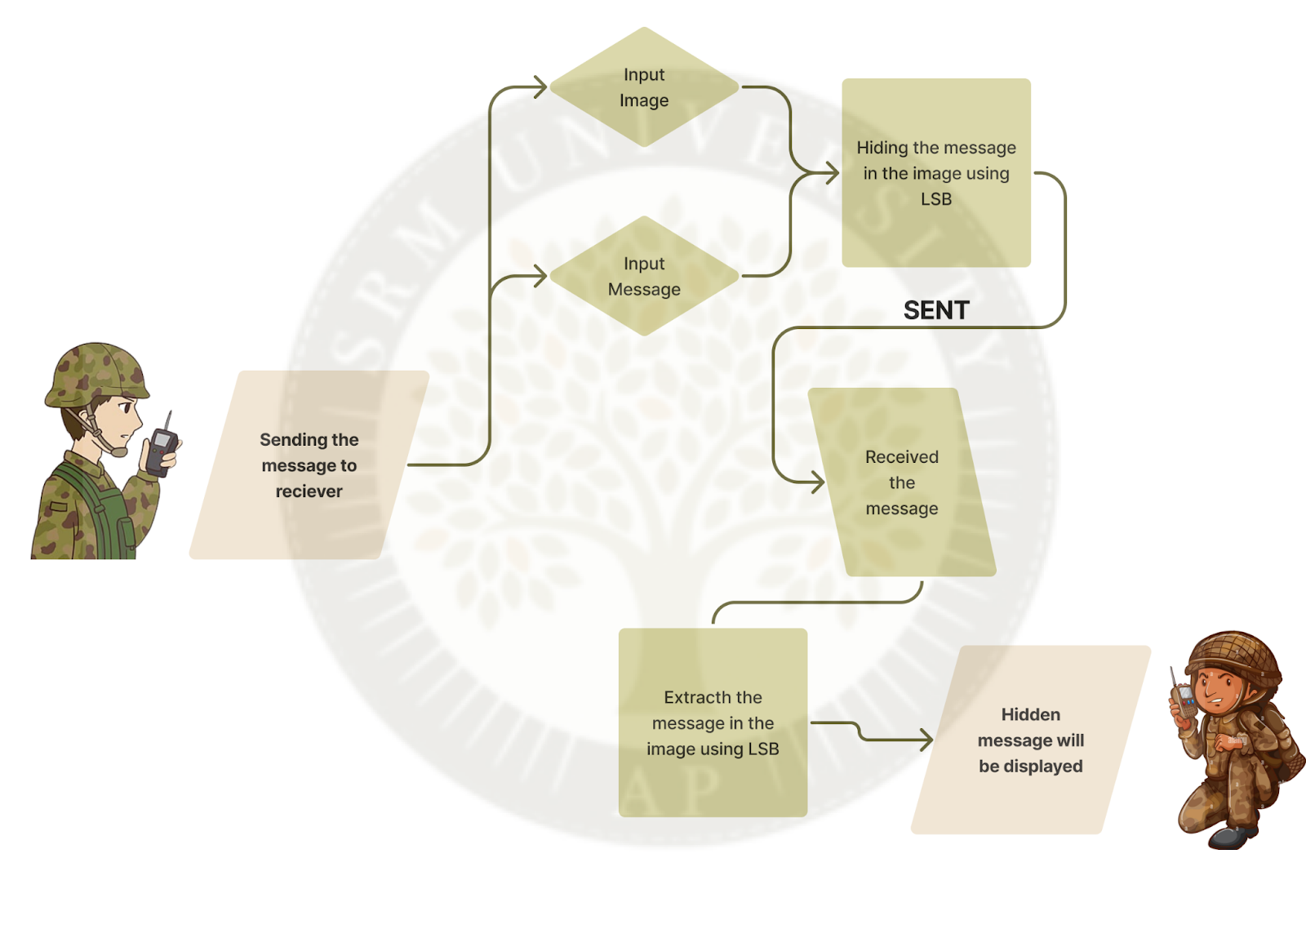
Flow Chart

Slide 5
About Our Code
We are using matlab to implement LSB Steganography.
In our code there are 6 files where 2 files are related to user interfaces and another 2 files for hiding the data in the image and another 2 files for retrieving the data from the image.
\

Slide 6
Source Code
Link:
https://github.com/SubhashSolleti/Securing-Military-Communications-Using-LSB-Steganography.git

Slide 7
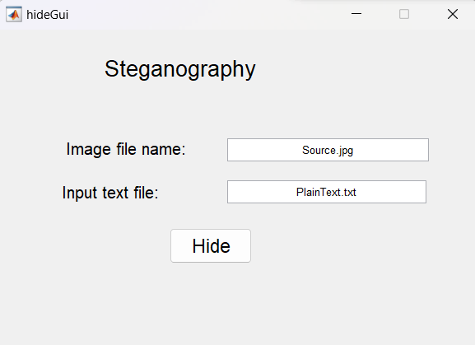
Results
Hide Gui
We are giving the image name and text file name as a input. By the clicking on the hide button we are getting encrypted image as a result.

Slide 8
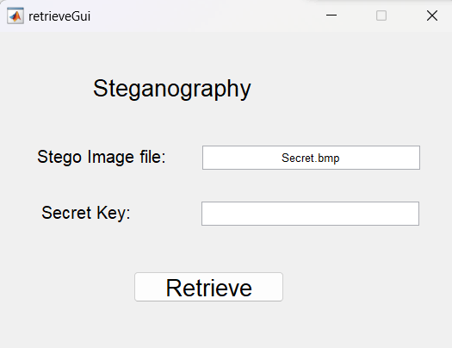
Retrive Gui
Stegoimage name is given as input and by clicking on the retrieve we will get the plaintext which is hided in the stegoimage

Slide 9
Other Possible Ways
Cryptographic techniques can be used to secure data by encrypting and decrypting
AES
RSA

Slide 10
In conclusion, steganography is a powerful tool for secure communication and data hiding. It allows for secure data exchange and storage by hiding data in plain sight. It has many applications in both commercial and military contexts and can be used in a wide variety of ways. Steganography is an important component of any information security strategy, as it allows for secure communication and data storage that is undetectable by conventional methods of detection. As technology continues to evolve, the uses of steganography are sure to expand.
Conclusion

Slide 11

THANK YOU

