Slide 1

TNSDC - GENERATIVE AI FOR ENGINEERING
FINAL PROJECT
SUBMITTED BY
Subhashinee G K
311521104058

Slide 2
PROJECT TITLE
Image Noise Reduction using Autoencoder

Slide 3
Agenda
PROBLEM STATEMENT
Project Overview
End Users
Value Proposition
Solution
Modelling
Results

Slide 4
PROBLEM STATEMENT
The project's problem statement revolves around the need to remove noise from images to enhance their quality and utility for downstream tasks. Image noise can arise from various sources, including sensor limitations, transmission errors, or environmental factors, posing challenges for accurate analysis and interpretation. The goal is to develop a robust method capable of effectively reducing noise while preserving important image features

Slide 5
PROJECT OVERVIEW
The project aims to address the task of image denoising using convolutional autoencoders, focusing on removing unwanted noise from images while preserving important features. Leveraging the MNIST dataset, which comprises grayscale images of handwritten digits, the project endeavors to develop and evaluate an effective denoising algorithm. By employing convolutional autoencoder architectures, the project aims to create a robust solution capable of handling various types and levels of noise in images. Through this endeavor, the project seeks to contribute to the advancement of image denoising techniques and provide a practical approach for enhancing image quality across diverse applications, including medical imaging, surveillance, and digital photography.

Slide 6
PROJECT OVERVIEW
OBJECTIVE
Develop an image denoising algorithm using convolutional autoencoders.
Ensure the algorithm effectively removes noise from images while preserving important features.
Utilize the MNIST dataset for training and testing the denoising algorithm.
Create a robust solution capable of handling various types and levels of noise.
Contribute to the advancement of image processing techniques.
Provide a practical tool for enhancing image quality in applications like medical imaging, surveillance, and digital photography.

Slide 7
PROJECT OVERVIEW
EXPECTED OUTCOME
The expected outcome of the project is a well-optimized image denoising algorithm that effectively reduces noise while preserving image details. The algorithm is expected to demonstrate superior performance in denoising images from the MNIST dataset, producing visually appealing results with minimal loss of important features. Through rigorous evaluation and testing, the project aims to validate the effectiveness and robustness of the denoising algorithm, showcasing its potential for real-world applications. Additionally, the project aims to provide insights into the capabilities and limitations of convolutional autoencoder-based approaches for image denoising tasks.

Slide 8
•Medical Professionals
•Surveillance Operators
•Social media influencers
•Photographers
•Researchers
•General Users
END USERS

Slide 9
VALUE PROPOSITION
The value proposition of the image denoising algorithm lies in its ability to effectively remove noise while preserving essential image features. It offers improved image quality, enhanced accuracy, versatility in handling different types of noise, time and cost efficiency through automation, and ease of implementation. This makes it a valuable tool across various applications, including medical imaging, surveillance, and digital photography, ultimately enhancing user experience and decision-making processes.

Slide 10
The solution involves creating an image denoising algorithm with convolutional autoencoders. It begins by preparing the MNIST dataset and introducing noise to generate training images. A convolutional autoencoder architecture is designed. The model is trained using noisy input and clean output images, optimized with the Adam optimizer and binary cross-entropy loss. Evaluation involves assessing performance on a separate set of noisy test images using visual inspection and quantitative metrics like PSNR or SSIM. Finally, the trained model can be deployed to denoise new images in real-world applications, improving image quality and aiding accurate analysis.
SOLUTION

Slide 11
Data Preprocessing: Load and preprocess the MNIST dataset, ensuring uniformity in size and format.
Noise Injection: Introduce Gaussian noise to the dataset, simulating real-world noisy image scenarios.
Model Selection: Choose a suitable architecture, such as a convolutional autoencoder, for image denoising tasks.
Encoder Design: Construct the encoder part of the model to extract relevant features from the noisy input images.
Decoder Design: Develop the decoder segment to reconstruct clean images from the encoded representations.
6.Model Compilation: Compile the model with appropriate loss functions and optimizers for training.
MODELLING

Slide 12
7.Training: Train the model using the noisy images as input and the corresponding clean images as targets.
8.Validation: Validate the model's performance using a separate validation set to monitor for overfitting.
9.Hyperparameter Tuning: Fine-tune model hyperparameters to optimize performance, such as learning rate and batch size.
10.Evaluation: Evaluate the trained model on unseen noisy images to assess denoising effectiveness and generalization.
11.Deployment: Deploy the trained model for real-world denoising applications, ensuring compatibility and efficiency in deployment environments.
MODELLING

Slide 13
RESULTS
Performance metrics include qualitative evaluation through visual inspection of denoised images and potentially quantitative metrics such as PSNR or SSIM. Visual inspection allows assessing the effectiveness of the denoising process, while quantitative metrics provide additional insights into the quality of the reconstructed images.

Slide 14
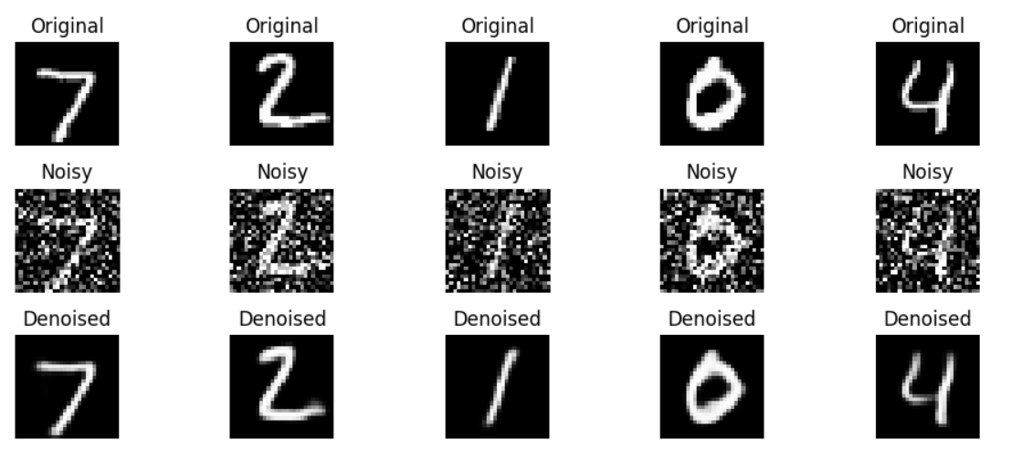
OUTPUT

Slide 15

PROJECT LINK
https://github.com/Subhashinee-G-K/GenAI.git

