Slide 1

TNSDC - GENERATIVE AI FOR ENGINEERING
FINAL PROJECT
SUBMITTED BY
Subhashinee G K
311521104058

Slide 2
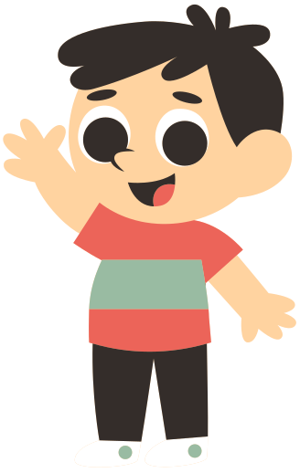
PROJECT TITLE
CARTOONING AN IMAGE USING OPENCV

Slide 3
Agenda
PROBLEM STATEMENT
Project Overview
End Users
Value Proposition
Solution
Modelling
Results

Slide 4
PROBLEM STATEMENT
The task is to develop a cartoonify image application that transforms ordinary images into captivating cartoon-style representations. The application should utilize machine learning and image processing techniques to achieve high-quality cartoonification results while providing users with a simple and intuitive interface for customization. The primary challenges include accurate edge detection, efficient color quantization, and seamless blending of cartoon-like features while preserving essential details from the original image. Additionally, the application should be optimized for performance and resource efficiency to ensure smooth operation across various platforms and devices. The goal is to create a versatile tool that empowers users to unleash their creativity and artistic vision through digital image manipulation.

Slide 5
PROJECT OVERVIEW
The project aims to develop a cartoonify image application that transforms ordinary photographs into captivating cartoon-style representations. Leveraging machine learning and image processing techniques, the application will provide users with a simple and intuitive tool for creative image manipulation. Users will have the flexibility to upload their images and customize cartoonification parameters to achieve desired effects. The application will employ advanced algorithms for edge detection, color quantization, and image smoothing to ensure high-quality cartoonification results. Ultimately, the project seeks to democratize the process of creating cartoon-style images, enabling users from diverse backgrounds to express their creativity through digital art.

Slide 6
PROJECT OVERVIEW
OBJECTIVE
Develop a cartoonify image application using machine learning and image processing techniques.
Automate the process of transforming images into cartoon-style representations.
Ensure accuracy in the cartoonification process to produce high-quality results.
Create a user-friendly interface for easy navigation and interaction.
Provide customization options to allow users to adjust cartoonification parameters.
Optimize the performance of the application for efficient processing.
Ensure compatibility with various operating systems and devices.
Document usage guidelines and instructions for users.

Slide 7
PROJECT OVERVIEW
EXPECTED OUTCOME
It will transform ordinary images into captivating cartoon-style representations. Leveraging advanced algorithms, the application will accurately detect edges, simplify color palettes, and preserve essential details during filtering. The user-friendly interface will facilitate easy customization of cartoonification parameters, ensuring creative expression. Compatibility with various devices and operating systems will enhance accessibility, while efficient processing capabilities will ensure timely results. Continuous improvement based on user feedback will drive the application's evolution.

Slide 8
•Amateur and professional photographers
•Artists and graphic designers
•Social media influencers
•Individuals interested in creative image manipulation
•Users seeking to transform their photographs into cartoon-style representations
•People with varying levels of expertise in image editing
END USERS

Slide 9
VALUE PROPOSITION
The project's value proposition lies in simplifying image manipulation by transforming photos into cartoon-style representations. It offers customizable parameters for users to adjust according to their preferences and creative vision. Through advanced algorithms, it ensures high-quality results suitable for various purposes, such as social media sharing and graphic design projects. Ultimately, it aims to enhance user engagement and interaction in the digital realm through innovative digital imaging techniques.

Slide 10
The proposed solution entails the integration of edge detection, color quantization, and bilateral filtering techniques to achieve high-quality cartoonification results. Edge detection algorithms will be employed to identify prominent features in the input image, while color quantization techniques such as KMeans clustering will simplify color palettes. Bilateral filtering will then be applied to smooth the image while preserving edge details, resulting in a seamless cartoonification effect. The application will provide users with options to customize cartoonification parameters, enabling creative expression and artistic control.
SOLUTION

Slide 11
Edge detection algorithms like adaptive thresholding are used to identify significant features in the input image.
Color quantization techniques, such as KMeans clustering, simplify color palettes to enhance visual appeal.
Bilateral filtering smoothens the image while preserving edge details, resulting in a seamless cartoonification effect.
These models collectively transform the input image into a cartoon-style representation while retaining essential characteristics and details.
MODELLING

Slide 12
RESULTS
The result of the cartoonify image application is a transformed image that resembles a cartoon, created from the original input image. The application successfully applies edge detection, color quantization, and bilateral filtering techniques to achieve this result. Users can observe the original image alongside the cartoonified version, showcasing the effectiveness of the transformation processThe resultant cartoon-style image retains essential features and details from the original while exhibiting the characteristic stylized appearance of a cartoon.

Slide 13
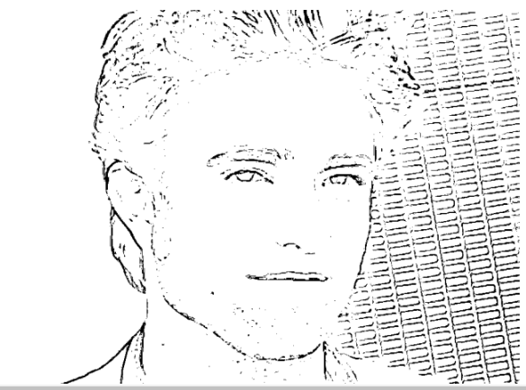
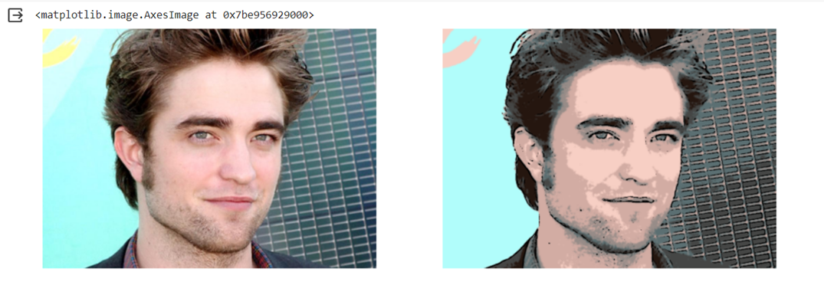
OUTPUT

Slide 14

PROJECT LINK
https://github.com/Subhashinee-G-K/TNSDC-GenerativeAI.git

