Slide 1
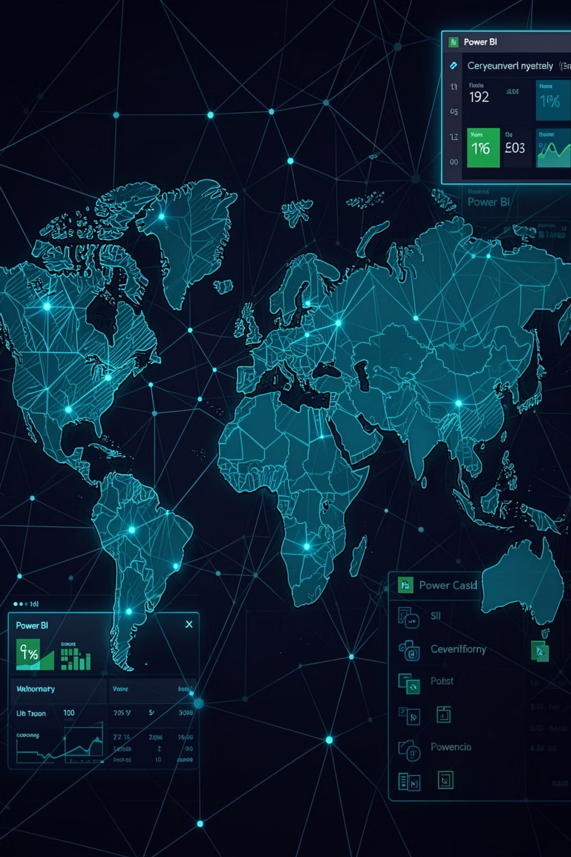
Cyber Threat Analytics Platform with Incident Visualization System Group 1
Presented By: Subhashree Subhasmita
Internship/Organization: INFOSYS SPRINGBOARD VIRTUAL INTERNSHIP 7.0
Mentor: Ms. S J Nityasree

Slide 2

Project Objectives
Analyze Incident Data
Use Power BI to analyze real-world cybersecurity incidents and surface actionable patterns.
Identify Attack Patterns
Detect common tactics, techniques, and procedures (TTPs), threat actors, and motives.
Monitor Global Threats
Interactive maps and filters to track geographic spread and hotspots in near real-time.
Drive Decisions
Convert raw events into business-ready insights to support security operations and leadership.

Slide 3
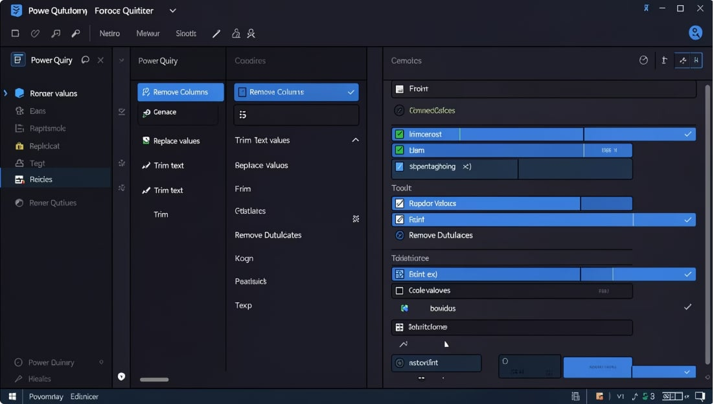
Project Description
The project focused on analysing a cybersecurity incident dataset using Microsoft Power BI. Data preprocessing, modelling, DAX measures, and interactive visualizations were used to transform cybersecurity data into meaningful insights.
MODULE 1: Dataset Understanding
Studied the structure, attributes, data types, and relevant cybersecurity fields.
MODULE 2: Data Preprocessing
Handled missing values, duplicates, inconsistent entries, unnecessary columns, and data types.
MODULE 3: Data Modelling
Created relationships, calculated measures, and DAX expressions for analysis.
MODULE 4: Dashboard Development
Developed seven interactive Power BI dashboards covering cybersecurity trends and patterns.
MODULE 5: Visualization & Analysis
Used charts, maps, KPI cards, slicers, filters, matrices, and other visuals.
MODULE 6: Testing & Documentation
Validated calculations, filters, interactions, dashboards, screenshots, observations, and key findings.

Slide 4
Top Visualization
Visual Type | Purpose / What It Shows | Icon
KPI Cards | Total incidents, average incidents, countries, threat level and other KPIs | 📊
Bar / Column Charts | Compare attack types, countries, attackers and incidents | 📈
Maps | Show global distribution and attacker country locations | 🌍
Treemaps | Display incident distribution by attacker descriptions and categories | ▦
Slicers / Filters | Enable interactive filtering by year, country, motive, attack type and asset type | 🔎
Matrix | Compare attack types, motives, assets and other categories | ▤
Area / Trend Charts | Analyse cybersecurity incident and threat patterns over time | 📉

Slide 5
Project Execution Milestones
The project was executed through 4 structured milestones to ensure systematic progress and accuracy.
Dataset / Source Used:
Cybersecurity Incident Dataset (CSV) – publicly available dataset used for cybersecurity incident analysis.
Milestone 1 – Data Foundation & Preparation
Dataset collection, preprocessing, cleaning, and data validation. Date: 09/06/2026
Milestone 2 – Core Dashboard Development
Built the first two interactive Power BI dashboards for cybersecurity analysis. Date: 16/07/2026
Milestone 3 – Advanced Visualization & Reporting
Created three additional dashboards, generated insights, and completed documentation. Date: 23/07/2026
Milestone 4 – Advanced Threat Pattern Analysis
Created two additional interactive dashboards for deeper threat pattern analysis and insights. Date: 13/08/2026

Slide 6
Challenges Faced and Resolution
Understanding the Cybersecurity Dataset
Challenge: Understanding the large dataset, attributes, and relationships was initially difficult.
Resolution 1: Studied column descriptions and identified attributes relevant to cybersecurity analysis.
2. Data Preprocessing
Challenge: Handling missing values, duplicates, inconsistent entries, and unnecessary columns.
Resolution 2: Used Power Query in Microsoft Power BI for systematic data cleaning and transformation.
3. Selecting Appropriate Visualizations
Challenge: Selecting suitable charts for different cybersecurity information.
Resolution 3: Tested different visualization types and selected the most meaningful visuals for trends
and comparisons.

Slide 7
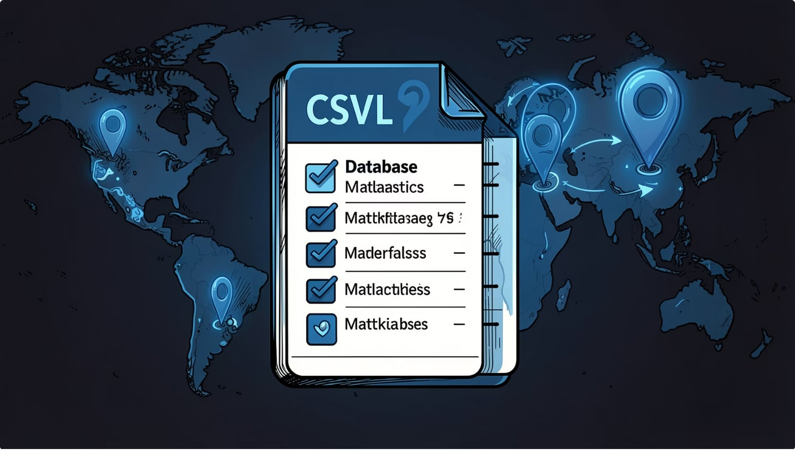
Learning & Skills Acquired
Technical Skills
Microsoft Power BI
Power Query
DAX
Interactive Data Visualization
Soft Skills
Communication
Documentation
Time Management
Analytical Thinking
Team Collaboration
Overall Learning / Experience
Gained practical experience in cybersecurity analytics, data visualization, business intelligence, and data-driven decision-making through interactive Power BI dashboards.

Slide 8
Future Enhancements
Future Enhancements
Real-Time Data Integration – Integrate real-time cybersecurity data.
Predictive Analytics – Implement machine learning for threat prediction.
Automated Alerts – Add automated alerts and advanced dashboard features.
Advanced Dashboard Features – Enhance interactive cybersecurity monitoring.
Key Insights
Hacking emerged as one of the most frequently observed attack methods.
External threat actors accounted for a significant number of incidents.
The 2010s recorded the highest threat activity, with a significant increase in cyber incidents

Slide 9

Conclusion
Advanced Threat Incident Analytics and Security Visualization Framework successfully transformed cybersecurity incident data into meaningful interactive insights using Microsoft Power BI.
The project strengthened technical, analytical, and problem-solving skills through data preprocessing, DAX, data modelling, and dashboard development.
It provided practical experience in cybersecurity analytics, business intelligence, and data-driven decision-making.
Overall, the internship complemented academic learning and provided valuable preparation for future opportunities in data analytics, cybersecurity, and business intelligence.

Slide 10
Acknowledgement and Reference
I would like to express my heartfelt gratitude to:
Infosys Springboard Team For providing a structured, industry-aligned virtual internship and practical learning platform.
Mentor – Ms. Nityasree For continuous guidance, valuable feedback, and encouragement throughout the project.
Team Members Vennela Pathipaka, Tejasri Lakshmi Maddula, and Twinkle Mohanty for collaboration, accountability, and teamwork.
Other Acknowledgement Microsoft Power BI documentation and community resources, and Kaggle for publicly available datasets.
References
Microsoft Power BI Documentation & Community Resources
Kaggle – Cybersecurity Incident Dataset
Infosys Springboard Virtual Internship 7.0 Learning Resources

Slide 11
THANK YOU

