Slide 1
Predicting Hospital Readmission Risk
For Patients with Chronic Conditions
By – Team(sc2)_25

Slide 2
Problem Statement
Hospital readmissions are costly and impact patient health.
Chronic conditions (diabetes, heart disease, hypertension) increase readmission rates.
Goal: Identify risk factors & reduce unnecessary readmissions.

Slide 3
Objectives
Analyze key risk factors influencing readmissions.
Predict high-risk patients using the dataset.
Recommend actionable steps to minimize readmissions.

Slide 4
Dataset Overview
Source: Kaggle Healthcare Dataset.
Key Features: Patient demographics, medical history, lab tests, medications, readmission status.
Size: Includes multiple records & attributes.

Slide 5
Key Risk Factors
Age and co-morbidities (diabetes, hypertension).
Length of hospital stay & number of prior admissions.
Lab results and follow-up care.
Medication adherence & discharge planning.

Slide 6
Data Trends & Insights
Patterns in readmission vs. hospital stay length.
% readmissions by age group.
Impact of chronic disease severity.

Slide 7
Predictive Model
Model: Logistic Regression or Random Forest.
Performance: Accuracy, Precision, Recall.
Feature Importance: Key drivers of readmission risk.

Slide 8
Recommendations
Early discharge planning & follow-up care.
Patient education on medication & lifestyle.
Remote monitoring for high-risk patients.
Enhanced chronic disease management.

Slide 9
Conclusion
Key risk factors identified from dataset.
Predictive models can proactively reduce readmissions.
Healthcare providers can save costs & improve outcomes.

Slide 10
References
Kaggle Healthcare Dataset.
Research papers/articles on chronic disease & readmissions.

Slide 11
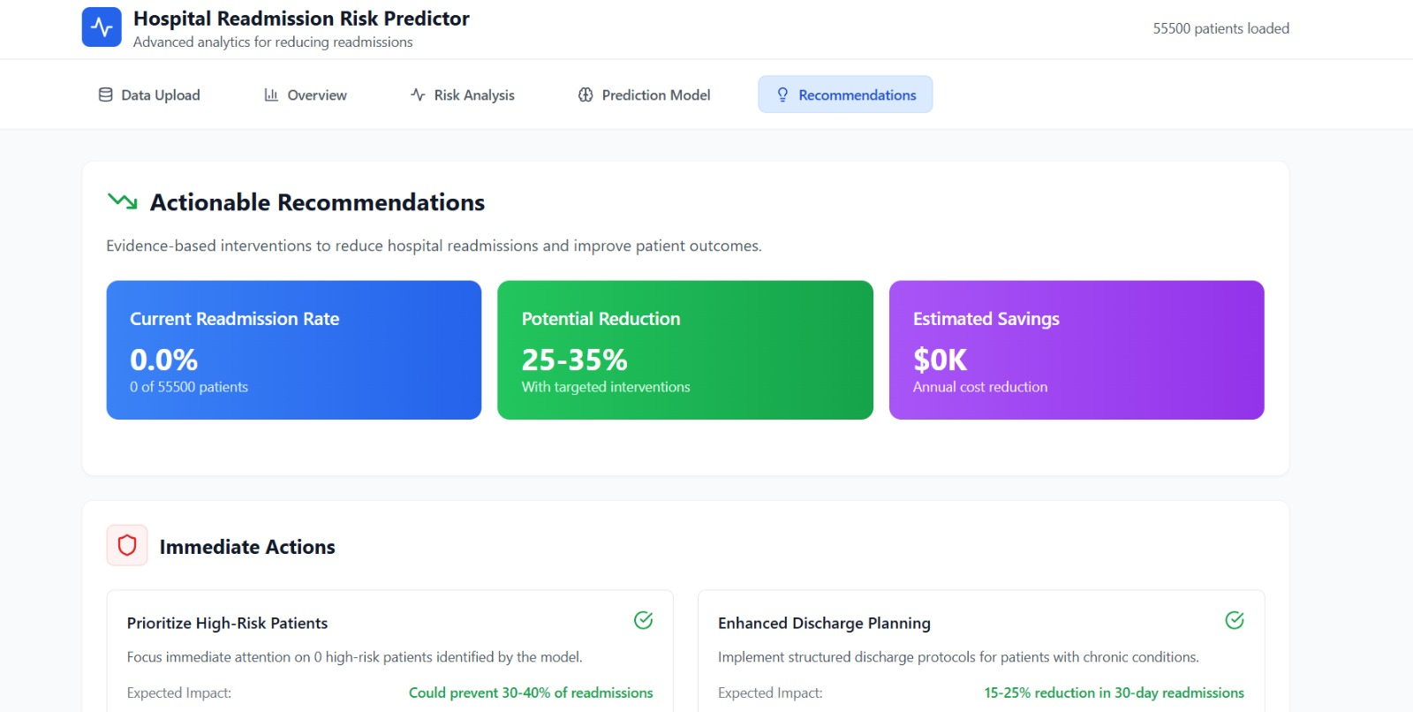
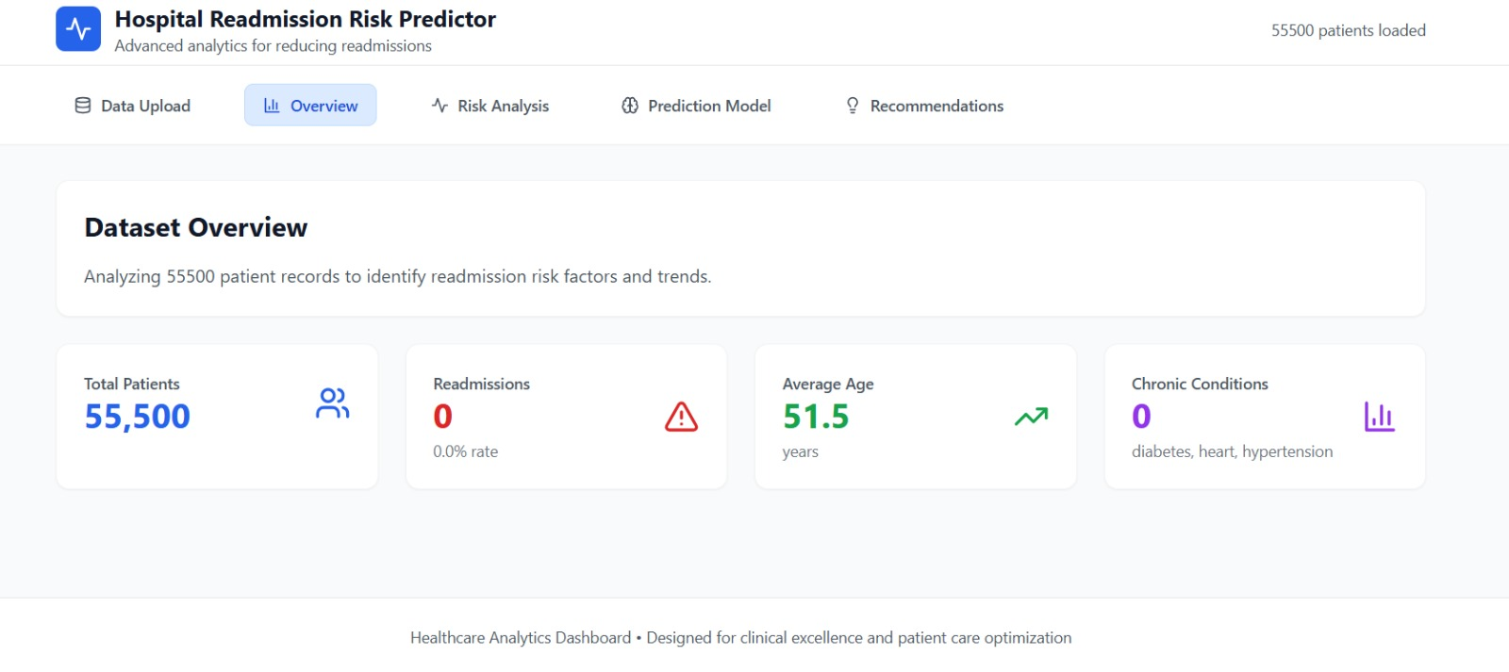
Screenshot

Slide 12
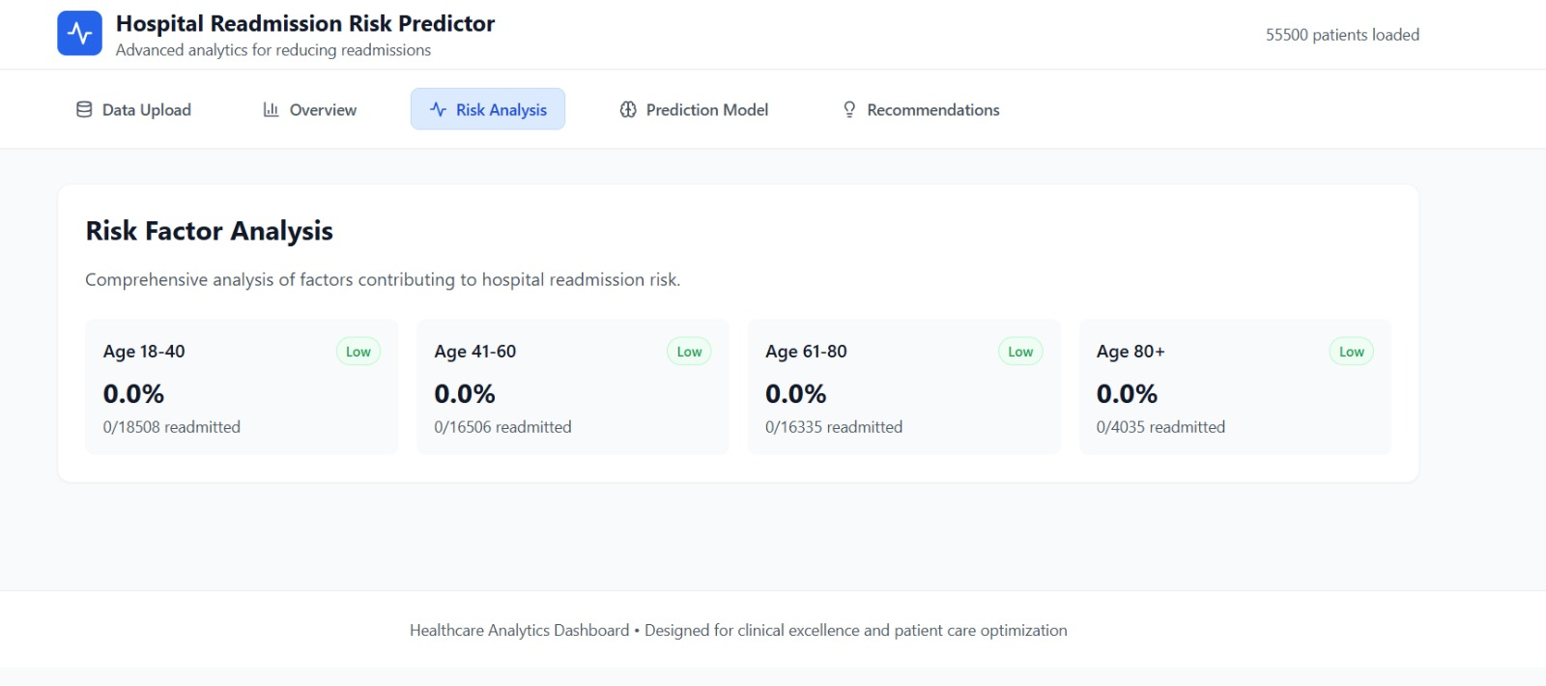
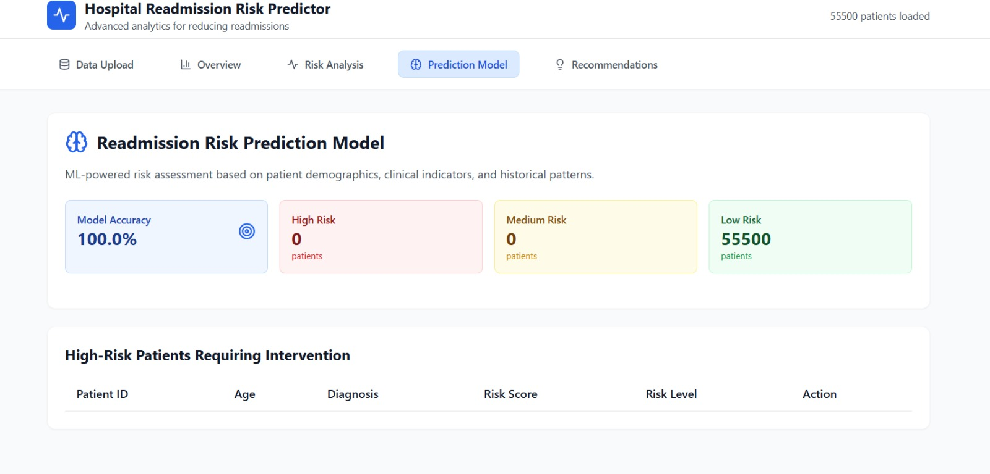

Slide 13
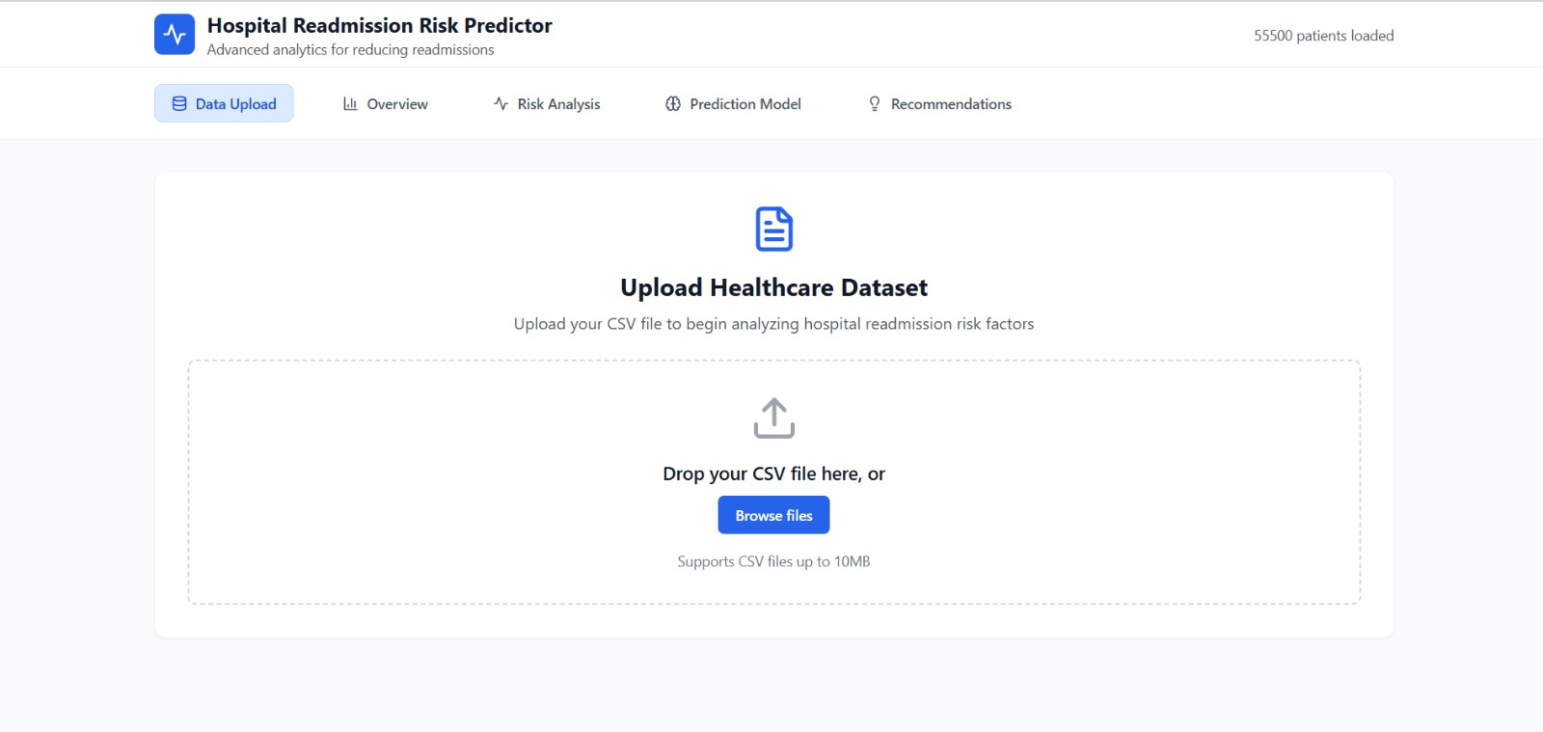

Slide 14
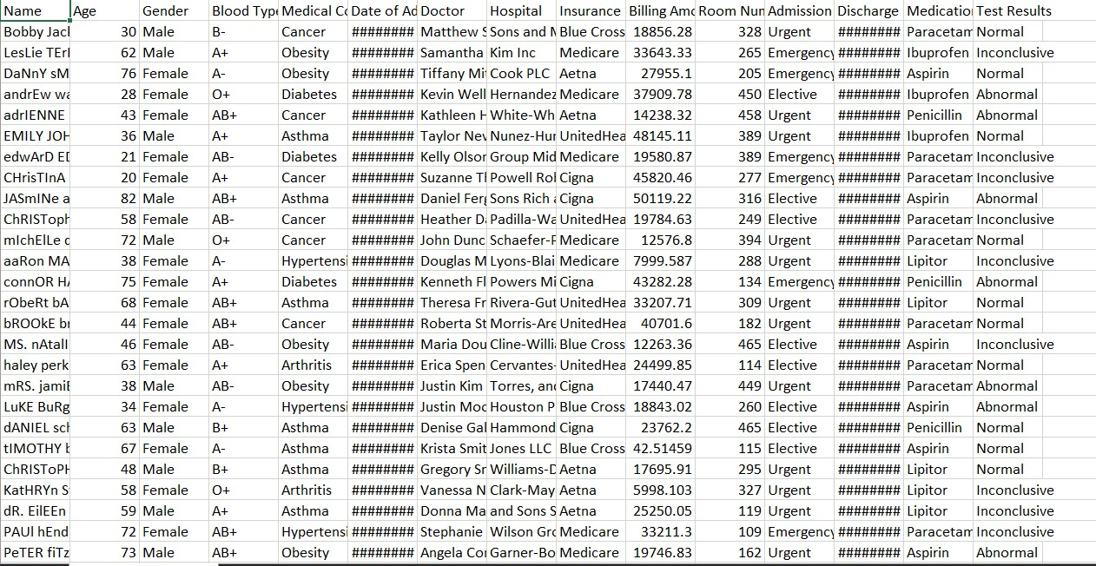
Dataset

Slide 15
THANKYOU!!!

