Slide 1
Identification of Different Medicinal Plants/Raw materials through Image Processing Using Machine Learning Algorithms
CSE7301 University Project
Final Review
Batch Number: CSE-G48
Under the Supervision of,
Dr. Saurabh Sarkar
Assistant Professor
School of Computer Science and Engineering
Presidency University
Roll Number 20211CSE0887 20211CSE0429 20211CSE0431 | Student Name MANASA S RISHAB SINGH SUBHASISH
Name of the Program: BTech
Name of the HoD: Dr. Asif Mohammad HB
Name of the Program Project Coordinator: Mr. Jerrin Joe Francis
Name of the School Project Coordinators: Dr. Sampath A K / Mr. Jerrin Joe Francis/ Mr. Md Ziaur Rahman

Slide 2
Content
Problem Statement
Analysis of Problem Statement
Timeline of the Project

Slide 3
Problem Statement Number:
Organization: Ministry of AYUSH
Category (Hardware / Software / Both) : Software
Problem Description: Software MedTech / BioTech / HealthTech India, with a rich heritage of floral diversity, is well-known for its medicinal plant wealth, but their identification is one of the major burning issues in Ayurvedic Pharmaceutics. Several crude drugs are being sold under the same name in the market leading to confusion and their misidentification. Even the collectors and traders are not completely aware of the exact morphological appearance or differentiating attributes of the many drugs owing to seasonal and geographical availability, and similar characteristics. Moreover, the extensive consumption to meet demand-supply ratio exerts a heavy strain on the existing resources. It further leads to the practice of adulteration, substitution, and disbelief in the curative capability of the system eventually. Thus, software capable of identifying different medicinal plants/ raw materials through Image Processing Using Different Machine Learning Algorithms will be of immense use. It will be helpful at every level viz. wholesaler, distributor, etc. of the supply chain of raw material being utilized in the system.
Difficulty Level: Complex

Slide 4
Analysis of Problem Statement
Problem Statement:
India, known for its rich floral diversity, faces a major challenge in identifying medicinal plants accurately in Ayurvedic Pharmaceutics. Many crude drugs are sold under the same name, leading to confusion, misidentification, and adulteration. Traders and collectors often lack proper knowledge about plant morphology due to seasonal and geographical variations. This results in:
Adulteration & Substitution – Reduced efficacy of Ayurvedic medicines.
Misidentification – Incorrect plant usage can lead to ineffective or harmful treatment.
Supply Chain Issues – Difficulty in maintaining authenticity from collection to distribution.

Slide 5
Analysis of Problem Statement
Proposed Solution:
Developing a Machine Learning-based Image Processing Software to identify medicinal plants and raw materials accurately.
Automated Image Recognition: Using ML algorithms (CNNs, Transfer Learning) for plant classification.\
Feature Extraction: Morphological features like leaf shape, texture, and color analysis.
Real-time Verification: A mobile or web-based application for instant plant identification.
Database Integration: Linking identified plants to a medicinal database for reference.

Slide 6
Analysis of Problem Statement
Expected Impact:
Ensures authenticity of medicinal plants across the supply chain.
Prevents adulteration & substitution, improving public trust in Ayurveda.
Assists wholesalers, distributors, and researchers in plant identification

Slide 7
Objectives
Automated Identification: Develop an efficient system for recognizing and classifying medicinal plants and raw materials based on their morphological characteristics using image processing techniques.
Minimizing Misidentification: Reduce errors in plant identification that arise due to similar physical attributes, seasonal variations, and geographical differences, ensuring authenticity in Ayurvedic pharmaceutics.
Detection of Adulteration & Substitution: Aid in detecting adulteration and substitution in medicinal raw materials to maintain quality standards and build trust in traditional medicine.
Assist Traders & Collectors: Provide an easy-to-use tool for collectors, wholesalers, and distributors to verify plant authenticity, thereby improving supply chain efficiency.

Slide 8
Objectives
Enhancing Ayurvedic Practices: Support the Ayurvedic pharmaceutical industry by ensuring the use of genuine medicinal raw materials, thereby preserving the efficacy and credibility of herbal treatments.
Machine Learning for Accuracy: Utilize different machine learning algorithms to improve classification accuracy and enhance the adaptability of the system to various plant species.
Database Creation: Develop a digital repository of medicinal plants with their images, characteristics, and classification data for future reference and continuous learning.
Sustainability & Conservation: Promote sustainable harvesting practices by preventing overexploitation of specific medicinal plant species and encouraging biodiversity conservation.

Slide 9
Methodology
Data Collection & Preprocessing: Gather, label, and enhance images using resizing and noise reduction.
Feature Extraction & Augmentation: Extract key features (texture, color) and apply augmentation (rotation, scaling).
Model Training: Train and optimize ML models (CNN, SVM, Random Forest) for accurate classification.
Validation & Testing: Evaluate performance using accuracy, precision, and recall on unseen data.
System Development: Build a web/mobile interface for real-time plant identification.
Deployment & Optimization: Deploy, update the dataset, and refine the model for better accuracy.

Slide 10
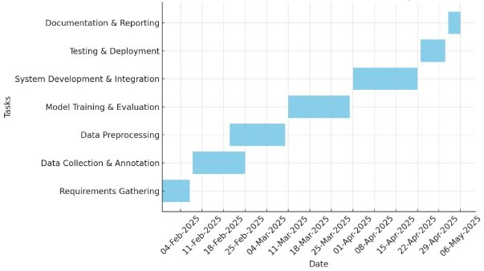
Timeline of the Project (Gantt Chart)

Slide 11
Expected Outcome
Accurate Identification: A machine learning-based system for recognizing medicinal plants and raw materials using image processing.
Reduced Misidentification & Adulteration: Ensures authenticity, preventing substitution and improving Ayurvedic product quality.
Efficient Supply Chain: A user-friendly tool for traders and collectors to verify plant authenticity, streamlining distribution.
Comprehensive Digital Database: A repository of plant images, descriptions, and classification data for reference and learning.
Scalable & Sustainable Solution: Supports conservation, reduces human dependency, and can be integrated into mobile or web applications.

Slide 12


