Slide 1
Time Series analysis of gold price
Name: Subhasish Basak
Roll: 3-14-15-0446
Supervisor’s name: Prof. Debjit Sengupta
April 26,2018

Slide 2
Purpose of the study
This study emphasizes on the application of various tools & methodologies of "Time series analysis" in modelling, analysing & forecasting gold price.
Objectives
Step 1
Isolation of the different components of the time series.
Step 2
Estimation of the different components separately
Step 3
Forecasting the time series using the estimates.

Slide 3
Isolation of the components in a time series
Time Series
Stationary Component
Non-Stationary Component
Weakly Stationary
Strongly Stationary
Trend
Seasonal component
Cyclical component
Irregular component

Slide 4
Stationary component of a Time series
That component present in a time series whose statistical properties remains the same over time.
Stationary component
Strongly stationary
(Y_{t1}, Y_{t2}, ....... ,Y_{tk}) D (Y_{t1+h}, Y_{t2+h},....... ,Y_{tk+h})
Weakly stationary
E(Y_{t}) & V(Y_{t} ) is constant
Cov(Y_{t},Y_{t+h})
depends only on lag h.

Slide 5
Non-stationary component of a Time series
The changes in the values of a time series variable over a period of time is due to the Non-stationary component present in that time series.
In the Classical approach of decomposition, the non stationary part of the time series is assumed to be composed the following components:
Trend (T_{t})
Seasonal component (S_{t})
Cyclical component (C_{t})
Irregular component (I_{t})

Slide 6
Components of a Non-stationary time series
Trend (T_{t})
Trend is the smooth, regular, long term movement.
Seasonal component (S_{t})
periodic movement in a time series where the period is not longer than a year.
Cyclical component (C_{t})
the component which is wholly unaccountable or caused by unforseen events as was, floods, strikes etc.
Irregular component (I_{t})
oscillatory movement in time series, the period of oscillation being more than one.
Y_{t} = f ( T_{t} , S_{t} , C_{t} , I_{t} )
Graphical tools like time series plots are used to identify the model i.e. the functional form of f(.)

Slide 7
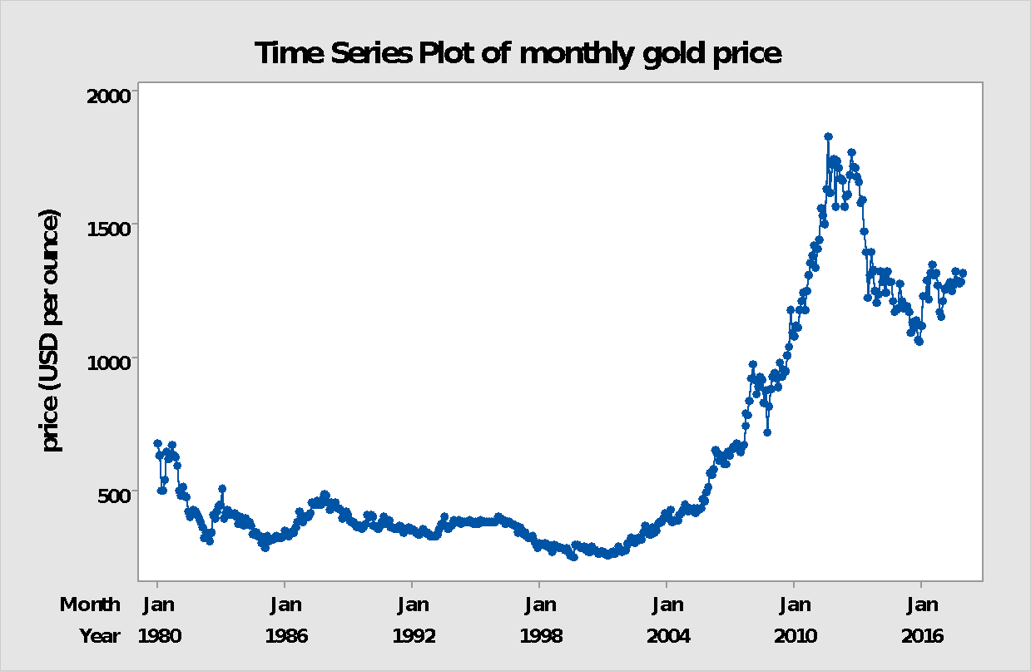
Time series plot of gold price

Slide 8
Conclusions drawn;
The plot shows an up trend, concave upwards till 2012. The trend is reversed after attaining a peak later ward.
No identifiable cyclical fluctuation is observed in the data, hence in the later analysis I have dropped the cyclical component, assuming its absence.
The components of time series viz. Trend, seasonal & irregular seems to be interdependent as each of them is supposed to have significant effect on others. Hence a multiplicative model is considered as follows:
Y_{t} = Tt x S_{t} x I_{t}

Slide 9
Estimation of the components
Steps followed:
Using a simple moving average of 12-pt SMA(12), the effects of seasonal components are smoothed out from the monthly data.
These averages obtained, give an estimate of the TREND component.
Then the time series is divided by the estimated values to obtain the detrended series, on which the method of Monthly averages is applied to get the estimates of SEASONAL INDICES.

Slide 10
Estimation of the Seasonal indices
Method of Monthly Averages:
The data is stored into a 12x38 table such that each column gives prices for a particular year.
The Geometric means calculated over the years from the table, divided by the adjustment factor i.e. the grand Geometric mean provides the estimates for the seasonal components, as follows:
Month | Jan | Feb | Mar | Apr | May | June | Jul | Aug | Sep | Oct | Nov | Dec
Seasonal Indices | 0.9849 | 1.0046 | 1.00399 | 1.00310 | 1.00757 | 1.00648 | 0.9960 | 1.00612 | 1.00149 | 0.99592 | 0.99443 | 0.99520

Slide 11
Forecasting formula for Trend
Since the Method of Moving averages is not able to produce forecasts, Method of mathematical curve fitting is used to serve the purpose of the forecasting formula for Trend.
Choice of mathematical model:
There is no economic or context related reason behind the choice of the model. A mathematical curve giving best fit to the data is chosen.

Slide 12
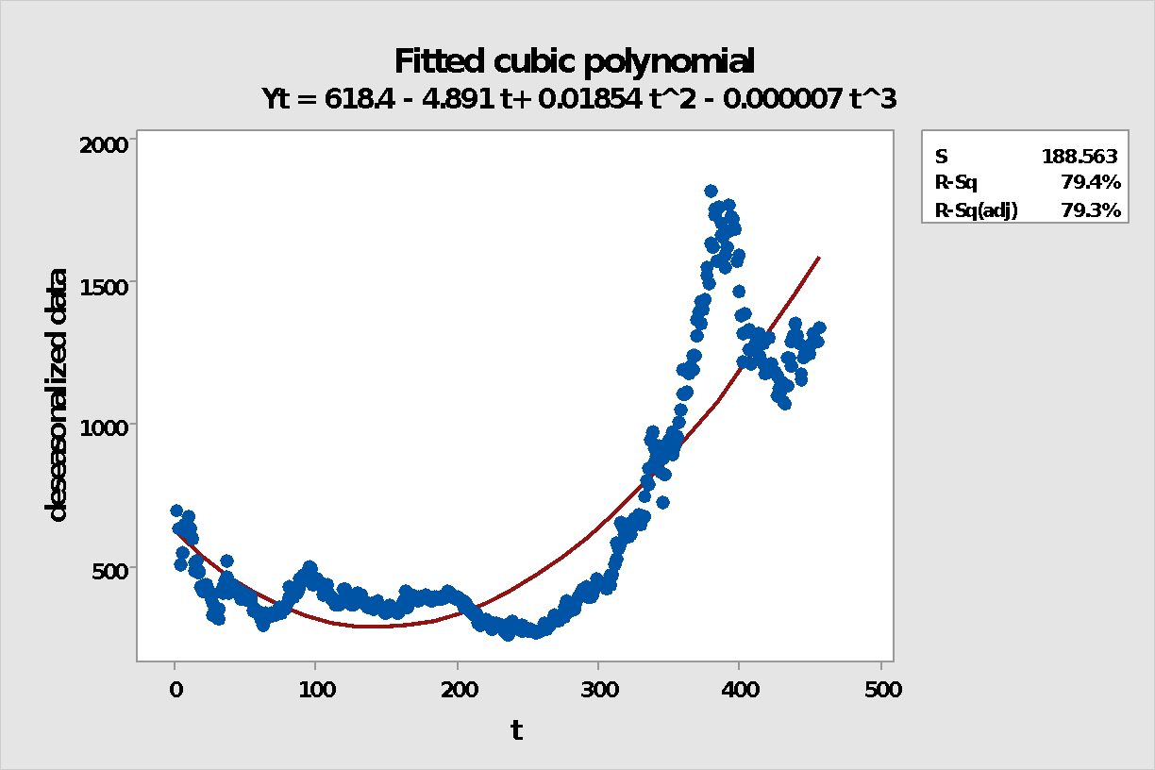
Trend equation
From the graph it is observed that the trend line gives a moderate fit to the deseasonalized gold price.
The R-sq value 0.79 also implies a moderate fit.

Slide 13
Forecasting the Non-Stationary component
Having the Seasonal indices estimated by method of monthly averages & the trend component by the cubic polynomial, a forecasting model for the Non-stationary component of the given time series can be obtained by using the multiplicative model as follows:
Yt = St x Tt

Slide 14
Analysis of the Stationary component
Obtaining the residuals:
Having estimated the Non-stationary component the whole Time series is detrended and deseasonalized .The portion which is left off is called the residual part.
The statsitical behaviour of this portion is due to unaccountable causes and thus it is considered to be a stochastic component.
A test for stationarity (Augmented Dickey-Fuller Test) is performed on this residual series.

Slide 15
Augmented Dickey-Fuller Test for stationarity
the Hypothesis of interest of an ADF test as,
H0: series is non stationary. Vs H1: series is stationary.
For a given time series y_{t} ,the ADF test considers the model,
y_{t} = a + b*t +c*y_{t-1} +d1*y_{t-1} + ... +dp-1*y_{t-p+1} + ut
Where, “a” is a constant , “b” is the coefficient on a time trend and “c” is the lag order. It is equivalent to test,
H0: c =0 against H1: c<0.
Test statistic : D = cest / S.E(cest)
Test rule : Reject H0 iff D_{obs} < D-crit (obtained from table)
We have, D_{obs} = -10.806 & p-value :0.01 < 0.05
Hence we reject H0 against H1 at 5% level of significance and conclude that the obtained residual series is stationary.

Slide 16
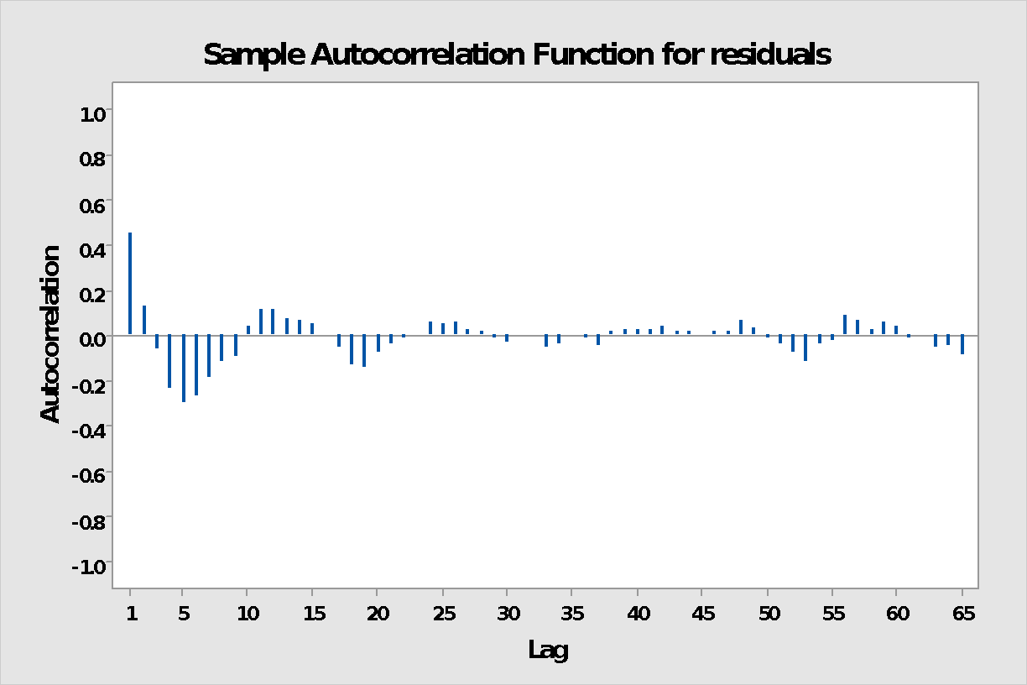
Sample autocorrelation plot of residuals

Slide 17
Clearly, the ACF shape is damped oscillatory type, which gives a clear indication of Stationarity of the residual series.
Now, the task is to model it with appropriate stochastic processes. From the shape of the ACF which is a damped oscillatory curve, it clearly indicates that an AR(2) process will be appropriate here. The fitted equation is as follows:
Y_{t} = 0.4989 Y_{t-1} - .0913 Y_{t-2} + 0.3506 + X_{t}

Slide 18
Forecasts
The analysis till now provides isolation and separate estimation of the “Non-stationary” & “Stationary” component of the time series data. The estimation of the “Non-stationary” part is done using the “Method of Classical Decomposition” and the analysis of the “Stationary” part is done by the fitting of AR (2) process to the residual series.
The formula combining both provides a complete forecasting formula for the study variable Gold price. Using this the forecasts of gold price for the first 6 months of 2018 are computed as follows,
Month | Jan | Feb | Mar | Apr | May | June
Predicted price | 1553.89 | 1592.64 | 1599.21 | 1605.48 | 1620.39 | 1626.39
Actual price | 1343 | 1317 | 1322 | - | - | -

Slide 19
Conclusions
Clearly the forecasts are not satisfactory since their deviations from the actual prices are significantly high. This might have been so due to some severe drawback of the analysing techniques adopted which can be listed as follows;
No proper justification behind the choice of model in estimating trend.
Assumption of Multiplicative model.
Assumptions of a 4-component non stationary model.

Slide 20
Future scope of this study
One may use advanced forecasting techniques like ARIMA, in which a time series is transformed by suitable methods (using Lag operator, Difference operator, Log transformation etc.) into a stationary series and then various probability models are fitted.

Slide 21
THANK YOU

