Slide 1


Foodborne & Occupational module
WP 3 - ANSES
Subhasish BASAK
Lucie COLLINEAU

Slide 2
RECAP - WP 3

Slide 3
QMRA model
Environmental module
Recreational exposure
Manure tank
Surface water
Drinking water
Fresh produce consumption
Interventions
Foodborne module
Human exposure to ESBL E. coli
Farm module
Slaughter
Processing
Home preparation
Chicken meat consumption
Interventions
Occupational module
Direct contact
Occupational exposure

Slide 4
QMRA model
Environmental module
Recreational exposure
Manure tank
Surface water
Drinking water
Fresh produce consumption
Interventions
Foodborne module
Human exposure to ESBL E. coli
Farm module
Slaughter
Processing
Home preparation
Chicken meat consumption
Interventions
Occupational module
Direct contact
Occupational exposure

Slide 5
Foodborne module

Slide 6












Farm to Fork model
Thinning
SI model
Barn
Load
Input
Production
Output
36 Days
Scalding
Evisceration
Chilling
Post-processing
Excretion
OR
Defeathering
Washing
Portioning
Home cooking
Ingestion
WithinFlock
Prev.
Decay
Growth
Simulates within flock Prevalence (Pprev) and Load (Cload) on carcass/portion at each stage
Transport
FARM MODULE
FOOD-BORNE MODULE
DYNAMICS of ESBL E. coli in farm environment
Transmisson model Dame-Korevaar et al. (2020)
Horizontal Gene Transfer Fisher at al. (2019)
Susceptible-Infected model Becker et al. (2022)
DYNAMICS of ESBL E. coli in processing
Collineau et al. (2020) in ESBL E. coli setup
Updated with EU poultry farming practices
Simulates the processing of 1 chicken flock
Flock Risk from 1 chicken portion consumed
Prob. of ESBL E. coli carriage by consumer
Conditional on Pprev, Cload after cooking
PDR : Dose-Response Furusawa et al. (2024)
Sarnino et al. (in prep.)
Basak et al. (in prep.)
6

Slide 7
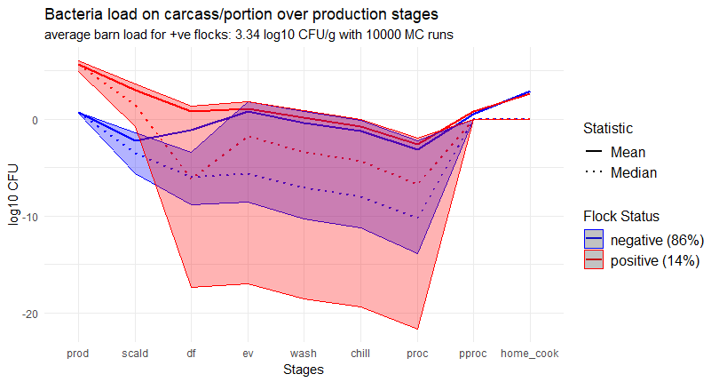
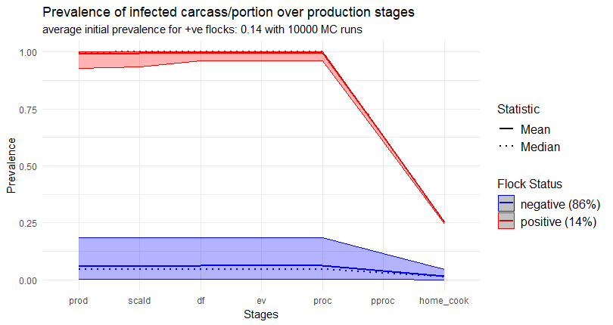
Simulation results
Simulated ESBL E. coli concentration + CI (5% - 95%)
Heavy tailed distributions ! Average load on chicken portions 8,2e2 CFU (sd 5,2e4)
Simulated ESBL E. coli prevalence + CI (5% - 95%)
Results validation with Faverjon et al. (2022)
Average prevalence of chicken portions 0,05 (sd 0,08)

Slide 8
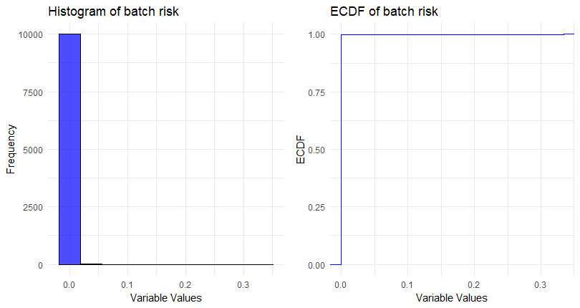
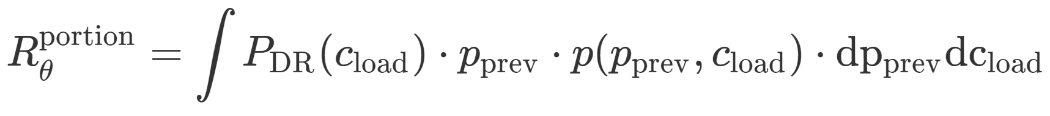
Estimation of average risk
Risk from 1 chicken portion consumed
Prob. of ESBL E. coli carriage by consumer
Conditional on Pprev, Cload after cooking
PDR : Dose-Response Furusawa et al. (2024)
Avgerage risk of ESBL E. coli carriage from consuming 1 chicken portion
To estimate: 10k independent flocks simulated with Monte Carlo runs
Average risk in a baseline scenario defined by input parameters Ɵ : 9,6e-5
Confirms heavy tailed distributions !
Quantile metrics ?
Difficult to interpret ?

Slide 9
Occupational module

Slide 10
Occupational module
Quantity of interest : For a particular broiler flock characterized by production parameters Ɵ = {Ɵfarm, Ɵfoodborne}, we want to estimate the risk of getting ESBL E. coli carriership for a worker working at processing stage s given the hygiene practice parameters H.
Thinning
SI model
Input
Production
Output
Scalding
Evisceration
Chilling
Post-processing
Excretion
Transmission
OR
Defeathering
Washing
Portioning
Home cooking
s = 1
s = 2
s = 3
s = 4
s = 5
s = 6
s = 7
s = 8
s = 9
Thinning
Clearing
Cleaning
Unloading
hanging
Post-bleeding
Post-df
Post-ev
Portioning
Notes:
On est intéressé par la quantification de l'exposition des travailleurs à E. coli ESBL à différentes étapes de la production de poulets de chair.
Pour un lot spécifique de poulets de chair caractérisé par les paramètres de production Ɵ = {Ɵfarm, Ɵfoodborne} et les pratiques d'hygiène H, on cherche à estimer le risque ou la probabilité qu'un travailleur à l'étape de production s devienne porteur de E. coli BLSE. ici vous voyez les différentes étapes en jaunes où le travailleur est exposé aux bactéries par contact avec l'oiseau, la carcasse ou les équipements. s en rouge est l'indicateur pour chaque étape. pour chaque étape, nous calculons deux choses, la concentration des bactéries sur l‘objet contaminé et la prévalence dans le lot. d'autres modules qui calculent ces sorties.

Slide 11
Contamination pathways
Either (1) direct contact of contaminated elements or (2) through inhalation of air particles
s = 1
s = 2
s = 3
s = 4
s = 5
s = 6
s = 7
s = 8
s = 9
Thinning
Clearing
Cleaning
Unloading
hanging
Post-bleeding
Post-df
Post-ev
Portioning
Contact-transmitted
Contact-transmitted
Airborne
Contact-transmitted
Contact-transmitted
Contact-transmitted
Contact-transmitted
Contact-transmitted
Contact-transmitted
Airborne

Slide 12
Exposure assessment
Direct Contacts of worker hands with the contaminated broilers/carcasses/surfaces
s = 1
s = 2
s = 3
s = 4
s = 5
s = 6
s = 7
s = 8
Thinning
Clearing
Unloading
hanging
Post-bleeding
Post-df
Post-ev
Portioning
Broilers
Broilers
Crates
Broilers
Carcass
Carcass
Carcass
Carcass
Affecting variables
t : transmission rate form literature
n_contact : number of contact
For each stage s
t
Contaminated surfaces
Worker hands
n_contact
For n < n_contact_max King et al. (2020)
Chand,n = Chand,n-1 + t * [Csurface - Chand,n-1]

Slide 13
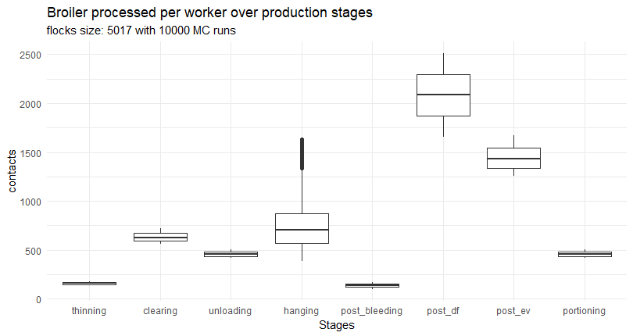
Simulated number of contacts
Affecting factors
Number of workers
Number of broilers per flock
Number of contacts per worker at stage s

Slide 14
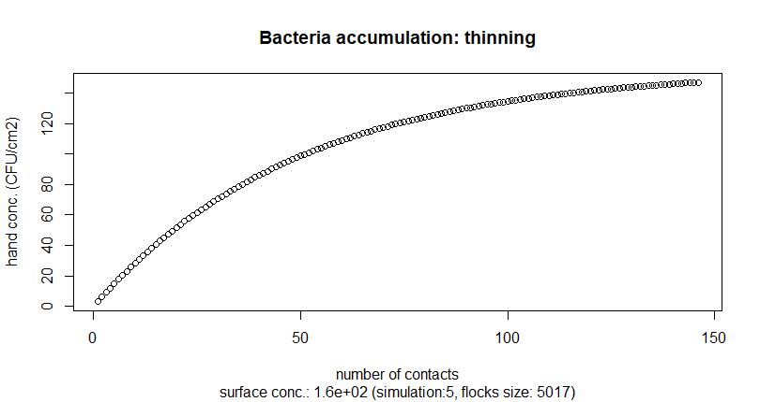
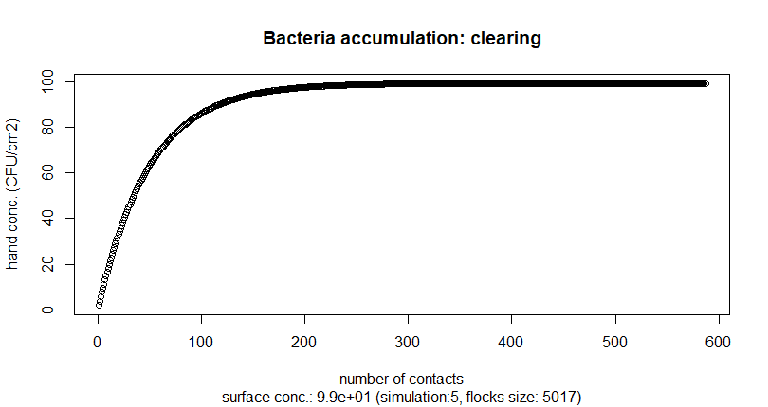
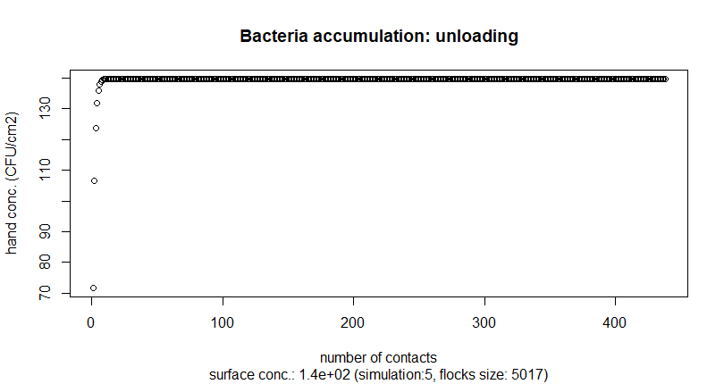
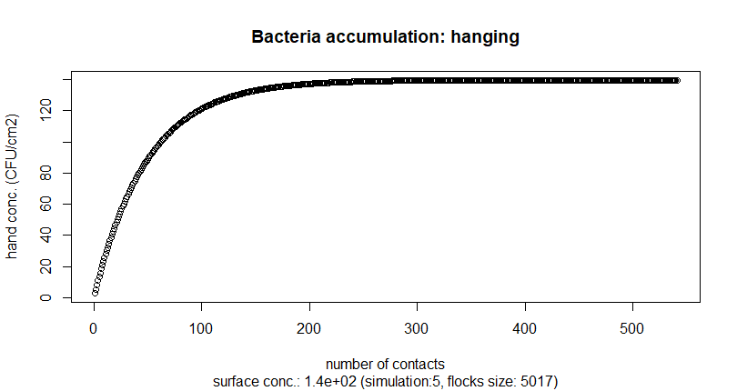
ESBL E. coli concentration on workers’ hand
Multiple contacts for single worker For different stages:
Different transfer rates
Different initial concentrations
Different number of contacts

Slide 15
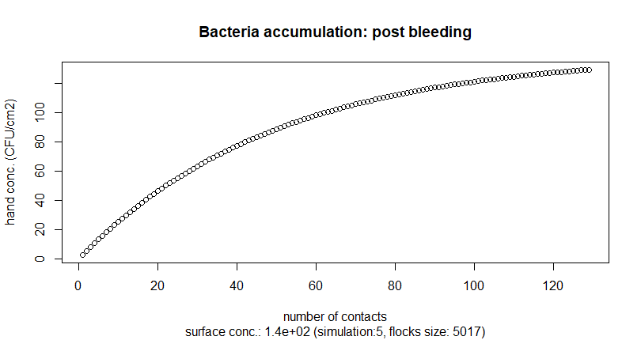
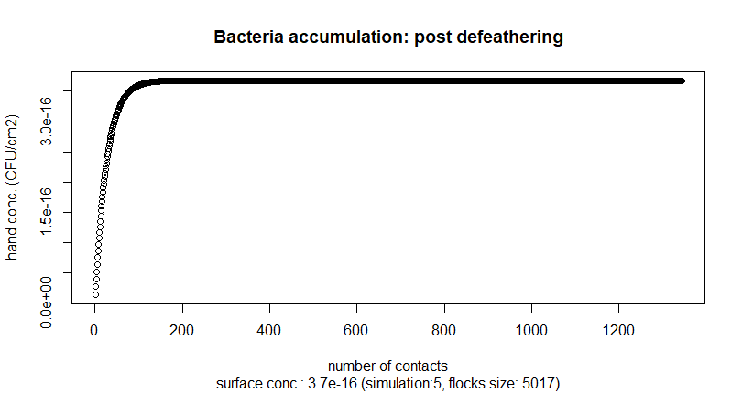

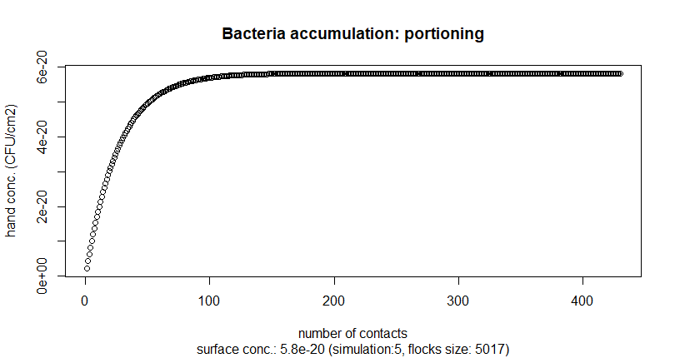
ESBL E. coli concentration on workers’ hand
Multiple contacts for single worker
Equilibrium conc. on hands
Hands become saturated
Final conc. on hands Chand are simulated

Slide 16
Hygiene and biosecurity
q_glove
q_wash
q_mask
C_hand_s
Gloves
Hands
Wash
Mask
Lips
C_lips_s
E_glove
E_wash
E_mask
Compute average concentraion C_lips_s_bar for stage s worker’s lips conditional on E_touch:
C_lips_s_bar
= E[C_lips_s | 1_{E_touch} = 1, c_hand_s]
= f(q_mask, q_glove, q_wash, q_lips, P[E_mask], P[E_glove], P[E_handwash], c_hand_s)

Slide 17
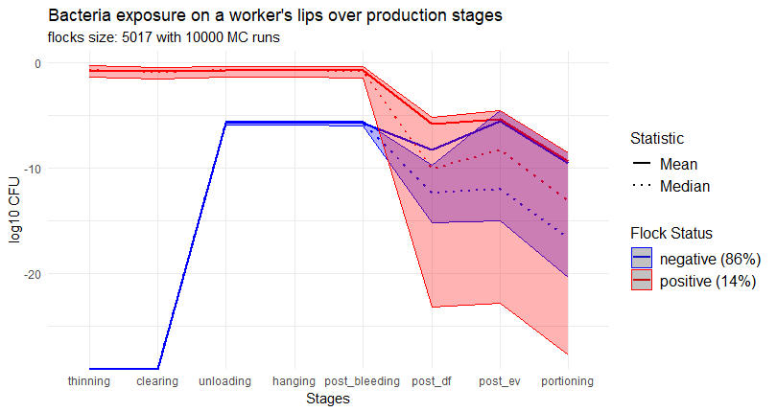
Simulated exposure on workers’ lips
For different stages:
Number of contacts have no effect
Exposure is non significant
Heavy tailed distributions
Comparable with experimental data

Slide 18
Résumé

Slide 19

Workflow – WP3
Foodborne module
Farm-to-Fork QMRA
Based on existing model
Implementation
Model validation
Faverjon et al. (2022)
Collineau et al. (2020)
Occupational module
Exposure assessment
New model proposed
Implementation
Model validation
Wadepohl et al. (2020)
Price et al. (2007)
WIP – WP1 data integration
Poland
Tunisia
Germany ATB
Germany FUB
Lithuania
Anses Ploufragan

Slide 20
WIP – WP1 data integration
Poland – Intervention with Phages – Estimate log reduction – farm module
Tunisia – Interverntion with Phytotherapy – Estimate log reduction – farm module
Germany ATB - Anaerobic digestion of manure - Estimate log reduction – environmental module
Germany FUB – To discuss
Lithuania - To discuss
France Anses Ploufragan – Manure composting - Estimate log reduction – environmental module

Slide 21
Scientific communications
12 March – Discussion with FIA
16 May – Presentation at ModStatSAP – Paris, France
13 June – Presentation on FSKX automation at BfR, Berlin, Germany
24 August –Poster presentation at ModAH – Nantes, France
12 November - Poster presentation at EcoToxicoMic – Gotenberg, Sweden
Misc.
June and November - Short study visit – Berlin, Germany
16 October – Visit poultry abattoire – Ardèche, France

Slide 22
Thank you ! Questions ?

