Slide 1


Foodborne & Occupational EXPOSURE of ESBL E. coli from broiler production
Subhasish BASAK
Lucie COLLINEAU

Slide 2
Objectives - WP 3

Slide 3
QMRA model
Environmental module
Recreational exposure
Manure tank
Surface water
Fresh produce consumption
Interventions
Foodborne module
Farm module
Human exposure to ESBL E. coli
Slaughter
Processing
Home preparation
Chicken meat consumption
Interventions
Occupational module
Direct contact
Occupational exposure

Slide 4
QMRA model
Environmental module
Recreational exposure
Manure tank
Surface water
Fresh produce consumption
Interventions
Foodborne module
Farm module
Human exposure to ESBL E. coli
Slaughter
Processing
Home preparation
Chicken meat consumption
Interventions
Occupational module
Direct contact
Occupational exposure

Slide 5
Farm-to-Fork model

Slide 6










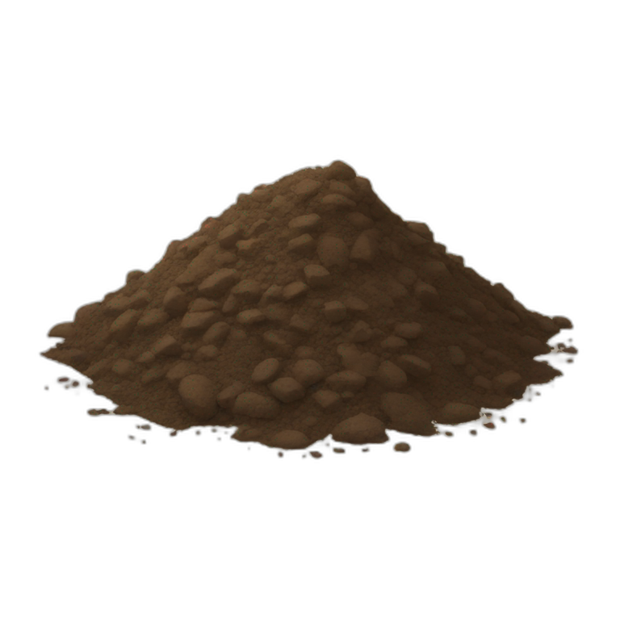

Farm to Fork model
Thinning
SI model
Barn
Load
Input
Production
Output
36 Days
Scalding
Evisceration
Chilling
Post-processing
Excretion
OR
Defeathering
Washing
Portioning
Home cooking
Ingestion
WithinFlock
Prev.
Decay
Growth
Simulates within flock Prevalence (Pprev) and Load (Cload) on carcass/portion at each stage
Transport
FARM MODULE
FOOD-BORNE MODULE
Thinning
Clearing
Cleaning
Unloading
hanging
Post-bleeding
Post-df
Post-ev
Portioning
Contaminated items
Worker hands
Worker lips
6

Slide 7
Simulation results

Slide 8
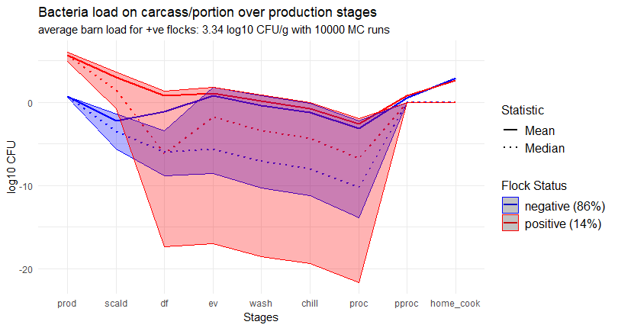
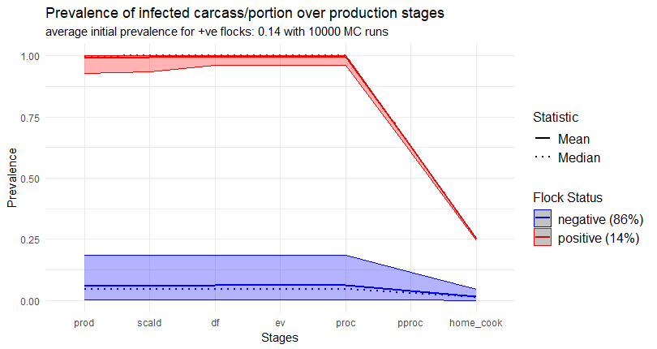
Baseline scenario
Simulated ESBL E. coli concentration + CI (5% - 95%)
Heavy tailed distributions ! Average load on chicken portions 8,2e2 CFU (sd 5,2e4)
Simulated ESBL E. coli prevalence + CI (5% - 95%)
Results validation with Faverjon et al. (2022)
Average prevalence of chicken portions 0,05 (sd 0,08)

Slide 9
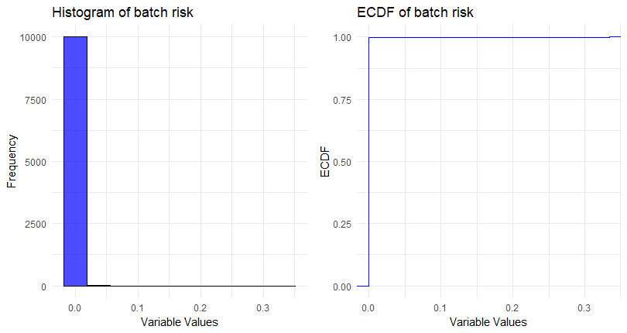
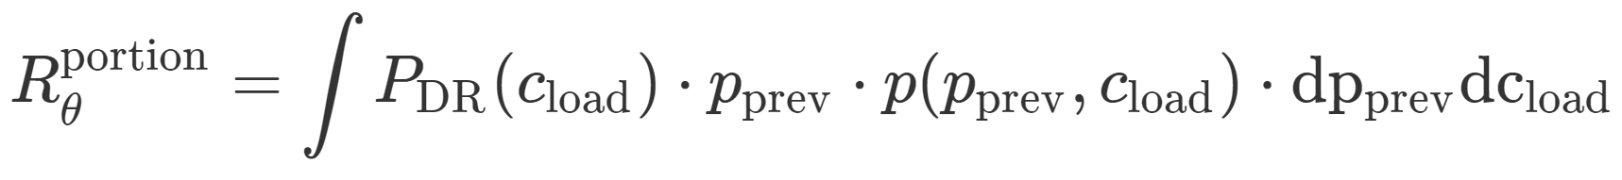
Foodborne risk
Risk from 1 chicken portion consumed
Prob. of ESBL E. coli carriage by consumer
Conditional on Pprev, Cload after cooking
PDR : Dose-Response Furusawa et al. (2024)
Avgerage risk of ESBL E. coli carriage from consuming 1 chicken portion
To estimate: 10k independent flocks simulated with Monte Carlo runs
Average risk in a baseline scenario defined by input parameters Ɵ : 9,6e-5
Confirms heavy tailed distributions !
Quantile metrics ?
Difficult to interpret ?

Slide 10
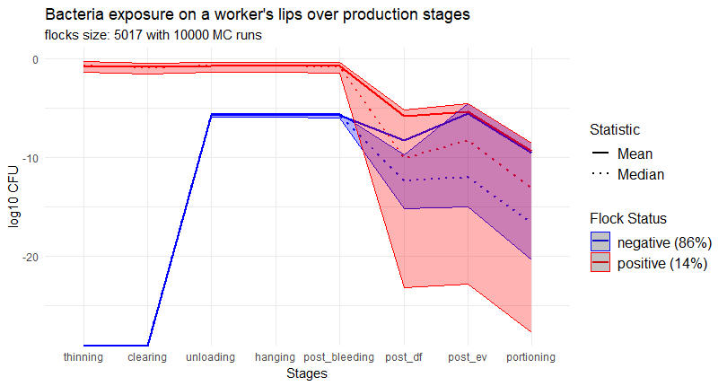
Occupational exposure
Key takeaways:
Low baseline exposure (< 1 CFU)
Heavy tailed distributions
Perspectives:
Validation with literature
Airborne pathways

Slide 11
Thank you ! Questions ?

