Slide 1

Multi-pathway QMRA model
estimating human exposure to ESBL E. coli
from broiler production.
Subhasish BASAK
Lucie COLLINEAU
ANSES - Laboratoire de Lyon

Slide 2
WP 3 - Recapitulation

Slide 3













Objective: Build a QMRA model
Quantitative Microbial Risk Assessment
Inputs
QMRA
model
Outputs
Total 165
Model parameters
Probability
of
ESBL E. coli
Colonization
in humans

Slide 4

Model implementation
Built on R – 4.1.2
Now available on GitHub https://github.com/ENVIRE-JPIAMR

Slide 5
How it works ?

Slide 6



















What is modelled ?
Recreational swimming
Environmental
Agricultural crop irrigation
Day 1
Day N
OR
Farm
OR
Broiler meat consumption
Foodborne
Occupational contact
Occupational
Thinning

Slide 7
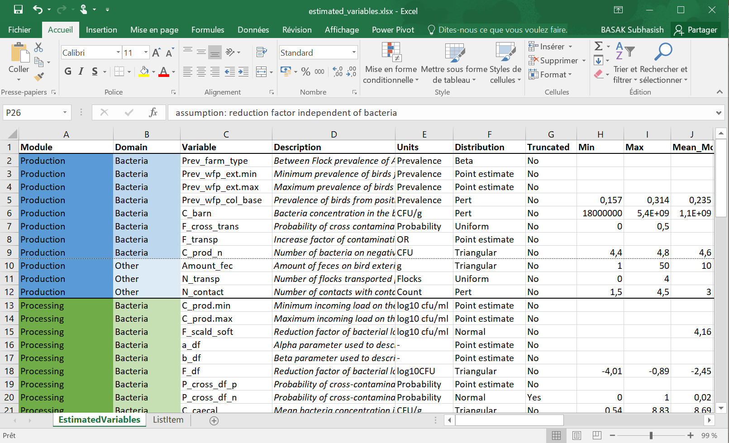
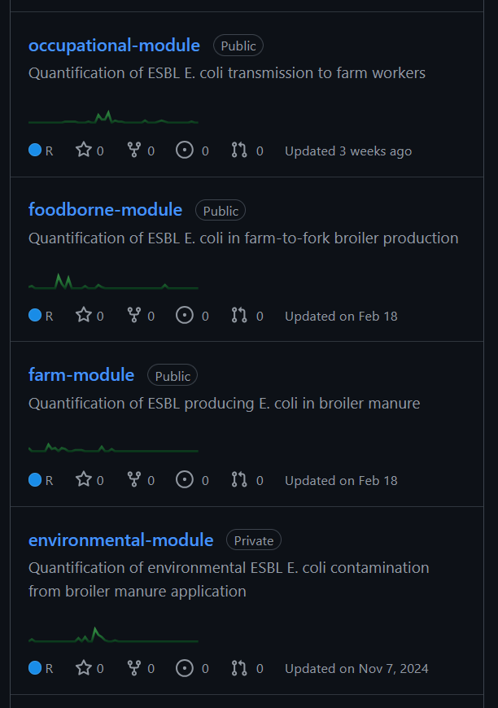
How to run the model?
Ɵenvironmental
GitHub repositories
Environmental
Ɵfoodborne
Farm
Foodborne
Ɵfarm
Ɵoccupational
Occupational

Slide 8
How to run the model?
Dose-Response
DOSE → RISK
RISK = Probability
of ESBL E. coli
Colonization
Ɵenvironmental
Dose swim (CFU)
Environmental
Dose lettuce (CFU)
Ɵfoodborne
Dose meat (CFU)
HYPOTHETICAL
BASELINE SCENARIO
defined by Ɵ
Farm
Cfarm, d
Foodborne
Prevalence meat
Pfarm, d
Ɵfarm
1 simulation
=
1 BROILER FLOCK
Ɵoccupational
Occupational
Dose worker (CFU)

Slide 9
Why do QMRA ?

Slide 10
Use of QMRA models
“Models are always incomplete representations of the system they are intended to model, but they can still be useful” – WHO (2021)
Testing expensive intervention protocols
Identifying influential parameters
Compare different scenarios
Categorize pathways with high exposure
Guidelines by Codex Alimentarius Commission – FAO and WHO (1999)
QMRA
Risk
Risk management
Policy making
characterization

Slide 11

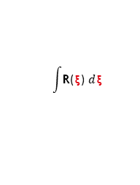
WORK IN PROGRESS - Risk characterization
How to interpret the estimated risk ?
BOTTOM UP appraoch: Estimate the number of cases caused by a typical lot produced by a process Ɵ
TOP DOWN approach: Estimate the number of cases over a time period (yearly) in a region with due to a process Ɵ
Dose
CFU Ingested – Related to a broiler flock $\text{ξ}$
Dose-Response model
Encounter
R($\text{ξ}$)
Conditional risk (probability) of illness per serving from broiler flock $\text{ξ}$
$$\int{\text{R}\text{(}\text{ξ}\text{)} d\text{ξ}}$$
BOTTOM UP approach
RƟ
Average risk (probability) of illness per Encounter
TOP DOWN approach
1-(1-RƟ)^n
Average risk (probability) of illness per individual (yearly)
n
Number of Encounters per individual (yearly)

Slide 12
Communications

Slide 13
Scientific communications
Presentations:
16 May ‘24 – Presentation at ModStatSAP – Paris
15 May ’25 – Presentation at PROMISE Seminar – Online
Posters:
24 August ‘24– Poster at ModAH – Nantes
12 November ‘24– Poster at EcoToxicoMic – Gotenberg
Miscellaneous:
June and November ‘24 - Short study visit – Berlin
16 October ‘24 & 12 February ’25 – Visit poultry abattoir – Ardèche
Article 1: Occupational module under review MRA Journal
Article 2: Risk characterization under preparation

Slide 14
Thank you !
Questions ?

