Slide 1
Application, Challenges, and Perspectives in farm-to-fork QMRA modelling:
NAMs for foodborne risk management and policy making
Subhasish BASAK
INRAE Bordeaux-Aquitaine, France
ILSI - Early Career Scientists Event
October 10, 2025
Prague, Czech Republic

Slide 2

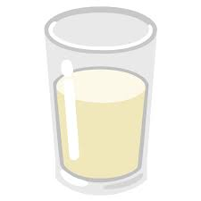






Subhasish Basak | INRAE-Bordeaux Aquitaine | ILSI - Early Career Scientists Event | NAMs in Risk Assessment | Prague, October 10, 2025
What is QMRA ?
QMRA : Quantitative Microbial Risk Assessment
Mathematical model : production to consumption of food item
Example: QMRA for raw milk cheese (Basak et al., 2024)
Milk contamination in farm
Bacteria evolution in production
Consumption and illness
Goal: Reduce risk of the foodborne illness

Slide 3



Subhasish Basak | INRAE-Bordeaux Aquitaine | ILSI - Early Career Scientists Event | NAMs in Risk Assessment | Prague, October 10, 2025
Risk reduction
Intervention strategies in practice
Intervention 1.
Test milk tanks
Intervention 2.
Test cheese batches
Day 1
> 50 CFU
Batch n°1
Day 2
< 50 CFU
Batch n°2

Slide 4
Subhasish Basak | INRAE-Bordeaux Aquitaine | ILSI - Early Career Scientists Event | NAMs in Risk Assessment | Prague, October 10, 2025
How to build QMRA model ?
NAMs : New Approach Methodologies serves as building blocks
Q1.
How to estimate bacteria concentration in milk tank?
Q2.
How to model bacteria evolution during production?
Q3.
How to compute risk of illness from eating cheese ?
Probabilistic modeling
Monte-Carlo simulations
Bayesian approaches
Predictive microbiology
In-Silico models
Evolution under pH, T, aw
Dose Response: Probability of illness
DALY: Disability Adjusted Life Years
Risk (Probability) -> DALY (Life years)

Slide 5



Subhasish Basak | INRAE-Bordeaux Aquitaine | ILSI - Early Career Scientists Event | NAMs in Risk Assessment | Prague, October 10, 2025
How to run QMRA model ?
QMRA model inputs and outputs (toy example)
Milk
testing
frequency
100 %
QMRA model
DALY
25g cheese
2 x 10⁻⁷
Milk
rejection
threshold
50 CFU/ml
Cheese testing
frequency
30 %
Cost of intervention
1000 €
Cheese testing
sample size
5

Slide 6
Subhasish Basak | INRAE-Bordeaux Aquitaine | ILSI - Early Career Scientists Event | NAMs in Risk Assessment | Prague, October 10, 2025
Risk management with QMRA model
Find intervention parameters that minimize both outputs
Milk
testing
frequency
All batches ?
10 % batches ?
QMRA model
DALY
per portion
30 CFU/ml ?
50 CFU/ml ?
Milk
rejection
threshold
Trade off
All batches ?
50% batches ?
Cheese testing
frequency
Cost of intervention
10 samples ?
20 samples ? …
Cheese testing
sample size

Slide 7
Subhasish Basak | INRAE-Bordeaux Aquitaine | ILSI - Early Career Scientists Event | NAMs in Risk Assessment | Prague, October 10, 2025
Compare different scenarios with QMRA model
Toy Example of intervention parameter values
Milk testing frequency
Milk testing threshold (CFU/ml)
Cheese testing frequency
Cheese testing sample size
Scenario 1:
All possible combinations: Total 216 scenarios
Estimate DALY & Cost for all scenarios
10%, 50%, 100%
10, 20, 30, 50, 100, 200
10%, 30%, 50%
1, 5, 10, 15
10%, 100, 10%, 15
DALY 5 x 10⁻⁷
Cost 500 €

Slide 8
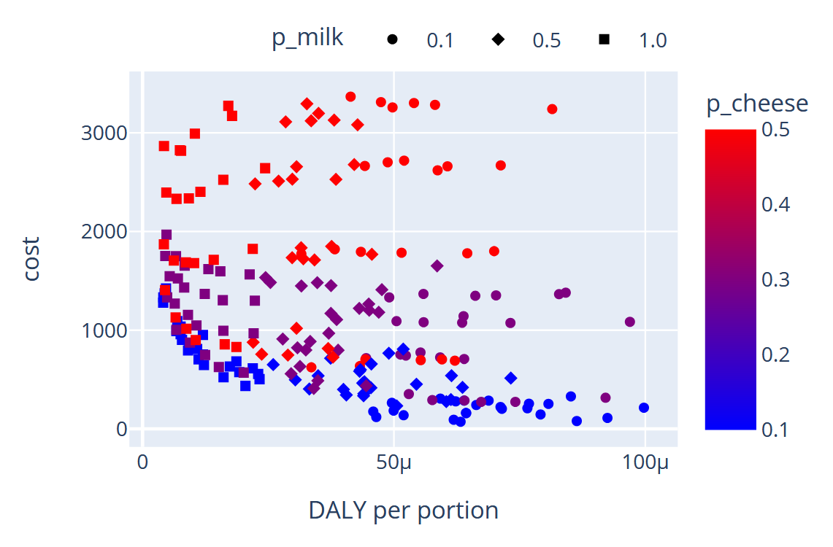
Subhasish Basak | INRAE-Bordeaux Aquitaine | ILSI - Early Career Scientists Event | NAMs in Risk Assessment | Prague, October 10, 2025
Compare DALY & Cost for 216 different scenarios
Which is the optimal scenario ?
Milk testing frequency
Cheese testing frequency
High cost
Low DALY
Low cost
High DALY

Slide 9

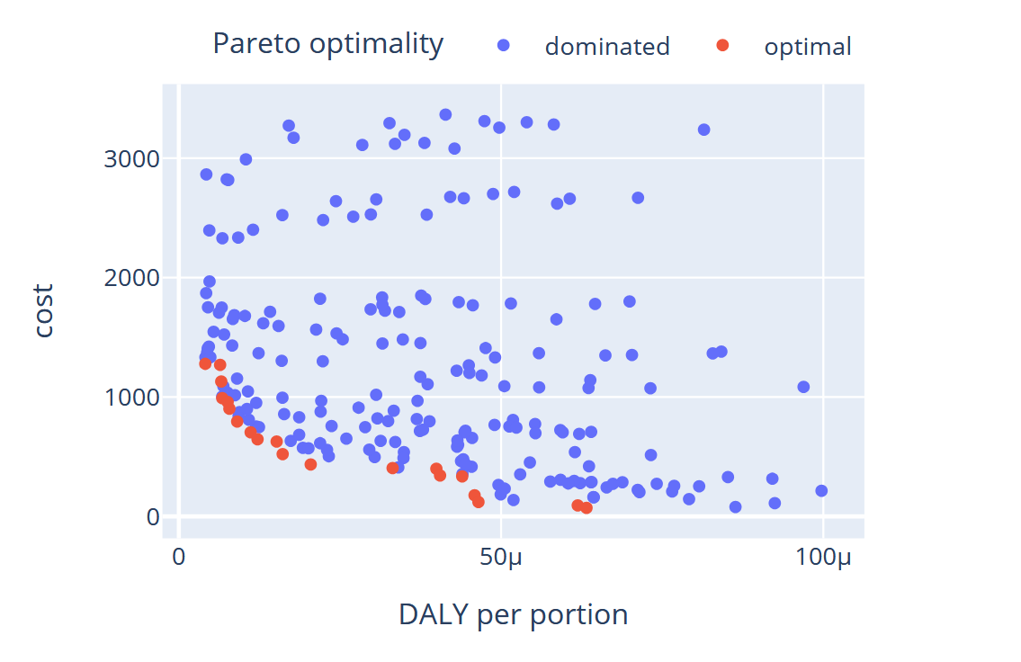

Subhasish Basak | INRAE-Bordeaux Aquitaine | ILSI - Early Career Scientists Event | NAMs in Risk Assessment | Prague, October 10, 2025
No unique optimal scenario
216 scenarios
~ 22 hrs of computation
20 scenarios
Pareto optimal
CHALLENGE 2
Stochastic model
Uncertainty
Choice to
Policy Makers
Bayesian optimization
Algorithms
CHALLENGE 1
computationally expensive in real life
Basak (2024) PhD thesis

Slide 10
Subhasish Basak | INRAE-Bordeaux Aquitaine | ILSI - Early Career Scientists Event | NAMs in Risk Assessment | Prague, October 10, 2025
Take home-key messages
QMRA is vital for evidence-based food safety policy making
NAMs provide the tools to build robust & scalable models
QMRA helps implementing efficient intervention strategies
Bayesian methods for computationally expensive + stochastic models
Reference: Subhasish Basak. Multipathogen quantitative risk assessment in raw milk soft cheese : monotone integration and Bayesian optimization. Machine Learning [stat.ML]. Université Paris-Saclay, 2024.

Slide 11
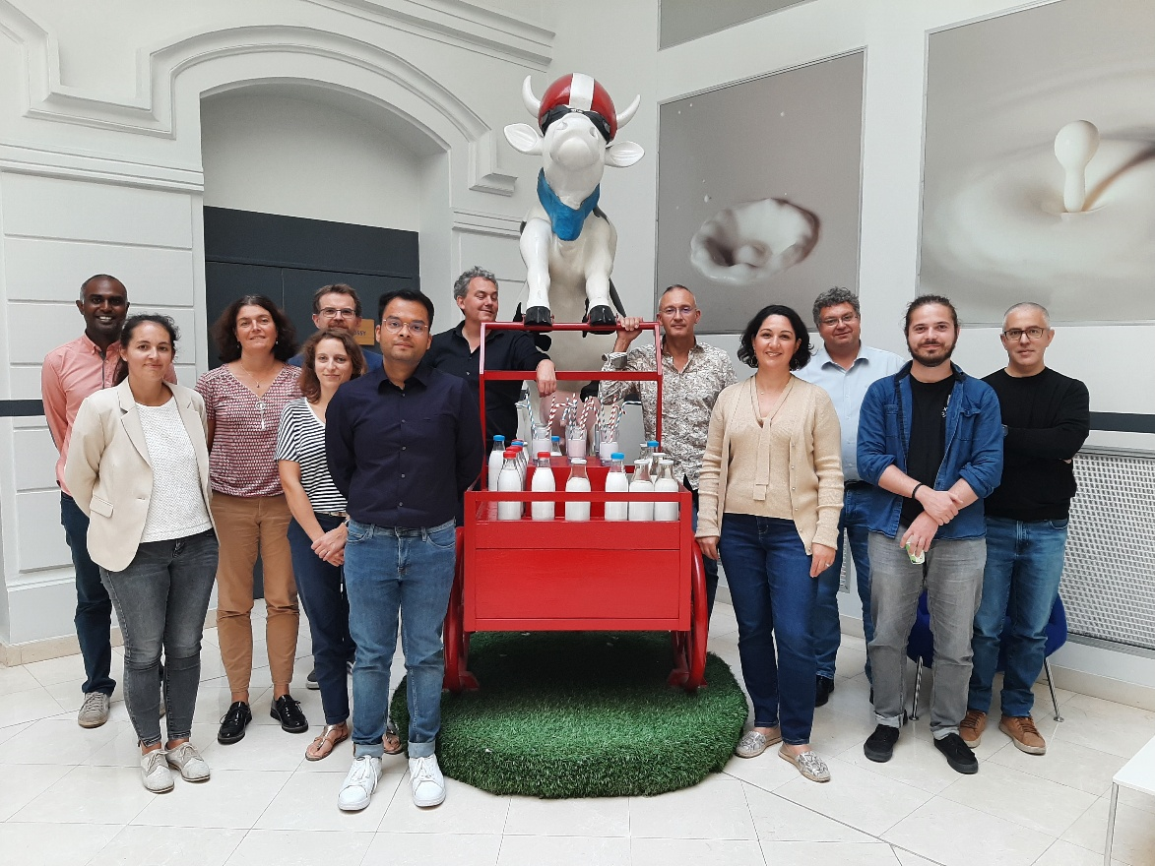

Subhasish Basak | INRAE-Bordeaux Aquitaine | ILSI - Early Career Scientists Event | NAMs in Risk Assessment | Prague, October 10, 2025
Thank you all !
Work realized by the consortium
EU Project ArtiSaneFood, ANSES-CNIEL-CentraleSupélec

