Slide 1




Risk assessment model to estimate human exposure to ESBL E. Coli from poultry production via
foodborne, occupational and environmental pathways
Subhasish BASAK
ANSES - Laboratoire de Lyon
4 & 5 June 2025 | Anses – Maisons-Alfort

Slide 2










JPIAMR project ENVIRE
Objective
  Reduction of selection and spread of Antimicrobial Resistance (AMR)
  from broiler chicken farms to the environment , and humans
Project partners
Quantitative Microbiological Risk Assessment (QMRA) model
Multipathway exposure of ESBL E. coli

Slide 3


























Multipathway QMRA model
Dose (CFU) per Encounter
Recreational swimming
Accidental ingestion
D
O
S
E
R
E
S
P
O
N
S
E
Drinking water
treatment
Environmental
Drinking tap water
Consumption of fresh vegetables
Flock Risk
Day 1
Day Clearing
Crop irrigation
Probability of colonization
Per encounter
from one flock of broilers
OR
Farm
OR
Broiler meat consumption
Foodborne
Consumption of contaminated meat
Occupational contact
Occupational
Accidental contact between hands and lips
Thinning
Ɵfarm
Ɵenvironmental
Ɵfoodborne
Ɵoccupational

Slide 4

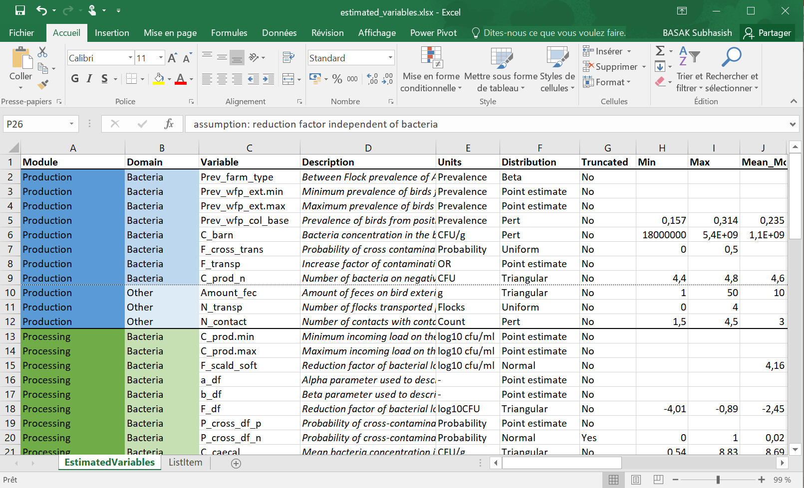
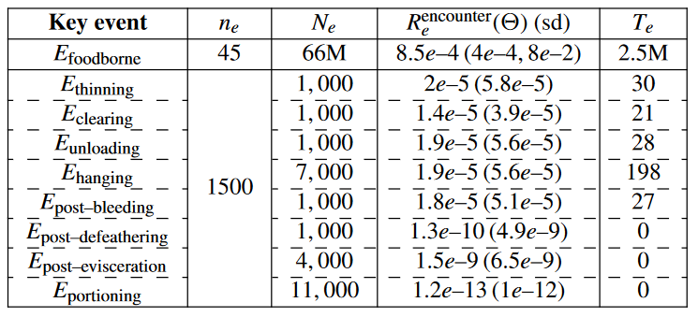


How to run the model ?
Annual encounter events per person
Total population exposed
Annual ESBL colonization cases
R(Ɵ)
$$\int{\text{R}\text{(}\text{ξ}\text{)} d\text{ξ}}$$
R($\text{ξ}$)
Average Risk
Flock Risk

Slide 5

Use of QMRA model
“Models are always incomplete representations of the system they are intended to model, but they can still be useful” – WHO (2021)
Testing expensive intervention protocols
Identifying influential parameters
Compare different production scenarios
Categorize pathways with high exposure
Guidelines by Codex Alimentarius Commission – FAO and WHO (1999)
QMRA
Risk management
Policy making

Slide 6
Thank you for your attention !
Subhasish BASAK
ANSES - Laboratoire de Lyon
subhasish.basak@anses.fr
4 & 5 June 2025 | Anses – Maisons-Alfort

