Slide 1


Cyber School Manager
A Complete Online Solution to Manage All School Needs
Powered by:

Slide 2
A Smartest Way to Get Closer
PARENT, TEACHER & STUDENT
Powered by:

Slide 3
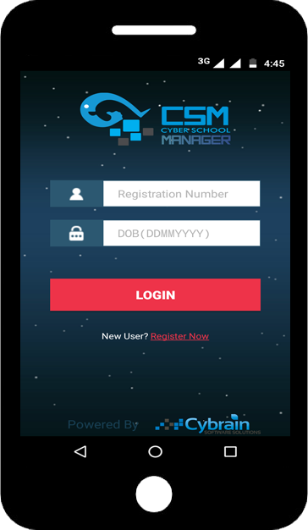

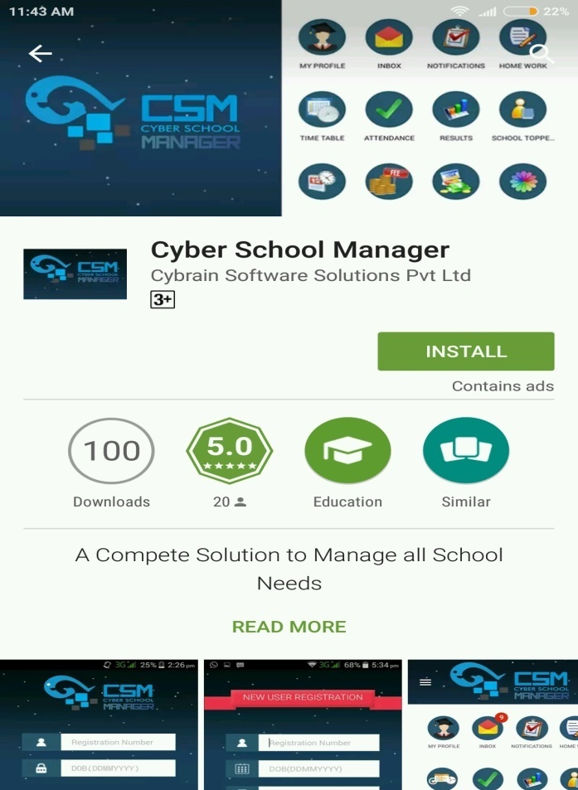
Type “cyber school manager” in Google Play Store
To Download the app, click on Install
Powered by:

Slide 4
How to Register
After successful Installation Users need to register. For new registration click on Register Now link.
Powered by:

Slide 5
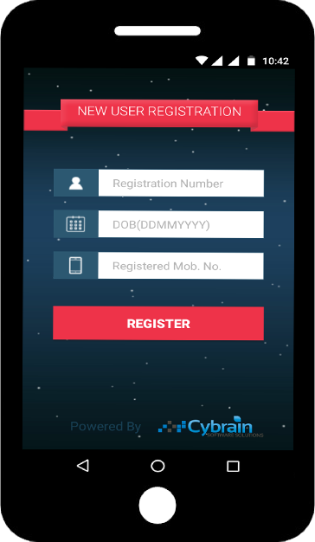
New User Registration
Enter Student’s Registration Number (Provided by School, unique id of student)
Enter Student’s Date of Birth (in DDMMYYYY Format)
Enter Parent’s Mobile Number registered in school records.
Click on Register Button
Powered by:

Slide 6
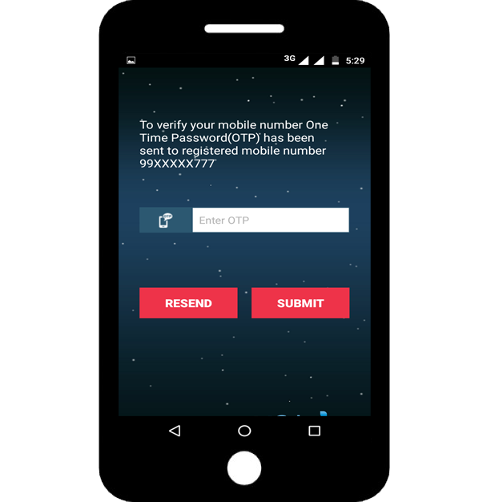
Verify Mobile Number
Enter One Time Password (OTP) received on registered mobile number
Click on Submit Button
Powered by:

Slide 7
Congratulations!!!
Your mobile number is successfully verified. Now CSM Mobile App is ready to use.
Now parent can also login in multiple mobiles using Student’s Registration Number as User id and Date of Birth as login password.
Click on Login Button
Powered by:

Slide 8
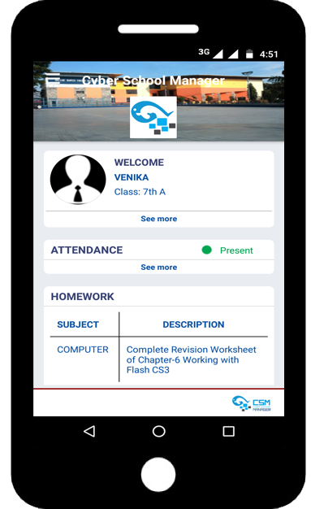
Welcome on the Dashboard.
After Successful Login on home screen user can see Student’s Profile, Attendance Status, Latest Homework, Messages, Notifications and School Gallery etc.
Powered by:

Slide 9
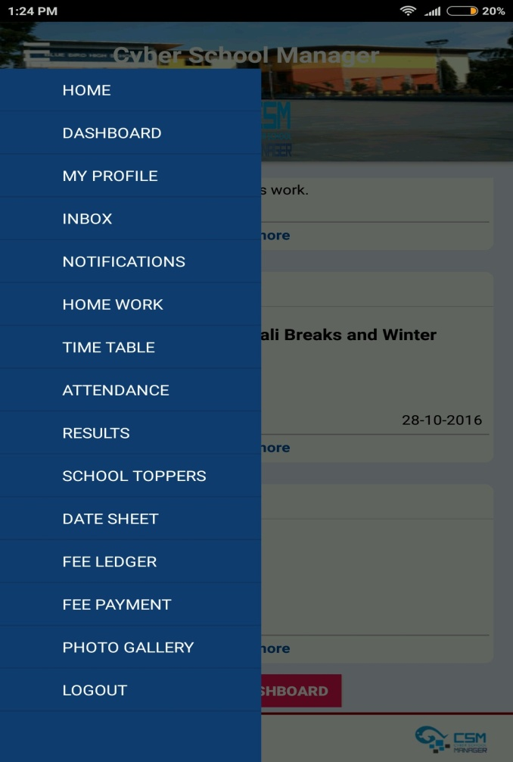
CSM Menu Items
On the left side of home screen, in menu list now user can see all the functions of CSM app like Student Profile, Inbox, Notifications, Home Work, Time table, Results, Date Sheet, Fee Ledger etc.
Powered by:

Slide 10
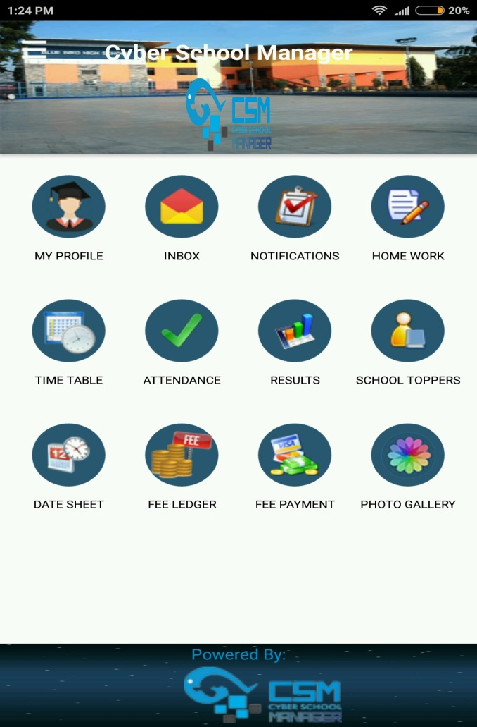
CSM Dashboard
On the Dashboard user can access all the CSM features.
To see the student’s profile, tap on My Profile icon.
Powered by:

Slide 11
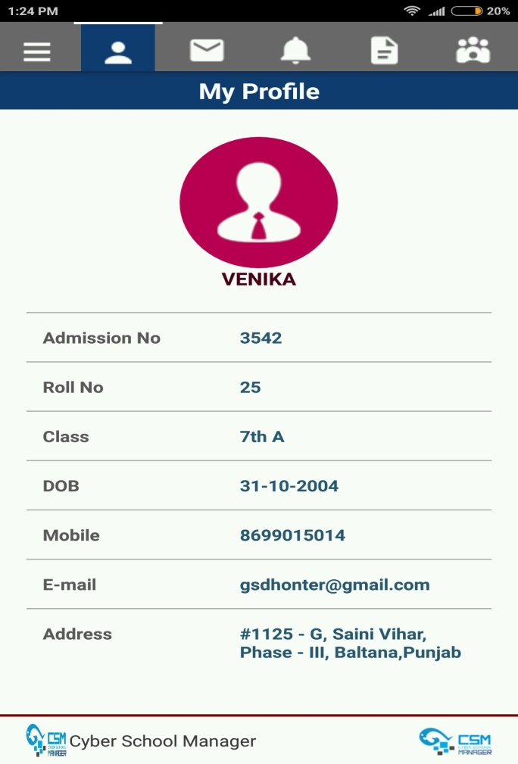
Student Profile
Here all basic information about the student can check like Admission Number, Roll Number, Class, Date of Birth, Parent’s Mobile Number, Email Id and Address etc.
Powered by:

Slide 12
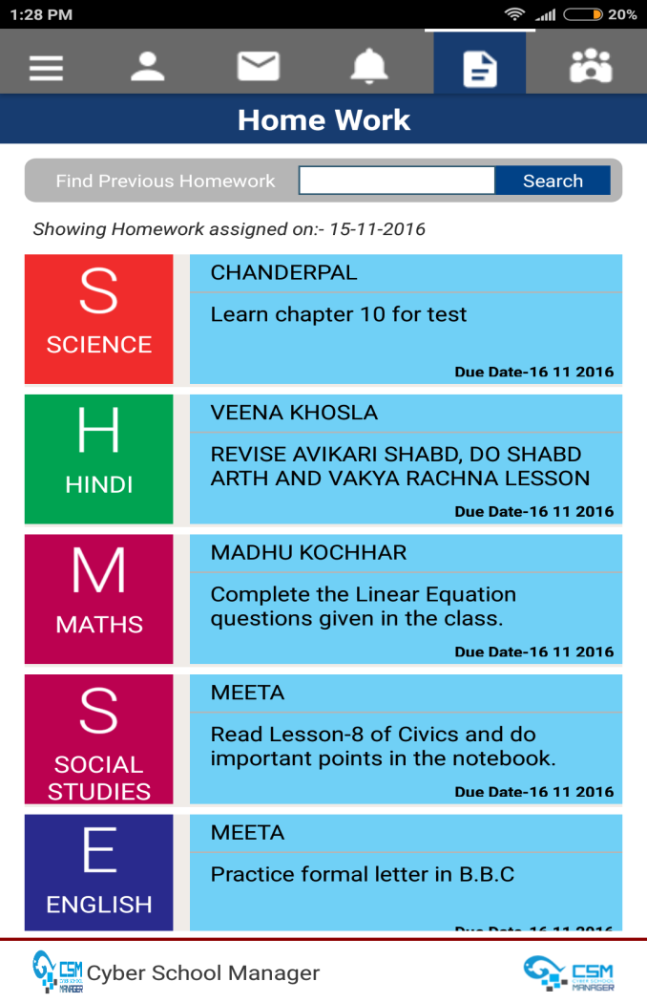
E-Home Work
No need to write the homework in diaries or notebooks. Just one click in a CSM app and Students/Parents will get the full information.
Powered by:

Slide 13
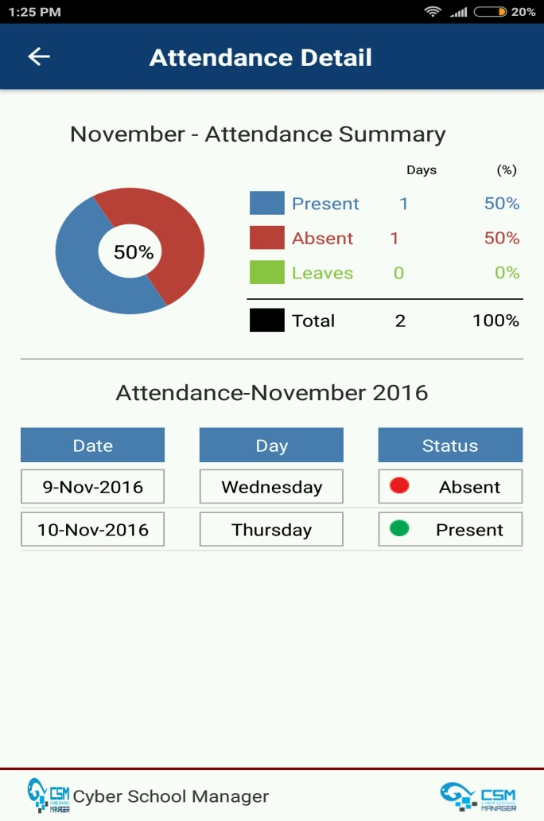
Attendance
Check full Attendance details of student, even parent can see how many days their ward was absent and present.
Powered by:

Slide 14
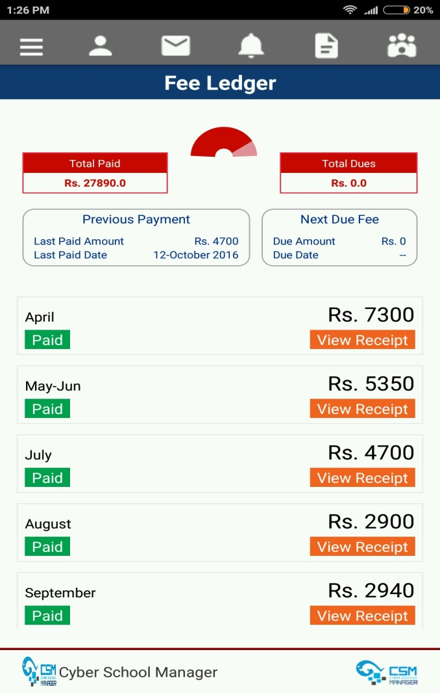
Fee Ledger
Now Parent have complete details of fee like paid fee, last paid date, Next due amount and due date. They will get instant acknowledgement from CSM App as fee Receipt upon successful payment.
Powered by:

Slide 15
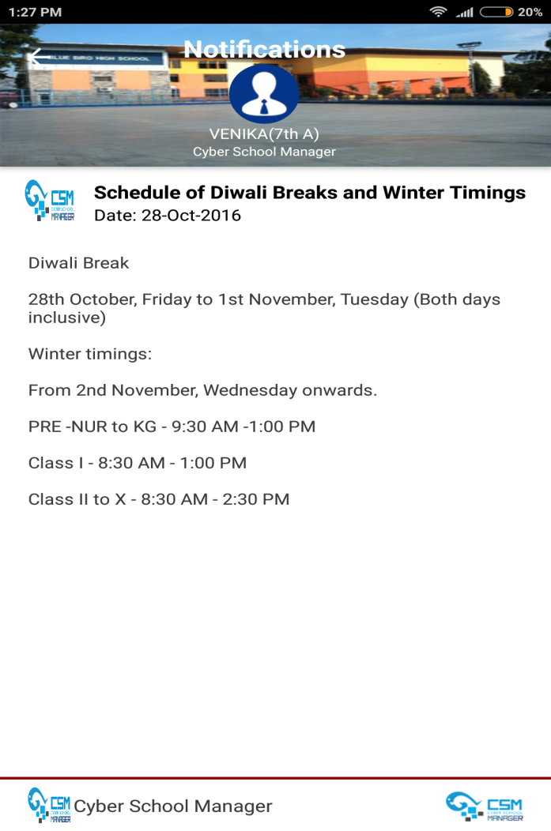
Notifications
School’s Notifications are very important for parent. Now parent have instant information regarding any events, activities and all kind of communication by school.
Powered by:

Slide 16
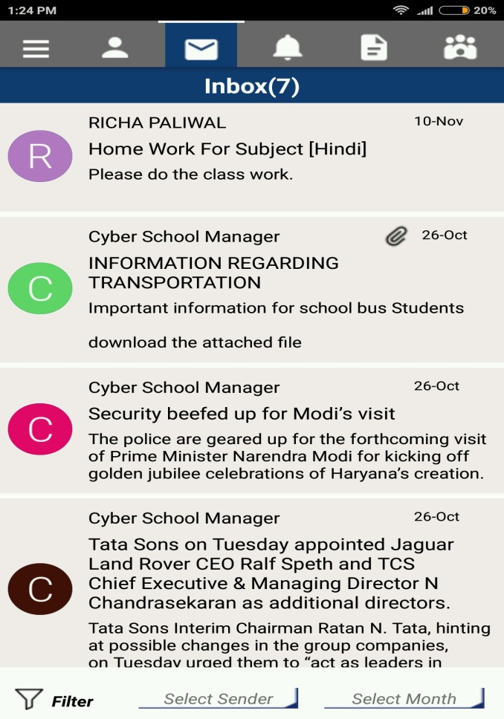
Inbox
In inbox parent can see all the messages specifically related to your ward sent by the school or teachers.
Powered by:

Slide 17
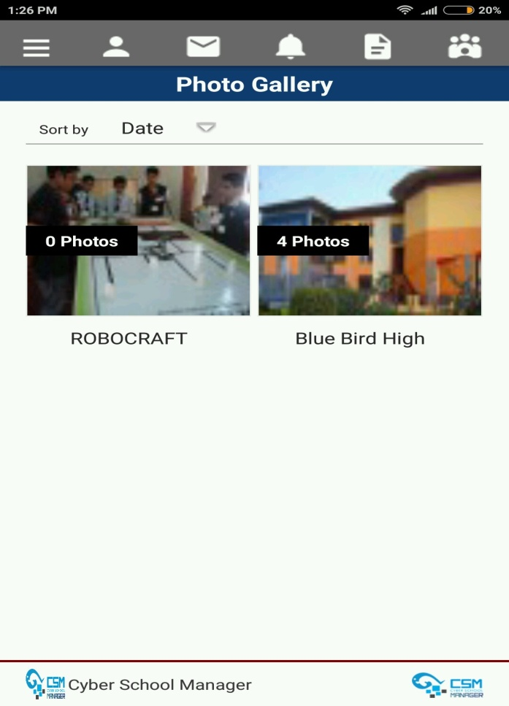
Photo Gallery
The photo gallery is basically collection of photos and videos related to the school. you can see all the events happen in the schools in a single click.
Powered by:

Slide 18
For more details Visit: www.cyberschoolmanager.com Call us :+91-9216953958, 9988899777, 0172-5053958 Email us : info@cybrain.co.in Follow us on Facebook: www.facebook.com/cybrainsoft/
Powered by:

Slide 19
Thank you
Powered by:

