Slide 1
Fitness Buddy – AI Health Coach
CAPSTONE PROJECT
Presented By:-
SUBHASMITA PAL
ITER Siksha ‘O’ Anusandhan – B.Tech CSE

Slide 2
OUTLINE
Problem Statement (Should not include solution)
Proposed System/Solution
System Development Approach (Technology Used)
Algorithm & Deployment
Result (Output Image)
Conclusion
Future Scope
References

Slide 3
Problem Statement
People struggle with:
Choosing the right workout for their fitness level
Planning healthy meals
Staying motivated & consistent
Need for a personalized coach that is:
Available anytime
Adaptive to goals, preferences & feedback
Free and easy to access

Slide 4
Proposed Solution
Smart Nutrition Guidance
AI-Powered Personal Coach - A conversational AI agent built on IBM Watsonx.ai that acts as a friendly fitness and lifestyle coach, available anytime.
Personalized Workout Plans - Generates home-friendly workout routines tailored to the user’s fitness level, goals, time availability, and past progress.
Smart Nutrition Guidance -Suggests balanced meals and healthy snacks based on dietary preferences (e.g., vegetarian) and caloric needs.
Motivation & Habit Tracking -Provides daily encouragement, streak reminders, and habit tips to keep users
consistent and motivated in their fitness journey.
Adaptive & Feedback Driven - Learns from user feedback and previous interactions, improving recommendations overtime to create a more personalized experience.
Accessible & Cost-Free - Deployed using IBM Cloud Lite free services, ensuring the solution is affordable, scalable, and accessible to anyone without premium tools.

Slide 5
System Approach
Technology Used:-
IBM Watsonx.ai Agent Lab – agent creation & deployment
IBM Watson Machine Learning – inference & endpoint
Voice Input – browser speech-to-text (Web Speech API)
Image Input – Watsonx multimodal tool or descriptive text
System Requirements
1.. Hardware Requirements
A standard laptop/desktop with internet access
Minimum: 4 GB RAM, Dual-core processor
Webcam/Microphone (optional, for voice input demos)
2 .Software Requirements
IBM Cloud Lite account (free tier)
Watsonx.ai Agent Lab for building and testing the AI agent
Web browser (Chrome/Edge recommended) for preview and interaction

Slide 6
Algorithm & Deployment
Algorithm (Approach Used)
Input Collection – User provides query via text/voice/image.
Context Building – Agent combines system prompt, user profile (goals, level, diet), and past feedback.
AI Processing – Watsonx.ai foundation model generates personalized workout, nutrition, or motivation response.
Feedback Loop – User feedback is considered for refining future recommendations.
Output Delivery – Personalized response (workout plan, meal suggestion, or motivational message) is displayed to the user.
Deployment
Agent Creation – Designed in Watsonx.ai Agent Lab with role prompt and tools.
Testing – Verified through Agent Lab Preview using sample queries.
Deployment Space – Agent deployed to IBM Cloud Lite Deployment Space.
Endpoint Generation – A public API endpoint created for real-time access.
User Access – Users can interact with the agent through Watsonx Preview interface (and optionally via future frontend integration).

Slide 7
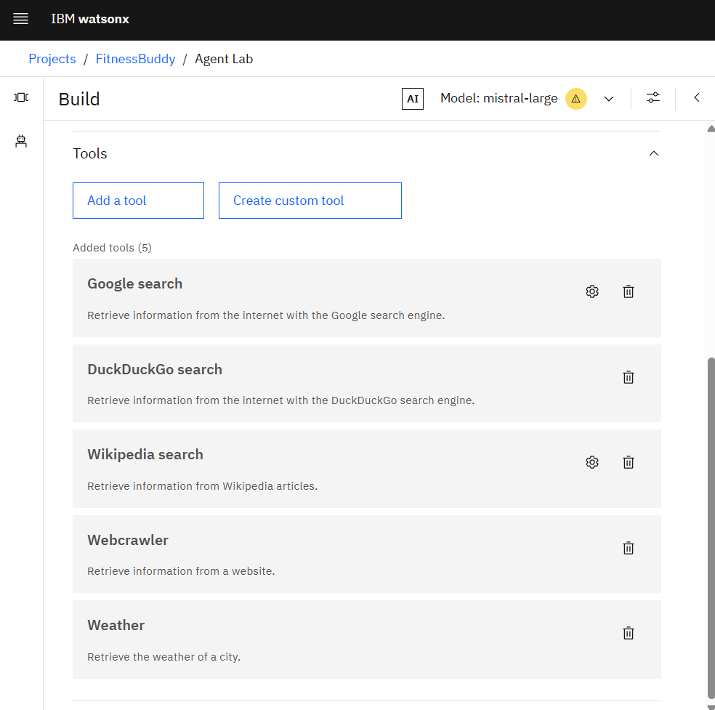
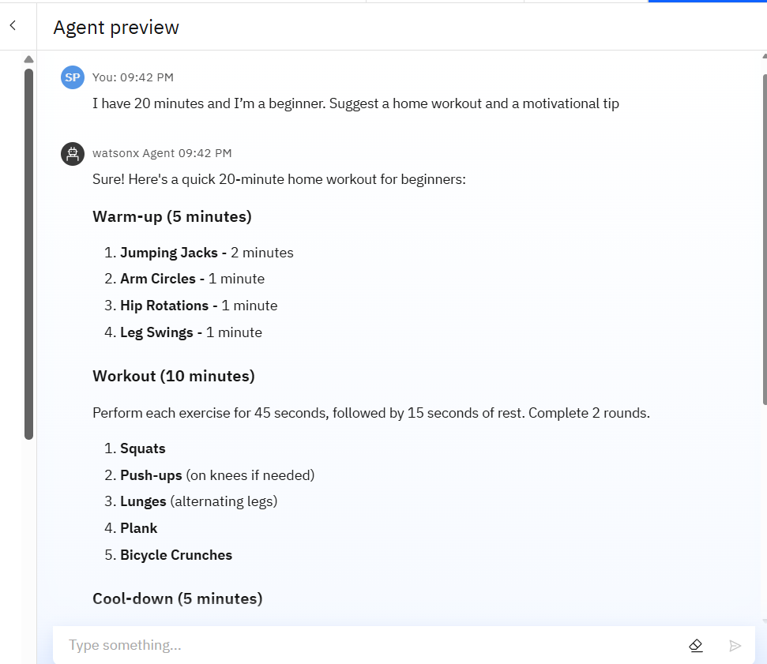
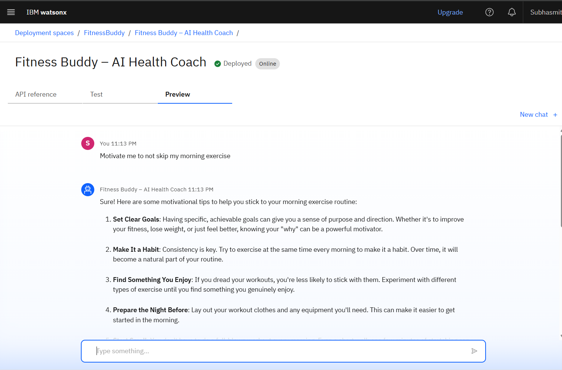
Result

Slide 8
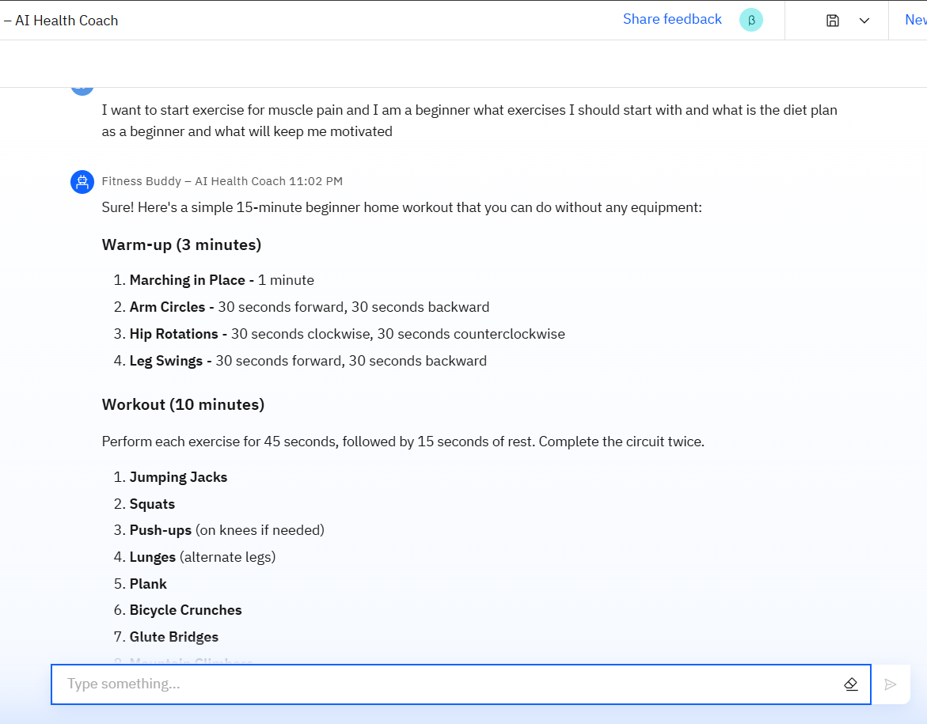
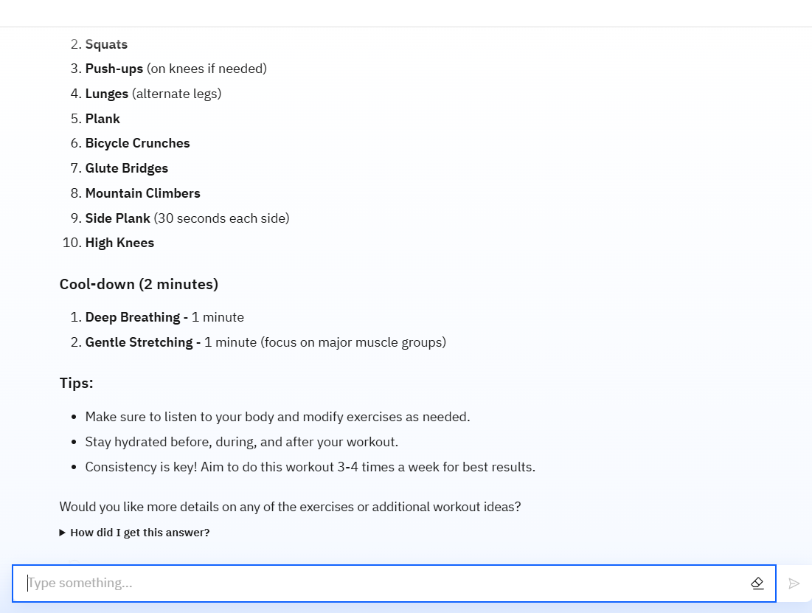
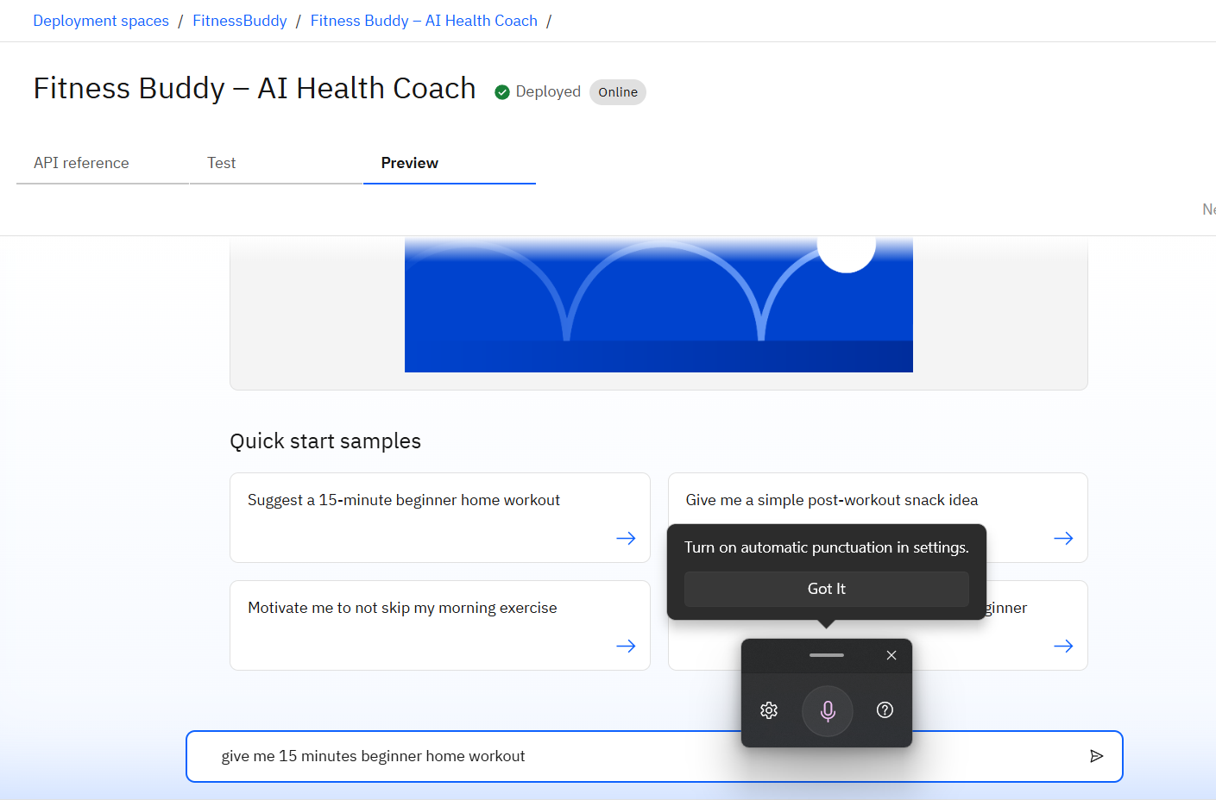
Result

Slide 9

Project Link
https://github.com/SubhasmitaPal/IBM-Cloud-and-Skillsbuild.git

Slide 10
Conclusion
Fitness Buddy AI Coach successfully delivers personalized workouts, nutrition advice, and motivation using IBM Watsonx.ai.
The solution is accessible anytime through IBM Cloud Lite, making it cost-effective and scalable.
It adapts to user goals, preferences, and feedback, offering a more tailored fitness experience.
Demonstrates the potential of AI-powered personal assistants in promoting a healthy and active lifestyle.

Slide 11
Future scope
Mobile and web app- Easy user access anytime, anywhere
Advanced Feedback System- Auto adjusts plans based on user progress.
Wearable Device Integration- Real-time fitness and health-tracking.
Multilingual and Voice Support- Wider reach and hands-free interaction.
.
Full Web & Mobile Application.

Slide 12
References
IBM Watsonx.ai Documentation – https://www.ibm.com/watsonx/ai
IBM Cloud Lite Services – https://www.ibm.com/cloud/free
IBM Watson Machine Learning – https://cloud.ibm.com/catalog/services/machine-learning
Research articles and resources on AI in Fitness & Nutrition

Slide 13
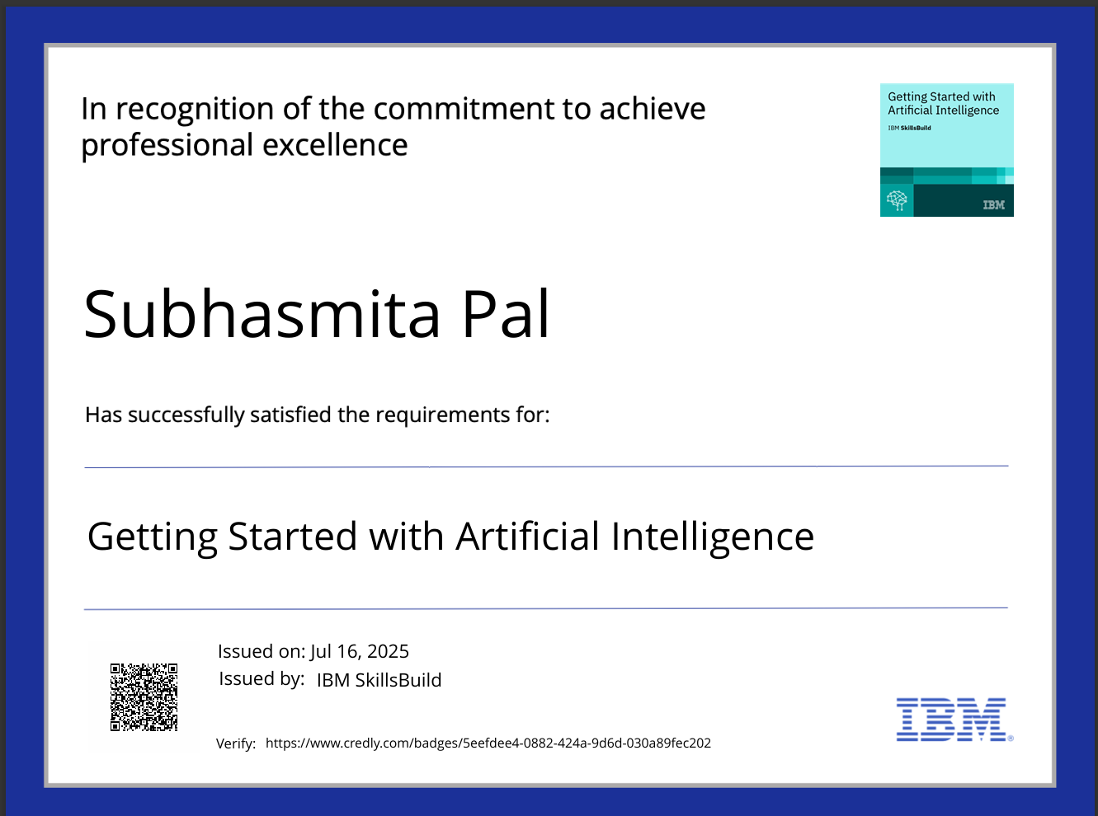
IBM Certifications

Slide 14
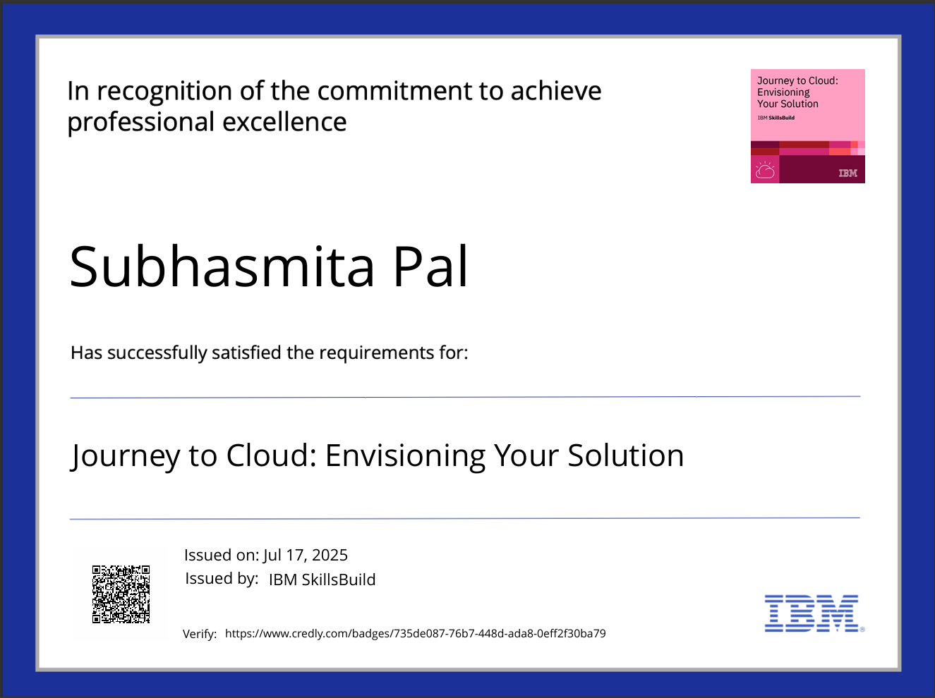
IBM Certifications

Slide 15
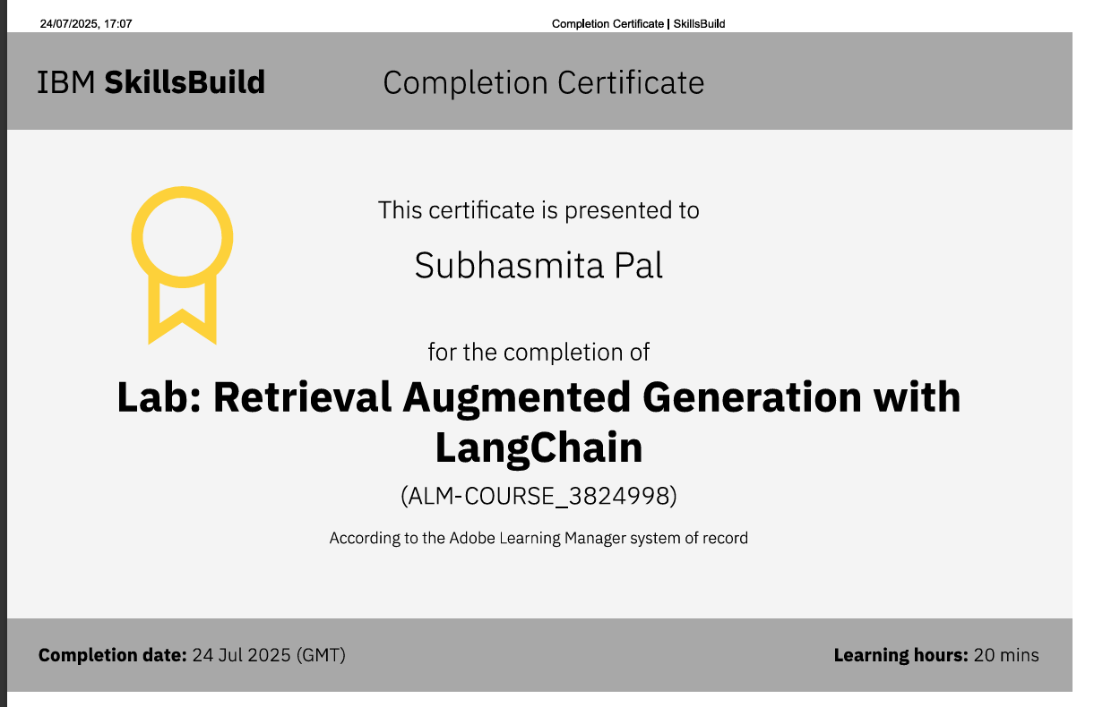
IBM Certifications

Slide 16
THANK YOU

