Slide 1
CHATBOT WITH DEEP LEARNING
BY:
Name : P.Subha sri
Degree : B.E
Branch : CSE
College : PET ENGINEERING COLLEGE
NM ID : au963221104052
Email ID : subhasri8506@gmail.com

Slide 2
OUTLINE
→ PROBLEM STATEMENT
→ PROPOSED SOLUTION
SYSTEM DEVELOPMENT APPROACH
→ ALGORITHM & DEPLOYMENT
→ RESULT
→ CONCLUSION
→ REFERENCES

Slide 3
PROBLEM STATEMENT
→PROBLEM STATEMENT:
Design and develop a chatbot using deep learning techniques to facilitate seamless interaction between users and the system. The chatbot should be capable of understanding natural language inputs, generating appropriate responses, and providing relevant information or assistance to users across various domains or applications.
→OBJECTIVE:
The primary objective of developing a chatbot using deep learning techniques is to create an intelligent conversational agent capable of understanding natural language inputs, generating contextually relevant responses, and providing valuable assistance or information to users across diverse domains. The following objectives delineate the specific goals to be achieved in pursuit of this overarching aim.

Slide 4
PROPOSED SOLUTION
→DATA COLLECTION AND PREPROCESSING: Gather A Diverse Dataset Of Conversational Data To Train The Chatbot.Preprocess The Data To Clean And Format It For Training.
→NATURAL LANGUAGE UNDERSTANDING NLU): Implement Deep Learning Models Such As Recurrent Neural Networks (Rnns), Convolutional Neural Networks (Cnns), Ortransformers To Understand User Queries And Extract Relevant Information
.
→DIALOGUE MANAGEMENT: Use Deep Learning Architectures Like Reinforcement Learning (Rl) Or Sequence-to-sequence Models To Manage The Flow Of Conversation And Decide On Appropriateresponses Based On The Current Context And User Input.
→NATURAL LANGUAGE GENERATION (NLG): Employ Deep Learning Techniques To Generate Natural And Coherent Responses.

Slide 5
PROPOSED SOLUTION-CONT.
→DEPLOYMENT AND INTEGRATION: Integrate The Trained Deep Learning Models Into A Chatbot Application Or Platform, Making It Accessible To Users Through Various Channels Such As Web Interfaces, Messaging Apps, Or Voice Assistants.
→CONTINUOUS LEARNING AND IMPROVEMENT: Implement Mechanisms For The Chatbot To Continuously Learn And Adapt To New Data And User Interactions.

Slide 6
SYSTEM APPROACH
•SYSTEM REQUIREMENTS:
=>HARDWARE REQUIREMENTS:
→CPU: A Multicore Cpu Is Essential For Preprocessing Data, Training, And Serving The Chatbot. The More Cores, The Faster The Processing, Especially During Training.
→GPU: For Training Deep Learning Models Efficiently, Especially Larger Models Like Transformers Or Recurrent Neural Networks, A Gpu Is Highly Recommended. Nvidia Gpus Are Commonly Used Due To Their Excellent Support For Deep Learning Frameworks Such As Tensorflow And Pytorch
→MEMORY (RAM): Sufficient Ram Is Crucial For Handling Large Datasets During Preprocessing And Training. The Amount Of Ram Required Depends On The Size Of The Dataset And The Complexity Of The Model.

Slide 7
SYSTEM APPROACH-CONT.
=>SOFTWARE REQUIREMENTS
->DEEP LEARNING FRAMEWORK: Choose A Framework Such As Tensorflow, Pytorch, Or Keras For Building And Training Deep Learning Models.
->NATURAL LANGUAGE PROCESSING (NLP) LIBRARIES: Libraries Like Nltk, Spacy, Or Hugging Face Transformers For Preprocessing And Understanding Natural Language.
->DATA: Large Datasets Of Conversational Data For Training The Model. Common Datasets Include Cornell Movie Dialogs Corpus, Twitter Datasets, Or Custom Datasets.

Slide 8
ALGORITHM AND DEPLOYMENT
•ALGORITHM SELECTION:
->NATURAL LANGUAGE UNDERSTANDING (NLU):Use Algorithms Such As Recurrent Neural Networks (Rnns), Long Short-term Memory (Lstm) Networks, Or Transformer Models For Tasks Like Intent Classification And Entity Recognition.
->DIALOGUE MANAGEMENT: Consider Techniques Like Rule-based Systems, Finite State Machines (Fsms), Or Reinforcement Learning (Rl) For Managing The Flow Of Conversation And Decision-making.
->NATURAL LANGUAGE GENERATION (NLG): Employ Algorithms Like Sequenceto-sequence Models, Gated Recurrent Units (Grus), Or Transformers For Generating Coherent And Contextually Relevant Responses.
•MODEL TRAINING: Train The Selected Algorithms Using Annotated Conversational Datasets For Tasks Such As Intent Classification, Entity Recognition, Dialogue State Tracking, And Response Generation.

Slide 9
ALGORITHM AND DEPLOYMENT-CONT.
•DEPLOYMENT:
•Deploy The Trained Model As A Chatbot In A Suitable Environment, Such As A Web Application, Messaging Platform, Or Voice Interface.
•Host The Chatbot On Cloud Platforms Like Aws, Azure, Or Google Cloud.
•Package The Chatbot Application And Its Dependencies Into Containers.
•Integrate The Chatbot With Messaging Platforms Like Slack, Facebook Messenger, Or Whatsapp Using Their Respective Apis To Enable Communication With Users.
•Develop A Web-based Interface For The Chatbot Using Frameworks Like Flask, Django, Or React.Js, Allowing Users To Interact With The Chatbot Through A Browser.
•Integrate The Chatbot With Voice Assistants Like Amazon Alexa.

Slide 10
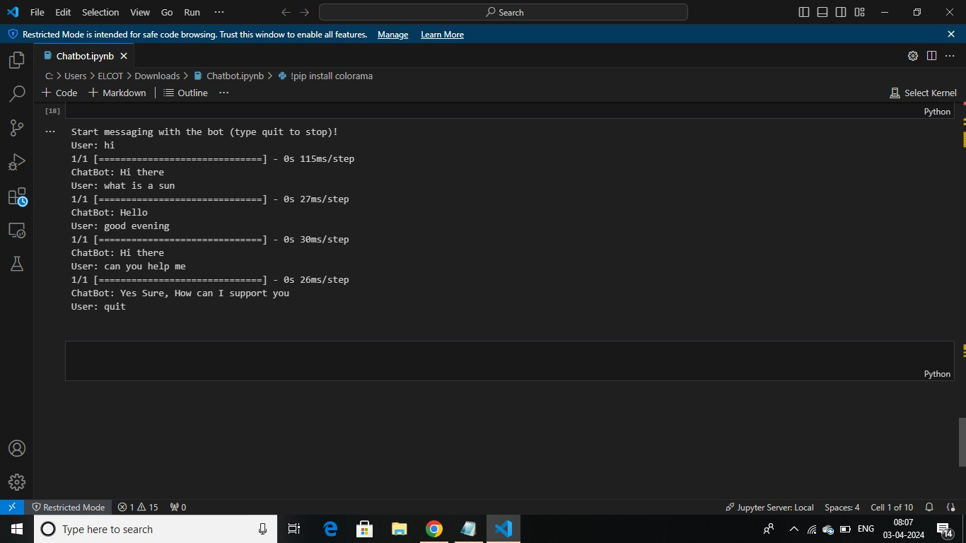
RESULT

Slide 11
CONCLUSION
In conclusion, leveraging deep learning techniques for developing chatbots offers significant potential for creating intelligent conversational agents capable of understanding and responding to human language in a natural and contextually relevant manner. By utilizing algorithms such as recurrent neural networks (RNNs), convolutional neural networks (CNNs), and transformer models, developers can address key components of chatbot functionality including natural language understanding (NLU), dialogue management, and natural language generation (NLG).

Slide 12
REFERENCES
https://arxiv.org/abs/1801.06700
https://content.botpress.com/conversational-ai-playbook
https://www.oreilly.com/library/view/practical-deeplearning/9781492034858/

