Slide 1

Medcare.com
Group Name – FIT-HUB_CODERS
Created by – Sourajyoti Chakraborty
Pronab Sarkar
Akash Bera
Subhayan Kapas

Slide 2
TECHNOLOGY USED
HTML
CSS
JAVASCRIPT
GOOGLE DOCUMENTS
GOOGLE SPREADSHEETS

Slide 3

Stay Safe, Stay Healthy

Slide 4
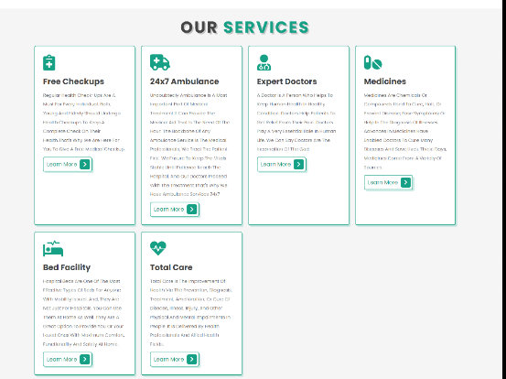
OUR SERVICES

Slide 5

ABOUT US

Slide 6

OUR DOCTORS

Slide 7

BOOK NOW

Slide 8
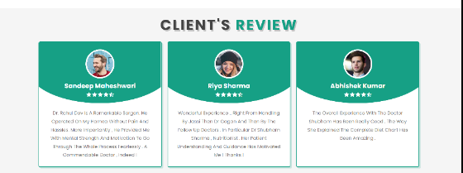
CLIENT'S REVIEW

Slide 9

OUR BLOGS

Slide 10
THANK YOU

